Slide 1
BASIC MEDICAL SCIENCE
FSC TECHNICIANS I
Dr Danish Nadeem

Slide 2
THE SKELETON
SKULL
OVERVIEW:
Complex structure composed of different bones
Each bone have specific characteristics & function

Slide 3
Bones of Skull
Frontal bone
Parietal bone
Temporal bone
Occipital bone
Sphenoid bone
Ethmoid bone

Slide 4
Continued
Nasal bone
Maxilla
Mandible
Zygomatic bone

Slide 5
Frontal bone
Located at front of skull
Forming forehead and eye sockets
Articulates with parietal bones along with coronal suture
With Nasal bone, Maxilla & zygomatic bones.

Slide 6
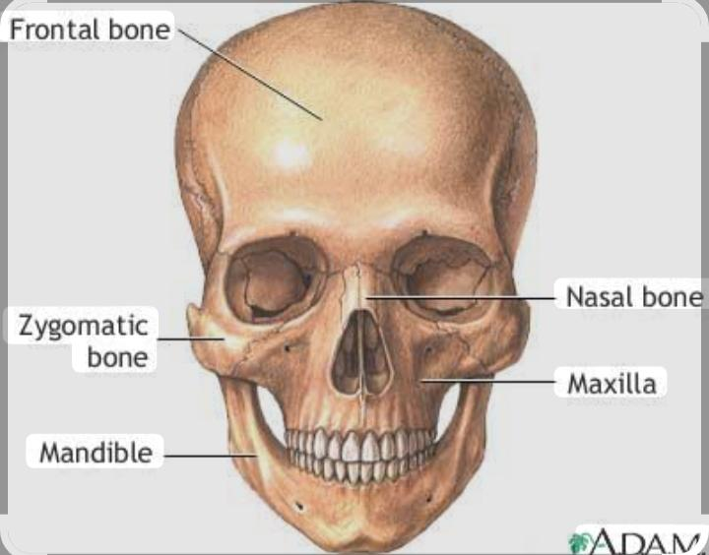

Slide 7
2. Parietal Bones
Paired bones forming sides and roof of skull
Articulate with each other at saggital suture
With frontal,temporal & occipital bone at other sutures.

Slide 8
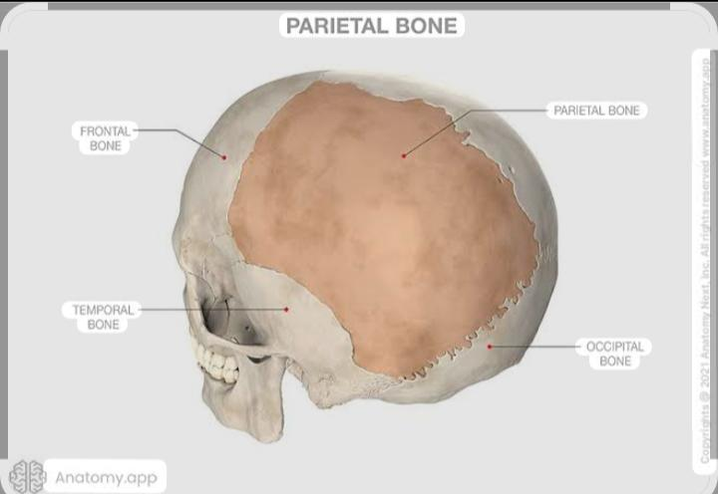

Slide 9
3. Temporal Bone
Paired bone located on the sides of the skull.
Consists of parts including squamous tympanic,mastoid & petrous parts.
Temporal bone related structures are middle and inner ear

Slide 10
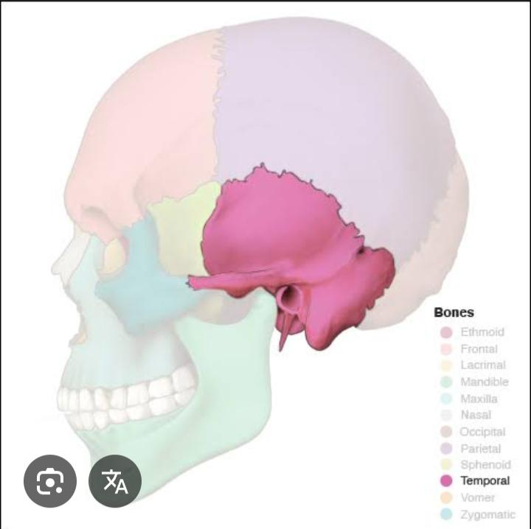

Slide 11
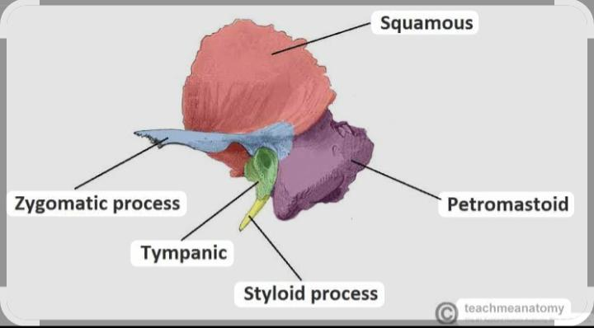

Slide 12

Any Question

Slide 13


