Slide 1
PHYSIOTHERAPY TECHNIQUES I
FSC PT I
Dr Danish Nadeem

Slide 2
Ultrasound therapy
Overview:
- Ultrasound is a therapeutic modality used by physical therapists since the 1940s.
- Applied using a round-headed wand or probe in direct contact with the patient’s skin.
- Ultrasound gel is used on all surfaces of the head to reduce friction and assist in transmission.
- Frequency range: about 0.8–3.0 MHz.
- Therapeutic ultrasound is generated by ultrasonic waves.

Slide 3
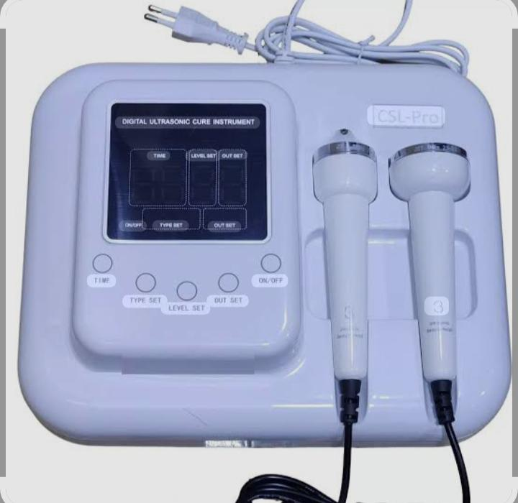
Ultrasound

Slide 4
Ultrasound Generation & wave Transmission
The waves are generated by a piezoelectric effect caused by the vibration of crystals within the head of the wand/probe.
Sound waves that pass through the skin cause a vibration or cavitation.

Slide 5
Effects on Tissues
- This vibration can cause a deep heating locally though usually no sensation of heat will be felt by the patient.
- In situations where a heating effect is not desirable, such a fresh injury with acute inflammation, the ultrasound can be pulsed rather than continuously transmitted.

Slide 6
Continued
Tissue relaxation & Blood flow: Ultrasound can cause increases in tissue relaxation, local blood flow.
Therapeutic uses:
- Help reduce local swelling and chronic inflammation.
- Promote bone fracture healing.

Slide 7
Power Density
- Measured in watts/cm².
- Can be adjusted depending on the desired effect.
- Goal is where scar tissue breakdown occurs.

Slide 8
Time & Method
3-5 minutes depending on the size of the area being treated.
- probe motion*:
- Should be in constant motion.
- Should feel no discomfort.
- Holding probe in one place:
- Can cause discomfort.
- Energy buildup can result in discomfort.

Slide 9
Indications
- Tendinitis
- Non-acute joint swelling
- Muscle spasm
- Break down of scar tissue

Slide 10
Contraindications
- Directly on the abdomen of pregnant women
- Over active epiphyseal regions (growth plates) in children
- Over the spinal cord in the area of a laminectomy
- Over the eyes, skull, or testes
- Local malignancy, metal implants, vascular abnormalities

Slide 11
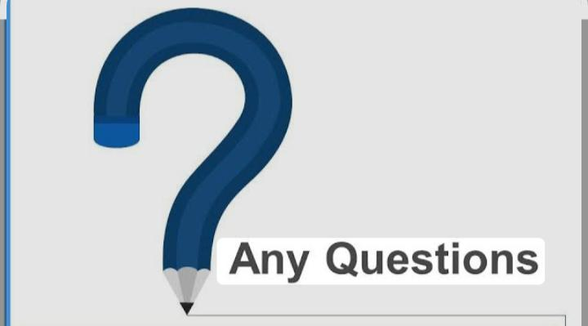

Slide 12


