Slide 1


Present Simple Tense
English|FSc Part I
Hafsa Rasheed

Slide 2
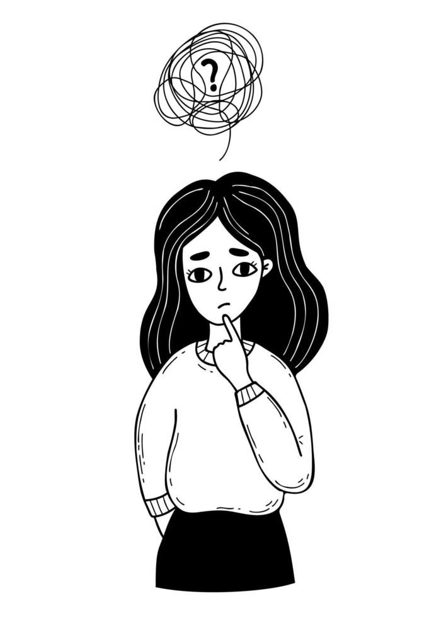
What’s Present Simple Tense?
It tells about habits, routines, schedules, facts and general truths, & more.
It’s also called “Present Indefinite Tense” — as it’s used for present scenarios.
Structure
Subject + verb (1st form + “s/es”)
She writes poems.
The sun rises in the east.
The bus comes at 4 pm.

Slide 3
Where to use “s/es”?
Use “s/es” with 3rd person singular—he, she, it (even if it’s name)
Example: John reads but she writes.
“s” | “es” | “ies”
Used with most verbs | For words ending with –s, -z, -ss, -o, -x, -sh, -ch, | Ending “y” changes into “ies” when there’s a constant before “y”
Examples: reads, writes, grows, walks, etc. | Examples: watches, buses, goes, boxes, splashes, | Examples: try – tries, study – studies
GOLDEN TIP: Use these same rules of “s/es” for spellings

Slide 4
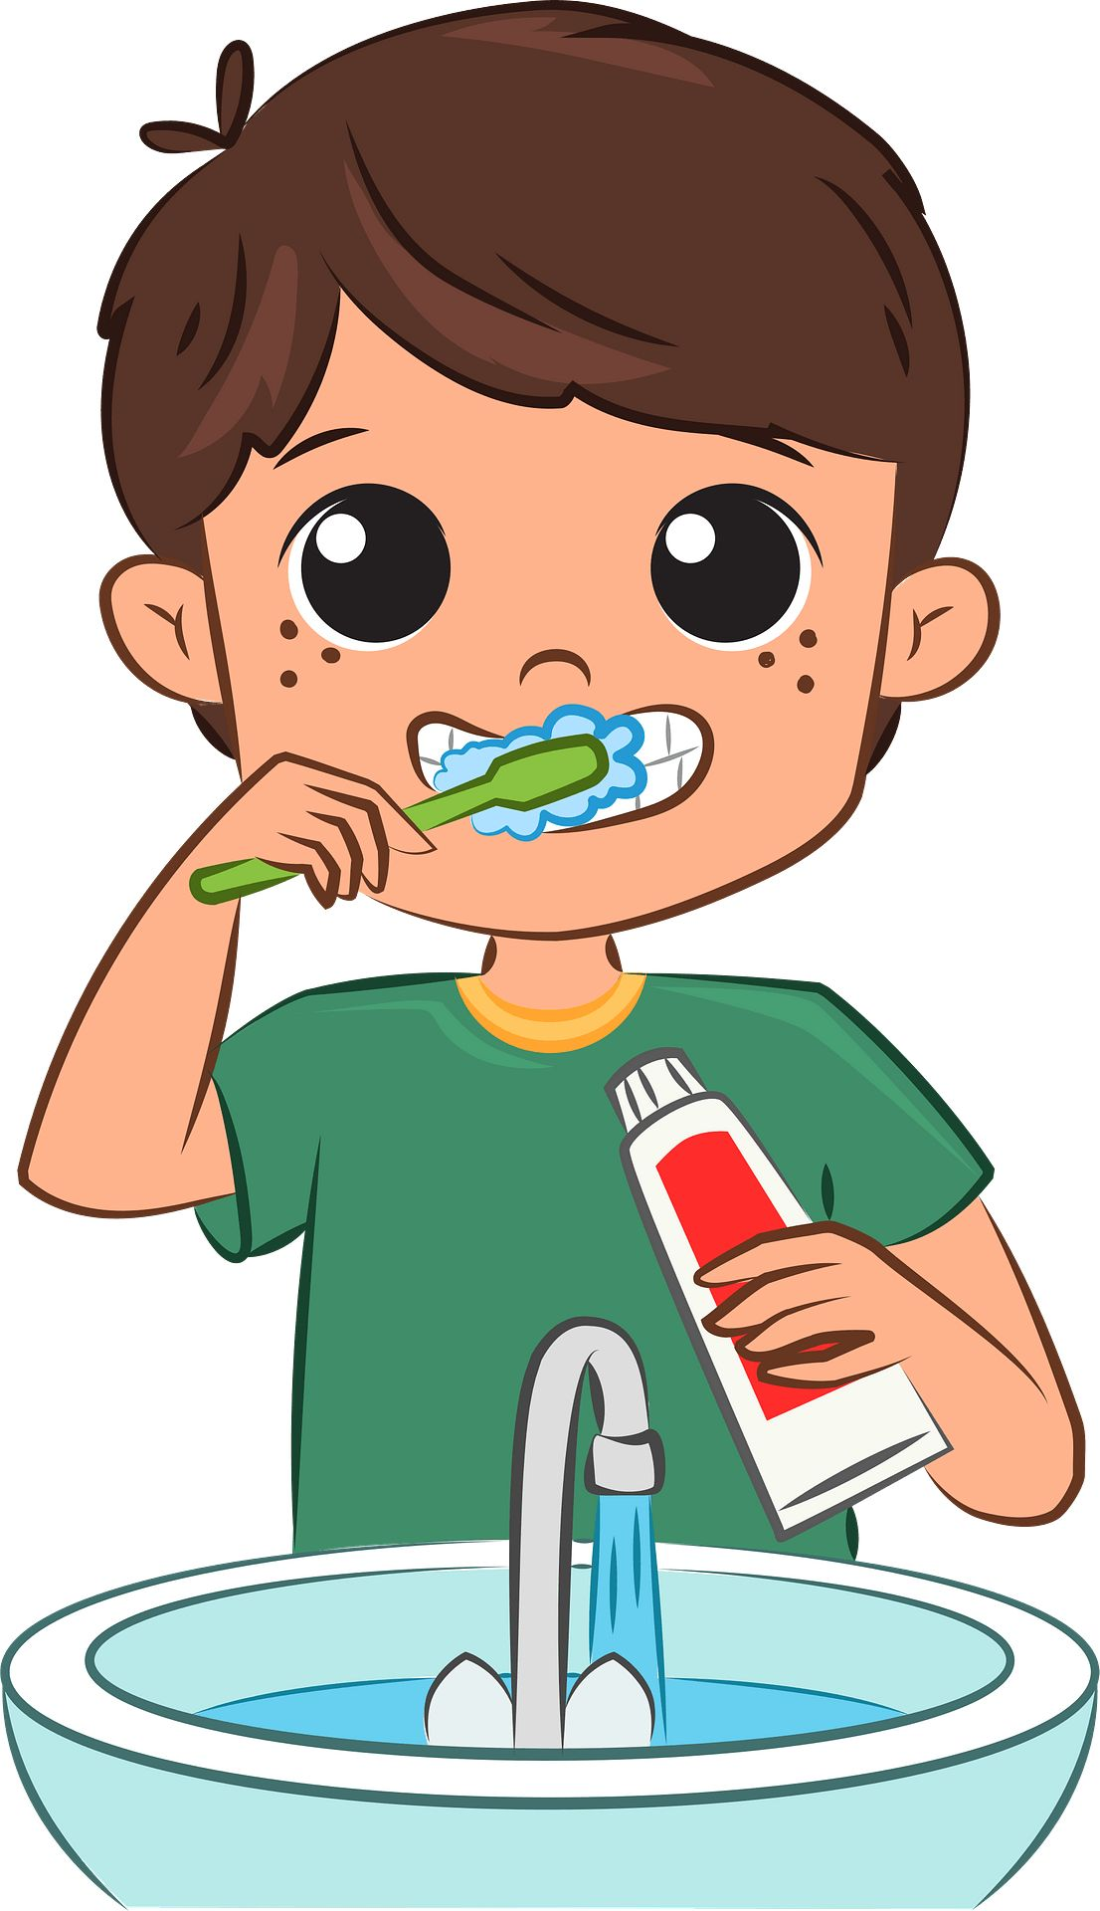
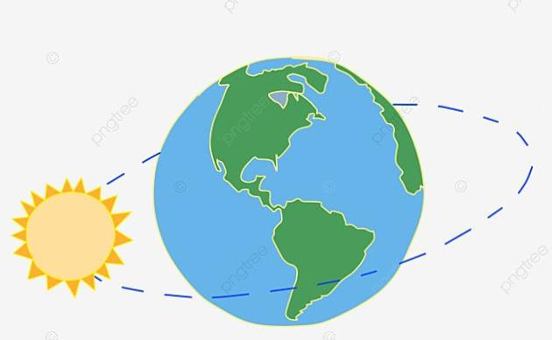
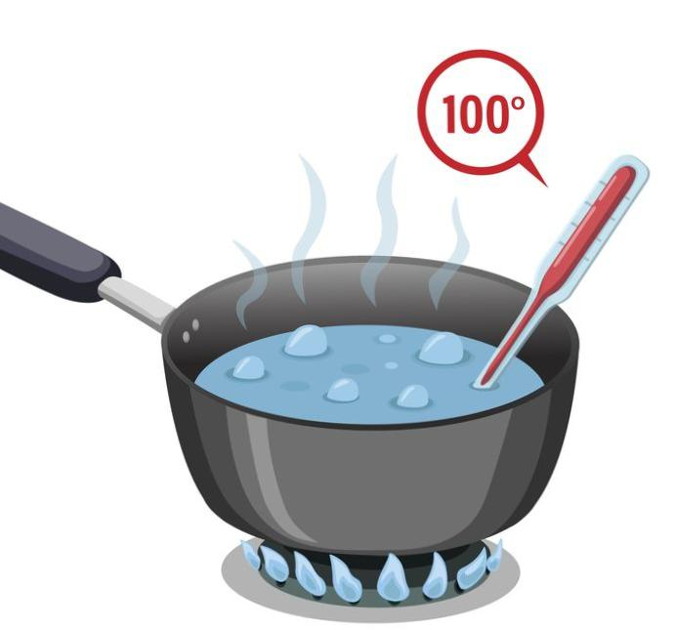
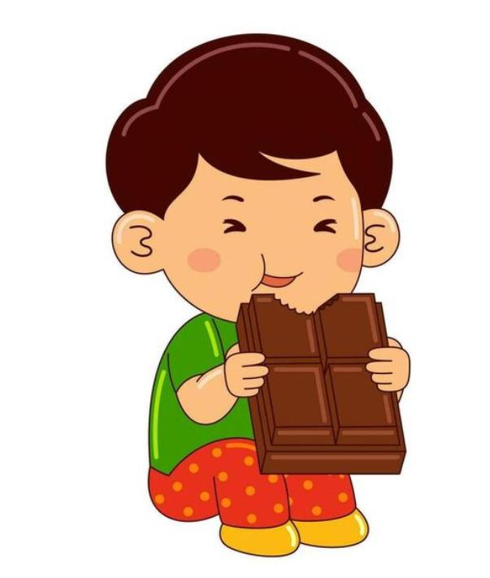
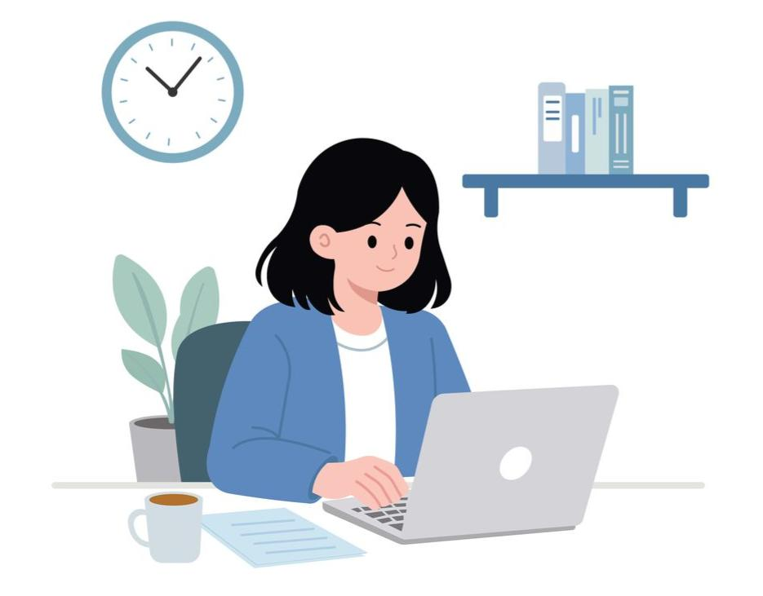
When to use it in daily life?
✓ Habit: I brush teeth every morning.
✓ General Truth: The earth revolves around the sun.
✓ Fact: Water boils at 100°C.
✓ Routine: She goes to office at 10 am.
✓ Feeling: I like chocolates.

Slide 5
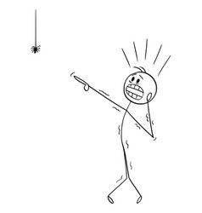
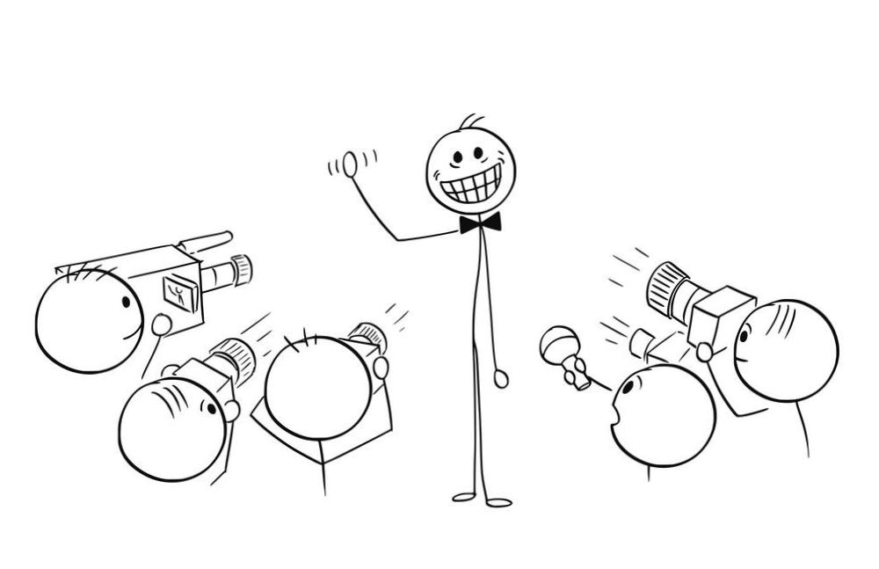
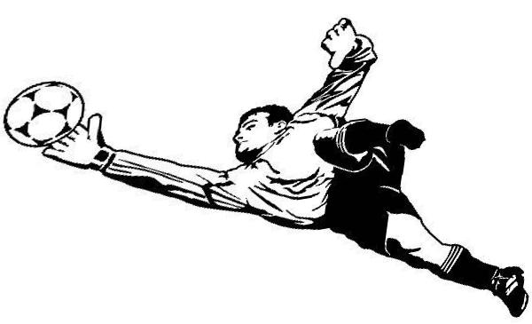
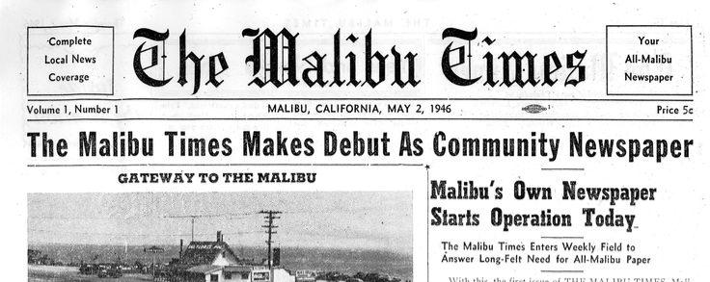

Why this tense is so COOL?
✓ commentary (for sports & for some actions in daily life too!):
Here we go!
Here he goes acting like a celebrity again! (sarcasm)
When? For expressing emotions & making something sensational.
✓ story telling: So I see the spider and scream!! Everybody comes asking: what happened???!
✓ instructions:
Open the book.
Set your chairs.
Attend classes daily.
✓ newspapers (to sound more direct): Olmsted sees another remarkable meteor storm.
He runs, trues to catch the ball. The ball is almost in his hands. And whoaaa! He grabs it and wins the match!!
Obviously, we can’t instruct in past & say: Opened the book!

Slide 6
Class Activity
Let’s change positive sentences into negative & question ones.
Our class starts at half past eight.
We watch movies on weekends.
The sun is also a star.
I love studying medical subjects.
Mr. Chips dies at the end of the story.

Slide 7
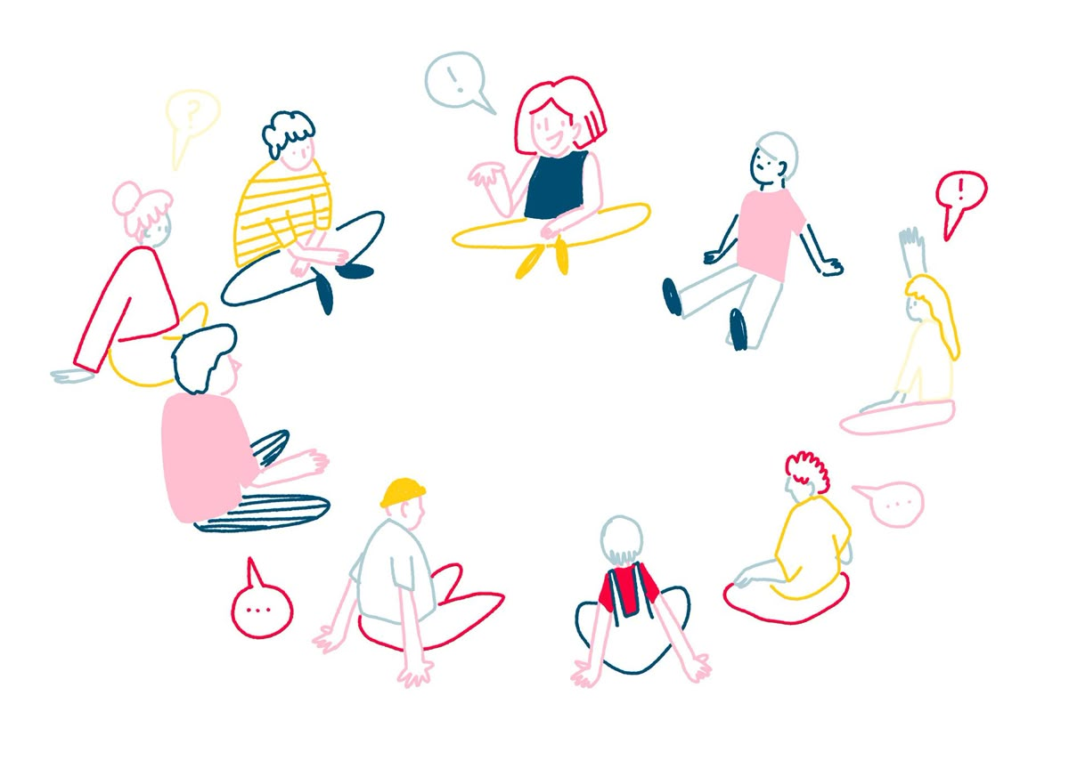
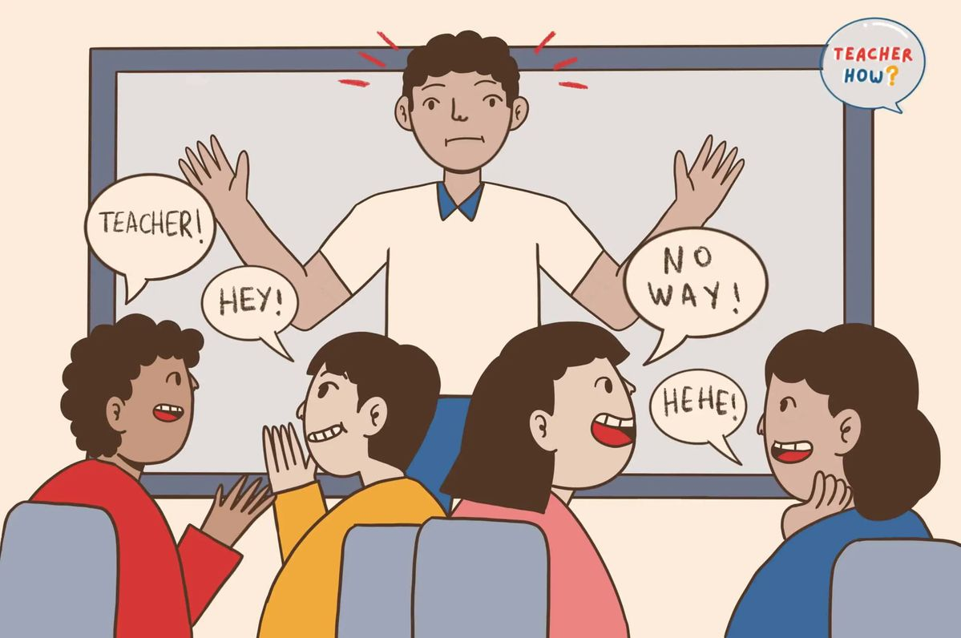
Some more Activity
Let’s do a small group conversation using Present Simple Tense.
Let’s make a story around this image using Present Simple Tense.
OR

