Slide 1
Electrotherapy
FSC PT TECHNIQUE 1
DR DANISH NADEEM

Slide 2
INTERFERENTIAL CURRENT
Allows deeper and more comfortable penetration
Produces low frequency effect in targeted tissue
- *Alternating Current:* Amplitude modulated medium-frequency current (2,000-5,000 Hz)
- *Use two channels of differing carrier frequencies* to create a “beat” frequency within the tissues

Slide 3
INTERFERENTIAL CLINICAL BENEFITS
Comfortable
Targeting hard to reach the tissues (e.g subscapularis)
Pain modulation
Acute pain
Chronic pain

Slide 4
High Frequency
High Frequency Treatment:
- This treatment can be applied directly or indirectly.
- To the skin and can be used to heal, stimulate or sanitise the skin.
- The machine uses a high frequency current that alternates over 100,000 cycles per seconds.

Slide 5
Continued
- The output of the machine is a high frequency, alternating/oscillating current.
- Frequency: 250,000 Hz.
- Characteristics:
- High voltage.
- Low current flow.
- The high frequency machine will have:
- An on/off switch.
- An intensity control.

Slide 6
Types
- *High frequency treatment overview*
- Uses a glass electrode applied directly onto the skin or over a layer of gauze.
- Current passes through the electrode and is dispersed with slow circular motions.
-Indirect high frequency treatment overview*
- Client holds the electrode in their hands.
- Therapist uses their hands to apply massage to the client’s skin.
- Causes current to transfer from the client’s skin to the therapist’s hands.
- *Frequency Detail*
- Frequency of 60Hz

Slide 7
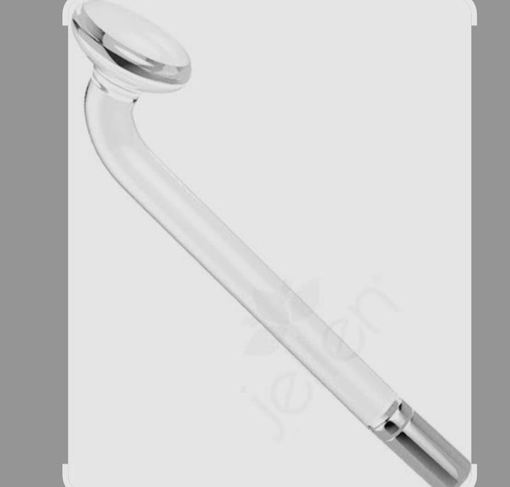
Types of Electrodes
Mushroom electrode

Slide 8
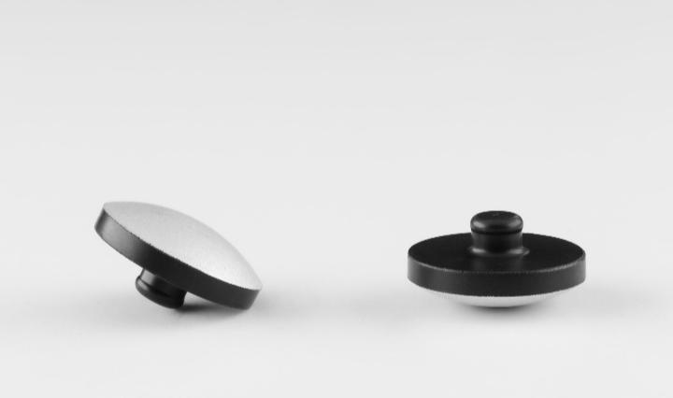
Continued
Flattened dome electrode

Slide 9
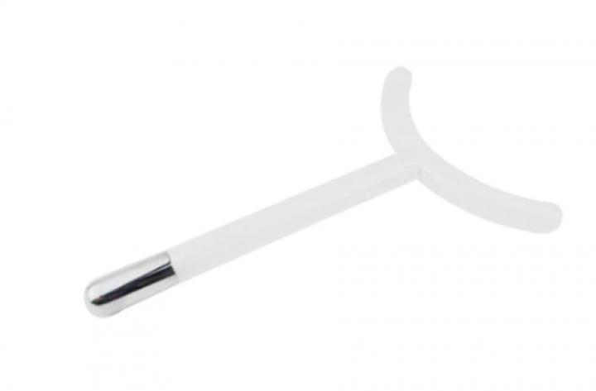
Continued
Horseshoe electrode

Slide 10
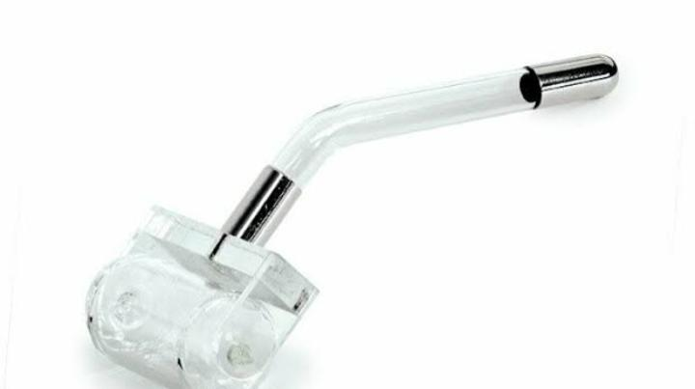
Continued
Roller electrode

Slide 11
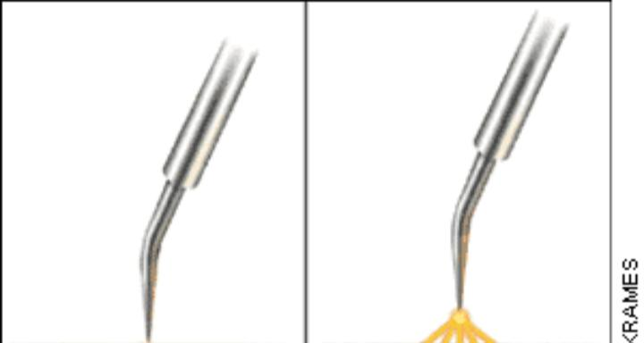
Continued
Fulgurator

Slide 12
INTERFERENTIAL Therapy (IFT)
- Utilizes the significant physiological effects of low frequency (≈<250pps) electrical stimulation of nerves.
- Aims to stimulate nerves without the associated painful and somewhat unpleasant side effects sometimes associated with low frequency stimulation.

Slide 13
Electrodiagnosis
Electrodiagnosis is a medical diagnostic technique that uses electrical impulses to assess and evaluate the function of nerves, muscles, and the nervous system.
Common electrodiagnostic tests include:
1. Electromyography (EMG)
2. Nerve Conduction Studies (NCS)
3. Electroencephalography (EEG)

Slide 14

ANY QUESTION

Slide 15


