Slide 1
BASIC MEDICAL SCIENCE
FSC TECHNICIANS I
DR DANISH NADEEM

Slide 2
NERVOUS TISSUES
Overview
Nervous tissues : the main tissue of the nervous system.
- *Functions*:
- Monitors and regulates the functions of the body.
Compositon:
- Consists of two cells:
- Nerve cells (neurons)
- Glial cells.

Slide 3
Continued
- Role of nervous Tissues:
- Helps transmit nerve impulses.
- Provides nutrition.
The brain, spinal cord, and nerves are composed of nervous tissue.
- They are specialized for being stimulated to transmit stimulus from one part of the body to another rapidly.

Slide 4
Structure
- It is made of nerve cells or neurons.
- All of the cells, which consists of an axon with long stem-like projections
Emerging out of the cell, responsible for communicating with other cells called the Target cells, thereby passing impulses.

Slide 5
Continued
- The main part of the cell contains the nucleus, cytoplasm and cell organelles.
- Dendrite is a highly branched processes responsible for receiving information from other neurons and synapses (specialized point of contact).
- Information in a neuron is unidirectional as it passes through neurons from dendrites, across the cell body down the axon.

Slide 6
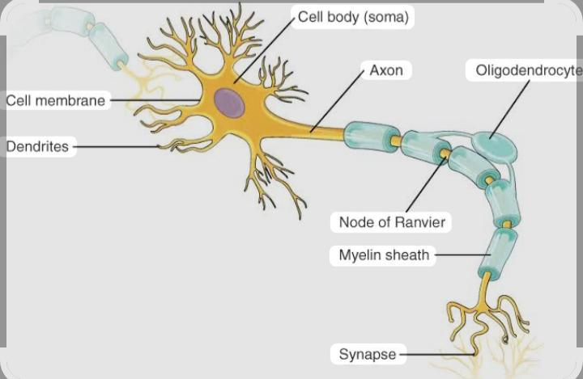
Nervous tissue Diagram

Slide 7
Nervous Tissue Location
- The nerve tissue or the nervous tissue is the chief tissue component of the two major parts of the nervous system.
Major Parts :
- Central nervous system (CNS)*: formed by the brain and the spinal cord.
Peripheral nervous system (PNS)*: that control and regulate the functions of the body and their activities.

Slide 8
CHARACTERISTICS
Nervous tissue makes up for the CNS and PNS of the nervous system
Contains two distinct cells – neurons and glial cells
It consists of the dendrites, cell body, axon and nerve endings
Neurons secrete chemical neurotransmitters which are responsible for stimulating other neurons
Presence of specialization at axonal terminals called synapsis
Nerve cells live long, cannot be divided and replaced (except memory cells)

Slide 9
Functions of Nervous Tissues
Neurons generate and carry out nerve impulses.
They produce electrical signals that are transmitted across distances they do so by secreting neurotransmitters.
Responds to stimuli
Carries out communication and integration
Provides electrical insulations to nerve cells and removes debris
Carries messages from other neurons to the cell body.

Slide 10

ANY QUESTION

Slide 11


