Slide 1
The Orbital Region
ADNAN RAMZAN
BS(OTT)

Slide 2
The Orbital Region
The orbits are a pair of bony cavities that contain the
Eyeballs; their associated muscles, nerves, vessels, and fat; and most of the lacrimal apparatus.
The orbital opening is guarded by two thin, movable folds, the eyelids.

Slide 3
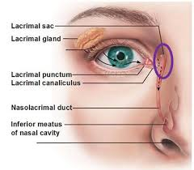

Slide 4
Eyelids
The eyelids protect the eye from injury and excessive light by their closure.
The upper eyelid is larger and more mobile than the lower, and they meet each other at the medial and lateral angles.
The palpebral fissure is the elliptical opening between the eyelids and is the entrance into the conjunctival sac.

Slide 5
Eye Lids
When the eye is closed, the upper eyelid completely covers the cornea of the eye.
When the eye is open and looking straight ahead, the upper lid just covers the upper margin of the cornea.
The lower lid lies just below the cornea when the eye is open and rises only slightly when the eye is closed.

Slide 7
Eyelids
The superficial surface of the eyelids is covered by skin, and the deep surface is covered by a mucous membrane called the conjunctiva.
The conjunctiva thus forms a potential space, the conjunctival sac, which is open at the palpebral fissure.

Slide 8
Eye lids
The eyelashes are short, curved hairs on the free edges of the eyelids
They are arranged in double or triple rows at the mucocutaneous junction.
The more rounded medial angle is separated from the eyeball by a small space, the lacus lacrimalis, in the center of which is a small, reddish yellow elevation, the caruncula lacrimalis
Near the medial angle of the eye a small elevation, the papilla lacrimalis, is present.

Slide 9
Glands of Eye lids
The sebaceous glands (glands of Zeis) open directly into the eyelash follicles.
The ciliary glands (glands of Moll) are modified sweat glands that open separately between adjacent lashes.
The tarsal glands are long, modified sebaceous glands that pour their oily secretion onto the margin of the lid; their openings lie behind the eyelashes

Slide 10
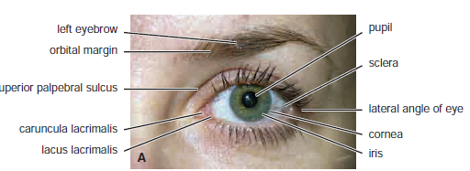

Slide 12
Terms of eye movements
Elevation is the rotation of the eye upward,
depression is the rotation of the eye downward,
abduction is the rotation of the eye laterally, and
adduction is the rotation of the eye medially.

Slide 15
Upward vision
Right eye, superior rectus muscle; left eye, inferior oblique muscle.
Both eyes, superior recti and inferior oblique muscles.
C. Right eye, inferior oblique muscle; left eye, superior rectus muscle.

Slide 16
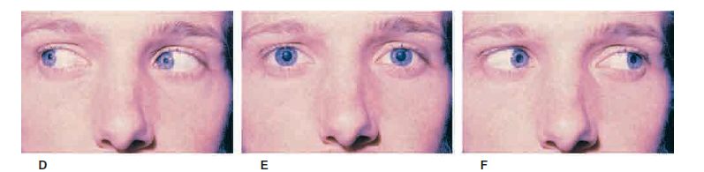
Middle vision
D. Right eye, lateral rectus muscle; left eye, medial rectus muscle.
E. Primary position, with the eyes fixed on a distant fixation
point.
F. Right eye, medial rectus muscle; left eye, lateral rectus muscle.

Slide 17
Structure of the Eye
The eyeball is embedded in orbital fat but is separated from it by the fascial sheath of the eyeball.
The eyeball consists of three coats, which, from without inward, are
The fibrous coat,
The vascular pigmented coat, and
The nervous coat.

Slide 19
1.Fibrous Coat
The fibrous coat is made up of a
Posterior opaque part, the sclera, and
An anterior transparent part, the cornea

Slide 20
The Sclera
The opaque sclera is composed of dense fibrous tissue and is white.
Posteriorly, it is pierced by the optic nerve and is fused with the dural sheath of that nerve.
The sclera is directly continuous in front with the cornea at the corneoscleral junction, or limbus.

Slide 21
The Cornea
The transparent cornea is largely responsible for the refraction of the light entering the eye
It is in contact posteriorly with the aqueous humor.
Blood Supply The cornea is avascular and devoid of lymphatic drainage.
It is nourished by diffusion from the aqueous humor and from the capillaries at its edge.
Nerve Supply Long ciliary nerves from the ophthalmic division of the trigeminal nerve

Slide 22
2.Vascular Pigmented Coat
The vascular pigmented coat consists, from behind forward, of the
choroid,
the ciliary body, and
the iris.

Slide 23
The Choroid
The choroid is composed of an outer pigmented layer and an inner, highly vascular layer.
The Ciliary Body
It is continuous posteriorly with the choroid, and anteriorly it lies behind the peripheral margin of the iris
It is composed of the ciliary ring, the ciliary processes, and the ciliary muscle.

Slide 24
The Iris and Pupil
The iris is a thin, contractile, pigmented diaphragm with a central aperture, the pupil.
It is suspended in the aqueous humor between the cornea and the lens.
The periphery of the iris is attached to the anterior surface of the ciliary body.
It divides the space between the lens and the cornea into an anterior and a posterior chamber.

Slide 25
3.Nervous Coat: The Retina
The retina consists of an outer pigmented layer and an inner nervous layer.
Its outer surface is in contact with the choroid, and its inner surface is in contact with the vitreous body.
The posterior three quarters of the retina is the receptor organ.

Slide 26
Retina
The anterior part of the retina is non receptive and consists merely of pigment cells, with a deeper layer of columnar epithelium.
This anterior part of the retina covers the ciliary processes and the back of the iris.
At the center of the posterior part of the retina is an oval, yellowish area, the macula lutea, which is the area of the retina for the most distinct vision. It has a central depression, the fovea centralis

Slide 27
Optic Disc
The optic nerve leaves the retina about 3 mm to the medial side of the macula lutea by the optic disc.
The optic disc is slightly depressed at its center, where it is pierced by the central artery of the retina.
At the optic disc is a complete absence of rods and cones so that it is insensitive to light and is referred to as the “blind spot.”

Slide 28
Contents of the Eyeball
The contents of the eyeball consist of the refractive media,
the aqueous humor,
the vitreous body, and
the lens.

Slide 29
Aqueous Humor
The aqueous humor is a clear fluid that fills the anterior and posterior chambers of the eyeball.
It is believed to be a secretion from the ciliary processes, from which it enters the posterior chamber.
It then flows into the anterior chamber through the pupil and is drained away through the spaces at the iridocorneal angle into the canal of Schlemm.

Slide 30
Functions
The function of the aqueous humor is to support the wall of the eyeball by exerting internal pressure and thus maintaining its optical shape.
Obstruction to the draining of the aqueous humor results in a rise in intraocular pressure called glaucoma.
This can produce degenerative changes in the retina, with consequent blindness.

Slide 31
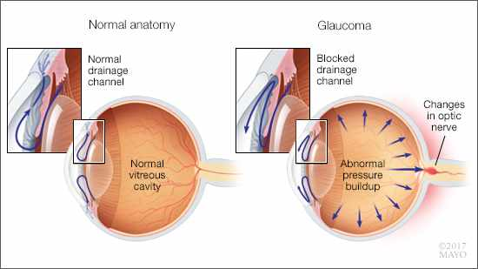

Slide 32
Vitreous Body
The vitreous body fills the eyeball behind the lens and is a transparent gel.
The hyaloid canal is a narrow channel that runs through the vitreous body from the optic disc to the posterior surface of the lens; in the fetus, it is filled by the hyaloid artery, which disappears before birth.
The function of the vitreous body is to contribute slightly to the magnifying power of the eye.

Slide 33
The Lens
The lens is a transparent, biconvex structure
enclosed in a transparent capsule.
It is situated behind the iris and in front of the vitreous body and is encircled by the ciliary processes.
Lens is attached to the ciliary processes of the ciliary body by the suspensory ligament.
The pull of the radiating fibers of the suspensory ligament tends to keep the elastic lens flattened so that the eye can be focused on distant objects.

Slide 34


