Slide 1

PHARMACOLOGY
BS RIT,OTT,MLT
2ND SEMESTER
DR DANISH
DPT(S.M.C),MPPTA

Slide 2
Analeptics
What are Analeptics?
Analeptics are drugs that stimulate the central nervous system (CNS).
They mainly stimulate the respiratory center in the brain.
They increase breathing and alertness.
Used rarely today because safer drugs are available.
Example
A person stops breathing after anesthesia.
→ An analeptic may help stimulate breathing.

Slide 3
Mechanism of Action of Analeptics
Stimulate the respiratory center in the medulla.
Increase respiratory rate.
Increase depth of breathing.
Some drugs also stimulate the cerebral cortex.
Easy Example
Like pressing the accelerator pedal to make a car move faster.

Slide 4
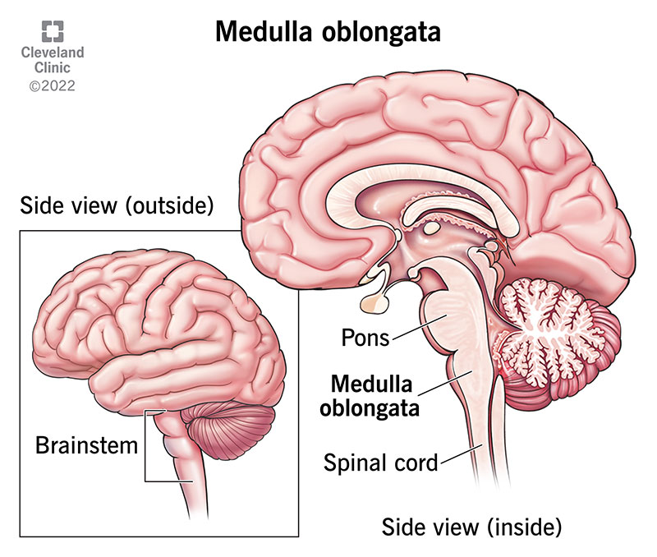

Slide 5
Examples of Analeptics
Doxapram
Caffeine
Theophylline
Aminophylline
Example
Caffeine in coffee makes people feel more awake.

Slide 6
Uses of Analeptics
Respiratory depression after anesthesia
Apnea in premature babies (caffeine)
Mild CNS stimulation
Diagnostic respiratory stimulation
Example
Premature newborns who stop breathing briefly are treated with caffeine.

Slide 7
Adverse Effects of Analeptics
Restlessness
Nervousness
Tremors
High blood pressure
Fast heart rate
Seizures (high doses)
Example
Too much coffee can make someone shaky and anxious.

Slide 8
Contraindications of Analeptics
Epilepsy
Severe hypertension
Heart disease
Hyperthyroidism

Slide 9
Anticoagulants
What are Anticoagulants?
Anticoagulants prevent blood clot formation.
They do not dissolve existing clots.
They prevent new clots from forming.
Example
They stop a small clot from becoming a dangerous clot.

Slide 10
Classification of Anticoagulants
1. Injectable
Heparin
Low Molecular Weight Heparins (LMWH)
  Enoxaparin
  Dalteparin

Slide 11
CONTINUED
2. Oral
Warfarin
Direct Oral Anticoagulants (DOACs)
  Apixaban
  Rivaroxaban
  Dabigatran
  Edoxaban

Slide 12
Heparin
Mechanism
Activates antithrombin III.
Inhibits thrombin (Factor IIa).
Inhibits Factor Xa.
Route
IV or SC
Onset
Immediate
Example
Used immediately after surgery to prevent blood clots.

Slide 13
Low Molecular Weight Heparins (LMWH)
Examples
Enoxaparin
Dalteparin
Features
Longer action
More predictable
Lower bleeding risk than unfractionated heparin
Less monitoring needed

Slide 14
Warfarin
Mechanism
Blocks vitamin K recycling.
Therefore decreases production of
Factor II
Factor VII
Factor IX
Factor X
Factors II, VII, IX, and X are vitamin K-dependent proteins synthesized in the liver.

Slide 15
CONTINUED
Route
Oral
Example
Patients with artificial heart valves often take warfarin.

Slide 16
Direct Oral Anticoagulants (DOACs)
Examples
Apixaban
Rivaroxaban
Dabigatran
Edoxaban
Advantages
Oral
Fixed dose
Rapid onset
Less monitoring

Slide 17
Uses of Anticoagulants
Deep vein thrombosis (DVT)
Pulmonary embolism (PE)
Atrial fibrillation
Mechanical heart valves (warfarin)
Prevention of postoperative clots
Acute coronary syndromes (heparin)
Example
A patient with a leg clot receives anticoagulants to stop the clot from growing.

Slide 18
Adverse Effects
Heparin
Bleeding
Heparin-induced thrombocytopenia (HIT)
Osteoporosis (long-term)
Warfarin
Bleeding
Skin necrosis (rare)
Birth defects in pregnancy
DOACs
Bleeding
Gastrointestinal upset

Slide 19
Comparison Table
Feature | Heparin | Warfarin | DOACs
Route | IV/SC | Oral | Oral
Onset | Immediate | Slow | Rapid
Monitoring | aPTT | INR | Usually none
Safe in pregnancy | Yes | No | Usually avoided
Antidote | Protamine | Vitamin K | Specific antidotes

Slide 20
Clinical Case
A 65-year-old man has a swollen painful leg.
Diagnosis:
Deep vein thrombosis (DVT)
Treatment:
Start heparin immediately.
Later switch to warfarin or a DOAC for long-term treatment.

Slide 21
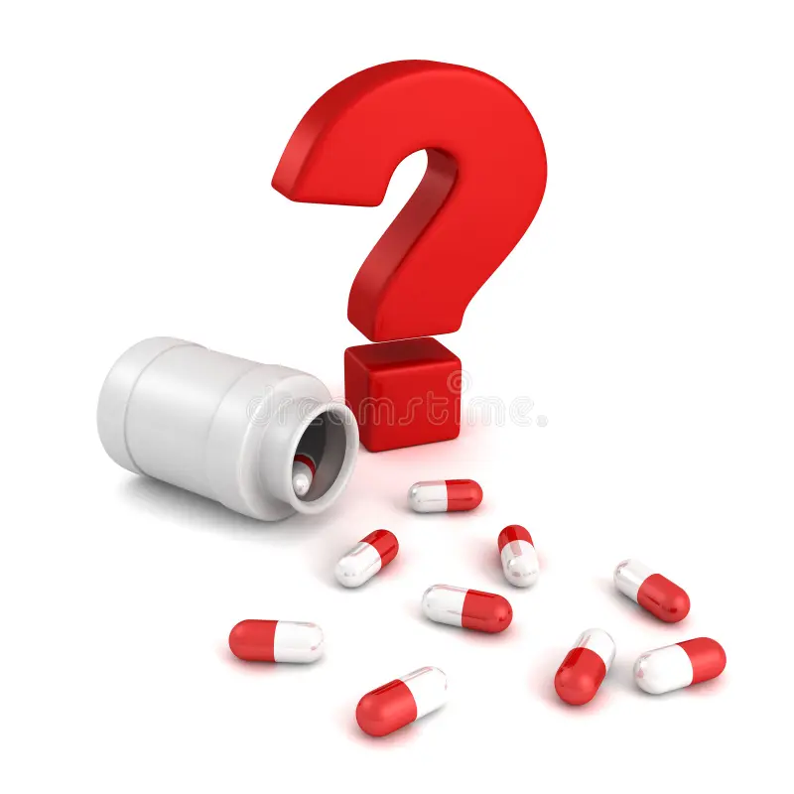

Slide 22


