Slide 1

ANATOMY
ABDOMEN,PELVIS
DPT
2ND SEMESTER
DR DANISH
DPT(S.M.C),MPPTA

Slide 2
Inguinal Canal
An oblique intermuscular passage in the lower anterior abdominal wall.
Approximately 4 cm long in adults.
Extends from the deep inguinal ring to the superficial inguinal ring.
Serves as a passageway for structures traveling between the abdomen and external genitalia.
Clinically important because it is a common site of inguinal hernias.

Slide 3
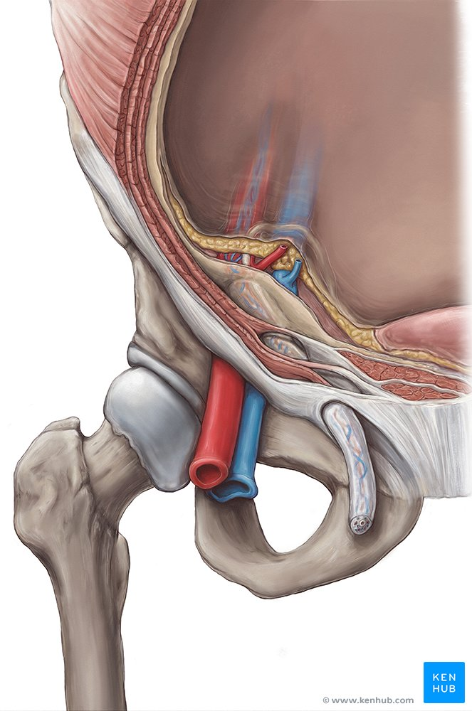

Slide 4
Definition
The inguinal canal is a slit-like passage located just above the medial half of the inguinal ligament.
It runs downward, medially, and forward through the lower abdominal wall.

Slide 6
Location and Extent
Location
Situated in the lower part of the anterior abdominal wall.
Lies parallel and superior to the inguinal ligament.
Extent
Begins at the deep inguinal ring.
Ends at the superficial inguinal ring.

Slide 8
CONTINUED
Direction
Obliquely downward.
Medially.
Anteriorly.
This oblique arrangement helps prevent herniation under normal conditions.

Slide 10
Deep Inguinal Ring
Definition
Entrance of the inguinal canal.
Location
Opening in the transversalis fascia.
Located approximately:
  1.25 cm above the midpoint of the inguinal ligament.
Relations
Lateral to inferior epigastric vessels.

Slide 12
Superficial Inguinal Ring
Definition
Exit of the inguinal canal.
Location
Triangular opening in the aponeurosis of external oblique muscle.

Slide 13
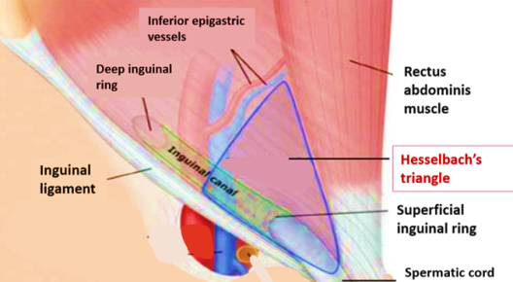

Slide 14
Boundaries
Medial Crus
Attached to pubic symphysis.
Lateral Crus
Attached to pubic tubercle.
Intercrural Fibers
Strengthen the margins of the ring.

Slide 16
Boundaries of the Inguinal Canal
The canal has:
Anterior wall
Posterior wall
Roof
Floor

Slide 18
Anterior Wall
Formed By
Throughout its Length
Aponeurosis of external oblique muscle.
Laterally
Internal oblique muscle fibers reinforce the wall.

Slide 20
Posterior Wall
Entire Length
Transversalis fascia.
Medially
Reflected inguinal ligament.

Slide 22
Roof of the Canal
Formed By
Arching fibers of:
  Internal oblique muscle.
  Transversus abdominis muscle.

Slide 24
Floor of the Canal
Formed By
Main Part
Inguinal ligament.
Medially
Lacunar ligament.
Shape
Gutter-like arrangement.
Function
Supports structures passing through the canal.

Slide 26


Slide 27


