Slide 1
Cerebral circulation and its anatomy
ADNAN RAMZAN
BS(OTT)

Slide 2
Arteries of the Brain
The brain is supplied by the two internal carotid and the two vertebral arteries.
The four arteries lie within the subarachnoid space, and their branches anastomose on the inferior surface of the brain to form the circle of Willis.
Internal Carotid Artery
The internal carotid artery begins at the bifurcation of the common carotid artery from carotid sinus.it gives many branches discussed already.
It divides into the anterior and middle cerebral arteries

Slide 3
Vertebral Artery
It is a branch of the first part of the subclavian A.
At the lower border of the pons, it joins the vessel of the opposite side to form the basilar artery.

Slide 4
Circle of Willis
The circle of Willis lies in the interpeduncular fossa at the base of the brain.
It is formed by the anastomosis between the branches of the two internal carotid arteries and the two vertebral arteries.
The anterior communicating, posterior cerebral, and basilar (formed by the junction of the two vertebral arteries) are all arteries that contribute to the circle.
Cortical and central branches arise from the circle and supply the brain.

Slide 5
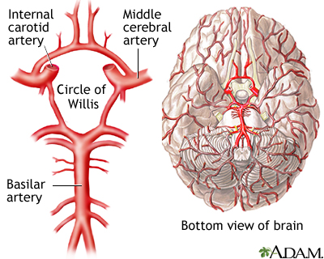
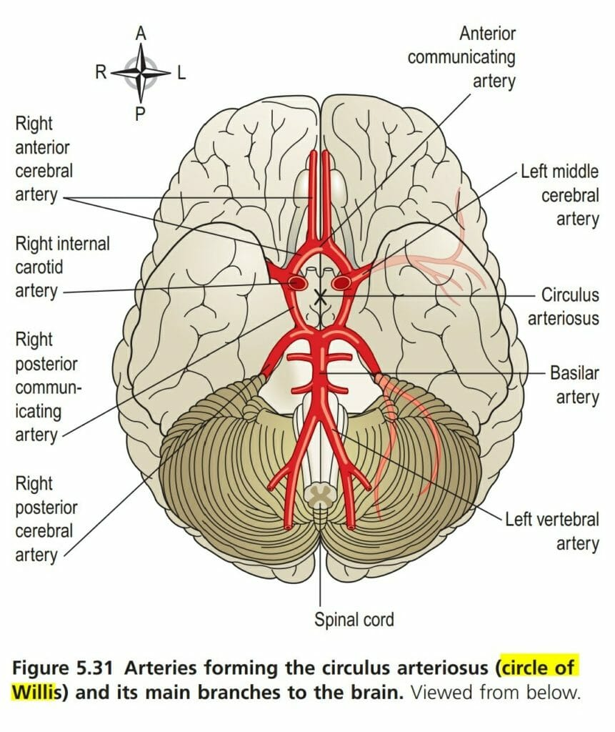

Slide 6
IMPORTANCE
The circle of Willis allows blood that enters by either internal carotid or vertebral arteries to be distributed to any part of both cerebral hemispheres. Cortical and central branches arise from the circle and supply the brain substance
If, however, the internal carotid or vertebral artery is occluded, the blood passes forward or backward across that point to compensate for the reduction in blood flow.
The most important factor in forcing the blood through the brain is the arterial blood pressure.

Slide 7
This is opposed by such factors as a raised intracranial pressure, increased blood viscosity, and narrowing of the vascular diameter.
Cerebral blood flow remains remarkably constant despite changes in the general blood pressure.
This autoregulation of the circulation is accomplished by a compensatory lowering of the cerebral vascular resistance when the arterial pressure is decreased and a raising of the vascular resistance when the arterial pressure is increased.
The diameter of the cerebral blood vessels is the main factor contributing to the cerebrovascular resistance.

Slide 8


