Slide 1
Parts of the Brain
Adnan Ramzan
BS(OTT)

Slide 2
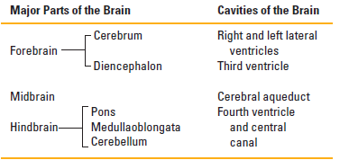
Parts of the Brain
The brain is that part of the central nervous system that lies inside the cranial cavity. It is continuous with the spinal cord through the foramen magnum.

Slide 3
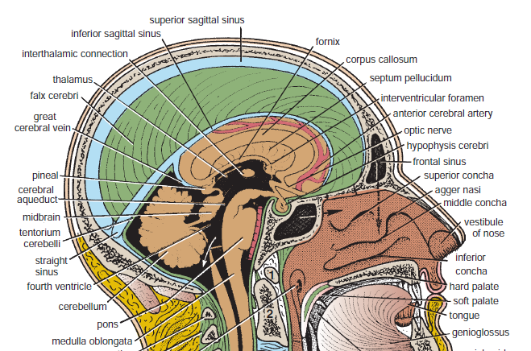

Slide 4
Cerebrum
The cerebrum is the largest part of the brain and consists of two cerebral hemispheres connected by a mass of white matter called the corpus callosum.
Each hemisphere extends from the frontal to the occipital bones; above the anterior and middle cranial fossae; and, posteriorly, above the tentorium cerebelli.

Slide 5
Cortex: The outer layer of neural tissue of the cerebrum of the brain.
Gyri (singular: Gyrus): The ridges or bumps on the surface of the brain.
Sulci (singular: Sulcus): The shallow grooves or depressions separating the gyri.
Fissures: The deep grooves that divide the brain into lobes or large sections.

Slide 6
The surface layer of each hemisphere is called the cortex and is composed of gray matter.
cortex is thrown into folds, or gyri, separated by fissures, or sulci.
By this means, the surface area of the cortex is greatly increased.
Several of the large sulci conveniently subdivide the surface of each hemisphere into lobes.

Slide 7
Right side of Brain

Slide 8
Lobes of Cerebrum
The frontal lobe is situated in front of the central sulcus and above the lateral sulcus.
The parietal lobe is situated behind the central sulcus and above the lateral sulcus.
The occipital lobe lies below the parietooccipital sulcus.
Below the lateral sulcus is situated the temporal lobe.

Slide 9
Motor Area
The precentral gyrus lies immediately anterior to the central sulcus and is known as the motor area.
The large motor nerve cells in this area control voluntary movements on the opposite side of the body.
In the motor area, the body is represented in an inverted position, with the nerve cells controlling the movements of the feet located in the upper part and those controlling the movements of the face and hands in the lower part

Slide 10
Sensory Area
The postcentral gyrus lies immediately posterior to the central sulcus and is known as the sensory area
The small nerve cells in this area receive and interpret sensations of pain, temperature, touch, and pressure from the opposite side of the body.

Slide 11
Auditory Area
The superior temporal gyrus lies immediately below the lateral sulcus
The middle of this gyrus is concerned with the reception and interpretation of sound and is known as the auditory area.

Slide 12
Speech Area
Broca’s area, or the motor speech area, lies just above the lateral sulcus
It is dominant in the left hemisphere in right-handed persons and in the right hemisphere in left-handed persons.

Slide 13
Visual Area
The visual area is situated on the posterior pole and medial aspect of the cerebral hemisphere in the region of the calcarine sulcus
It is the receiving area for visual impressions.

Slide 14
Lateral ventricle
The cavity present within each cerebral hemisphere is called the lateral ventricle.
lateral ventricles communicate with the third ventricle through the interventricular
foramina

Slide 15
Diencephalon
The diencephalon is almost completely hidden from the surface of the brain.
It consists of a dorsal thalamus and a ventral hypothalamus.
The thalamus is a large mass of gray matter that lies on either side of the third ventricle.
It is the great relay station on the afferent sensory pathway to the cerebral cortex.

Slide 16
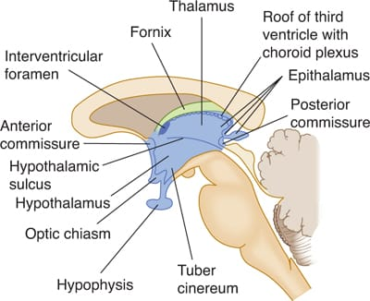

Slide 17
The hypothalamus forms the lower part of the lateral wall and floor of the third ventricle.
The following structures are found in the floor of the third ventricle from before backward: the optic chiasma the tuber cinereum and the infundibulum, the mammillary bodies, and the posterior perforated substance.

Slide 18


