Slide 1
Brainstem
ADNAN RAMZAN
BS(OTT)

Slide 2
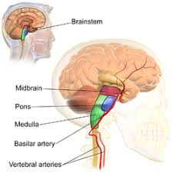
Brainstem
Brainstem is the stalk-like structure connecting the brain to the spinal cord
It consists of three parts
Mid brain
Pons and Medulla oblongata
Notes:
تنے نما بناوٹ

Slide 3
Mid Brain
The midbrain is the narrow part of the brain that passes through the tentorial notch and connects the forebrain to the hindbrain.
The midbrain comprises two lateral halves called the cerebral peduncles; each of these is divided into an anterior part, the crus cerebri; and a posterior part, the tegmentum, by a pigmented band of gray matter, the substantia nigra
Notes:
(Neurons) کا وہ مجموعہ ہے جو دماغ کے مختلف حصوں کو آپس میں جوڑتا ہے

Slide 4
continued
The narrow cavity of the midbrain is the
cerebral aqueduct, which connects the third and fourth ventricles.
The tectum is the part of the midbrain posterior to the cerebral aqueduct; it has four small surface swellings, namely, the two superior and two inferior colliculi.

Slide 5
The pineal body is a small glandular structure that lies between the superior colliculi
It is attached by a stalk to the region of the posterior wall of the third ventricle
The pineal commonly calcifies in middle age, and thus it can be visualized on radiographs.
Notes:
Pineal body is used as a land mark . Normally present in the center of skull . If it displaced from midline then it show the presence of tumor or heamorraghe.calcium deposition with age and show white colour in X RAY

Slide 6
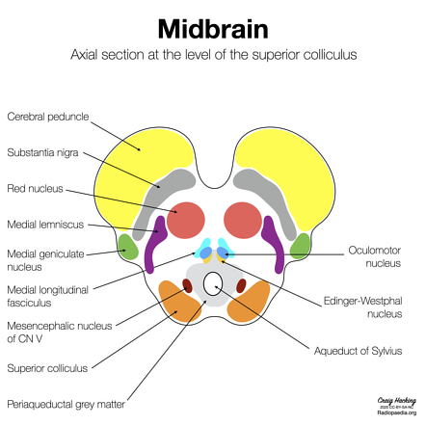

Slide 7
Pons
The pons is situated on the anterior surface of the cerebellum below the midbrain and above the medulla oblongata.
It is composed mainly of nerve fibers, which connect the two halves of the cerebellum.
It also contains ascending and descending fibers connecting the forebrain, the midbrain, and the spinal cord.

Slide 8
Medulla Oblongata
The medulla oblongata is conical in shape and connects the pons above to the spinal cord below.
A median fissure is present on the anterior surface of the medulla, and on each side of this is a swelling called the pyramid.
The pyramids are composed of bundles of nerve fibers that originate in large nerve cells in the precentral gyrus of the cerebral cortex.

Slide 9
The pyramids taper below, and here most of the descending fibers cross over to the opposite side, forming the decussation of the pyramids.
Posterior to the pyramids are the olives, which are oval elevations produced by the underlying olivary nuclei.
Behind the olives are the inferior cerebellar peduncles, which connect the medulla to the cerebellum.
Notes:
olives contain the inferior olivary nucleus, a large mass of gray matter responsible for motor coordination, motor learning, and relaying signals from the spinal cord to the cerebellum

Slide 10
Motor Pathway
Origin: Motor signals originate from the cerebral cortex (primary motor cortex).
The Pyramids: These descending fibers form two prominent ridges, called pyramids, on the ventral surface of the medulla.
The Crossing: At the base of these pyramids, roughly 90% of the fibers cross (decussate). This crossing over dictates that the right hemisphere of the brain controls voluntary movement on the left side of the body, and vice versa.

Slide 11
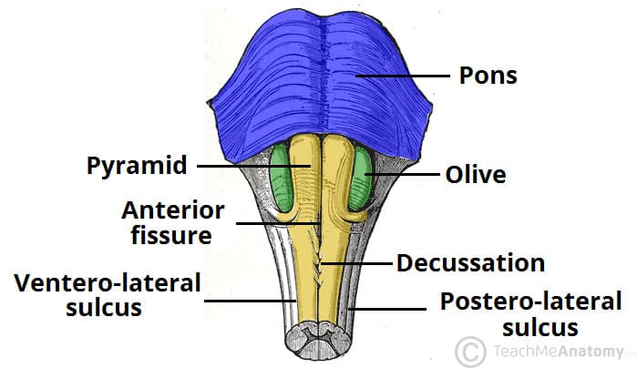
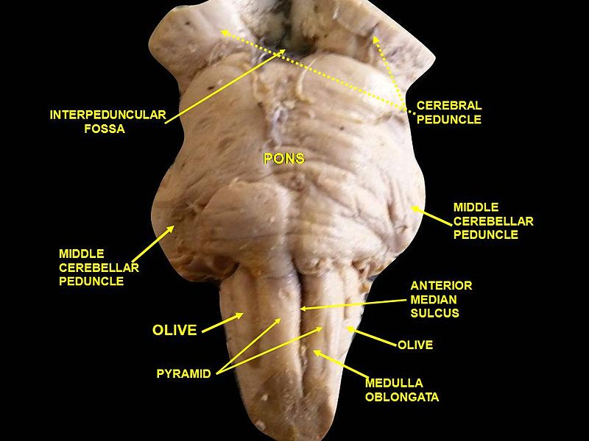

Slide 12
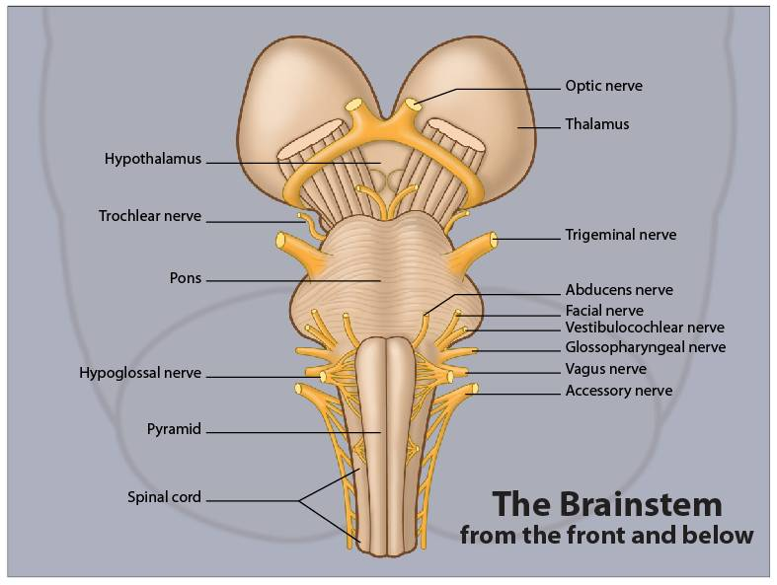

Slide 13


