Slide 1

ANATOMY
ABDOMEN,PELVIS
DPT
2ND SEMESTER
DR DANISH
DPT(S.M.C),MPPTA

Slide 2
Lumbar Vertebrae
The body of each lumbar vertebra is:
  Massive and kidney-shaped.
  Designed to bear most of the body weight.
The L5 vertebra:
  Articulates with the base of the sacrum.
  Forms the lumbosacral joint.
Transverse processes:
  Long and slender.
  Provide attachment sites for several abdominal wall muscles.

Slide 3
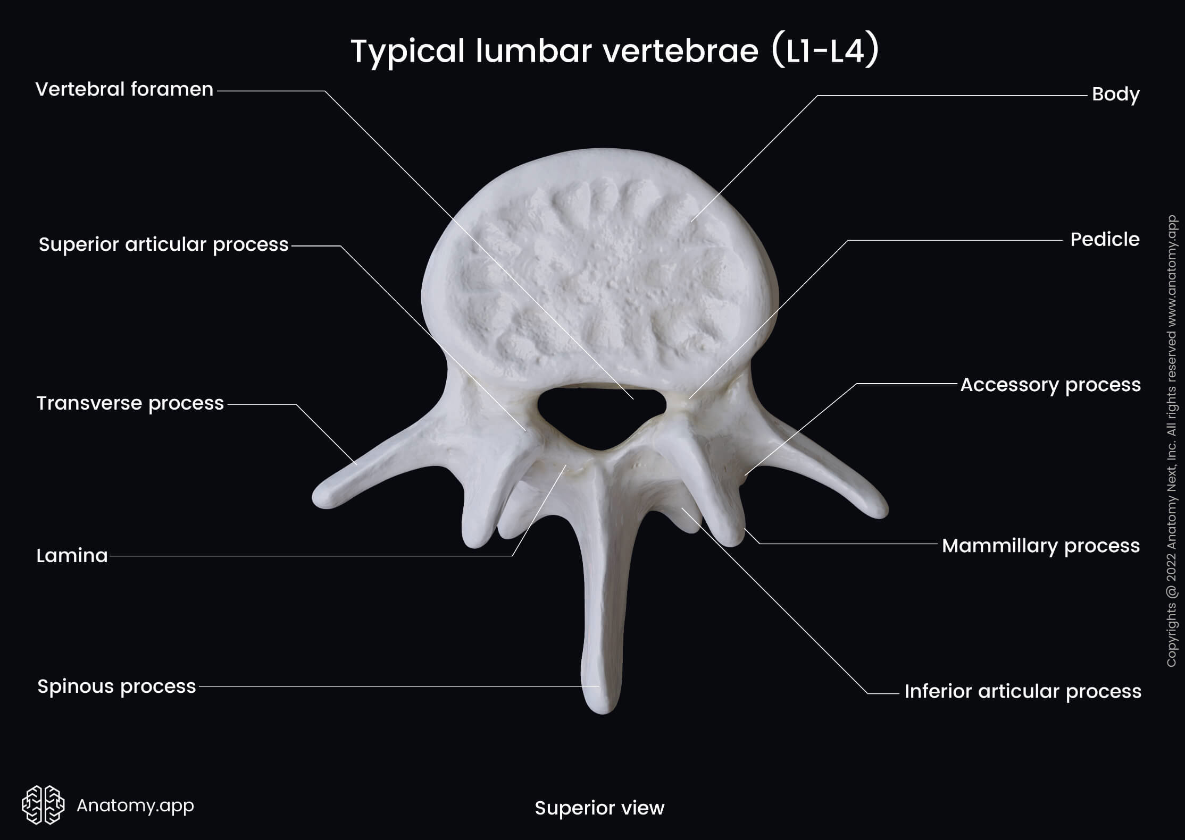

Slide 4
Intervertebral Discs
Lumbar intervertebral discs are thicker than those in other regions of the vertebral column.
They are wedge-shaped.
They are responsible for the normal posterior concavity (lordosis) of the lumbar vertebral column.

Slide 5
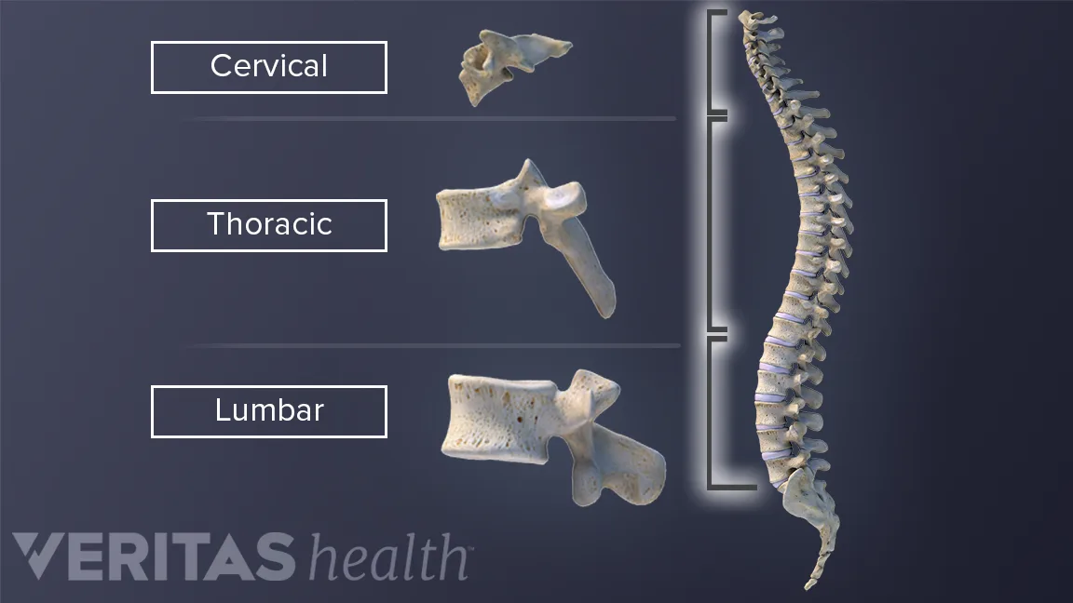

Slide 6
Thoracic Cage
Components most relevant to the abdominal wall include:
  Xiphoid process of the sternum.
  Costal margin (costal cartilages 7–10).
  Lower ribs.
The head of rib 12 differs from most other ribs because:
  It has a single facet for articulation with the body of the T12 vertebra.

Slide 7
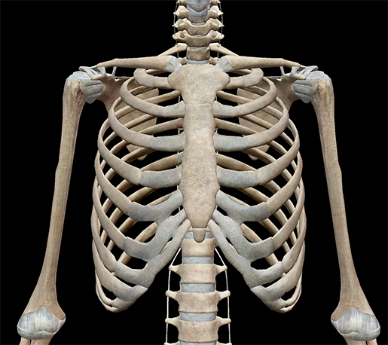

Slide 8
Continued
The anterior end of rib 12:
  Is pointed.
  Has a small costal cartilage embedded in the musculature of the anterior abdominal wall.

Slide 9
Pelvis
Os Coxae (Hip Bone):
The os coxae is composed of:
  Ilium
  Ischium
  Pubis
The medial surface of the ilium is divided into two parts by the arcuate line.

Slide 10
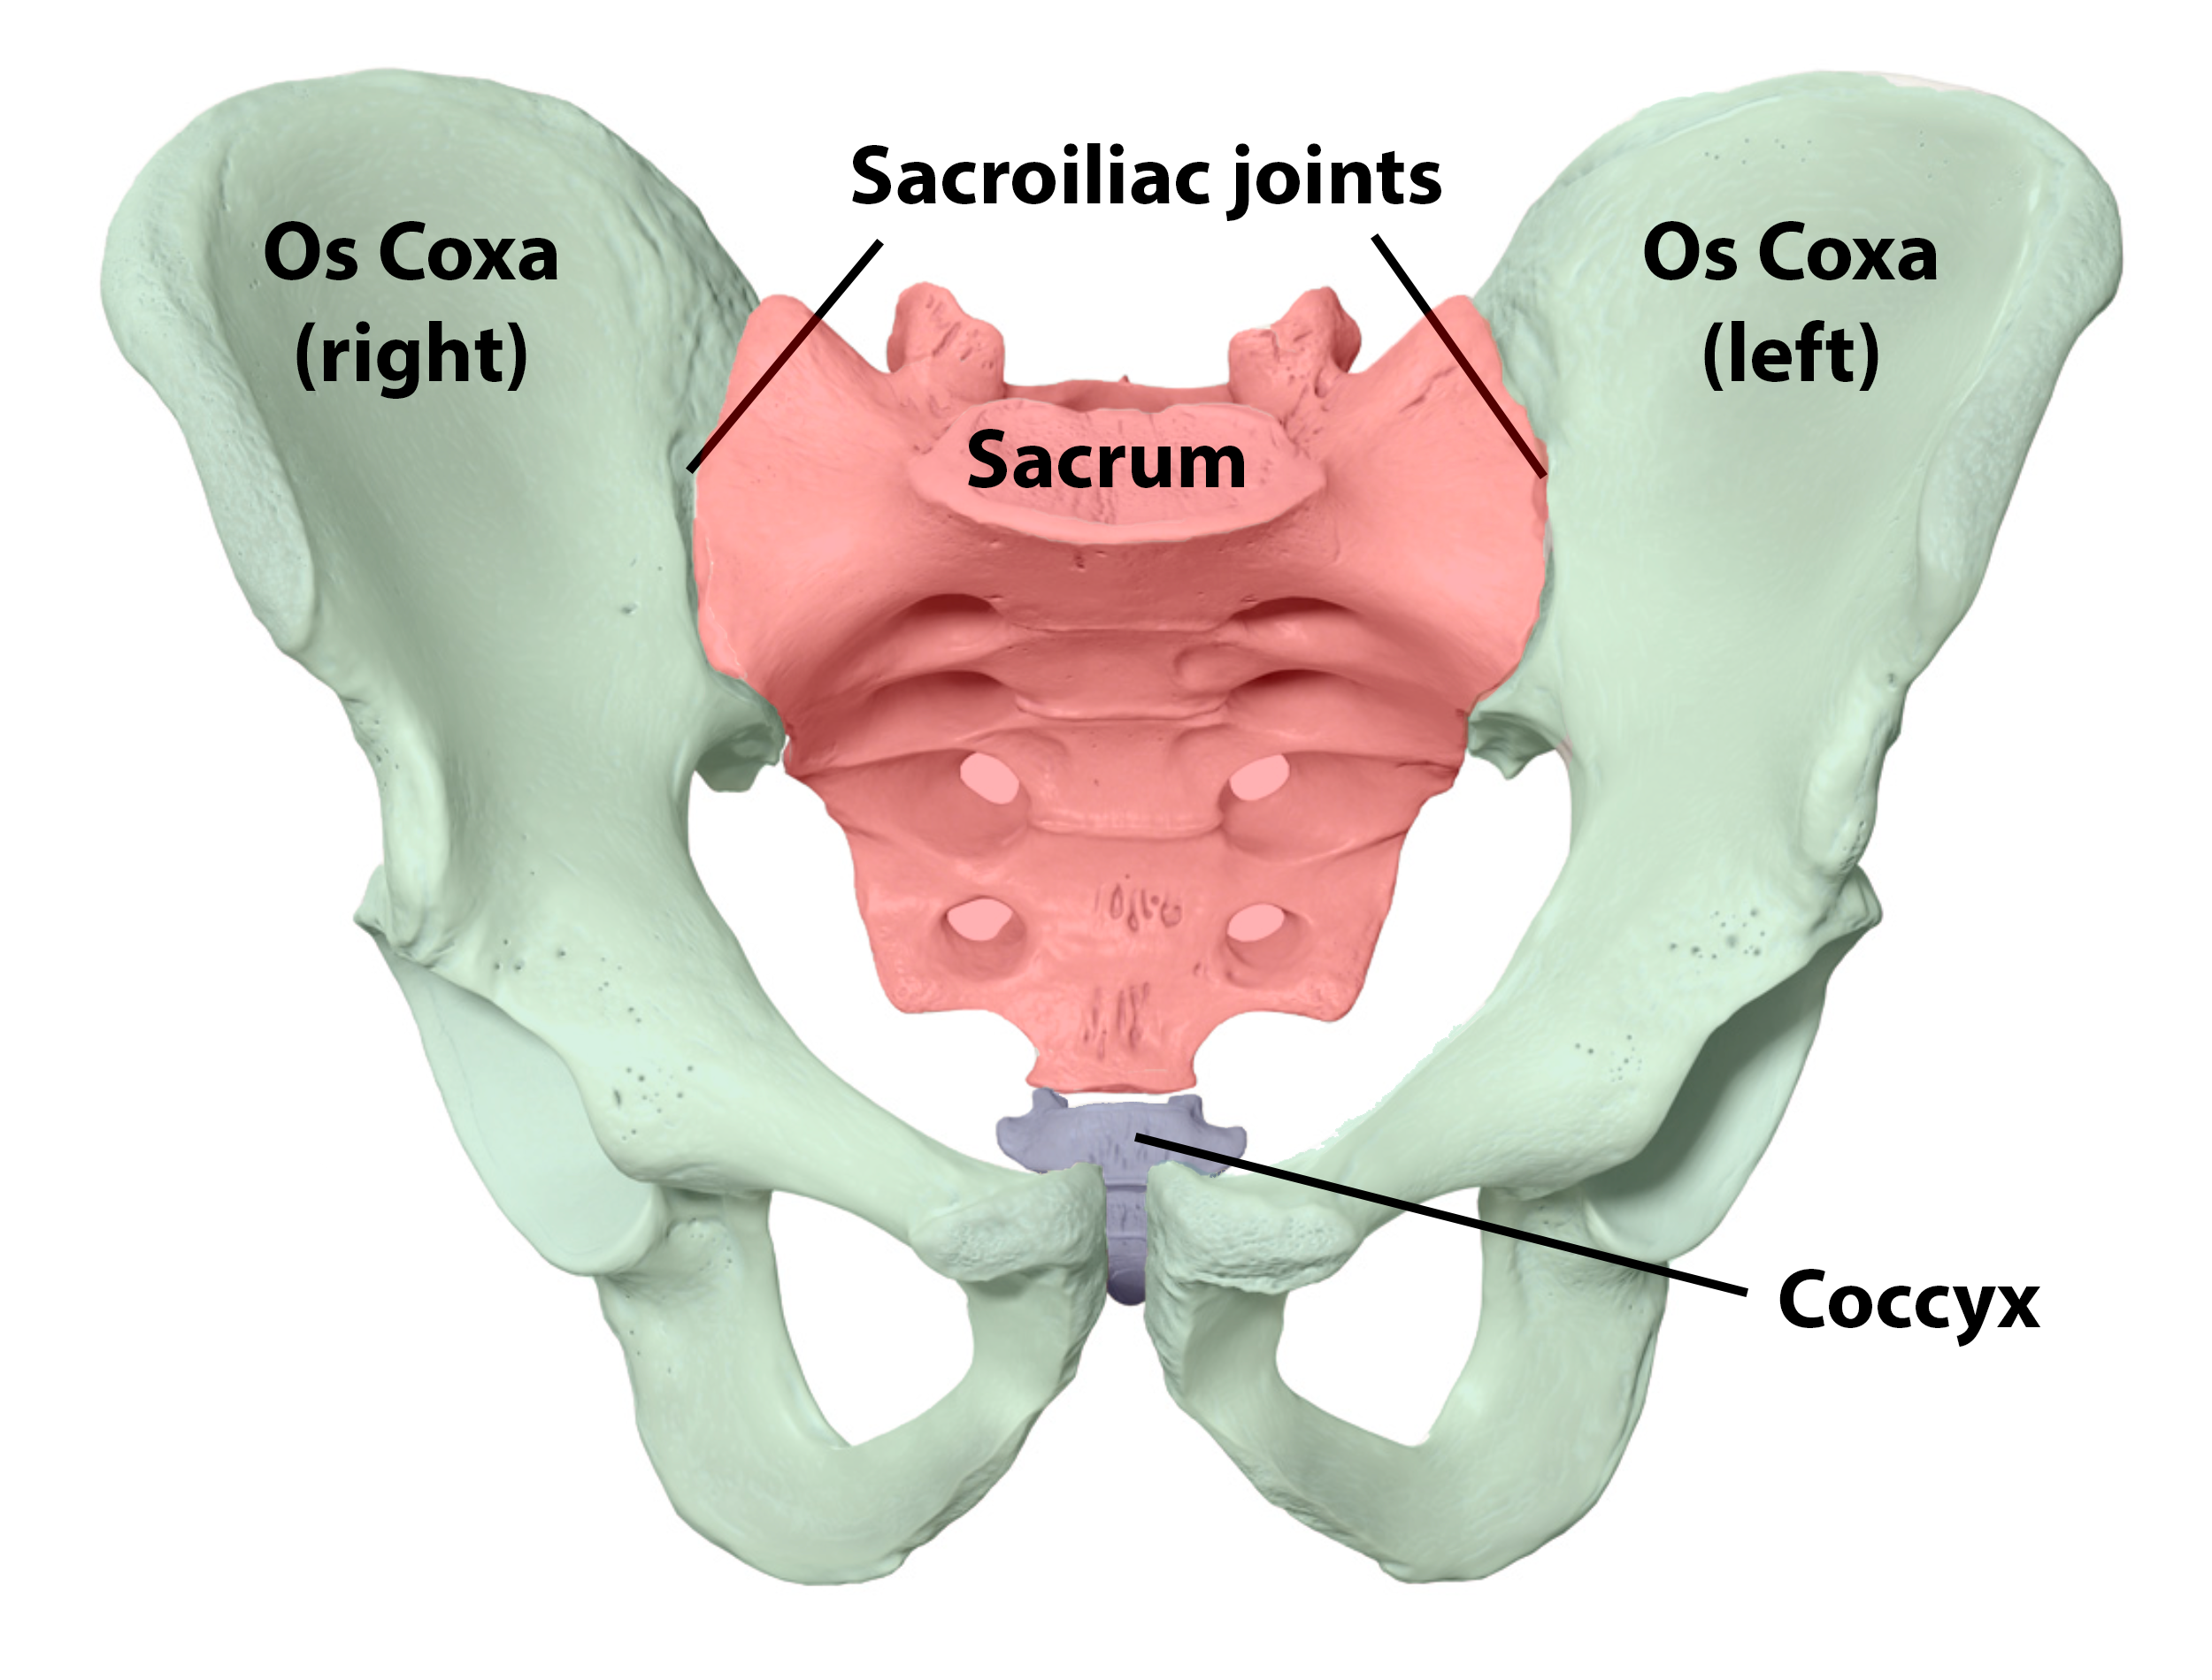

Slide 11
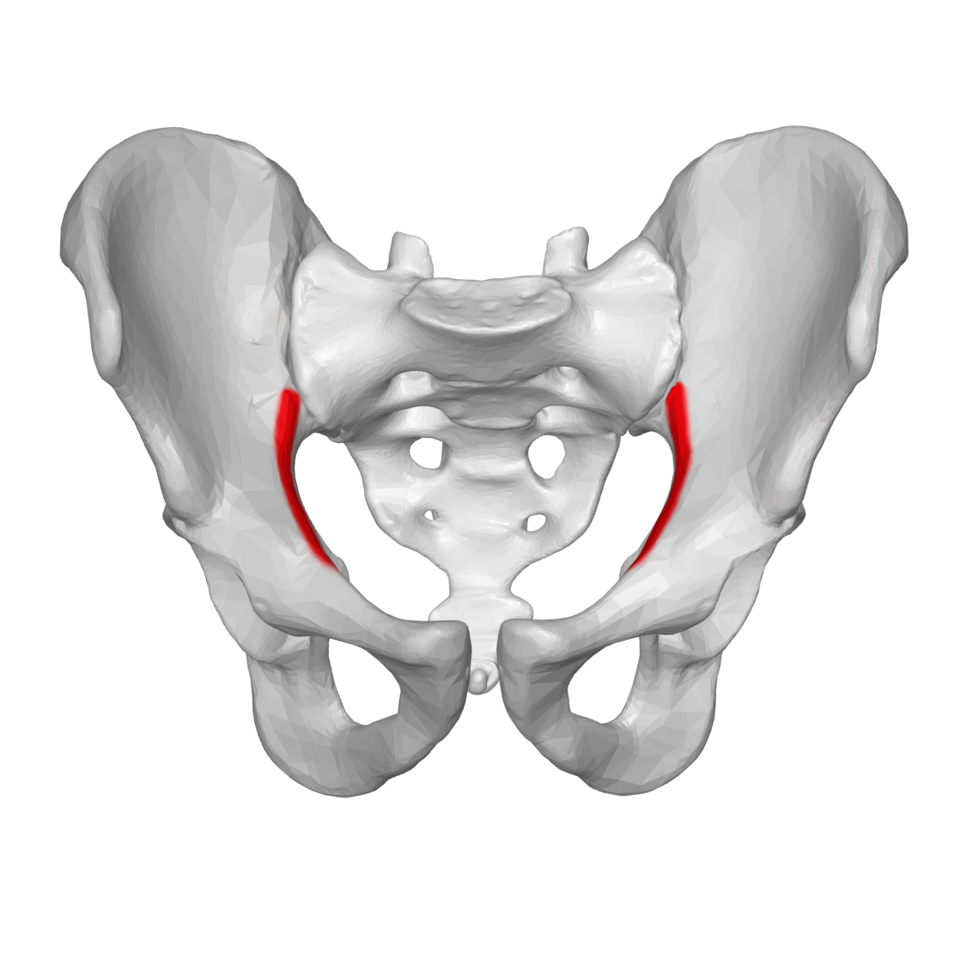

Slide 12
Iliac Fossa
The iliac fossa is:
  A concave surface.
  Located above the arcuate line.

Slide 13
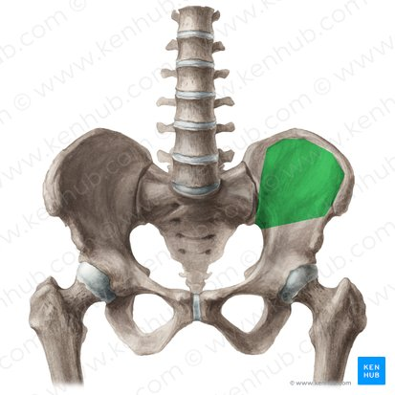

Slide 14
Surface Below the Arcuate Line
A flattened surface lies below the arcuate line.
It is continuous with the medial surfaces of:
  Pubis
  Ischium

Slide 15
Iliopectineal Line
The arcuate line of the ilium forms the posterior part of the iliopectineal line.
The pectineal line of the pubis forms the anterior part of the iliopectineal line.
The iliopectineal line separates:
  False pelvis
  True pelvis

Slide 17
General Appearance of the Abdominal Wall
The normal abdominal wall is:
  Soft
  Pliable
It moves in and out with respiration.
The contour of the abdominal wall varies depending on:
  Muscle tone
  Amount of subcutaneous fat
Well-developed abdominal muscles may make palpation of abdominal viscera more difficult.
An abundance of subcutaneous fat can also obstruct palpation of abdominal viscera.

Slide 18


Slide 19


