Slide 1

بسم اللہ الرحمٰن الرحیم

Slide 2


Slide 3
PAKISTAN STUDIES
Instructor: Khalid Makhdoom
Course code : PST-321
Credit hours : 02

Slide 4
CONTEMPORARY ISSUES
Foreign Relations of Pakistan
Security Challenges: Terrorism, Extremism and Reginal Conflicts
Environmental Problems and Sustainable Development Goals(SDGs)

Slide 5
FOREIGN RELATIONS OF PAKISTAN
Pakistan’s foreign relations are shaped by its security concerns, regional location, and efforts to balance ties with major powers. The strongest relationships are with China and many Muslim-majority countries, while relations with India and Afghanistan are more complicated because of border and political disputes.

Slide 6
FOREIGN RELATIONS OF PAKISTAN
Core foreign policy
Pakistan’s stated foreign policy is to build friendly relations with all countries, especially neighboring states and major powers. It also seeks economic cooperation, regional stability, and a stronger role in international affairs.

Slide 7
FOREIGN RELATIONS OF PAKISTAN
China: Pakistan's closest "all-weather" strategic ally with $60B+ CPEC investments driving infrastructure and energy, plus deep military cooperation and mutual diplomatic backing.
China-Pakistan ties remain immune to external pressures, with ongoing F-35 fighter co-production and trade exceeding $25B annually.
United States: Transactional relationship focused on counterterrorism and defense aid, but strained by post-Afghanistan withdrawal tensions, aid suspensions, and America's pro-India tilt.
Recent relations described as "new low normal" with limited cooperation despite Pakistan's strategic value and growing economic concerns.

Slide 8
FOREIGN RELATIONS OF PAKISTAN
Russia: Warming partnership since the 2010s in trade, energy (Pakistan Stream gas pipeline), defense, and SCO membership, with April 2025 talks advancing long-term strategic ties.
Relations counter U.S. pressures and align with Pakistan's multipolar foreign policy, including wheat/oil deals and military exercises.
Turkey: Fraternal strategic bonds via High-Level Strategic Cooperation Council (latest April 2026), defense co-production (drones, warships), and robust people-to-people/economic links.

Slide 9
SECURITY CHALLENGES
Terrorism
Extremism
Regional conflicts

Slide 10
TERRORISM
TTP (PAKISTANI TALIBAN)
Attacks increased 7-fold from 2022 to 2025 (118 → 838 attacks)
2025 had 699 attacks (34% increase), killing 1,034 people
Runs attacks from Afghan soil - Afghan Taliban accused of sheltering TTP fighters
Recent deadly attacks: 47 killed on train in Quetta (May 2026), 31 killed at Shia mosque in Islamabad (Feb 2026), 12 killed at courthouse (Nov 2025)

Slide 11
TERRORISM
BALOCHISTAN INSURGENCY (BLA)
Baloch Liberation Army targets security forces, civilians, and Chinese CPEC projects
120+ killed in one day (Jan 31, 2026) in coordinated attacks across Balochistan
36 civilians + 22 security forces killed in Jan 2026 attacks
KEY STATISTICS
Over 95% of attacks in Khyber Pakhtunkhwa & Balochistan
42% of victims are security forces
Attacks on mosques, markets, airports, military bases, police stations

Slide 12
EXTREMISM
79 jihadist groups operate in Pakistan, with TTP (Pakistani Taliban) being the deadliest, killing 140,000+ people since 2001
Main causes: Religious madrasas teaching extreme Islam, poverty/unemployment, weak education, political instability, and Taliban sheltering in Afghanistan

Slide 13
EXTREMISM
TTP's goal: Enforce strict Sharia law, overthrow government, attack religious minorities (especially Shias), and recruit children for suicide attacks
Who joins: Poor uneducated youth for money, some educated youth online, and even women through women-only madrasas

Slide 14
REGIONAL CONFLICTS
Afghanistan–Pakistan: Cross‑border militancy and the 2026 clashes after Pakistani strikes; TTP and other militants operate from Afghan territory, causing frequent attacks and border skirmishes.
India–Pakistan (Kashmir): Longstanding rivalry with periodic ceasefire violations, Kashmir insurgency, and conventional/nuclear deterrence that shapes military posture.

Slide 15
REGIONAL CONFLICTS
Balochistan insurgency: Local separatist groups (BLA) attack security forces and CPEC-linked projects, destabilising the southwest and threatening foreign investments.
Sectarian violence: Sunni–Shia tensions fuel targeted attacks on religious gatherings and minorities, increasing internal instability.

Slide 16
ENVIRONMENTAL PROBLEMS AND SUSTAINABLE DEVELOPMENT GOALS (SDGs)
The Sustainable Development Goals (SDGs) were established in September 2015 by all 193 member states of the United Nations (UN). They were officially launched on January 1, 2016, to serve as a universal call to action to end poverty, protect the planet, and ensure global peace and prosperity

Slide 17
ENVIRONMENTAL PROBLEMS AND SUSTAINABLE DEVELOPMENT GOALS (SDGs)
Major environmental problems: severe air pollution in cities, unsafe drinking water and river contamination, deforestation and land degradation, poor waste management (open dumping and burning), and worsening climate impacts ( floods, heatwaves, glacial melt).
Security/economic link: environmental decline raises health costs, reduces agricultural output, and strains the economy—weakening resilience to shocks.

Slide 18
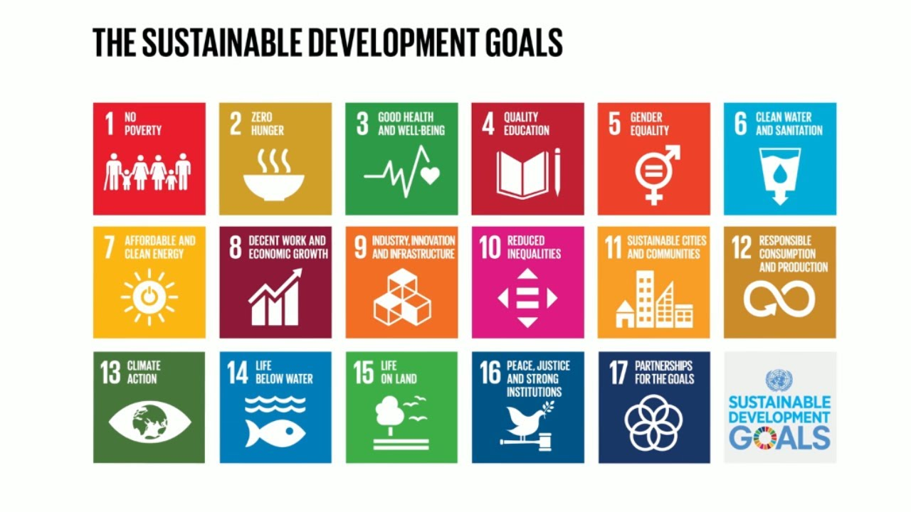

Slide 19
Thank you

Slide 20


