Slide 1

ANATOMY
THE LOWER LIMB
DPT
2ND SEMESTER
DR DANISH
DPT(S.M.C),MPPTA

Slide 2
Muscles of the Sole of the Foot
Layers of Sole Muscles
First Layer
  Abductor Hallucis
  Flexor Digitorum Brevis
  Abductor Digiti Minimi
Second Layer
  Quadratus Plantae
  Lumbricals (4)

Slide 3
CONTINUED
Third Layer
  Flexor Hallucis Brevis
  Adductor Hallucis
  Flexor Digiti Minimi Brevis
Fourth Layer
  Plantar Interossei (3)
  Dorsal Interossei (4)

Slide 4
Abductor Hallucis
Origin
Medial process of calcaneal tuberosity
Flexor retinaculum
Plantar aponeurosis
Insertion
Medial side of base of proximal phalanx of great toe
Nerve Supply
Medial plantar nerve
Root Value
S2, S3

Slide 5
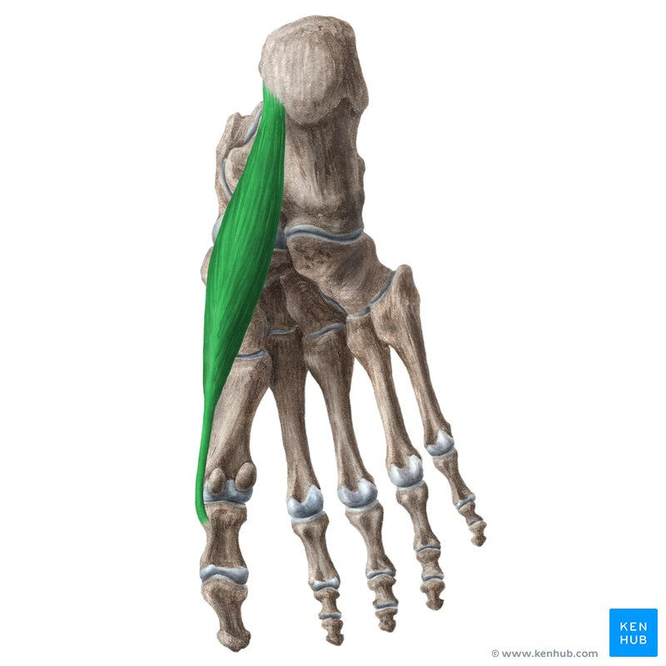

Slide 6
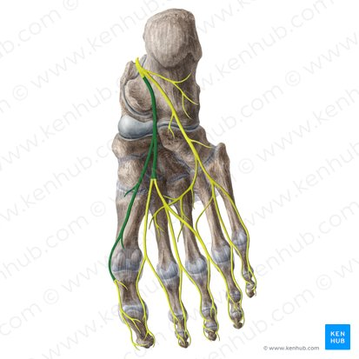

Slide 7
CONTINUED
Action
Abducts great toe
Assists flexion of metatarsophalangeal joint of great toe
Supports medial longitudinal arch

Slide 8
Flexor Digitorum Brevis
Origin
Medial process of calcaneal tuberosity
Plantar aponeurosis
Insertion
Both sides of middle phalanges of lateral four toes
Nerve Supply
Medial plantar nerve
Root Value
S2, S3

Slide 9
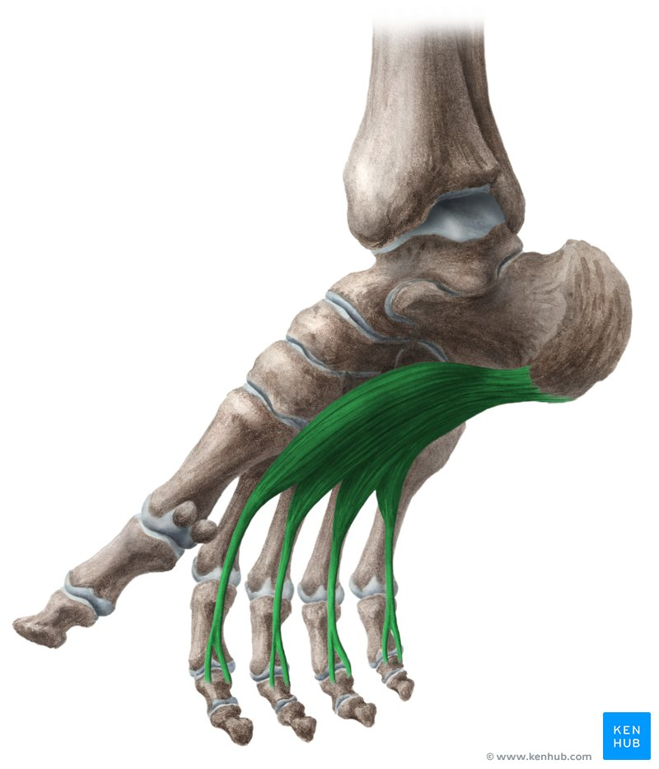

Slide 11
CONTINUED
Action
Flexes lateral four toes at proximal interphalangeal joints
Supports medial longitudinal arch

Slide 12
Abductor Digiti Minimi
Origin
Medial and lateral processes of calcaneal tuberosity
Insertion
Lateral side of base of proximal phalanx of fifth toe
Nerve Supply
Lateral plantar nerve
Root Value
S2, S3

Slide 13
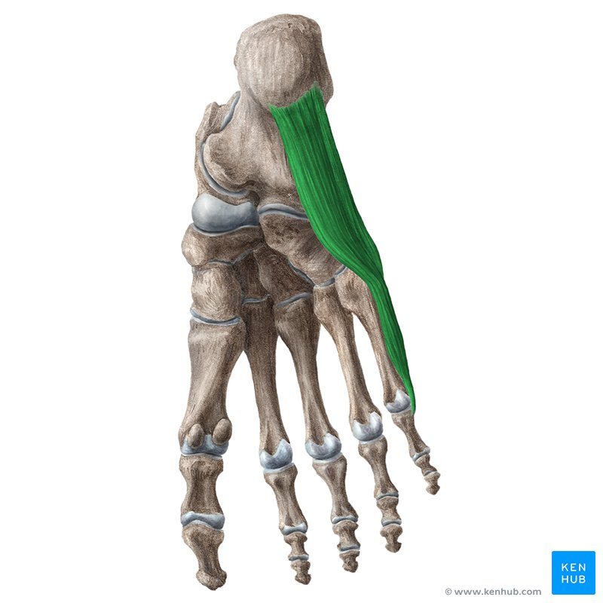

Slide 15
CONTINUED
Action
Abducts fifth toe
Assists flexion of fifth toe
Supports lateral longitudinal arch

Slide 16
Quadratus Plantae
Origin
Medial surface of calcaneus
Lateral surface of calcaneus
Insertion
Tendon of flexor digitorum longus
Nerve Supply
Lateral plantar nerve
Root Value
S2, S3

Slide 17
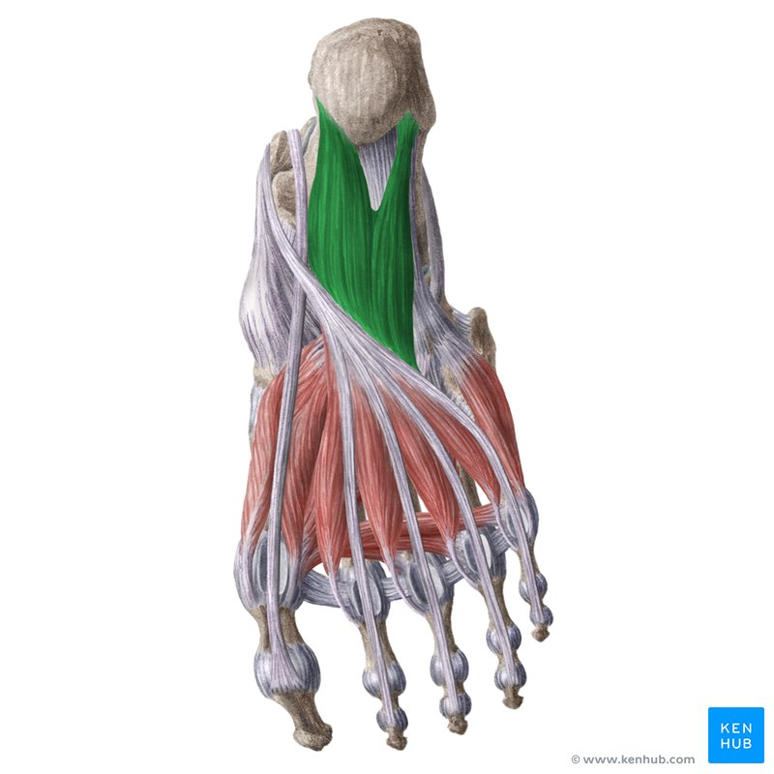

Slide 19
CONTINUED
Action
Assists flexor digitorum longus
Straightens pull of flexor digitorum longus

Slide 20
Lumbricals
Origin
Tendons of flexor digitorum longus
Insertion
Medial side of extensor expansions of lateral four toes
Nerve Supply
First lumbrical: Medial plantar nerve
Second, third, and fourth lumbricals: Lateral plantar nerve
Root Value
S2, S3

Slide 21
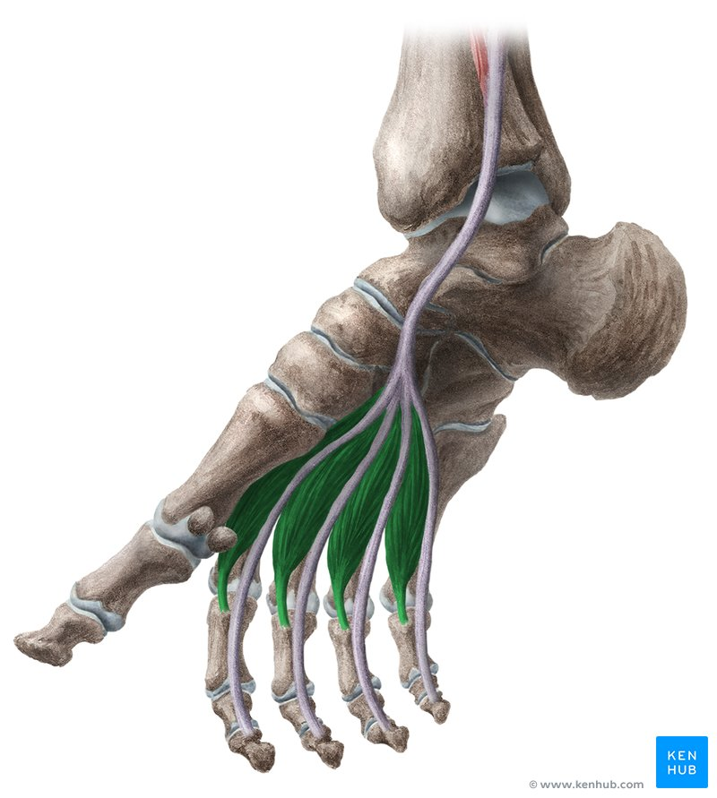

Slide 23
CONTINUED
Action
Flex metatarsophalangeal joints
Extend interphalangeal joints of lateral four toes

Slide 24
Flexor Hallucis Brevis
Origin
Plantar surfaces of cuboid and lateral cuneiform
Insertion
Medial and lateral sides of base of proximal phalanx of great toe
Through medial and lateral sesamoid bones
Nerve Supply
Medial plantar nerve
Root Value
S2, S3

Slide 25
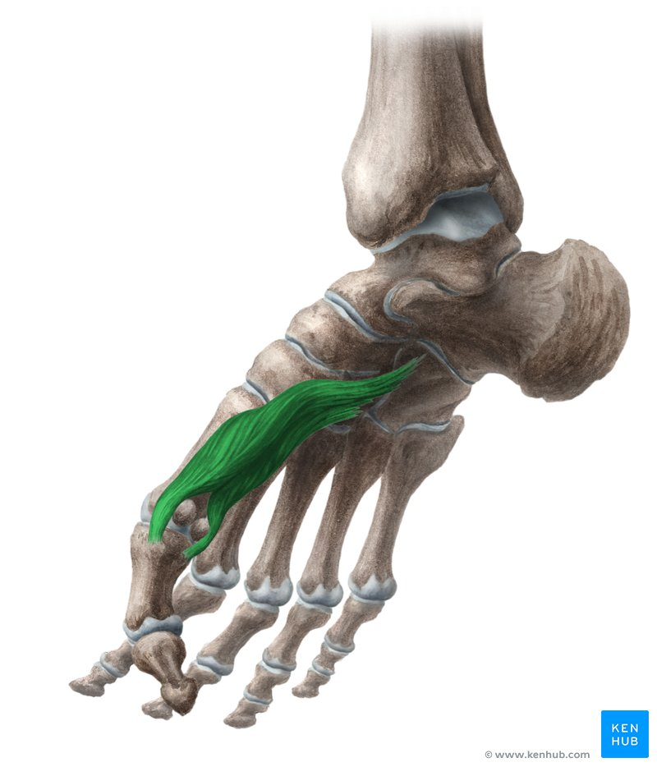

Slide 27
CONTINUED
Action
Flexes metatarsophalangeal joint of great toe
Supports medial longitudinal arch

Slide 28
Adductor Hallucis
Origin
Oblique Head
Bases of 2nd, 3rd, and 4th metatarsals
Transverse Head
Plantar ligaments of metatarsophalangeal joints of lateral three toes
Insertion
Lateral side of base of proximal phalanx of great toe
Nerve Supply
Deep branch of lateral plantar nerve
Root Value
S2, S3

Slide 29
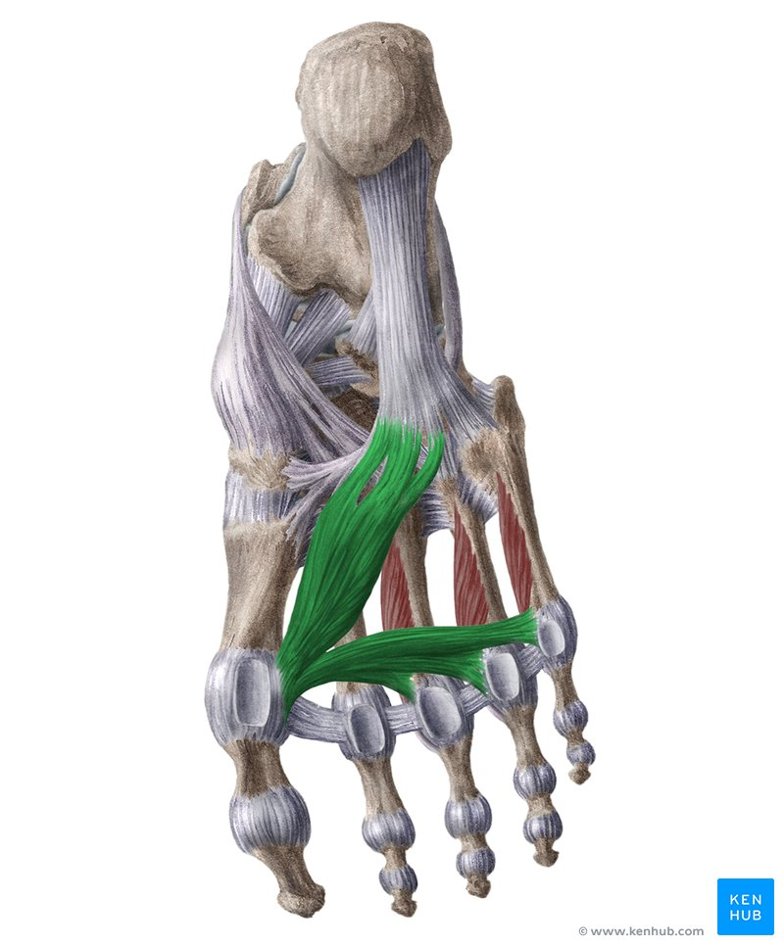

Slide 31
CONTINUED
Action
Adducts great toe
Assists flexion of great toe
Helps maintain transverse arch

Slide 32
Flexor Digiti Minimi Brevis
Origin
Base of fifth metatarsal
Insertion
Lateral side of base of proximal phalanx of fifth toe
Nerve Supply
Superficial branch of lateral plantar nerve
Root Value
S2, S3
Action
Flexes metatarsophalangeal joint of fifth toe

Slide 33
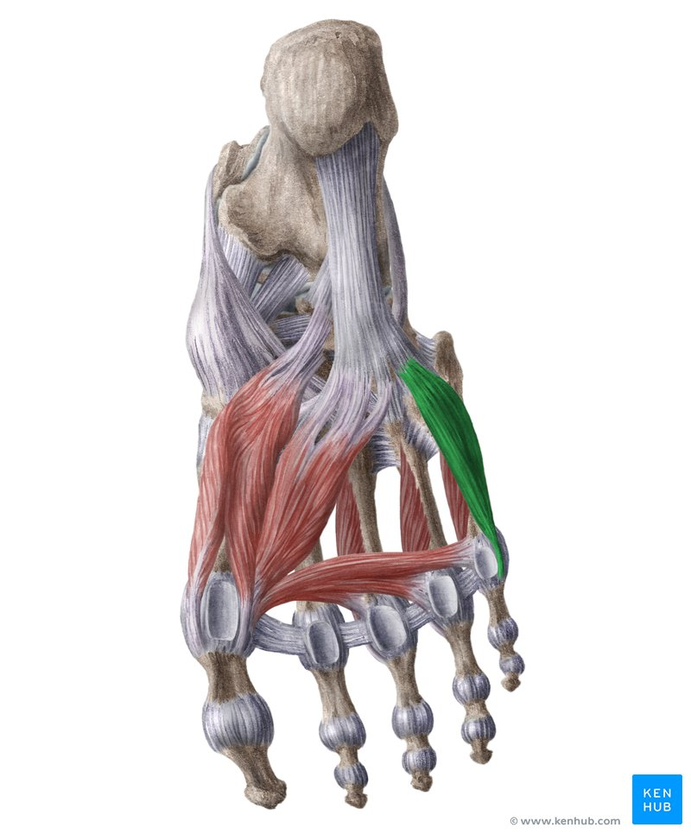

Slide 35
Plantar Interossei (3)
Origin
Medial sides of metatarsals 3, 4, and 5
Insertion
Medial sides of bases of proximal phalanges of toes 3, 4, and 5
Nerve Supply
Lateral plantar nerve
Root Value
S2, S3

Slide 36
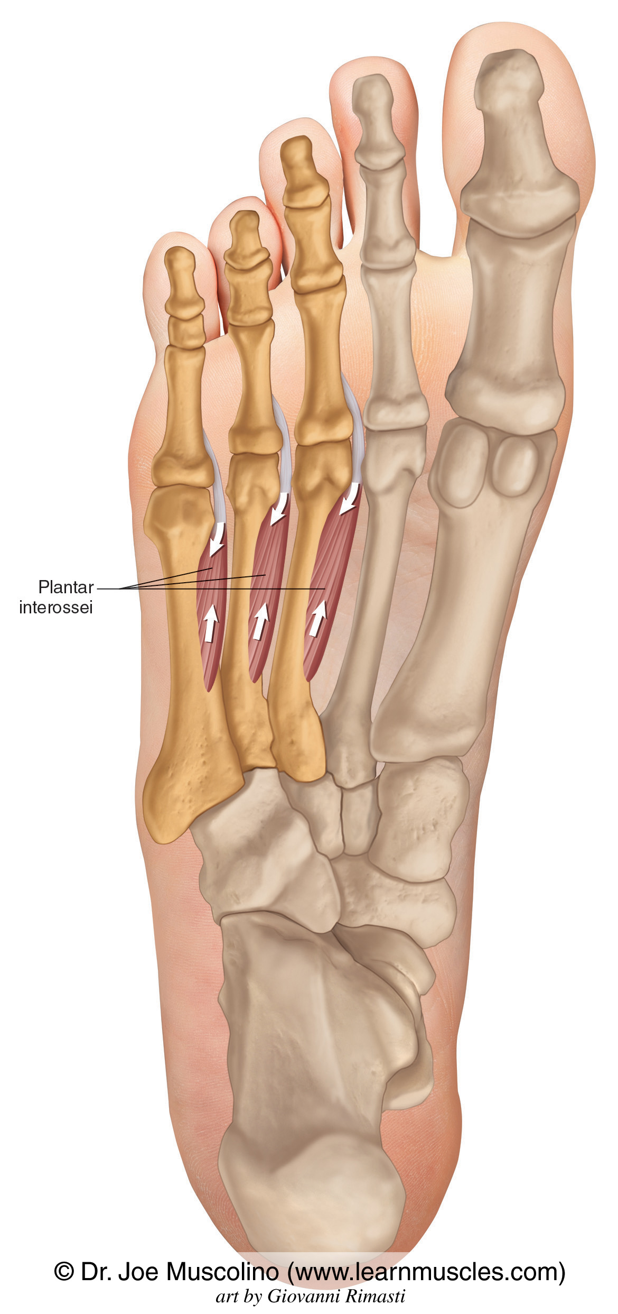

Slide 37
CONTINUED
Action
Adduct toes toward second toe
Flex metatarsophalangeal joints
Extend interphalangeal joints

Slide 38
Dorsal Interossei (4)
Origin
Adjacent sides of metatarsals
Insertion
First: Medial side of proximal phalanx of second toe
Second to Fourth: Lateral sides of proximal phalanges of second, third, and fourth toes
Nerve Supply
Lateral plantar nerve
Root Value
S2, S3

Slide 39
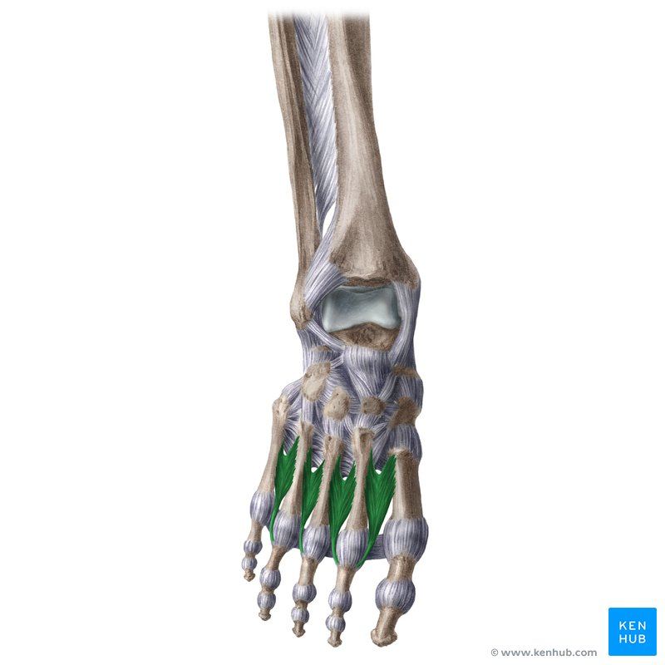

Slide 40
CONTINUED
Action
Abduct toes from second toe
Flex metatarsophalangeal joints
Extend interphalangeal joints

Slide 41


Slide 42


