Slide 1
Skull, Cranial cavity and meninges
ADNAN RAMZAN
BS(OTT)

Slide 2
Bones of Skull
Composition
The skull is composed of several separate bones united at immobile joints called sutures.
The connective tissue between the bones is called a sutural ligament.
The vault is the upper part of the cranium, and the base of the skull is the lowest part of the cranium

Slide 3
The skull bones are made up of external and internal tables of compact bone separated by a layer of spongy bone called the diploë
The bones are covered on the outer and inner surfaces with periosteum.
The cranium consists of the following bones, two of which are paired

Slide 4
Cranial Bones
Frontal bone: 1
Parietal bones: 2
Occipital bone: 1
Temporal bones: 2
Sphenoid bone: 1
Ethmoid bone: 1

Slide 5
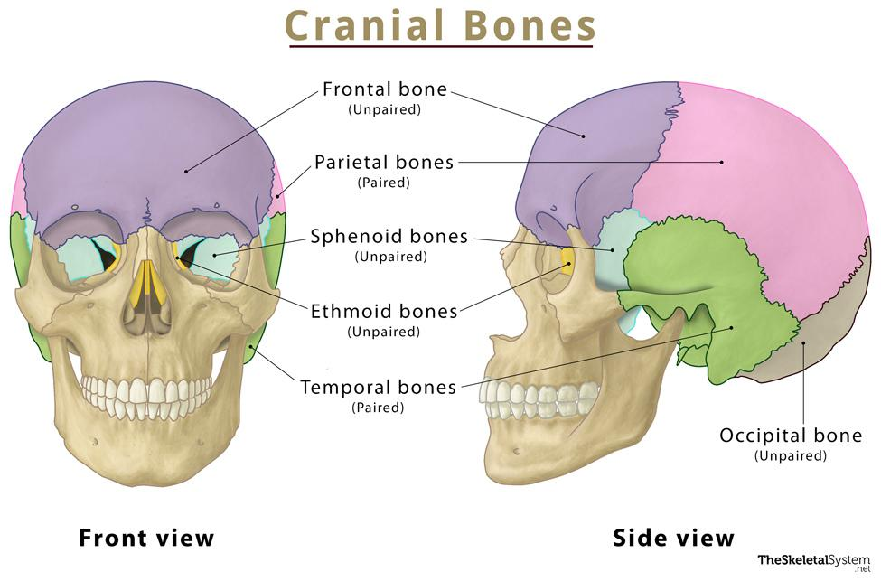

Slide 6
Facial bones
Zygomatic bones: 2
Maxillae: 2
Nasal bones: 2
Lacrimal bones: 2
Vomer: 1
Palatine bones: 2
Inferior conchae: 2
Mandible: 1

Slide 7
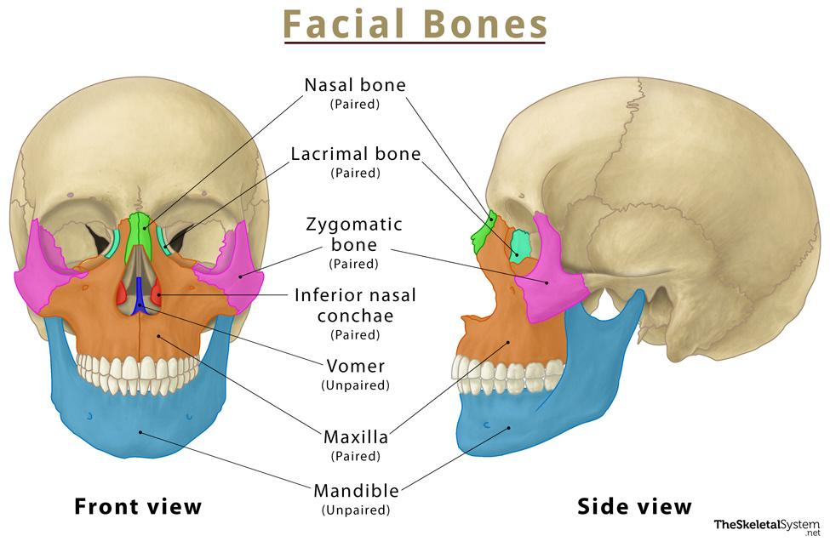

Slide 8
External Views of the Skull
It consists of
Anterior view of skull
Lateral view of skull
Posterior view of skull
Superior view
Inferior view

Slide 9
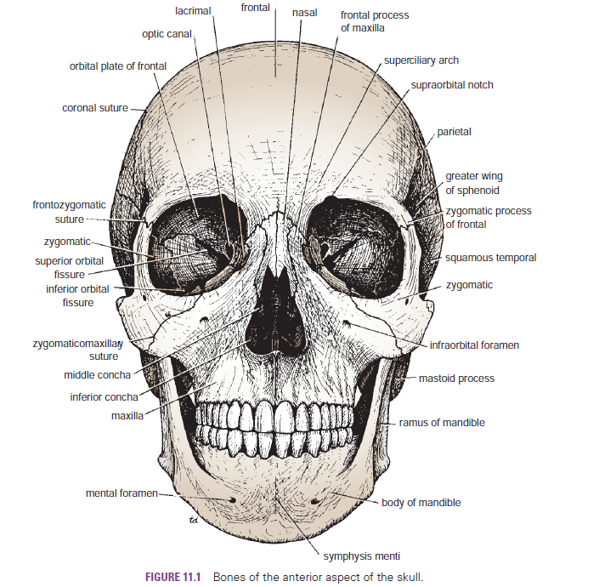

Slide 10
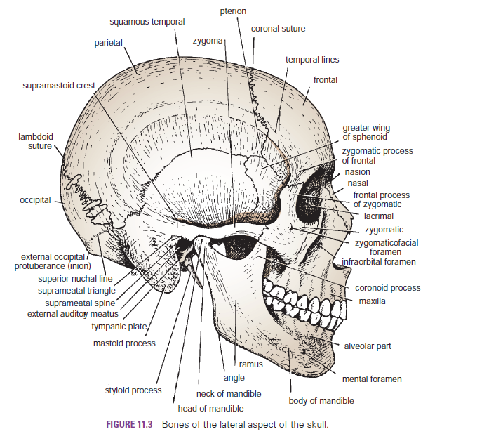

Slide 11
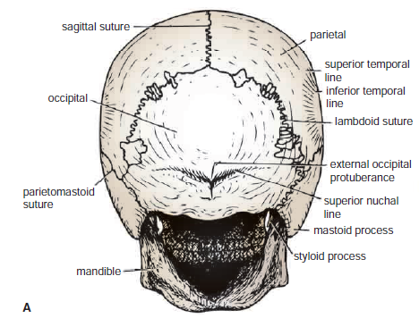
Posterior

Slide 12
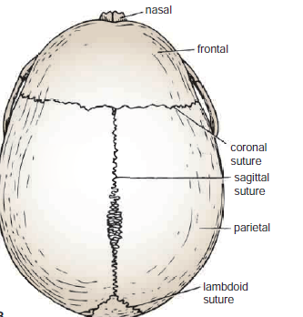
Superior

Slide 13
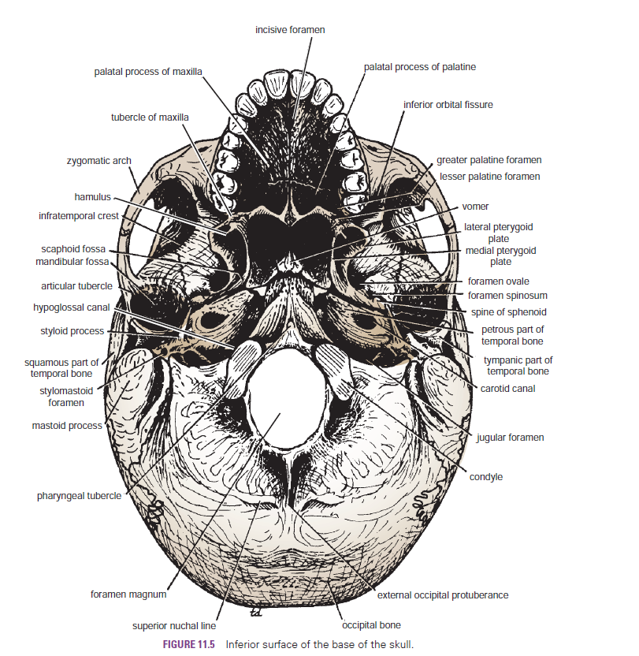

Slide 14
The Cranial Cavity
The cranial cavity contains
the brain and its surrounding meninges,
portions of the cranial nerves,
arteries,
veins, and
venous sinuses.

Slide 16
Vault of the Skull
The internal surface of the vault shows the coronal, sagittal, and lambdoid sutures.
In the midline is a shallow sagittal groove that lodges the superior sagittal sinus.
On each side of the groove are several small pits, called granular pits, which lodge the lateral lacunae and arachnoid granulations

Slide 17
Base of the Skull
The interior of the base of the skull is divided into three cranial fossae: anterior, middle, and posterior.
The anterior cranial fossa is separated from the middle cranial fossa by the lesser wing of the sphenoid, and the middle cranial fossa is separated from the posterior cranial fossa by the petrous part of the temporal bone.

Slide 18
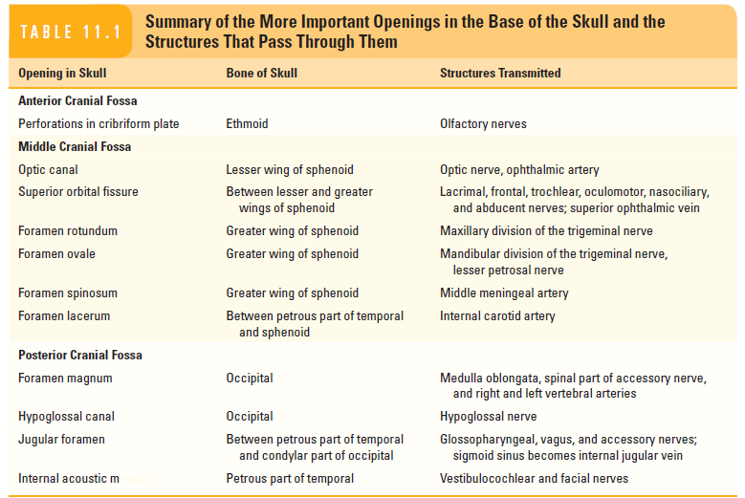

Slide 19
Meninges
The brain in the skull is surrounded by three protective membranes, or meninges:
The dura mater,
The arachnoid mater, and
The pia mater.

Slide 20
Dura Mater of the Brain
The dura mater is conventionally described as two layers:
The endosteal layer and the meningeal layer These are closely united except along certain lines, where they separate to form venous sinuses.
The endosteal layer is nothing more than the ordinary periosteum covering the inner surface of the skull bones.
Notes:
"Dura" means hard or tough in Latin.

Slide 21
The meningeal layer is the dura mater proper.
It is a dense, strong, fibrous membrane covering the brain and is continuous through the foramen magnum with the dura mater of the spinal cord.
It provides tubular sheaths for the cranial nerves as the latter pass through the foramina in the skull.

Slide 22
Folds of Dura Matter
The falx cerebri is a sickle-shaped fold of dura mater that lies in the midline between the two cerebral hemispheres.
The tentorium cerebelli is a crescent-shaped fold of dura mater that roofs over the posterior cranial fossa.
The falx cerebelli is a small, sickle-shaped fold of dura mater
The diaphragma sellae is a small circular fold of dura mater

Slide 23
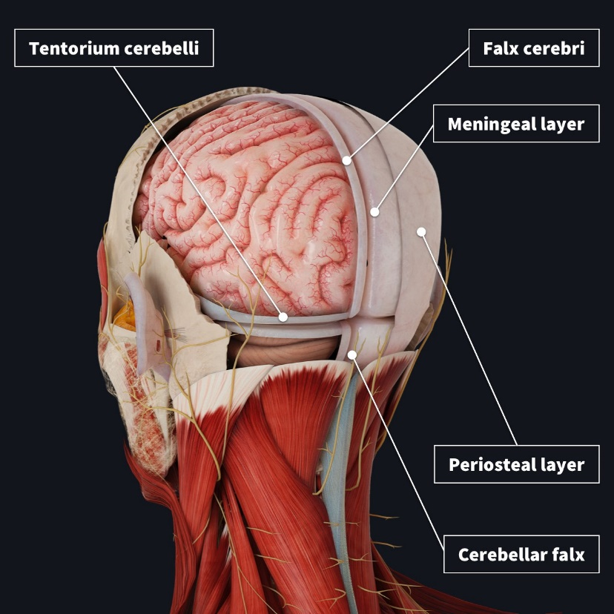

Slide 25
Arachnoid Mater of the Brain
The arachnoid mater is a delicate, impermeable membrane covering the brain and lying between the pia mater internally and the dura mater externally.
It is separated from the dura by a potential space, the subdural space, and from the pia by the subarachnoid space, which is filled with cerebrospinal fluid.
Notes:
"Dura" means hard or tough in Latin.

Slide 26
Cerebrospinal Fluid
The cerebrospinal fluid is produced by the choroid plexuses within the lateral, third, and fourth ventricles of the brain.
It escapes from the ventricular system of the brain through the three foramina in the roof of the fourth ventricle and so enters the subarachnoid space.
It now circulates both upward over the surfaces of the cerebral hemispheres and downward around the spinal cord.

Slide 27
The spinal subarachnoid space extends down as far as the second sacral vertebra .
Eventually, the fluid enters the bloodstream by passing into the arachnoid villi and diffusing through their walls.
The cerebrospinal fluid provides a fluid medium in which the brain floats.
This mechanism effectively protects the brain from trauma.

Slide 28
CSF circulates through the ventricular system and around the brain and spinal cord:
Lateral ventricles
Interventricular foramina (of Monro)
Third ventricle
Cerebral aqueduct (of Sylvius)
Fourth ventricle
Enters the subarachnoid space surrounding the brain and spinal cord

Slide 29
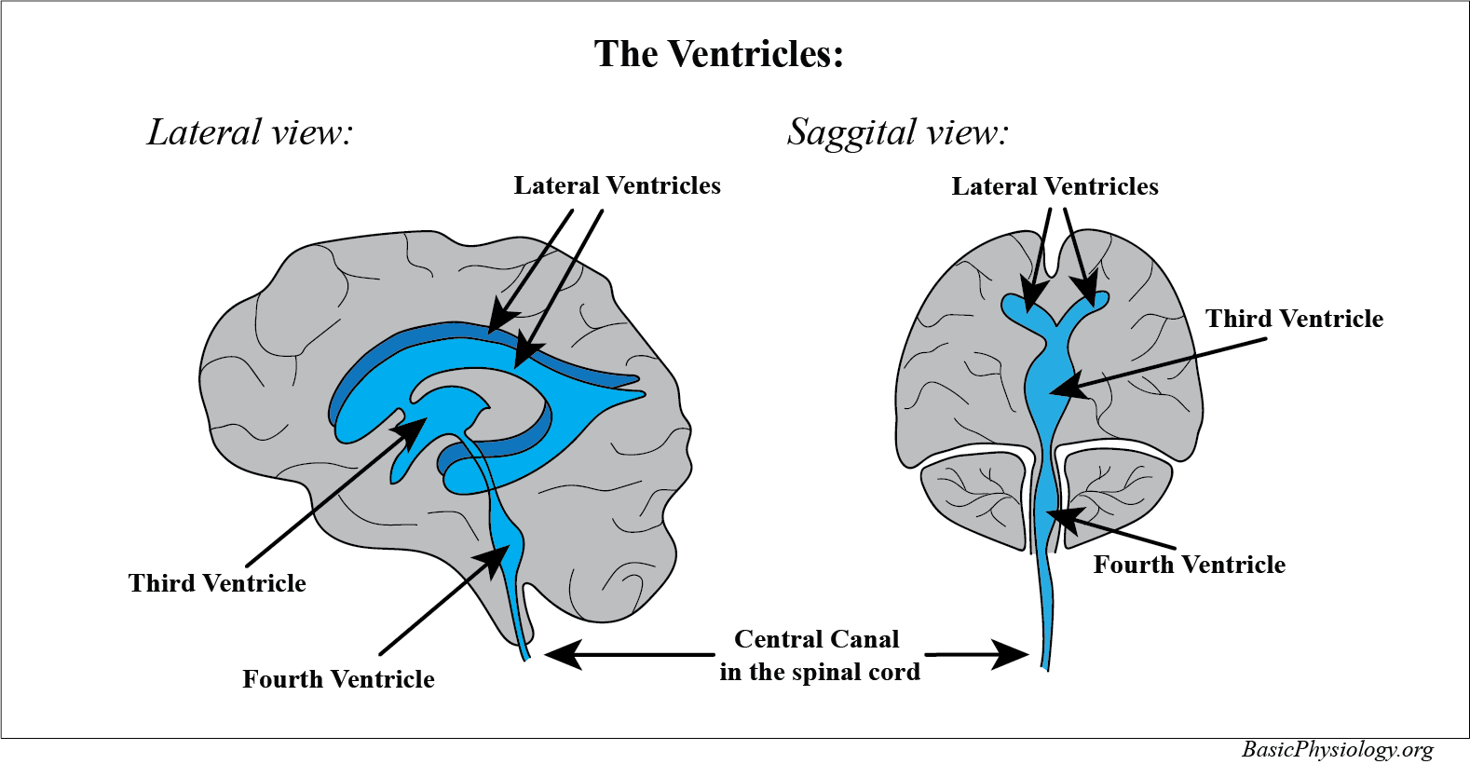

Slide 30
Pia Mater of the Brain
The pia mater is a vascular membrane that closely invests the brain, covering the gyri and descending into the deepest sulci.
It extends over the cranial nerves and fuses with their epineurium.
The cerebral arteries entering the substance of the brain carry a sheath of pia with them.
Notes:
"Pia" means tender or delicate.

Slide 31


