Slide 1
Physiology
DPT
Awais Hamza

Slide 2
Complications of blood transfusion with reference to ABO & RH incompatibility.
Definition: Blood transfusion is the intravenous administration of whole blood or blood components from a donor to a recipient.
Purpose of Blood Transfusion: Restore blood volume, Improve oxygen-carrying capacity, Replace clotting factors
Treat severe anemia
Manage massive hemorrhage
Important Principle: Compatibility between donor and recipient blood is essential to avoid life-threatening transfusion reactions.

Slide 3
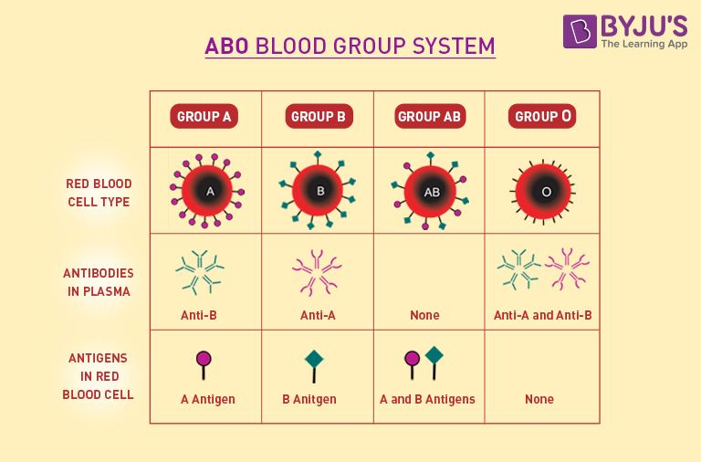
ABO Blood Group System

Slide 4
Rh Blood Group System
Rh Factor
Most important antigen is D antigen
Rh positive → D antigen present
Rh negative → D antigen absent
Characteristics
Rh antibodies are mainly IgG
No naturally occurring antibodies
Antibodies develop after sensitization
Rh antibodies can cross placenta

Slide 5
ABO Incompatibility
Mechanism: Occurs when recipient antibodies react with donor RBC antigens.
Example
Group A patient receives Group B blood
Anti-B antibodies attack donor RBCs
Result
Agglutination of RBCs
Complement activation
Rapid intravascular hemolysis
Severity: Potentially fatal emergency.

Slide 6
Pathophysiology of ABO Mismatched Transfusion
Sequence of Events
Incompatible blood transfused
Antigen-antibody reaction occurs
RBC agglutination develops
Complement system activated
Intravascular hemolysis occurs
Hemoglobin released into plasma
Renal damage and shock develop
Major Consequences: Hemoglobinemia, Hemoglobinuria, Acute kidney injury, Disseminated intravascular coagulation (DIC)

Slide 7
Clinical Features of ABO Incompatibility
Early Symptoms: Fever and chills
Chest pain, Back pain, Restlessness
Severe Features: Hypotension
Tachycardia, Dyspnea
Hemoglobinuria, Oliguria, Shock
Fatal Complications: Acute renal failure, DIC, Multi-organ failure

Slide 8
Management and Prevention of ABO Incompatibility
Immediate Management
Stop transfusion immediately
Maintain IV fluids
Inform blood bank
Monitor urine output and blood pressure
Prevention
Proper blood grouping
Cross-matching
Correct patient identification
Blood bank safety protocols

Slide 9
Rh Incompatibility
Rh Incompatibility During Transfusion
When an Rh-negative person receives Rh-positive blood for the first time, severe reactions usually do not occur immediately.
First Exposure
Rh antibodies develop within one month. Delayed transfusion reaction occurs.Usually mild
Second Exposure
Antibodies remain forever
Donor RBCs are rapidly agglutinated
Severe transfusion reactions occur immediately

Slide 10
Hemolytic Disease of Fetus and Newborn
Erythroblastosis Fetalis
Hemolytic disease in fetus and newborn caused by Rh incompatibility.
Basic Cause
Mother is Rh negative
Fetus is Rh positive
Rh factor inherited from father
Important Point
Usually the first child escapes severe complications.

Slide 11
Mechanism of Erythroblastosis Fetalis
First Pregnancy
Rh antigen usually does not cross placenta
At delivery, fetal Rh-positive blood enters maternal circulation
Mother develops Rh antibodies during postpartum period
Second Pregnancy
Maternal Rh antibodies cross placenta
Fetal RBCs undergo agglutination and hemolysis
Important Principle
Rh antigen cannot cross placenta
Rh antibody can cross placenta

Slide 12
Pathophysiology of Erythroblastosis Fetalis
Effects of Hemolysis
Severe destruction of fetal RBCs
Severe fetal jaundice develops
Bone marrow, spleen, and liver increase RBC production
Result
Large immature erythroblasts are released into circulation.

Slide 13
Major Complications of Erythroblastosis Fetalis
Severe Complications
Severe anemia
Hydrops fetalis
Kernicterus
Consequences
Cardiac failure
Brain damage
Intrauterine death
Neonatal death

Slide 14
Severe Anemia and Hydrops Fetalis
Severe Anemia
Excessive hemolysis destroys fetal RBCs
Severe hypoxia develops
Infant may die if anemia becomes severe
Hydrops Fetalis: A serious fetal condition characterized by edema.
Features
Generalized edema
Enlarged liver and spleen
Cardiac failure
Complication: May lead to intrauterine death.

Slide 15
Kernicterus
Definition
Kernicterus is brain damage caused by severe jaundice and high bilirubin levels.
Why Infants Are Vulnerable: Blood-brain barrier is not fully developed.
Commonly Affected Areas
Basal ganglia
Hippocampus
Cerebellum
Cranial nerve nuclei

Slide 16
Clinical Features of Kernicterus
Early Signs: Lethargy
Sleepiness, High-pitched cry, Hypotonia
Progressive Features
Hypertonia, Opisthotonus
Irritability, Poor feeding
Advanced Features
Seizures, Spasticity
Fever, Coma

Slide 17
Prevention and Treatment of Erythroblastosis Fetalis
Anti-D Immunoglobulin
Given to Rh-negative mother:
At 28 weeks gestation
At 34 weeks gestation
Within 48 hours after delivery of Rh-positive baby
Mechanism
Produces passive immunity and prevents formation of maternal Rh antibodies.
Treatment: Exchange transfusion using Rh-negative blood.

Slide 18
Other Blood Group Systems
Lewis Blood Group
Lewis antigens are secretor antigens
Present in saliva and gastric juice
Sometimes causes transfusion reactions
MNS Blood Group
Determined by reactions with:
Anti-M
Anti-N
Anti-S
Usually does not cause severe hemolysis.

Slide 19
Importance of Knowing Blood Group
Medical Importance
Safe blood transfusion
Tissue transplantation
Prevention of Rh incompatibility
Social Importance
Encourages blood donation during emergencies
Judicial Importance
Helpful in medico-legal and parental dispute cases.

