Slide 1

HISTOLOGY
DPT
2ND SEMESTER
DR DANISH
DPT(S.M.C),MPPTA

Slide 2
Skin and Its Appendages
Largest organ of the body
Forms the external covering of the body
Provides protection and sensory perception
Contains specialized appendages

Slide 3
Functions of Skin
Protection against mechanical injury
Barrier against microorganisms
Prevention of water loss
Regulation of body temperature
Sensory reception
Vitamin D synthesis
Excretion through sweat glands
Storage of fat in subcutaneous tissue

Slide 4
Layers of Skin
Skin consists of:
Epidermis
Dermis
Beneath the skin:
Hypodermis (subcutaneous tissue)
  Not considered part of skin proper
  Contains adipose tissue and large blood vessels

Slide 5
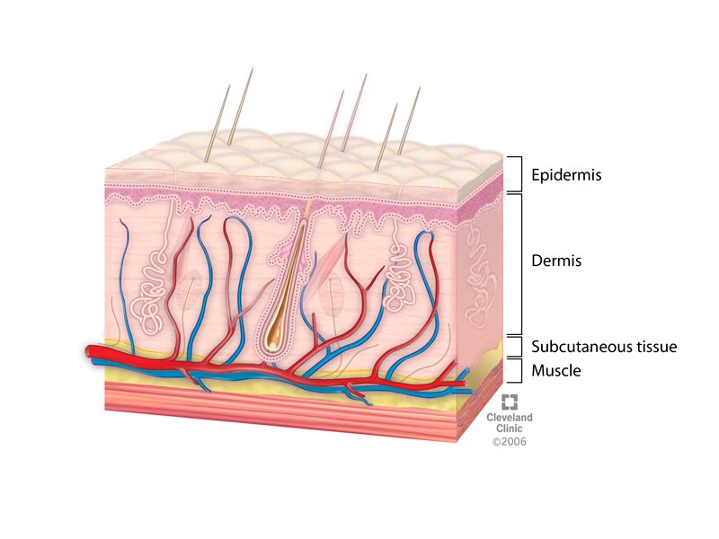

Slide 6
Epidermis
Surface epithelial layer
Keratinized stratified squamous epithelium
Avascular
Nourished by diffusion from dermis
Mainly composed of keratinocytes
Other cells:
Melanocytes
Langerhans cells
Merkel cells

Slide 7
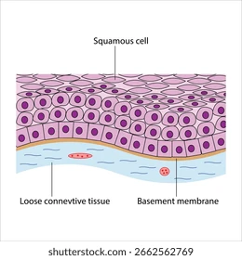

Slide 8
Layers of Epidermis
From deep to superficial:
Stratum basale
Stratum spinosum
Stratum granulosum
Stratum lucidum (only in thick skin)
Stratum corneum

Slide 9
Stratum Basale
Single layer of cuboidal or columnar cells
Mitotically active
Produces new keratinocytes
Contains melanocytes and Merkel cells
Attached to basement membrane

Slide 10
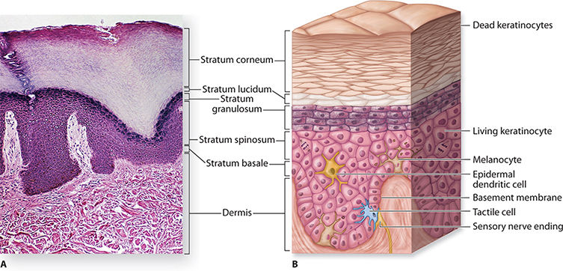

Slide 11
Stratum Spinosum
Several layers of polygonal cells
Prominent desmosomal connections
Appears “spiny” under microscope
Contains Langerhans cells
Active keratin synthesis

Slide 13
Stratum Granulosum
3–5 layers of flattened cells
Contains keratohyalin granules
Cells begin degeneration
Important for keratinization process

Slide 15
Stratum Lucidum
Present only in thick skin
Thin translucent layer
Found in palms and soles
Consists of dead flattened cells

Slide 17
Stratum Corneum
Outermost layer
Many layers of dead keratinized cells
Provides protection
Continuously shed and replaced

Slide 19
Cells of Epidermis
Keratinocytes
Most abundant cells
Produce keratin
Melanocytes
Produce melanin pigment
Located in stratum basale

Slide 20
CONTINUED
Langerhans Cells
Antigen-presenting cells
Immune defense
Merkel Cells
Sensory receptors
Associated with touch sensation

Slide 21
Dermis
Two layers:
Papillary layer
Reticular layer
Contains:
Blood vessels
Nerves
Hair follicles
Glands

Slide 23
Papillary Layer
Superficial layer
Loose connective tissue
Forms dermal papillae
Rich in capillaries
Contains sensory nerve endings

Slide 24
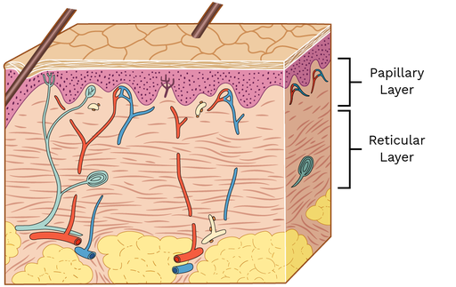

Slide 25
Reticular Layer
Deep layer
Dense irregular connective tissue
Rich in collagen and elastic fibers
Provides strength and elasticity

Slide 27
Thick and Thin Skin
Thick Skin
Palms and soles
Thick epidermis
Stratum lucidum present
No hair follicles
Numerous sweat glands
Thin Skin
Covers most of body
Thin epidermis
Hair follicles present
Fewer sweat glands

Slide 28
Skin Appendages
Hair follicles
Sebaceous glands
Sweat glands
Nails
Derived from epidermis

Slide 29
Hair Follicle
Invagination of epidermis into dermis
Produces hair shaft
Surrounded by connective tissue sheath
Parts:
Hair bulb
Hair root
Hair shaft

Slide 31
Hair Bulb
Expanded base of follicle
Contains hair matrix
Site of active cell division
Surrounds dermal papilla

Slide 33
Arrector Pili Muscle
Smooth muscle attached to hair follicle
Causes hair to stand erect
Responsible for “goose bumps”

Slide 34
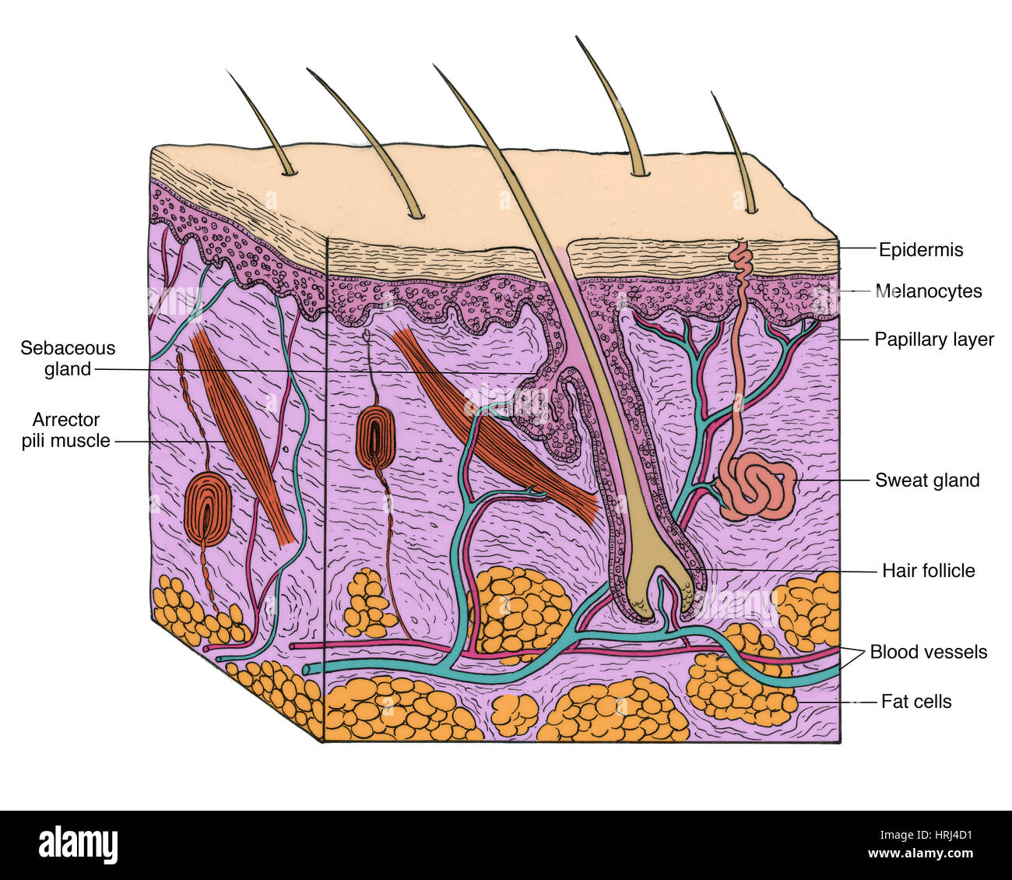

Slide 35
Sebaceous Glands
Branched alveolar glands
Usually associated with hair follicles
Secrete sebum
Functions:
Lubricates skin and hair
Prevents drying
Mode of secretion:
Holocrine

Slide 37
Sweat Glands
Types:
Eccrine sweat glands
Apocrine sweat glands

Slide 39
Eccrine Sweat Glands
Simple coiled tubular glands
Distributed throughout body
Most numerous on palms and soles
Open directly onto skin surface
Functions:
Thermoregulation
Excretion

Slide 40
Apocrine Sweat Glands
Larger than eccrine glands
Found in axilla, areola, and perineum
Open into hair follicles
Become active at puberty

Slide 41
Nails
Hard keratin plates
Protect distal ends of digits
Components:
Nail plate
Nail bed
Nail root
Nail matrix
Lunula

Slide 42


Slide 43


