Slide 1

SURGICAL
ANATOMY
BS OTT
2ND SEMESTER
DR DANISH
DPT(S.M.C),MPPTA

Slide 2
HUMERUS
OVERVIEW:
The humerus is the longest bone of the upper limb
Located in the arm (brachium)
Forms joints at:
  Proximally → Shoulder (glenohumeral joint)
  Distally → Elbow joint
Divided into three main regions:
  Proximal extremity
  Body (shaft)
  Distal extremity

Slide 3
ARTICULATIONS OF HUMERUS
Proximal articulation
  Head of humerus articulates with glenoid cavity of scapula.
  Forms the shoulder (glenohumeral) joint.

Slide 4
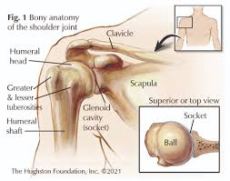

Slide 5
Continued
Distal articulation
  Capitulum → articulates with head of radius
  Trochlea → articulates with trochlear notch of ulna
  Forms the elbow joint

Slide 6
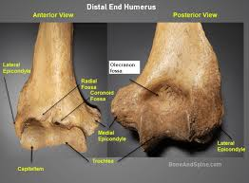

Slide 7
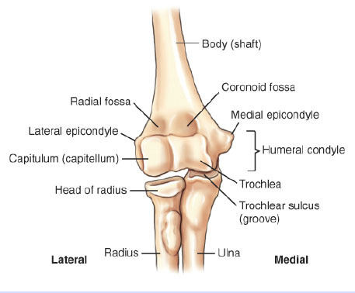

Slide 8
PROXIMAL EXTREMITY OF HUMERUS
Head:
Smooth, round, and spherical
Forms about one-third of a sphere
Oriented:
  Medially
  Superiorly
  Slightly posteriorly
Covered by articular cartilage

Slide 9
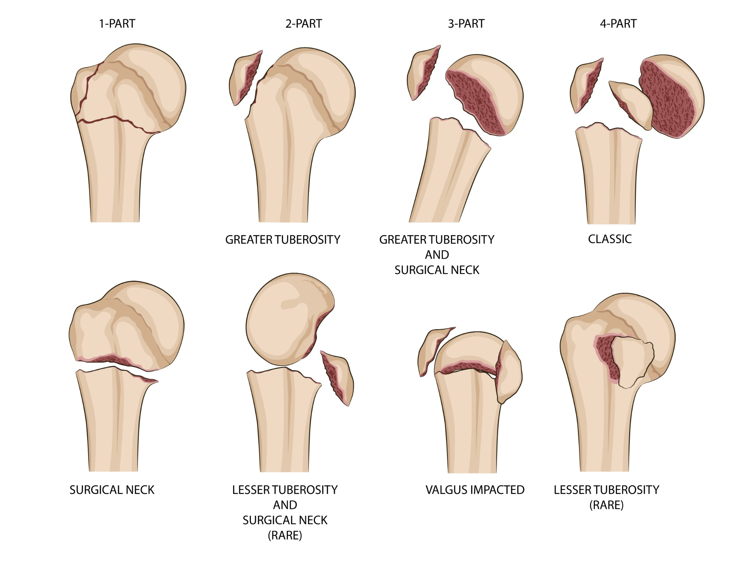

Slide 10
Continued
Anatomical Neck:
Slight constriction around the head
Capsule of shoulder joint attaches here
Common site for fractures (especially in elderly)

Slide 11
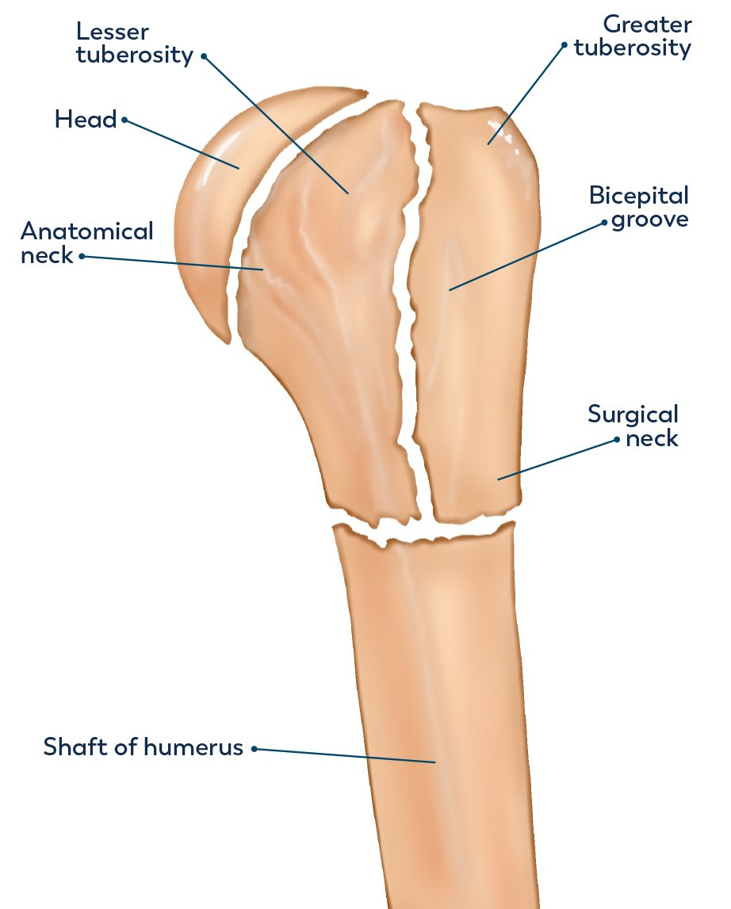

Slide 12
Continued
Greater Tubercle
Large, roughened projection
Located lateral to the head
Muscle attachments:
  Supraspinatus
  Infraspinatus
  Teres minor

Slide 14
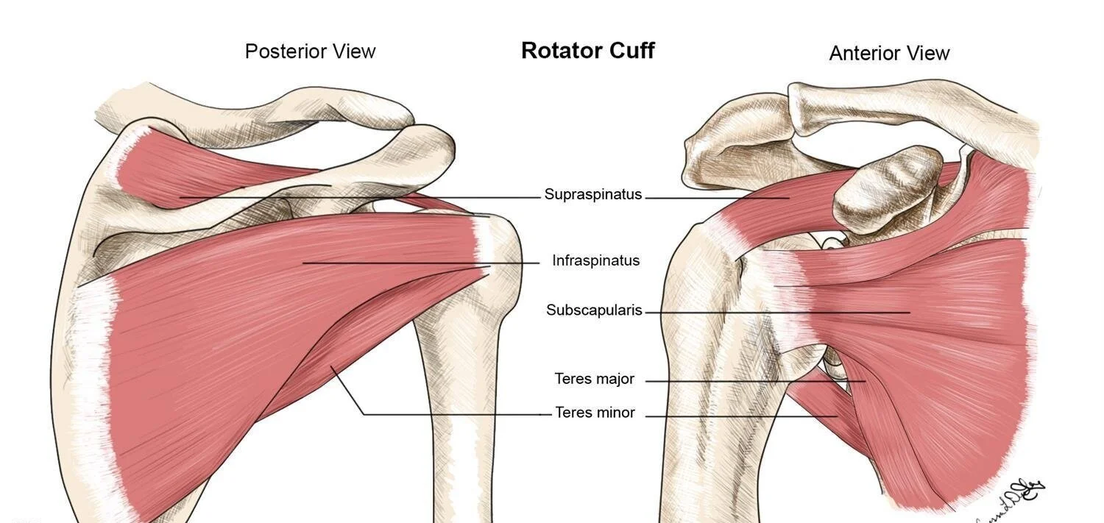

Slide 15
Continued
Lesser Tubercle
Smaller projection
Located anteriorly
Muscle attachment:
  Subscapularis

Slide 17
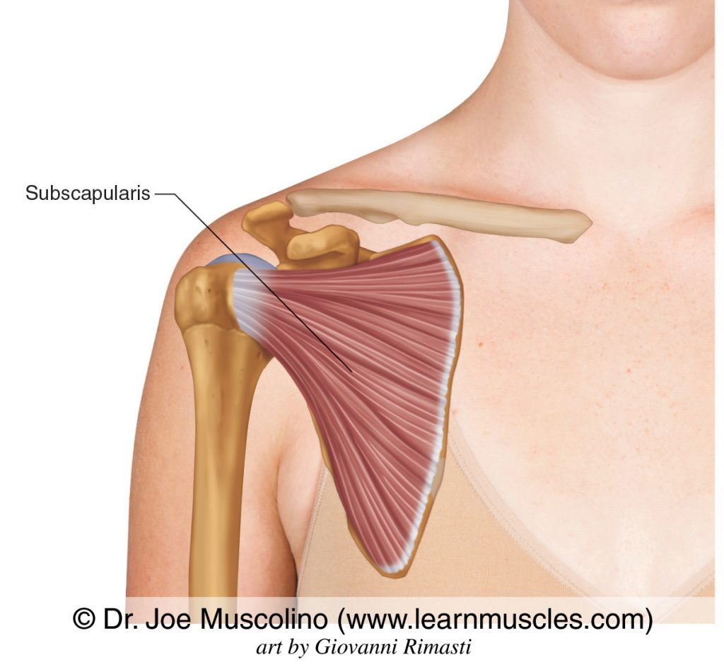

Slide 18
Continued
Intertubercular (Bicipital) Groove
Lies between greater and lesser tubercles
Contains tendon of:
  Long head of biceps brachii
Muscle attachments:
  Pectoralis major
  Latissimus dorsi
  Teres major

Slide 20
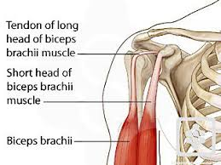

Slide 21
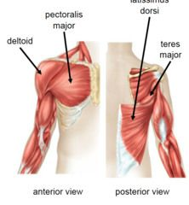

Slide 22
Continued
Surgical Neck
Narrow region below tubercles
Common fracture site

Slide 23
BODY (SHAFT) OF HUMERUS
Deltoid Tuberosity:
Rough triangular area on lateral surface
Attachment of deltoid muscle

Slide 24
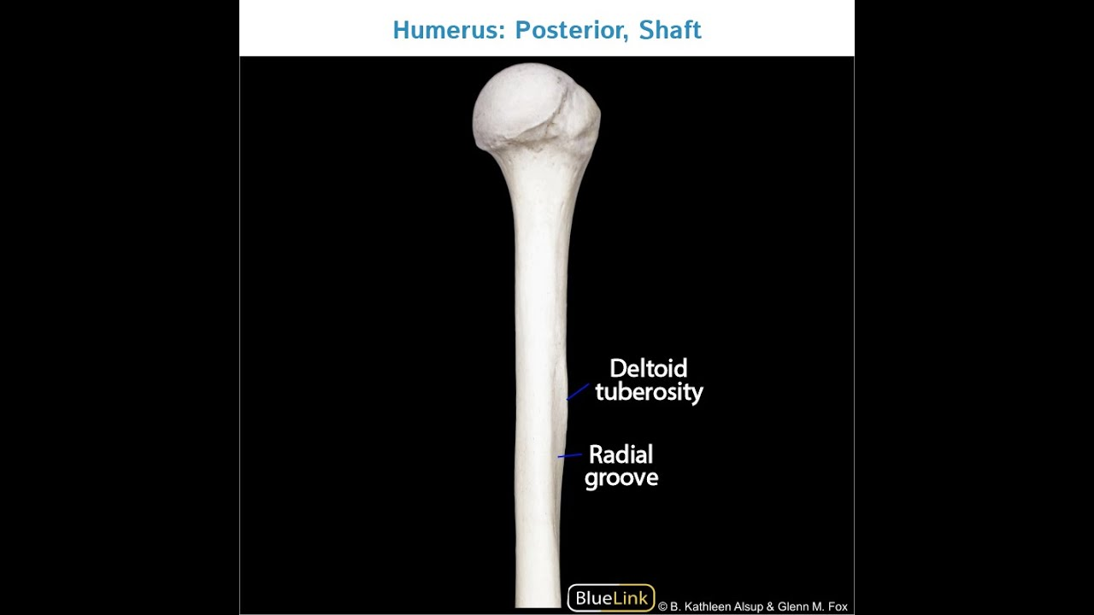

Slide 25
Continued
Radial (Spiral) Groove
Oblique groove on posterior surface
Contains:
  Radial nerve
  Profunda brachii vessels
Fractures here may injure radial nerve → wrist drop

Slide 27
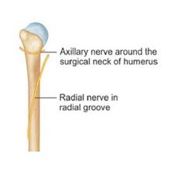

Slide 28
Continued
Borders and Surfaces:
Medial supracondylar ridge
Lateral supracondylar ridge
Serve as attachment sites for muscles of arm and forearm

Slide 29
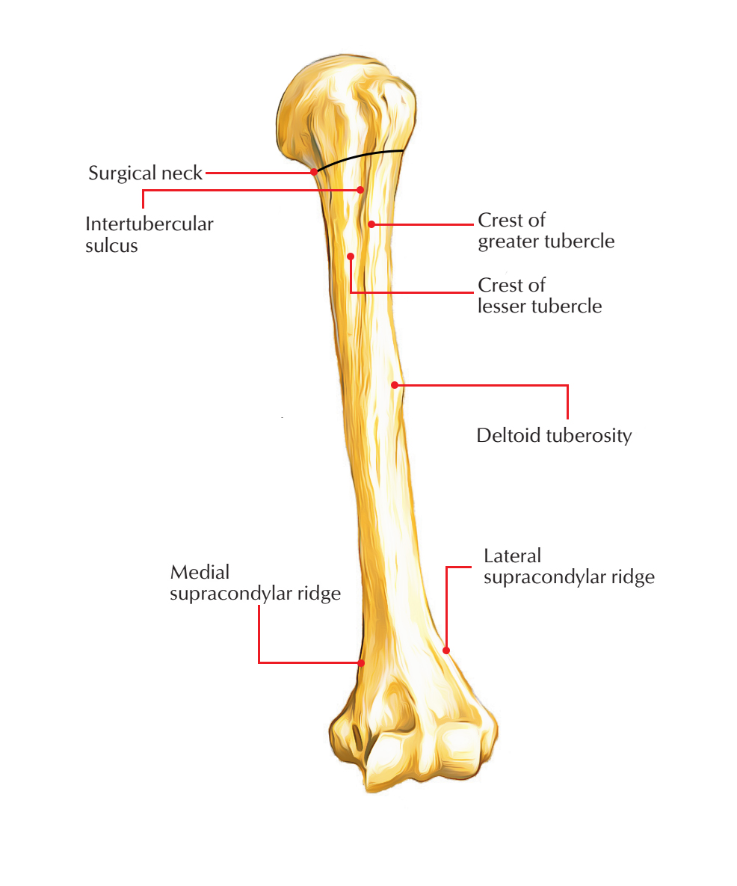

Slide 30


Slide 31
