Slide 1

SURGICAL
ANATOMY
BS OTT
2ND SEMESTER
DR DANISH
DPT(S.M.C),MPPTA

Slide 2
Distal Extremity of the Humerus
Overview:
The distal extremity of the humerus forms the upper part of the elbow joint
It articulates with:
  Radius (laterally)
  Ulna (medially)
Expanded from side to side and flattened anteroposteriorly
Composed of:
  Articular part
  Non-articular part

Slide 3
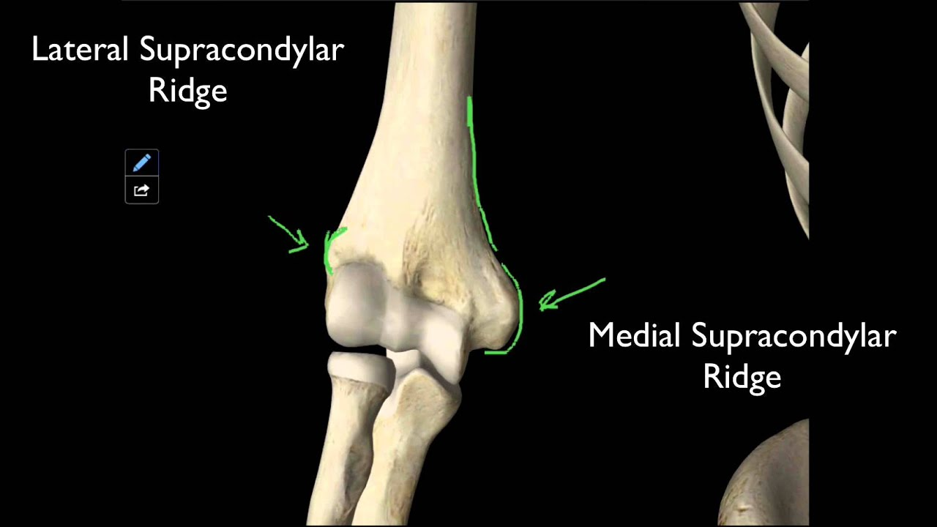

Slide 4
Articular Part
Located at the lower end of the humerus
Consists of:
  Capitulum
  Trochlea

Slide 5
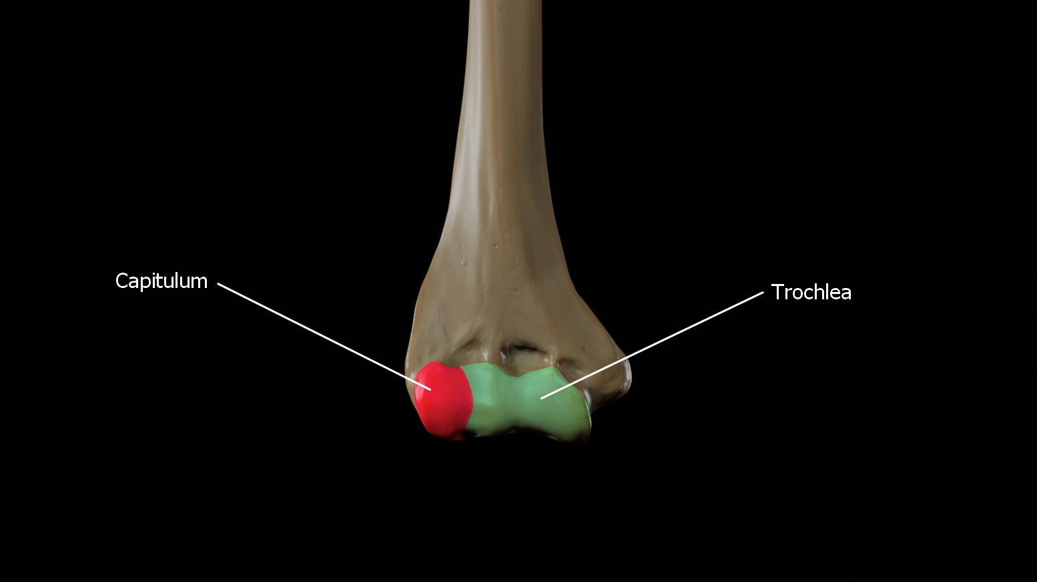

Slide 6
Capitulum
Rounded, smooth, and hemispherical
Located on the lateral side
Articulates with:
  Head of the radius
Restricted mainly to the anterior and inferior surfaces
Not visible from the posterior aspect
Covered with articular cartilage

Slide 7
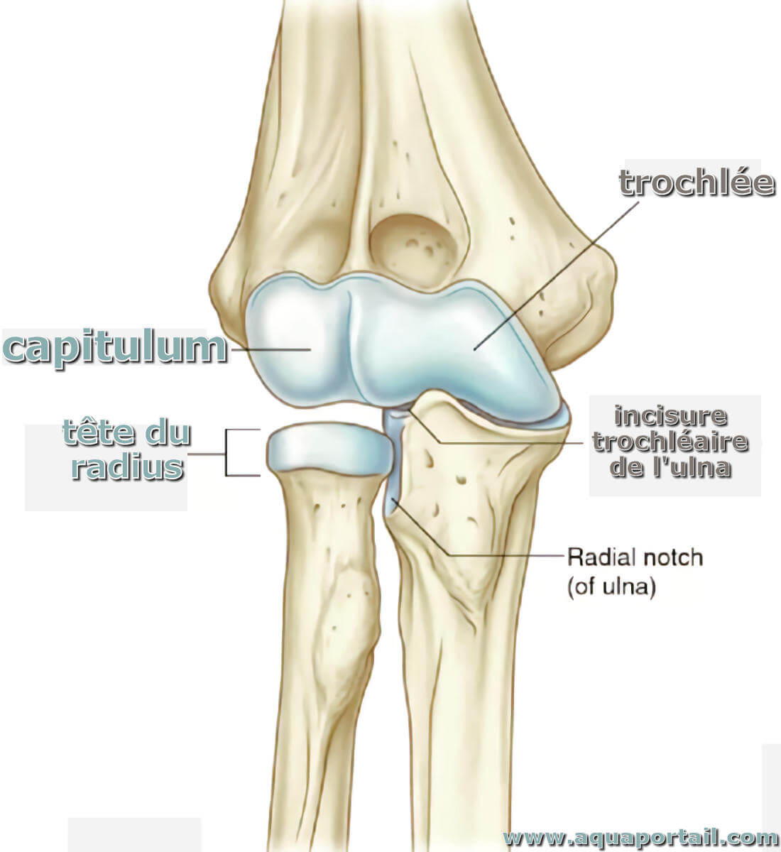

Slide 8
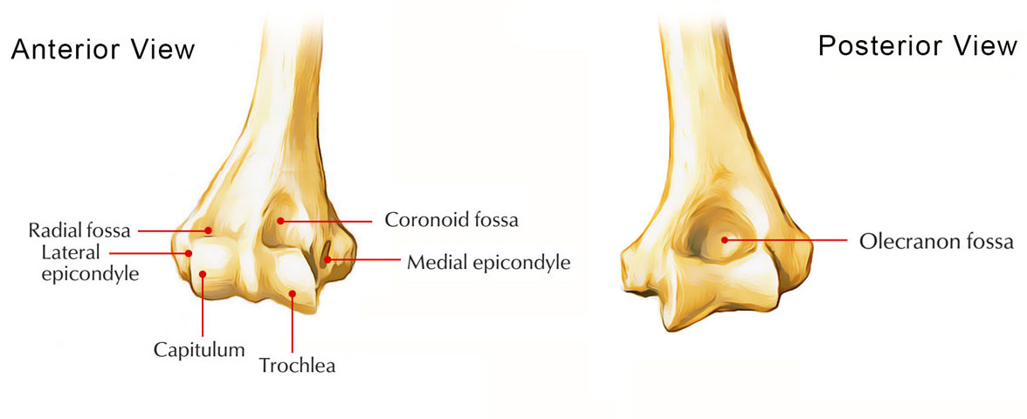

Slide 9
Trochlea
Pulley-shaped articular surface
Located on the medial side
Articulates with:
  Trochlear notch of the ulna
Extends onto:
  Anterior surface
  Inferior surface
  Posterior surface
Medial edge projects more distally than the lateral edge

Slide 10
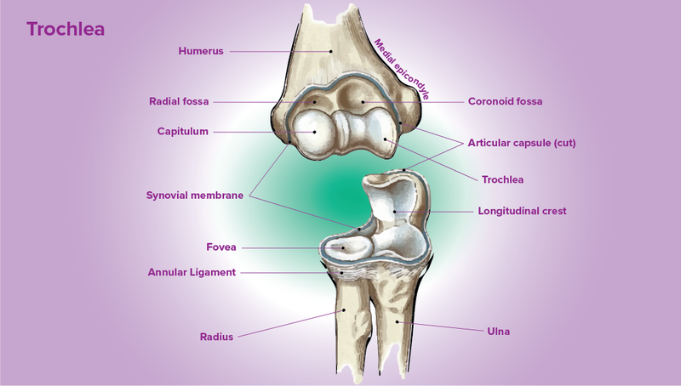

Slide 11
Non-Articular Part
Includes:
Medial epicondyle
Lateral epicondyle
Coronoid fossa
Radial fossa
Olecranon fossa

Slide 12
Medial Epicondyle
Large and prominent
Located on the medial side
Easily palpable
Gives attachment to:
  Common flexor muscles of the forearm
Groove behind it for:
  Ulnar nerve

Slide 13
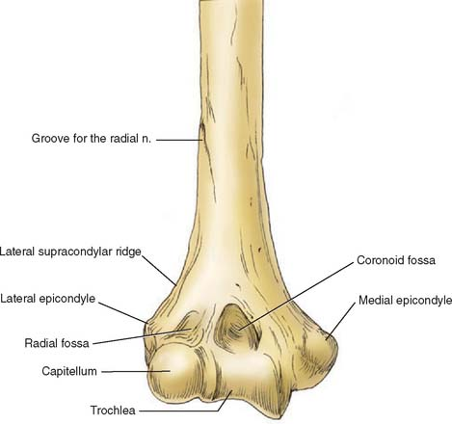

Slide 14
CONTINUED
Clinical relevance (Snell):
Ulnar nerve injury here causes:
  Tingling and numbness in the ring and little fingers
Commonly injured in supracondylar fractures

Slide 15
Lateral Epicondyle
Smaller and less prominent
Located on the lateral side
Gives attachment to:
  Common extensor muscles of the forearm

Slide 17
Coronoid Fossa
Shallow depression
Located on the anterior surface
Above the trochlea
Accommodates:
  Coronoid process of ulna during elbow flexion

Slide 19
Radial Fossa
Small depression
Located on the anterior surface
Above the capitulum
Receives:
  Head of the radius during elbow flexion

Slide 21
Olecranon Fossa
Large and deep depression
Located on the posterior surface
Above the trochlea
Accommodates:
  Olecranon process of ulna during elbow extension

Slide 23


Slide 24


