Slide 1

REGIONAL ANATOMY
BS RIT
2ND SEMESTER
DR DANISH
DPT(S.M.C),MPPTA

Slide 2
Nerve Supply of the Anterolateral Abdominal Wall
Supplied by anterior rami of T7–T12 and L1 nerves.
Thoracic nerves are continuations of the lower five intercostal nerves and the subcostal nerve.
Nerves run between the internal oblique and transversus abdominis muscles.
Supply:
  Skin of the anterolateral abdominal wall
  Abdominal muscles
  Parietal peritoneum

Slide 3
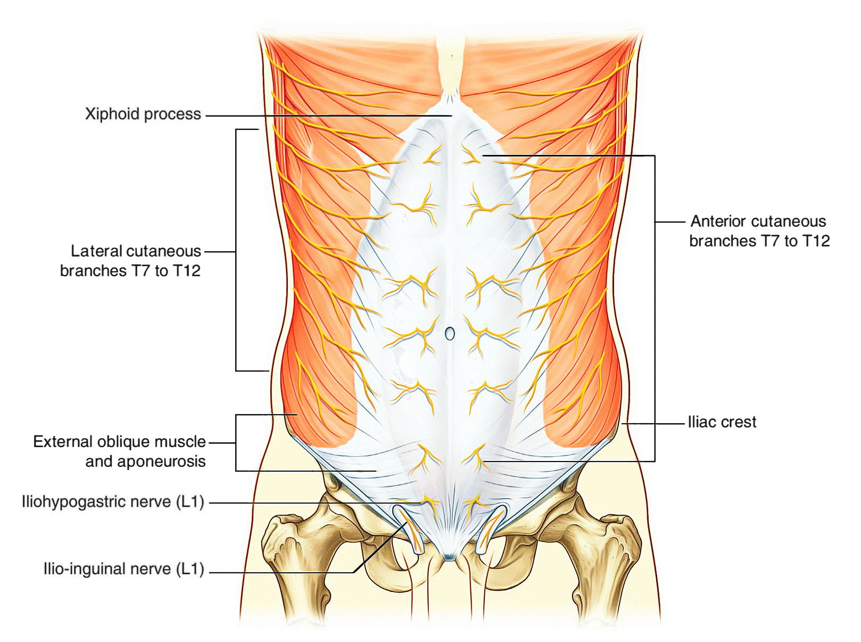

Slide 4
CONTINUED
T7–T12 nerves pierce the rectus sheath to supply the rectus abdominis and pyramidalis (T12 only).
L1 nerve divides into:
  Iliohypogastric nerve
  Ilioinguinal nerve

Slide 6
Arteries of the Anterolateral Abdominal Wall
Superior epigastric artery
Inferior epigastric artery
Deep circumflex iliac artery
Lower posterior intercostal arteries

Slide 7
Superior epigastric artery
Terminal branch of the internal thoracic artery.
Enters the rectus sheath and supplies the upper abdominal wall.
Anastomoses with the inferior epigastric artery.

Slide 8
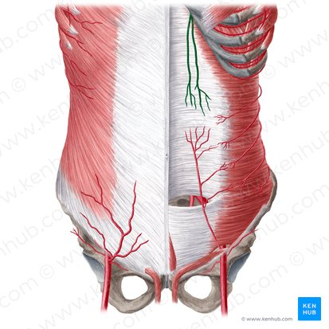

Slide 9
Inferior epigastric artery
Branch of the external iliac artery.
Enters the rectus sheath below the arcuate line.
Supplies the lower central abdominal wall.

Slide 10
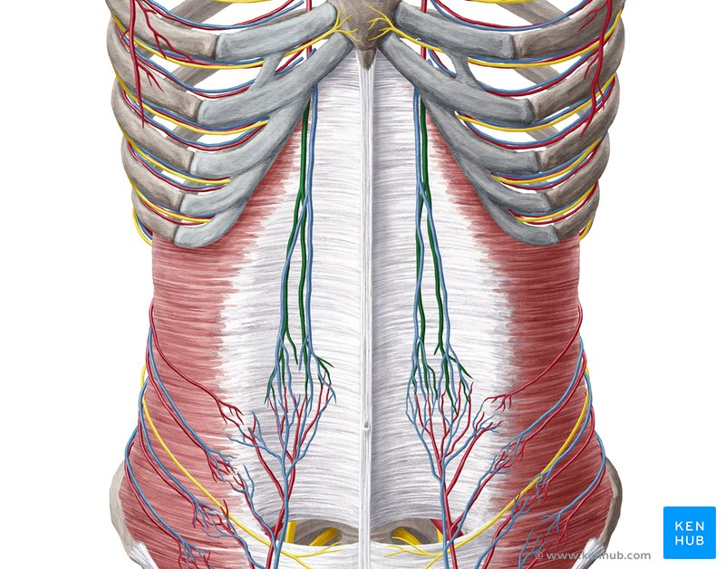

Slide 11
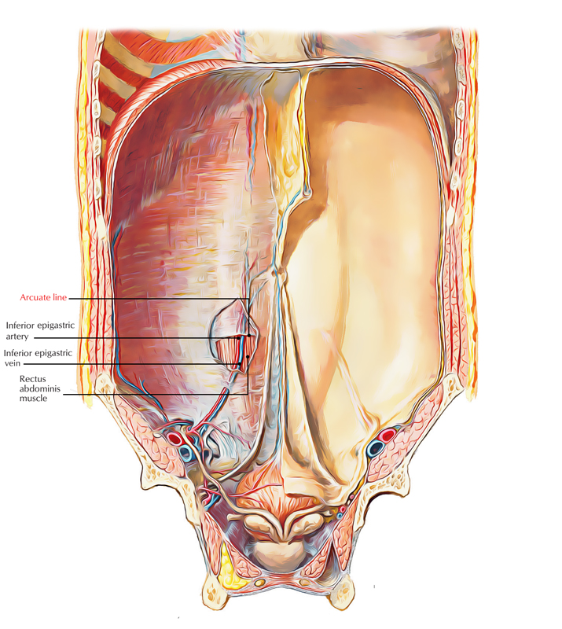

Slide 12
Deep circumflex iliac artery
Branch of the external iliac artery.
Runs upward and laterally toward the anterior superior iliac spine.

Slide 13
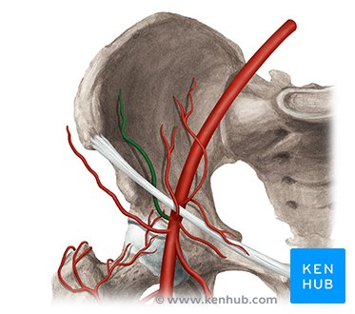

Slide 14
Lower posterior intercostal arteries
Supply the lateral abdominal wall.

Slide 15
Veins of the Anterolateral Abdominal Wall
Superficial veins form a network around the umbilicus.
Veins above the umbilicus drain into the axillary vein via the lateral thoracic vein.
Veins below the umbilicus drain into the femoral vein via the great saphenous vein.

Slide 16
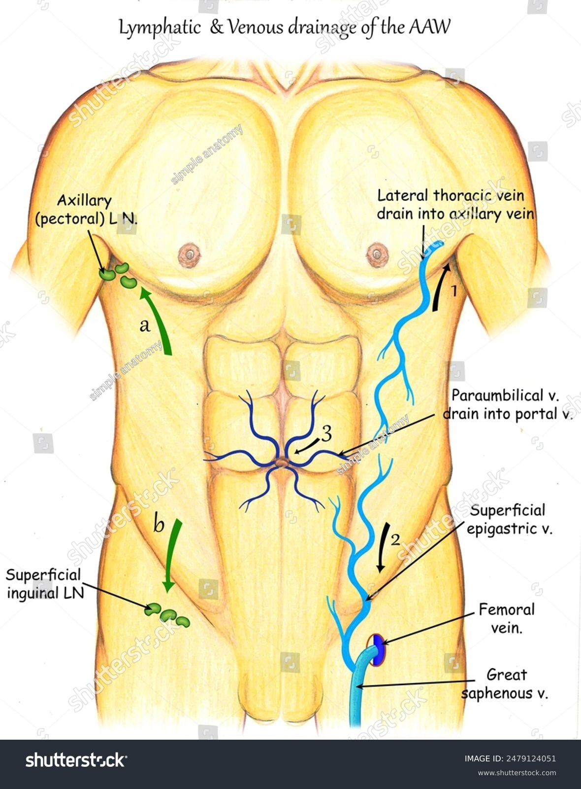

Slide 17


