Slide 1

ANATOMY
THE LOWER LIMB
DPT
2ND SEMESTER
DR DANISH
DPT(S.M.C),MPPTA

Slide 2
ANKLE REGION
The ankle is the transition zone between the leg and foot.
Structures pass between the leg and foot in an organized arrangement.
This arrangement ensures optimal function, support, and movement.

Slide 3
Structures Crossing the Anterior Aspect of the Ankle
Deep to the Extensor Retinacula (Medial → Lateral)
Tendon of tibialis anterior
Tendon of extensor hallucis longus
Anterior tibial artery with venae comitantes
Deep fibular (peroneal) nerve
Tendon of extensor digitorum longus
Tendon of fibularis (peroneus) tertius

Slide 4
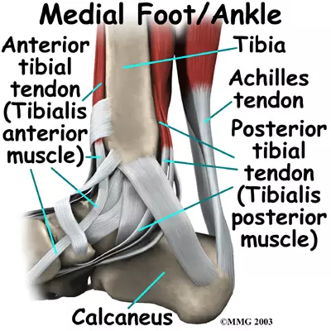

Slide 5
Structures Passing Immediately Anterior to the Medial Malleolus
Deep Structures (Medial → Lateral)
Tibialis posterior tendon
Flexor digitorum longus tendon
Posterior tibial artery with venae comitantes
Tibial nerve
Flexor hallucis longus tendon

Slide 6
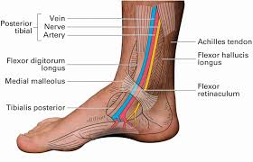

Slide 7
Structures Passing Immediately Anterior to the Lateral Malleolus
Fibularis (peroneus) longus tendon
Fibularis (peroneus) brevis tendon

Slide 8
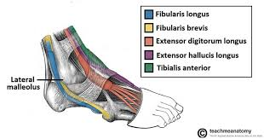

Slide 9
Great Saphenous Vein
Ascends from the medial side of the foot.
Passes anterior to the medial malleolus.
Drains into the dorsal venous network.

Slide 10
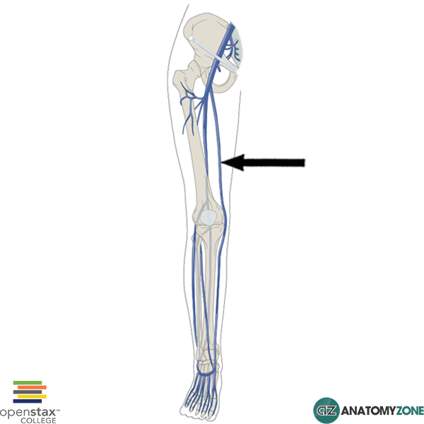

Slide 11


Slide 12


