Slide 1

REGIONAL ANATOMY
BS RIT
2ND SEMESTER
DR DANISH
DPT(S.M.C),MPPTA

Slide 2
Anterior Abdominal Wall Muscles
1. External Oblique
2. Internal Oblique
3. Transversus Abdominis
4. Rectus Abdominis
Pyramidalis (if present)

Slide 3
1. External Oblique
Origin: Ribs 5–12
Insertion: Xiphoid process, linea alba, pubic crest, pubic tubercle
Nerve Supply: T7–T12 nerves and iliohypogastric & ilioinguinal nerves (L1)
Actions:
  Supports abdominal contents
  Compresses abdomen
  Assists flexion and rotation of trunk
  Helps in forced expiration, micturition, defecation, parturition, and vomiting

Slide 4
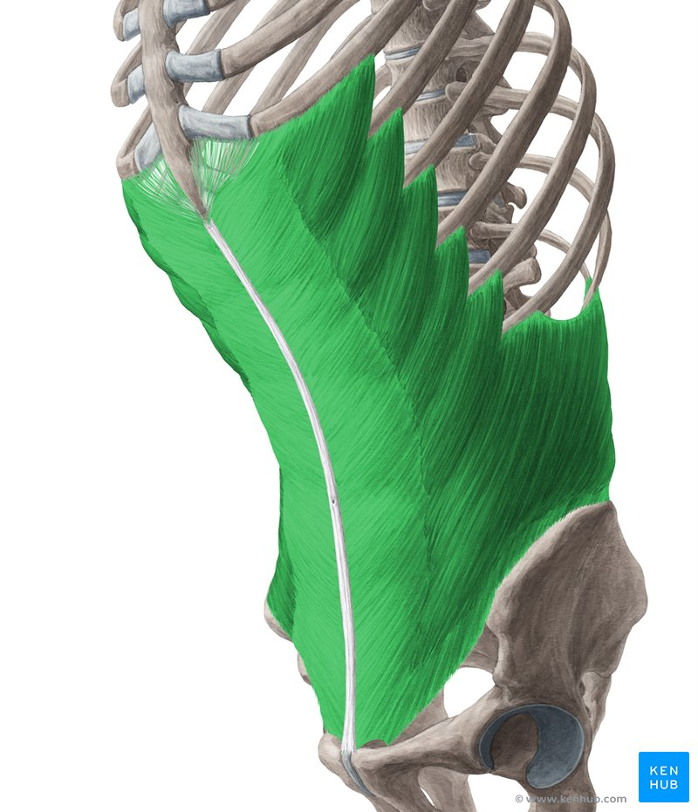

Slide 5
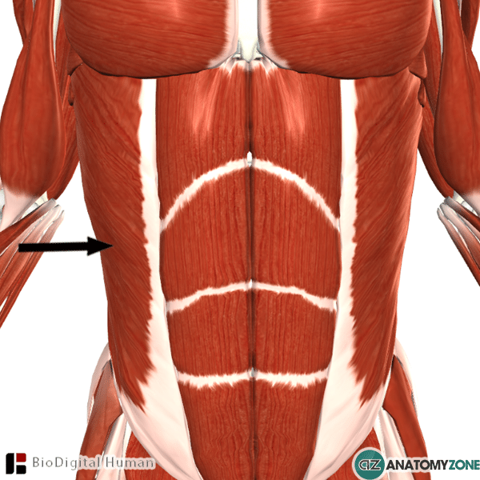

Slide 6
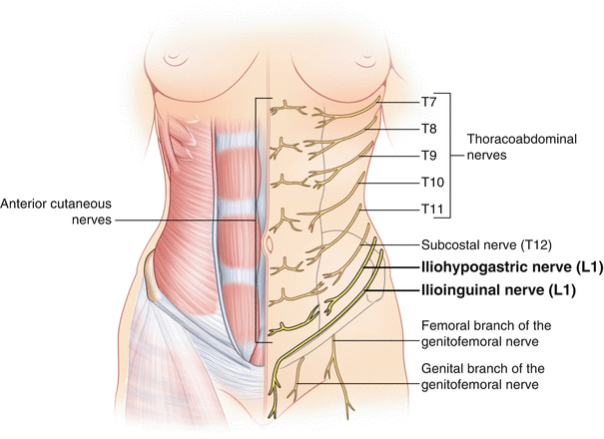

Slide 7
2. Internal Oblique
Origin:
  Lumbar fascia
  Iliac crest
  Lateral two-thirds of inguinal ligament
Insertion:
  Ribs 9–12 and costal cartilages
  Xiphoid process
  Linea alba
  Symphysis pubis
Nerve Supply: T7–T12 nerves and iliohypogastric & ilioinguinal nerves (L1)
Action: Same as external oblique

Slide 8
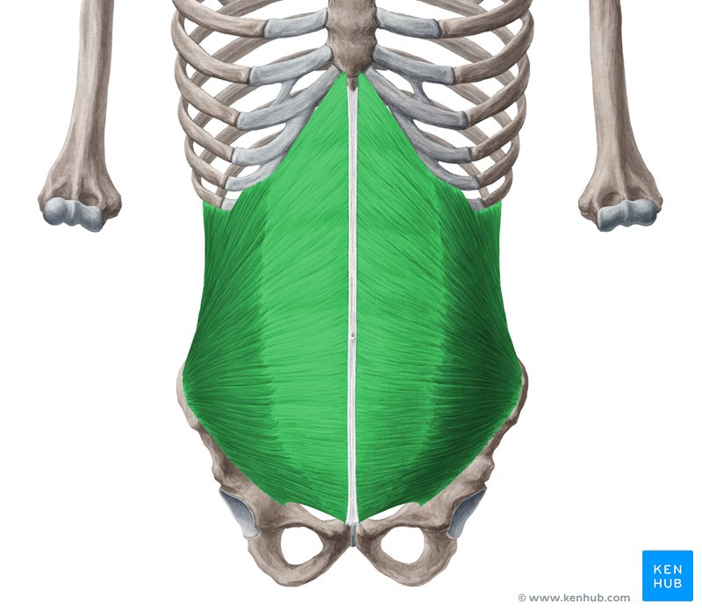

Slide 10
3. Transversus Abdominis
Origin:
  Lower six costal cartilages
  Thoracolumbar fascia
  Iliac crest
  Lateral third of inguinal ligament
Insertion:
  Xiphoid process
  Linea alba
  Symphysis pubis

Slide 11
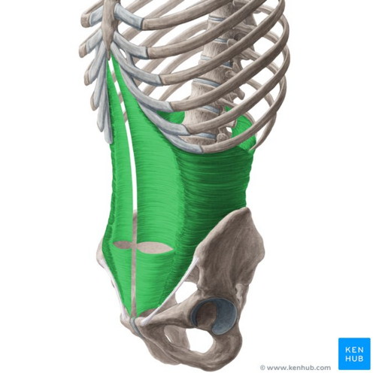

Slide 12
CONTINUED
Nerve Supply: T7–T12 nerves and iliohypogastric & ilioinguinal nerves (L1)
Action:
  Compresses abdominal contents
  Increases intra-abdominal pressure

Slide 14
4. Rectus Abdominis
Origin: Symphysis pubis and pubic crest
Insertion:
  Fifth, sixth, and seventh costal cartilages
  Xiphoid process
Nerve Supply: T7–T12 nerves
Actions:
  Compresses abdominal contents
  Flexes vertebral column
  Accessory muscle of expiration

Slide 15
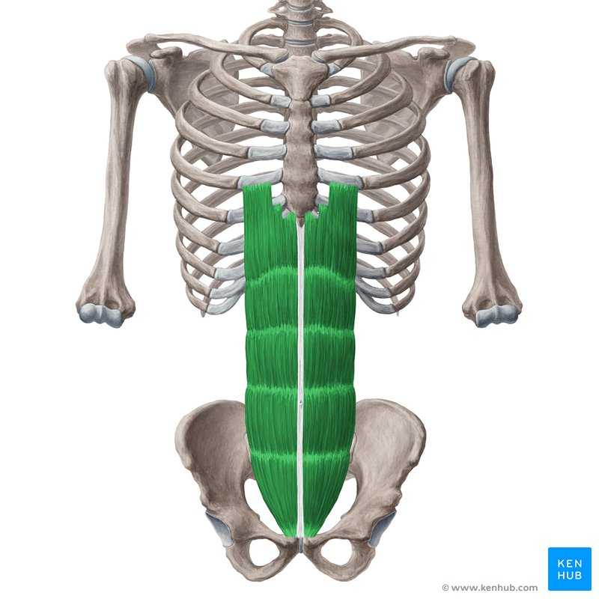

Slide 17
Pyramidalis (if present)
Origin: Anterior surface of pubis
Insertion: Linea alba
Nerve Supply: T12 nerve
Action: Tenses the linea alba

Slide 18
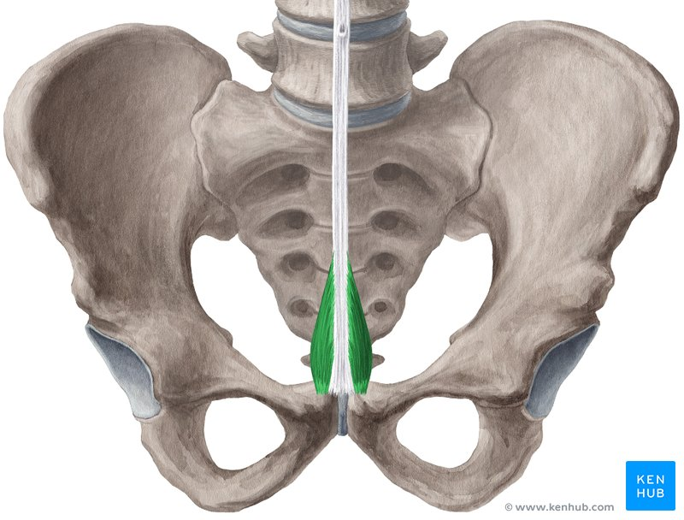

Slide 19
Transversalis Fascia
Thin layer of endoabdominal fascia lining the inner surface of the abdominal wall.
Lies deep to the transversus abdominis muscle.
Continues with diaphragmatic, pelvic, and iliac fascia.
Forms the deep inguinal ring.
Provides strength and support to the abdominal wall.
Separated from the parietal peritoneum by extraperitoneal fascia.

Slide 20
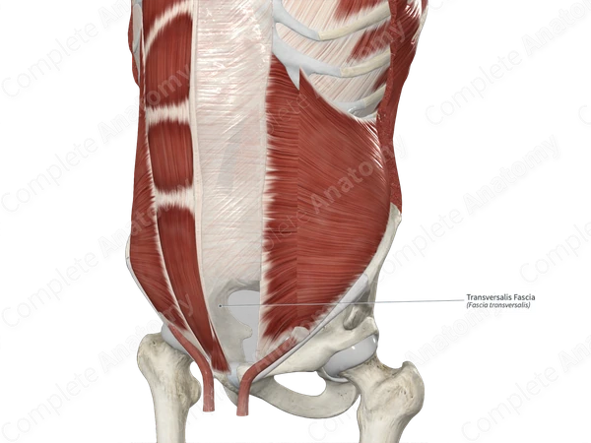

Slide 21
Extraperitoneal Fascia
Layer of loose connective tissue between transversalis fascia and parietal peritoneum.
Contains varying amounts of fat.
Allows movement of the peritoneum over the abdominal wall.
Contains blood vessels, lymphatics, and nerves.
More prominent in the lower anterior abdominal wall.

Slide 22
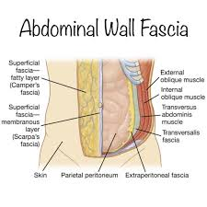

Slide 23
Parietal Peritoneum
Serous membrane lining the internal surface of the abdominopelvic cavity.
Continuous with visceral peritoneum covering abdominal organs.
Receives somatic nerve supply from the body wall.
Highly sensitive to:
  Pain
  Pressure
  Temperature
  Touch
Pain is usually well localized.
Helps reduce friction and allows free movement of abdominal viscera.

Slide 24


Slide 25


