Slide 1

ANATOMY
THE LOWER LIMB
DPT
2ND SEMESTER
DR DANISH
DPT(S.M.C),MPPTA

Slide 2
Muscles of Posterior Fascial Compartment of Leg
Superficial Group
Gastrocnemius
Plantaris
Soleus
Deep Group
Popliteus
Flexor Digitorum Longus
Flexor Hallucis Longus
Tibialis Posterior

Slide 3
Gastrocnemius
Origin:
  Lateral head: lateral condyle of femur
  Medial head: area above medial condyle
Insertion:
  Via tendo calcaneus into posterior surface of calcaneum
Nerve Supply: Tibial nerve
Nerve Root: S1, S2
Action:
  Plantar flexes foot at ankle joint
  Flexes knee joint

Slide 4
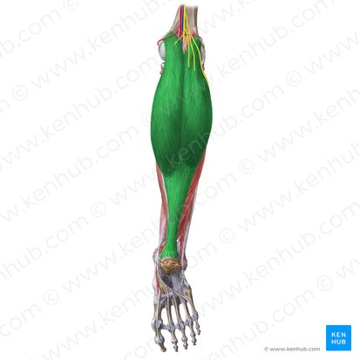

Slide 5
Plantaris
Origin:
  Lateral supracondylar ridge of femur
Insertion:
  Posterior surface of calcaneum

Slide 6
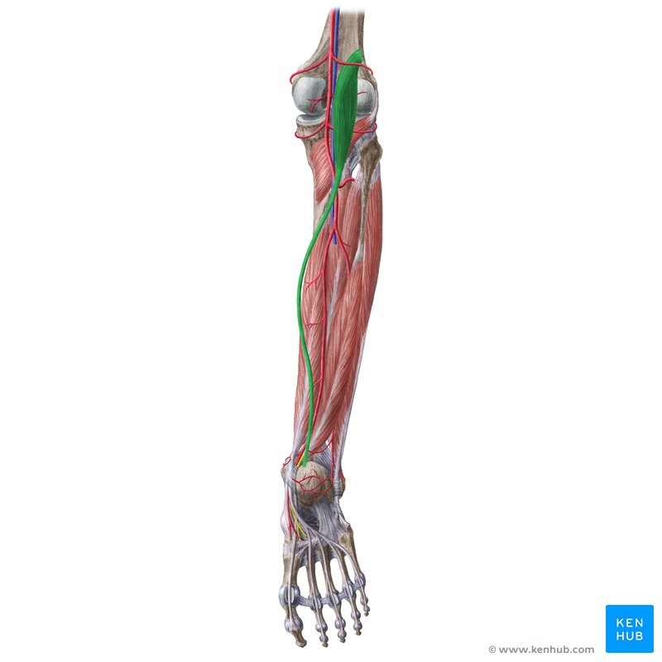

Slide 7
Soleus
Origin:
  Shafts of tibia and fibula
Insertion:
  Via tendo calcaneus into posterior surface of calcaneum
Nerve Supply: Tibial nerve
Nerve Root: S1, S2
Action:
  Together with gastrocnemius and plantaris, acts as a powerful plantar flexor of the ankle joint
  Provides the main propulsive force in walking and running

Slide 8
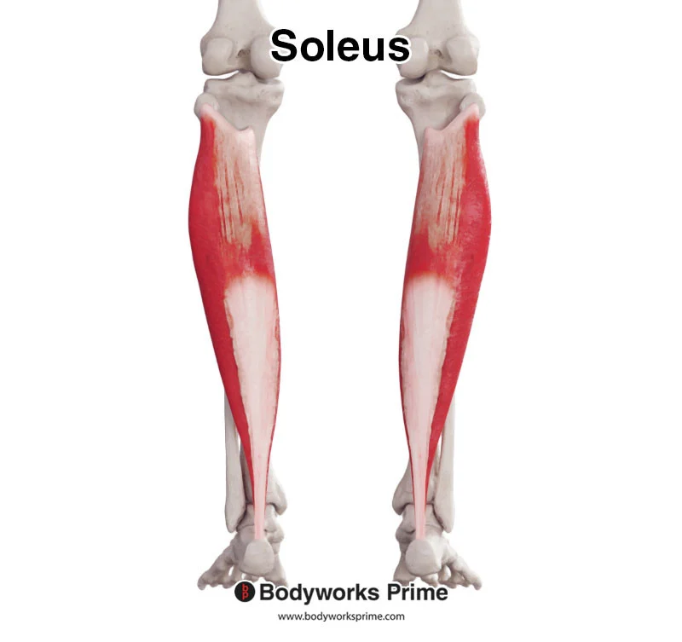

Slide 9
Popliteus
Origin:
  Lateral surface of lateral condyle of femur
Insertion:
  Posterior surface of shaft of tibia above soleal line
Nerve Supply: Tibial nerve
Nerve Root: L4, L5, S1
Action:
  Flexes leg at knee joint
  Unlocks knee joint by lateral rotation of femur on tibia
  Slackens ligaments of the joint

Slide 10
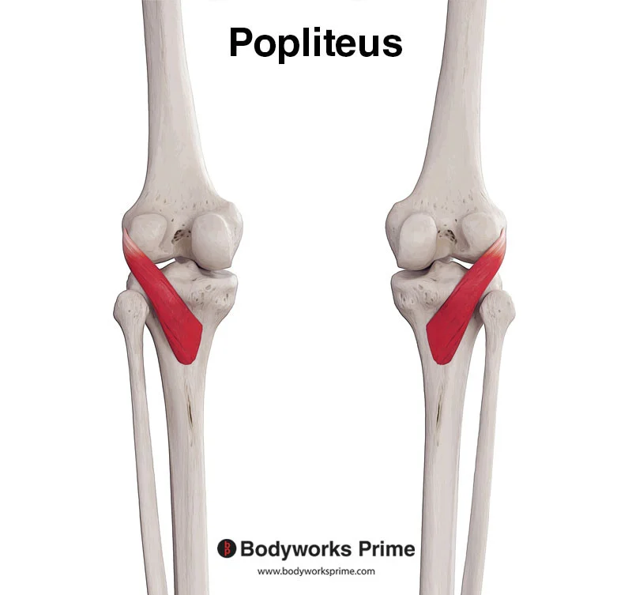

Slide 11
Flexor Digitorum Longus
Origin:
  Posterior surface of shaft of tibia
Insertion:
  Bases of distal phalanges of lateral four toes
Nerve Supply: Tibial nerve
Nerve Root: S2, S3
Action:
  Flexes distal phalanges of lateral four toes
  Plantar flexes foot at ankle joint
  Supports medial and lateral longitudinal arches of foot

Slide 12
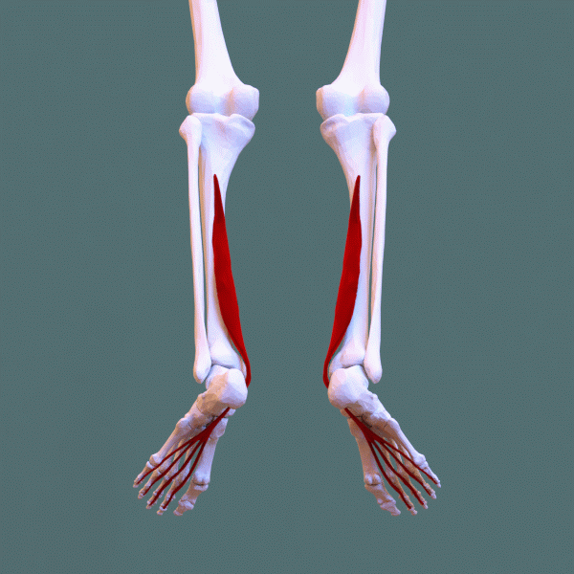

Slide 13
Flexor Hallucis Longus
Origin:
  Posterior surface of shaft of fibula
Insertion:
  Base of distal phalanx of great toe
Nerve Supply: Tibial nerve
Nerve Root: S2, S3
Action:
  Flexes distal phalanx of great toe
  Plantar flexes foot at ankle joint
  Supports medial longitudinal arch of foot

Slide 14
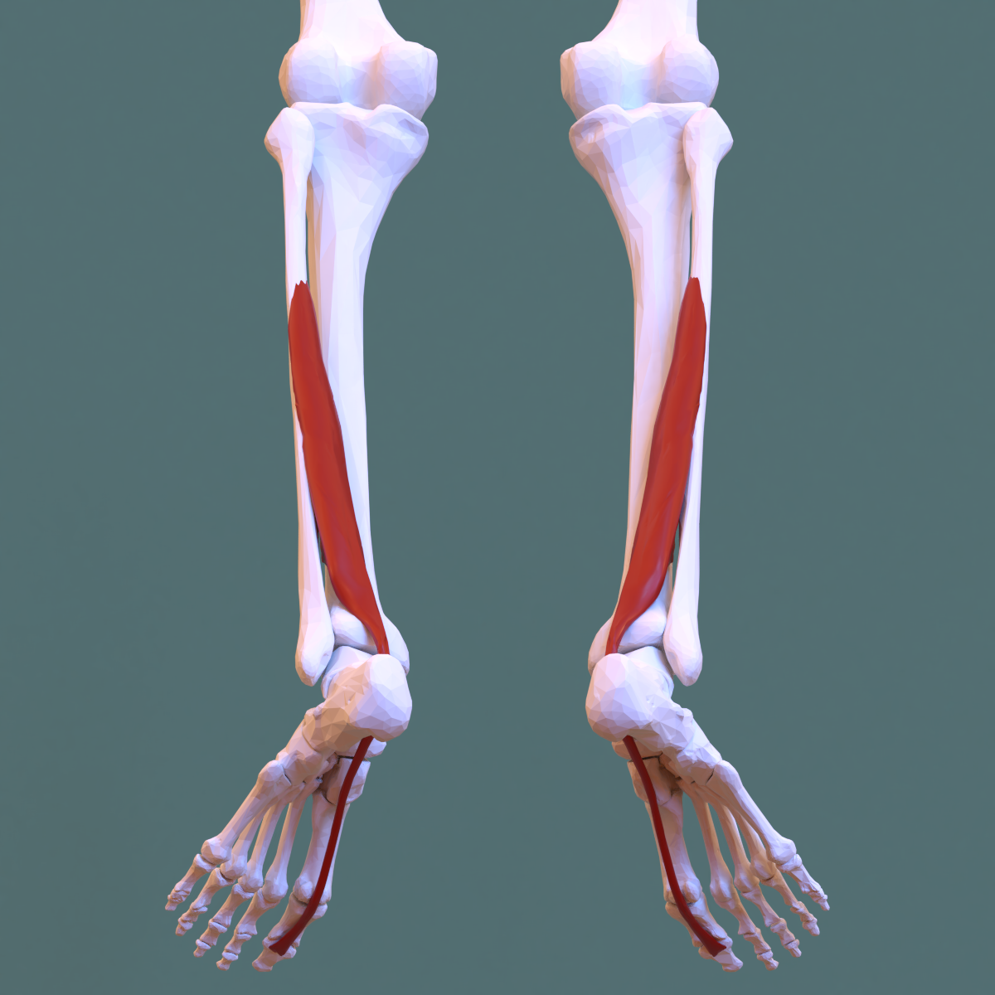

Slide 15
Tibialis Posterior
Origin:
  Posterior surfaces of shafts of tibia and fibula
  Interosseous membrane
Insertion:
  Tuberosity of navicular bone and other neighboring bones
Nerve Supply: Tibial nerve
Nerve Root: L4, L5
Action:
  Plantar flexes foot at ankle joint
  Inverts foot at subtalar and transverse tarsal joints
  Supports medial longitudinal arch of foot

Slide 16
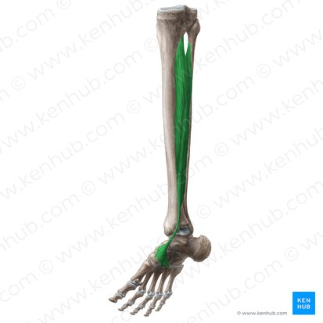

Slide 17
Posterior Tibial Artery
General Features
One of the terminal branches of the popliteal artery.
Begins at the level of the lower border of the popliteus muscle.
Passes downward deep to:
  Gastrocnemius
  Soleus

Slide 18
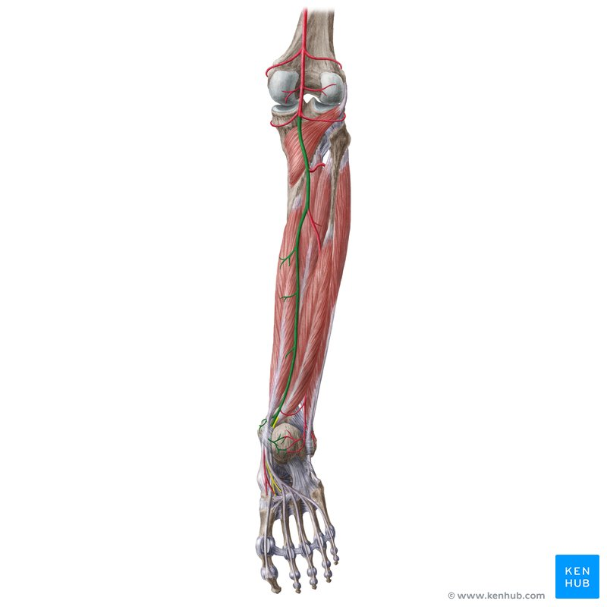

Slide 19
Continued
Lies:
  On the posterior surface of tibialis posterior muscle above
  On the posterior surface of tibia below
In the lower leg, covered only by skin and fascia.
Passes behind the medial malleolus deep to the flexor retinaculum.
Terminates by dividing into:
  Medial plantar artery
  Lateral plantar artery

Slide 20
Branches
Fibular Artery
Large artery arising close to the origin of the posterior tibial artery.
Descends behind the fibula.

Slide 21
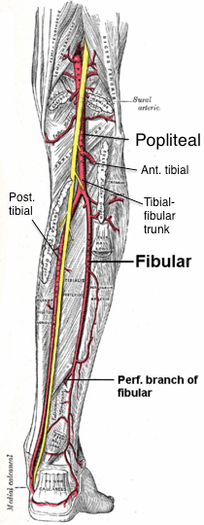

Slide 22


Slide 23


