Slide 1

SURGICAL ANATOMY
BS OTT
2ND SEMESTER
DR DANISH
DPT (S.M.C),MPPTA

Slide 2
Upper limb Overview
The upper limb is the region of the body attached to the trunk at the shoulder.
It includes the shoulder, arm, forearm, wrist, and hand.

Slide 3
Osteology
Definition: Osteology is the scientific study of bones, including their structure, development, function, and disorders.
Components: Focuses on bones, cartilage, ligaments, and joints.

Slide 4
Clavicle
Overview:
The clavicle, also called the collar bone, comes from the Latin clavicula meaning “little key.”
It is located between the sternum (medially) and the scapula (laterally).
Lies horizontally at the root of the neck.

Slide 5
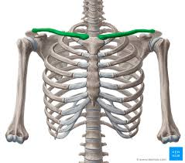

Slide 6
Shape & Structure
Roughly S-shaped and resembles a large key.
Acts as a light strut that keeps the upper limb away from the trunk, allowing free movement.
It is subcutaneous (just under the skin) and easily palpable throughout its length.

Slide 8
Development
The clavicle is the first bone to begin ossification (bone formation) during fetal development.

Slide 9
Sternal Extremity (Medial End)
The sternal extremity is the blunt, thickened medial end of the clavicle.
It articulates with the clavicular notch of the sternum.
Forms a compound synovial joint containing an articular disc (the sternoclavicular joint).

Slide 10
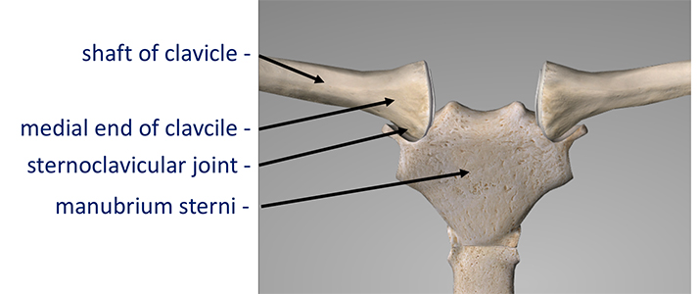

Slide 11
Acromial Extremity (Lateral End)
The acromial extremity is the flattened distal (lateral) end of the clavicle.
It articulates with the acromion process of the scapula.
Forms the acromioclavicular joint.

Slide 12
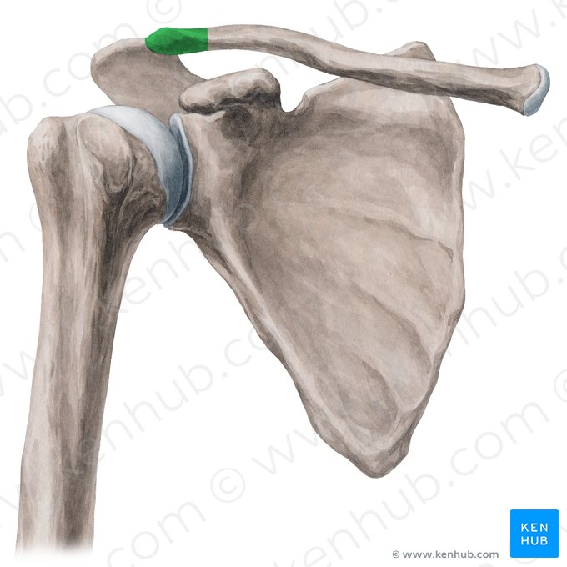

Slide 13
Conoid Tubercle
The conoid tubercle is a small roughened projection on the inferior surface of the lateral clavicle.
Serves as the attachment point for the conoid ligament, which is part of the coracoclavicular ligament complex.

Slide 14
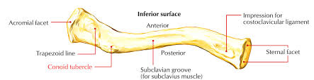

Slide 15
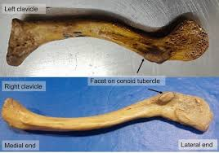

Slide 16
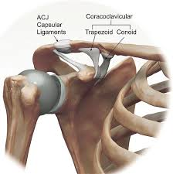

Slide 17
Functional Importance
Maintains the position of the upper limb, preventing the shoulder from collapsing medially.
Protects neurovascular structures passing between the thorax and upper limb.
Provides attachment sites for major muscles and ligaments involved in shoulder stability.

Slide 18
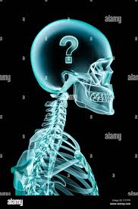

Slide 19
