Slide 1

Biosynthesis of Fatty Acids, Natural Fats (Triglycerides) & Fatty Acid Oxidation

Slide 2
Introduction to Lipid Metabolism
Lipid metabolism includes synthesis and breakdown of lipids
Fatty acids are synthesized and oxidized according to energy needs
Triglycerides serve as the major storage form of energy

Slide 3
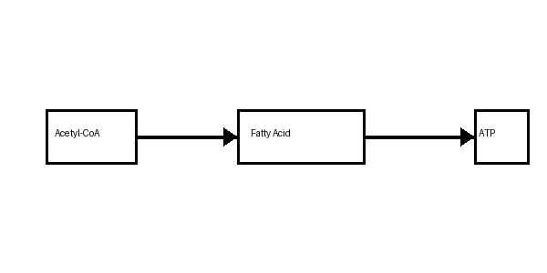
Fatty Acid Biosynthesis
Occurs mainly in the cytoplasm of liver, adipose tissue, and mammary glands
Uses acetyl-CoA as the starting material
Requires ATP and NADPH
Catalyzed by fatty acid synthase enzyme complex

Slide 4
Source of Acetyl-CoA
Acetyl-CoA is produced in mitochondria
Transported to cytoplasm in the form of citrate
ATP-citrate lyase converts citrate back to acetyl-CoA

Slide 5
Formation of Malonyl-CoA
Acetyl-CoA is converted into malonyl-CoA
Catalyzed by acetyl-CoA carboxylase
Biotin acts as a coenzyme
This is the rate-limiting step of fatty acid synthesis

Slide 6
Fatty Acid Synthase Complex
Large multifunctional enzyme complex
Adds two-carbon units during each cycle
Produces palmitic acid (16-carbon fatty acid)

Slide 7
Steps in Fatty Acid Synthesis
Condensation
Reduction
Dehydration
Second reduction
Cycle repeats until palmitate is formed

Slide 8
Overall Reaction of Fatty Acid Synthesis
Acetyl-CoA + ATP + NADPH are required
Produces palmitate, ADP, NADP+, and water

Slide 9
Regulation of Fatty Acid Synthesis
Insulin activates fatty acid synthesis
Glucagon and epinephrine inhibit synthesis
Citrate activates acetyl-CoA carboxylase
Palmitoyl-CoA inhibits the enzyme

Slide 10
Natural Fats and Triglycerides
Triglycerides are esters of glycerol and three fatty acids
Main storage form of lipids in animals
Stored in adipose tissue

Slide 11
Structure of Triglycerides
One glycerol molecule attached to three fatty acids
Can contain saturated or unsaturated fatty acids

Slide 12
Functions of Triglycerides
Major source of stored energy
Provide insulation and protection
Help in transport of fat-soluble vitamins

Slide 13
Natural Sources of Fats
Animal fats: butter, ghee, meat
Plant oils: olive oil, sunflower oil, coconut oil
Fish oils rich in omega-3 fatty acids

Slide 14
Physical Properties of Fats
Fats are insoluble in water
Melting point depends on fatty acid composition
Unsaturated fats are liquid at room temperature

Slide 15
Chemical Reactions of Triglycerides
Hydrolysis
Hydrogenation
Saponification
Oxidation

Slide 16
Fatty Acid Oxidation
Breakdown of fatty acids to produce energy
Occurs mainly in mitochondria
Known as beta-oxidation

Slide 17
Activation of Fatty Acids
Fatty acids are activated in cytoplasm
Converted into fatty acyl-CoA
Requires ATP

Slide 18
Transport into Mitochondria
Long-chain fatty acids require carnitine shuttle
Carnitine transports fatty acyl groups across mitochondrial membrane

Slide 19
Beta-Oxidation Pathway
Four major steps occur repeatedly
Oxidation
Hydration
Second oxidation
Thiolysis

Slide 20
Products of Beta-Oxidation
Acetyl-CoA
NADH
FADH2
These products generate ATP through the electron transport chain

Slide 21
Oxidation of Palmitic Acid
Palmitic acid produces 8 acetyl-CoA molecules
Generates large amount of ATP

Slide 22
Regulation of Fatty Acid Oxidation
Glucagon stimulates oxidation
Insulin inhibits oxidation
Malonyl-CoA inhibits carnitine shuttle

Slide 23
Clinical Importance
Defects in fatty acid oxidation cause metabolic disorders
Ketone bodies formed during prolonged fasting
Excess fat accumulation leads to obesity

Slide 24
Comparison: Synthesis vs Oxidation
Synthesis occurs in cytoplasm
Oxidation occurs in mitochondria
Synthesis uses NADPH
Oxidation produces NADH and FADH2

