Slide 1

ANATOMY
THE LOWER LIMB
DPT
2ND SEMESTER
DR DANISH
DPT(S.M.C),MPPTA

Slide 2
Lateral Fascial Compartment Contents
Muscles:
  Fibularis (Peroneus) Longus
  Fibularis (Peroneus) Brevis
Blood Supply:
  Branches of the fibular artery
Nerve Supply:
  Superficial fibular (peroneal) nerve

Slide 3
Fibularis Longus
Origin
Lateral surface of shaft of fibula
Insertion
Base of first metatarsal
Medial cuneiform
Nerve Supply
Superficial fibular nerve
Nerve Root
L5, S1, S2

Slide 4
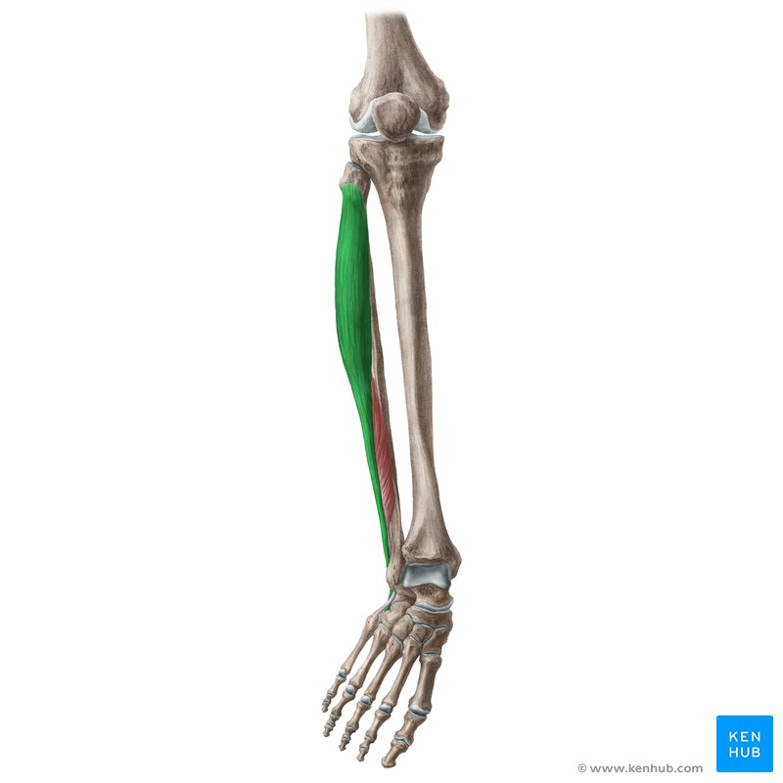

Slide 5
Continued
Actions
Plantar flexes foot at ankle joint
Everts foot at subtalar and transverse tarsal joints
Supports lateral longitudinal and transverse arches of the foot

Slide 6
Fibularis Brevis
Origin
Lateral surface of shaft of fibula
Insertion
Base of fifth metatarsal bone
Nerve Supply
Superficial fibular nerve
Nerve Root
L5, S1, S2

Slide 7
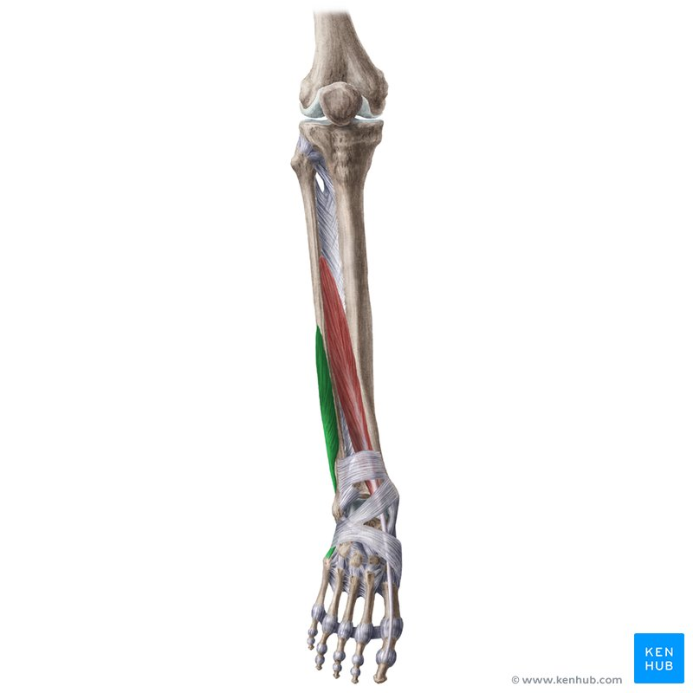

Slide 8
Continued
Actions
Plantar flexes foot at ankle joint
Everts foot at subtalar and transverse tarsal joints
Supports lateral longitudinal arch of the foot

Slide 9
Functions of Fibularis Muscles
Both fibularis longus and brevis:
  Flex the foot at the ankle joint
  Evert the foot at the subtalar and transverse tarsal joints
  Help maintain the lateral longitudinal arch of the foot
Fibularis longus:
  Acts as a tie for the transverse arch of the foot

Slide 10
Lateral Fascial Compartment Artery
Numerous branches arise from the fibular artery
Fibular artery lies in the posterior compartment of the leg
Branches pierce the posterior fascial septum
Supply the fibular muscles

Slide 11
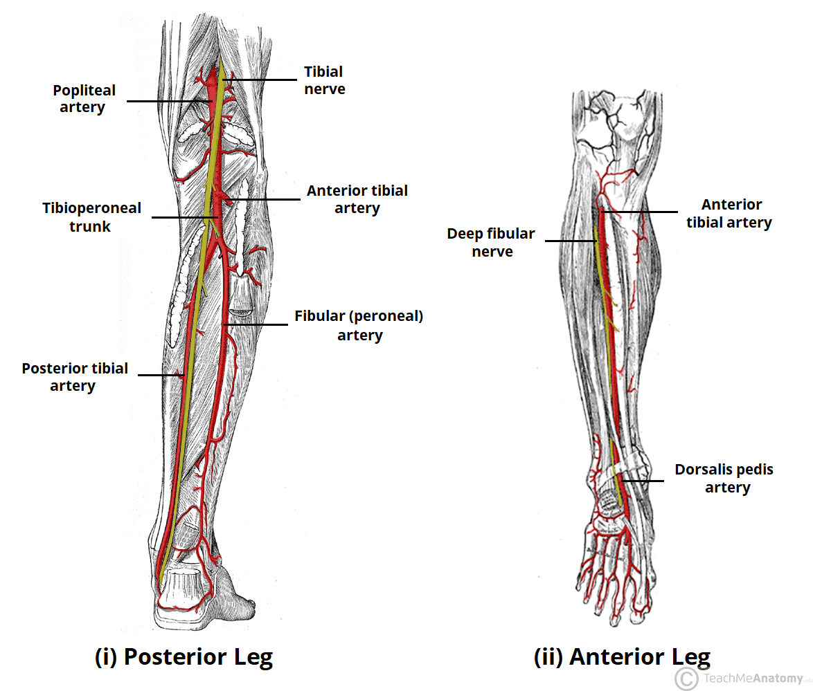

Slide 12
Lateral Fascial Compartment Nerve
Superficial Fibular (Peroneal) Nerve
Terminal branch of the common fibular (peroneal) nerve
Arises within the fibularis longus muscle
Located on the lateral side of the neck of the fibula
Descends between fibularis longus and fibularis brevis muscles
Becomes cutaneous in the lower part of the leg

Slide 13
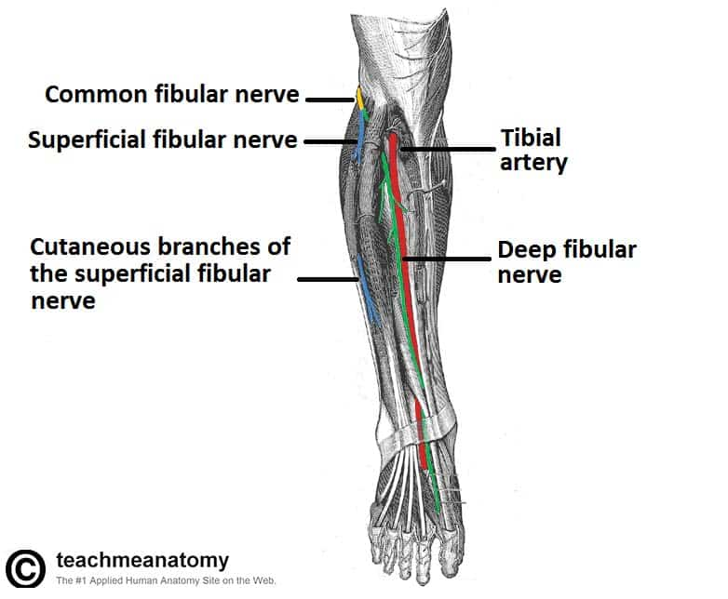

Slide 14
Continued
Muscular Branches
Supply:
  Fibularis longus
  Fibularis brevis
Cutaneous Branches
Medial and lateral branches supply:
  Skin of lower anterior leg
  Dorsum of the foot
Additional supply:
  Dorsal surfaces of all toes

Slide 15
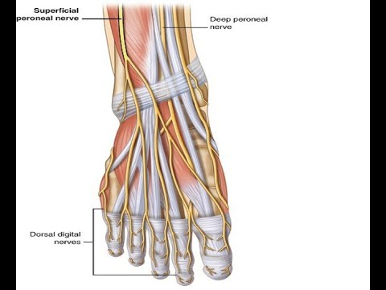

Slide 16


Slide 17


