Slide 1
Applied Sciences
Grade 11
Awais Hamza

Slide 2
Electric Charge
Charge is a basic property of a material body due to which it attracts or repels another object.
SI Unit : Coulomb (C)
Important Points
Friction produces two different types of charge.
Like charges repel each other.
Unlike charges attract each other.
Repulsion is the sure test of charge on a body.

Slide 3
Conservation of Electric Charge
Principle of Conservation of Charge
Electric charge can neither be created nor destroyed. It can only be transferred from one body to another.
Examples :
Charging by friction
Charging by conduction
Charging by induction

Slide 4
Coulomb's Law
The force of attraction or repulsion between two point charges is directly proportional to the product of the magnitude of charges and inversely proportional to the square of the distance between them."
Where:
F = Coulomb force
q₁ and q₂ = charges
r = distance between charges
k = constant of proportionality

Slide 5
Relationship Between Force and Charged Objects
Coulomb's Law explains the electrostatic force acting between two charged objects.
The force increases when the magnitude of the charges increases.
The force decreases when the distance between the charges increases.
Like charges repel each other.
Unlike charges attract each other.
The force acts along the line joining the two charges.

Slide 6
Capacitor
A capacitor is a device used to store electric charge.
Structure
Consists of two conducting plates.
Plates are separated by a very small distance.
Air or dielectric material exists between the plates.

Slide 7
Types of Capacitors
Types of Capacitors
Fixed Capacitors
Variable Capacitors
Common Examples
Ceramic Capacitor
Electrolytic Capacitor
Paper Capacitor
Mica Capacitor

Slide 8
Construction and Storage of Charge
Construction of Capacitor
When connected to a battery:
Battery transfers charge to the plates.
One plate acquires +Q charge.
Other plate acquires −Q charge.
Potential difference develops across the plates

Slide 9
Capacitance
"Capacitance is defined as the ability of the capacitor to store charge."
Unit : Farad (F)
The force depends on the magnitude of the charges and the distance separating them.
Larger charges produce a stronger force, while increasing the distance decreases the force.

Slide 10

Capacitors in Series
Characteristics
Same charge on each capacitor.
Equivalent capacitance decreases.
Voltage divides among capacitors.
Formula:
$\frac{1}{C}=\frac{1}{C_{1}}+\frac{1}{C_{2}}+\frac{1}{C_{3}}$

Slide 11

Capacitors in Parallel
Characteristics
Same voltage across each capacitor.
Total capacitance increases.
Charges are shared among capacitors.
Formula:
$C=C_{1}+C_{2}+C_{3}$

Slide 12
Factors Affecting Capacitance
Factors Affecting Capacitance
Capacitance depends upon:
Area of plates
Distance between plates
Nature of dielectric material
Effect
Larger area → Greater capacitance
Smaller separation → Greater capacitance

Slide 13
Alternating Current (AC)
Alternating current is a current whose magnitude and direction change continuously with time.
Uses
Domestic power supply
Industrial power systems
Transmission of electrical energy

Slide 14
AC vs DC
Alternating Current | Direct Current
Changes direction periodically | Flows in one direction
Produced by AC generators | Produced by batteries
Has frequency | Frequency is zero

Slide 15
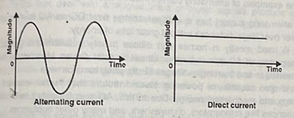
AC vs DC

Slide 16
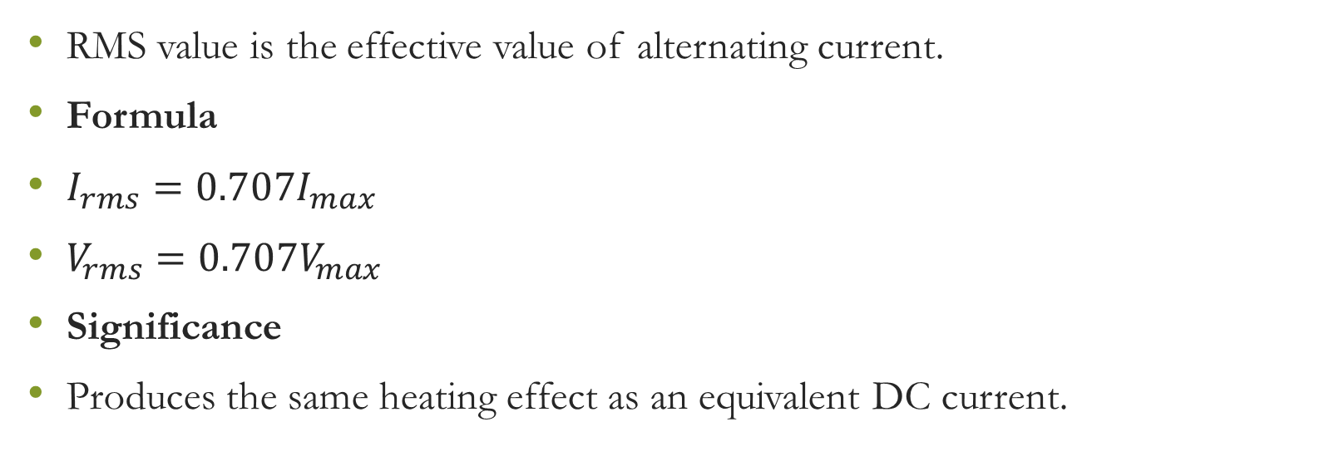
RMS Value
RMS value is the effective value of alternating current.
Formula
$I_{rms}=0.707I_{max}$
$V_{rms}=0.707V_{max}$
Significance
Produces the same heating effect as an equivalent DC current.

Slide 17
Peak Value of Sine Wave
Peak value is the maximum value reached by an alternating voltage or current during a cycle.
Types
Positive Peak
Negative Peak

Slide 18
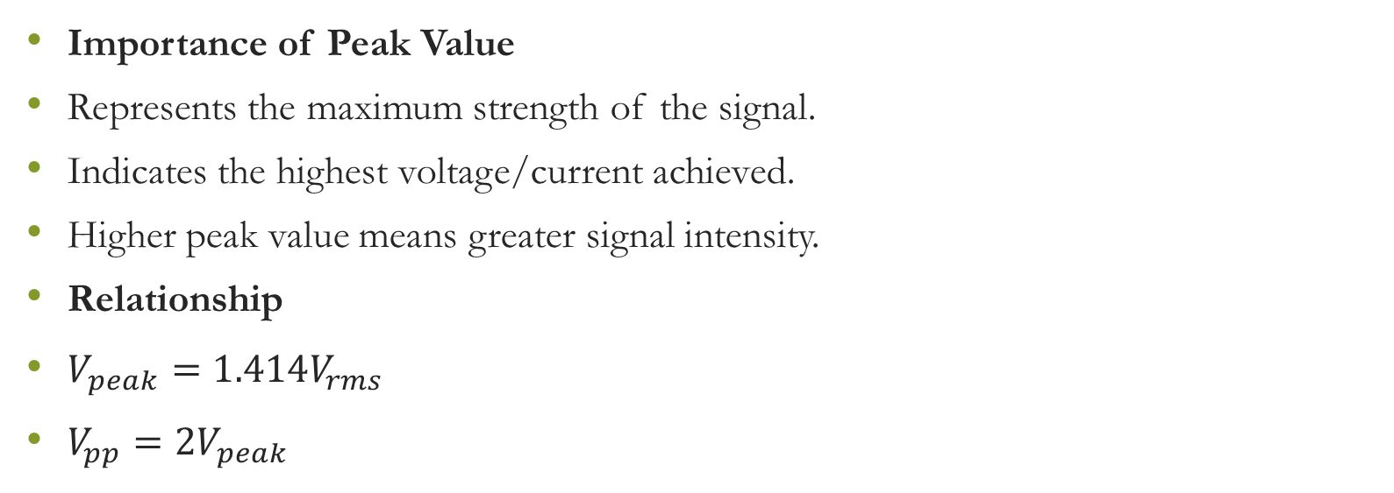
Peak Value and Strength of Sine Wave
Importance of Peak Value
Represents the maximum strength of the signal.
Indicates the highest voltage/current achieved.
Higher peak value means greater signal intensity.
Relationship
$V_{peak}=1.414V_{rms}$
$V_{pp}=2V_{peak}$

