Slide 1
Physiology
DPT
Awais Hamza

Slide 2
COAGULATION OF BLOOD
Coagulation or clotting is defined as the process in which blood loses its fluidity and becomes a jelly-like mass few minutes after it is shed out or collected in a container.
Coagulation of blood occurs through a series of reactions due to the activation of a group of substances. Substances necessary for clotting are called clotting factors.
Clotting factors were named after the scientists who discovered them or as per the activity, except factor IX.
Factor IX or Christmas factor was named after the patient in whom it was discovered.

Slide 3
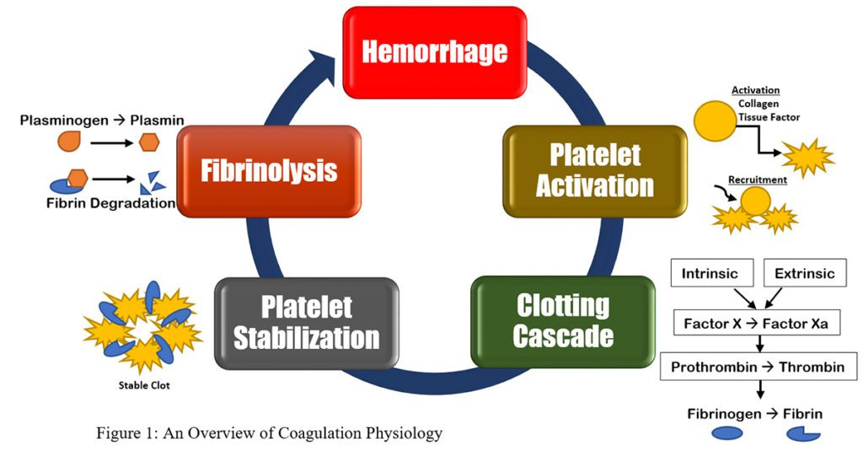

Slide 4
FACTORS INVOLVED IN BLOOD CLOTTING
Major Components
Platelets
Clotting factors
Calcium ions
Vitamin K
Liver function

Slide 5
Vitamin K and Calcium in Clotting
Vitamin K Dependent Factors
Factor II, Factor VII
Factor IX, Factor X
Functions of Vitamin K
Required for synthesis of clotting factors in liver, Deficiency causes bleeding tendency
Role of Calcium (Factor IV)
Essential for most coagulation reactions, Activates clotting factors
Needed for conversion of prothrombin to thrombin

Slide 6
Role of Platelets
Platelets in Coagulation Functions
Form platelet plug
Release clotting substances
Provide phospholipid surface
Help clot retraction
Assist vessel repair
Important Platelet Substances
ADP, Thromboxane A2
Serotonin, Platelet phospholipid

Slide 7
SEQUENCE OF CLOTTING MECHANISM
Three Major Steps
Formation of prothrombin activator
Conversion of prothrombin → thrombin
Conversion of fibrinogen → fibrin
Pathways
Extrinsic pathway
Intrinsic pathway
Common pathway

Slide 8
Extrinsic Pathway
Trigger: Tissue injury outside blood vessel.
Steps
Tissue damage releases tissue factor (Factor III)
Factor III activates Factor VII
Factor VII activates Factor X
Factor X forms prothrombin activator
Features
Rapid pathway, Takes seconds, Main pathway in trauma

Slide 9
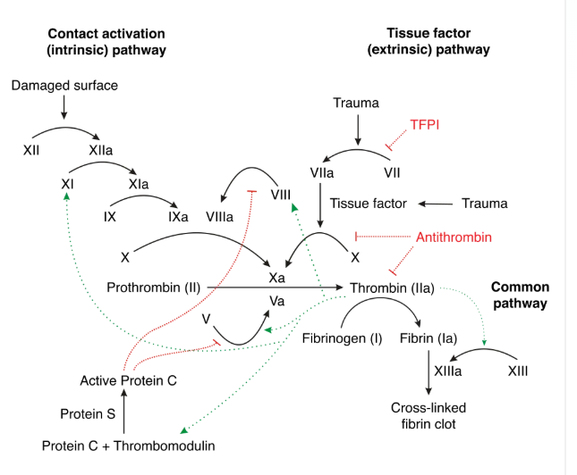

Slide 10
Extrinsic Pathway of Coagulation
Damage to the blood vessel means that factor VII exits the circulation into surrounding tissues
Tissue factor (factor III) is released by damaged cells outside the circulation
Factor VII and factor III form a complex, known as the TF-VIIa complex.
TF-VIIa then activates factor X into its active form, factor Xa
In conjunction with factor Va, this triggers the formation of thrombin.
Note that the extrinsic pathway is believed to be responsible for the initial generation of activated Factor X (Factor Xa), whereas the intrinsic pathway amplifies its production.

Slide 11
Intrinsic Pathway of Coagulation
Factor XII is activated once it comes into contact with negatively charged collagen on the damaged endothelium, triggering the cascade as detailed in Figure 1.
Along with clotting factors, platelets form a cellular ‘plug’ at the site of injury. These platelets also release mediators that facilitate further clotting, including Factor VIII.
Factor IX combines with Factor VIII to form an enzyme complex that activates factor X, which along with factor Va, stimulates the production of thrombin.

Slide 12
Common Pathway of Coagulation
The intrinsic and extrinsic pathways converge to give rise to the common pathway. The activated factor X causes a set of reactions resulting in the inactive enzyme prothrombin (also called factor II) being converted to its active form thrombin (factor IIa) by Prothrombinase.
The thrombin then converts soluble fibrinogen (also referred to as factor I) into insoluble fibrin strands. The fibrin strands which comprise the clot are stabilised by factor XIII.

Slide 13
Regulation of Clotting
To prevent excessive clotting and subsequent disease, mediators including Protein C and Protein S provide negative feedback on the clotting cascade.
Protein C is activated following contact by thrombomodulin, which is itself activated by thrombin. Along with co-factors including protein S, activated protein C degrades factor Va and factor VIIIa, thus slowing the rate of clotting.
Calcium ions play a role through their interaction with the activation of several clotting factors. Low levels of calcium are therefore inhibitory to the clotting cascade.
Antithrombin is a protease inhibitor that degrades thrombin, factor IXa, factor Xa, factor XIa and factor XIIa. It is constantly active but can be activated further by a group of common anticoagulants known as heparins.

Slide 14
Restoring Blood Flow – Fibrinolysis
In order for blood flow to be re-established as the blood vessel heals, the thrombus must eventually be degraded. During fibrinolysis, fibrin is dissolved leading to the consequent dissolution of the clot.
The endothelial cells of the blood vessel wall secrete tissue plasminogen activators (tPAs) which convert the precursor plasminogen into plasmin. Plasmin subsequently cleaves the fibrin within the thrombus, leading to its degradation.
tPAs are released very slowly following trauma from the endothelial cells, and therefore there is a substantial time delay until there is a sufficient concentration for fibrinolysis.

Slide 15
Thrombin and Fibrin
Role of Thrombin
Functions
Converts fibrinogen into fibrin. Activates Factor XIII
Enhances platelet aggregation. Accelerates coagulation by positive feedback
Fibrin
Forms meshwork of clot. Traps blood cells and platelets
Stabilizes damaged vessel

Slide 16
BLOOD CLOT
Blood Clot: A network of fibrin fibers containing RBCs, WBCs, platelets, and plasma.
Clot Retraction
Occurs within 20–60 minutes. Platelets contract using actin and myosin
Serum is squeezed out
Importance
Pulls wound edges together. Strengthens clot
Promotes healing

Slide 17
ANTICLOTTING MECHANISM IN THE BODY
Natural Anticlotting Mechanisms
Smooth endothelium
Antithrombin III
Heparin
Protein C and Protein S
Fibrinolytic system
Purpose
Prevent unwanted clotting inside intact vessels.

Slide 18
Natural Anticoagulants
Natural Anticoagulants
Antithrombin III
Inhibits thrombin and activated factors
2. Heparin
Released from mast cells and basophils
Enhances antithrombin III activity
3. Protein C & S
Inactivate Factors Va and VIIIa
Reduce coagulation

Slide 19
ANTICOAGULANTS
Definition: Substances that prevent or delay blood coagulation.
Laboratory Anticoagulants
EDTA, Sodium citrate, Oxalates
Therapeutic Anticoagulants
Heparin
Warfarin
Dabigatran
Rivaroxaban
Apixaban

Slide 20
PROCOAGULANTS
Definition: Substances that promote coagulation.
Examples: Vitamin K, Calcium, Tissue thromboplastin, Clotting factor concentrates
Clinical Uses
Vitamin K deficiency
Hemophilia treatment
Warfarin toxicity
Severe bleeding disorders

Slide 21
Anticlotting Mechanism in the Body
Under physiological conditions, intravascular clotting does not occur.
This is because of the presence of some physicochemical factors in the body:
1. Physical Factors
Continuous circulation of blood
Smooth endothelial lining of blood vessels
2. Chemical Factors
Natural anticoagulants present in the body

Slide 22
Physical Factors Preventing Clotting
Continuous Circulation of Blood
Prevents stagnation of blood
Reduces accumulation of clotting factors
Smooth Endothelial Lining
Provides a non-thrombogenic surface
Prevents platelet adhesion and activation

Slide 23
Chemical Factors – Natural Anticoagulants
Natural Anticoagulants
Heparin produced by the liver
Thrombomodulin produced by vascular endothelium
Clotting factors remain in inactive state under normal conditions

Slide 24
Thrombomodulin Mechanism
Thrombomodulin + Thrombin
↓
Thrombomodulin-Thrombin Complex
↓
Activation of Protein C
↓
Protein C + Protein S
↓
Inactivation of Factors V and VIII
↓Prevention of Clot Formation

Slide 25
Anticoagulants
Definition
Substances which prevent or postpone coagulation of blood are called anticoagulants.
Types
Anticoagulants used in vivo
Anticoagulants used in vitro
Anticoagulants used both in vivo and in vitro

Slide 26
Heparin – Introduction
Heparin
Naturally produced anticoagulant
Produced by mast cells
Mast cells are wandering cells present outside capillaries
Abundant in liver and lungs
Basophils also secrete heparin
Nature: Conjugated polysaccharide

Slide 27
Commercial Heparin
Prepared from:
Liver
Other organs of animals
Available as:
Liquid form
Sodium salts
Calcium salts
Ammonium salts
Lithium salts

Slide 28
Mechanism of Action of Heparin
Prevents blood clotting by Antithrombin activity
Directly suppresses thrombin activity
Combines with Antithrombin III and removes thrombin from circulation
Activates Antithrombin III
Inactivates Factors IX, X, XI and XII

Slide 29
Uses of Heparin
Clinical Uses
Intravenous injection:
0.5–1 mg/kg body weight
Postpones clotting for:
3–4 hours
Used:
During surgery
During dialysis
During cardiac surgery with heart-lung machine
Before blood transfusion

Slide 30
Coumarin Derivatives
Examples : Warfarin and Dicoumoral
Mechanism of Action
Coumarin derivatives inhibit the action of Vitamin K.Vitamin K is essential for formation of:
Factor II
Factor VII
Factor IX
Factor X

Slide 31
Ethylenediaminetetraacetic Acid (EDTA)
Strong anticoagulant. Available as: Disodium salt and Tripotassium salt
Mechanism
Removes calcium from blood
↓
Prevents coagulation

