Slide 1
Applied Science
Fsc Medical Technology

Slide 2
Magnet – Definition
A magnet is a material or object that produces a magnetic field and has the ability to attract ferromagnetic materials such as iron, nickel, cobalt, and some of their alloys.
Attractive Property : A magnet attracts magnetic materials such as iron, steel, nickel, and cobalt.
Directive Property :When freely suspended, a magnet always aligns itself in the north-south direction.
Polarity
  Every magnet has two poles:
    North Pole (N)
    South Pole (S) .Magnetic force is strongest at the poles.

Slide 3
Magnet Properties
Law of Magnetic Poles
Like poles repel each other (N-N or S-S). Unlike poles attract each other (N-S).
Poles Exist in Pairs : A magnet cannot have a single pole.
If a magnet is cut into two pieces,
each piece becomes a new magnet with its own north and south poles.
Magnetic Field
A magnet produces an invisible region around it called a magnetic field,
where magnetic forces can be detected.
Induction Property
A magnet can temporarily magnetize certain magnetic materials when brought close to them.
Strength at Poles
Magnetic force is greatest at the ends (poles) and weakest near the center of the magnet.

Slide 4
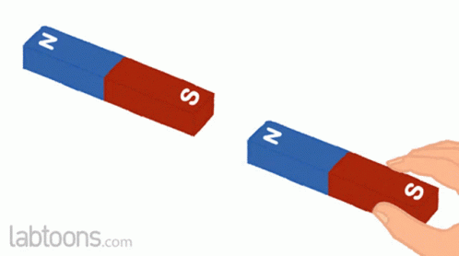
Concept of Magnetic Field
A magnetic field is the invisible region around a magnet where magnetic force can be experienced.
Important Points
The field surrounds every magnet.
Strongest near the poles.
Weakens with distance.
Effects on Nearby Objects
A magnet can:
Attract iron objects
Move compass needles
Influence electric charges

Slide 5
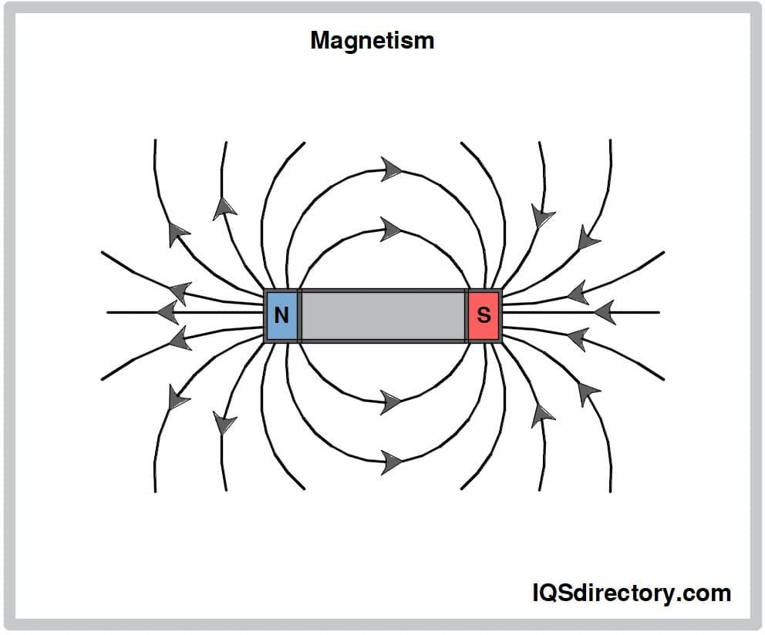
Magnetism and Electromagnetism
Magnetism is a force produced by magnets.
It can attract or repel certain materials like iron,
nickel, and cobalt.
Every magnet has:
  North Pole
  South Pole
Basic Rule
Opposite poles attract.
Like poles repel.

Slide 6
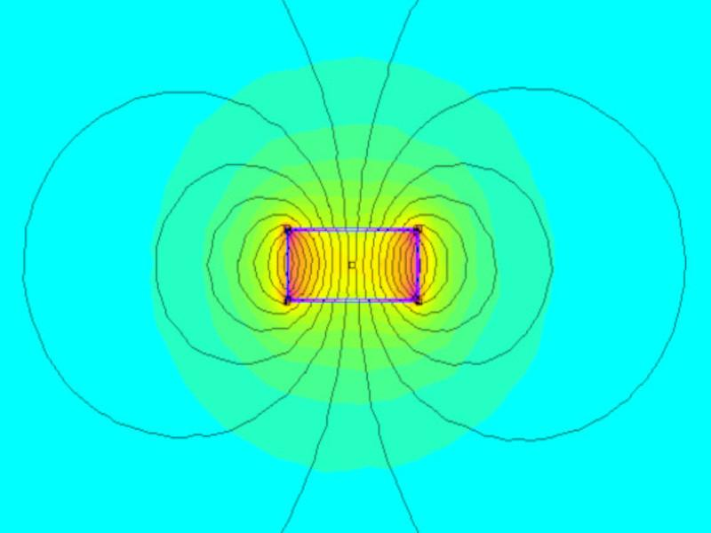
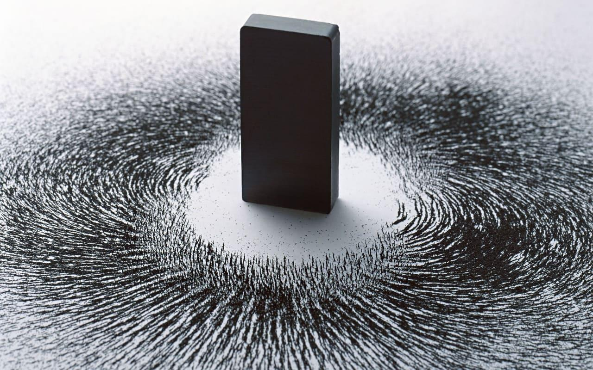
Magnetic Field

Slide 7
How Magnets Influence Space Around Them
Influence of Magnets
Magnets create an invisible force field in surrounding space.
Nearby Objects Experience
Attraction
Repulsion
Alignment with magnetic field
Example
A compass needle aligns with Earth’s magnetic field.
Real-World Applications
Navigation systems , Magnetic locks , Generators , Medical imaging

Slide 8
Magnetic Lines of Force
Definition
Magnetic lines of force are imaginary lines representing a magnetic field.
Characteristics
Originate from North Pole
Enter South Pole
Form closed loops
Never intersect each other
Importance
They help visualize: Direction , Shape , Strength of magnetic field

Slide 9
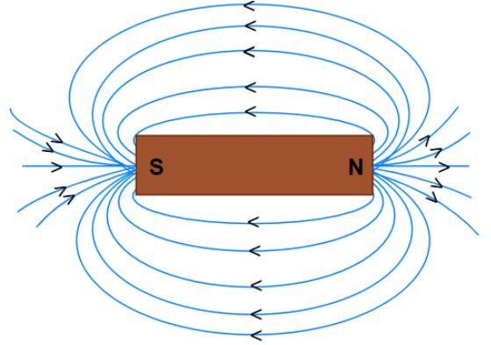
Magnetic Lines

Slide 10
Pattern Formed by Magnetic Field Lines
Field Pattern Around a Bar Magnet
Dense near poles → stronger field
Wider apart away from poles → weaker field
Circular Pattern
Field lines curve from:
North → South outside magnet
South → North inside magnet
Observation Method
Iron filings sprinkled near a magnet show the field pattern.

Slide 11
Direction of Magnetic Field
Direction Rule
Magnetic field direction is:
From North Pole to South Pole outside the magnet
Compass Method
A compass needle points in the direction of magnetic field lines.
Right-Hand Thumb Rule
Used for current-carrying conductors:
Thumb → current direction
Curled fingers → magnetic field direction

Slide 12
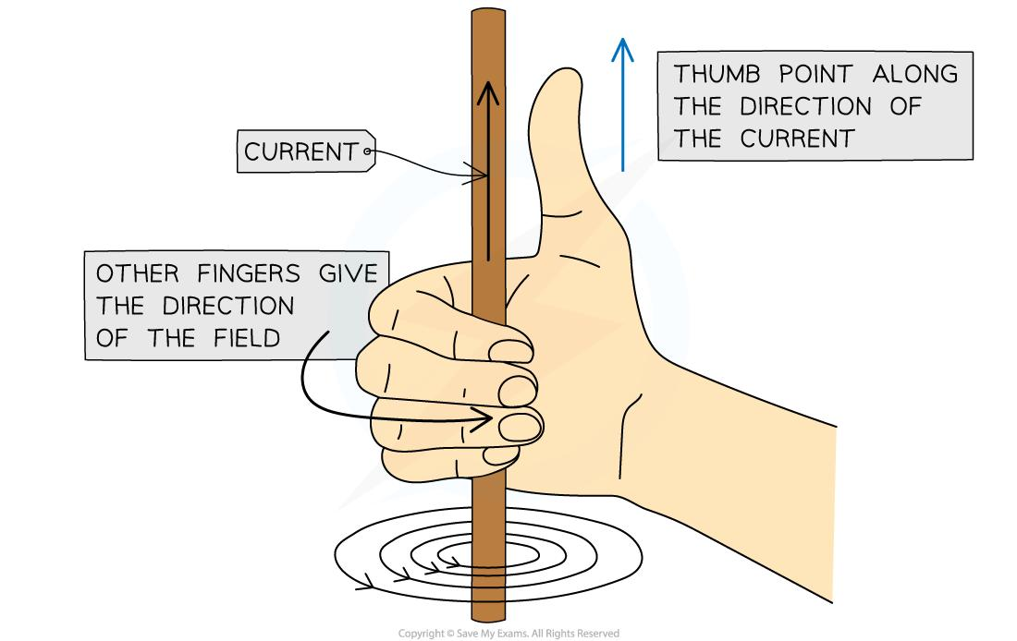
Thumb Rule

Slide 13
Strength of Magnetic Field
Factors Affecting Magnetic Field Strength
Distance from magnet
Size of magnet
Material of magnet
Electric current magnitude
Strong Field: Lines close together
Weak Field: Lines spread apart
Measurement Unit
Magnetic field strength is measured in: Tesla (T)

Slide 14
Introduction to Electromagnetism
Electromagnetism
Electromagnetism is the relationship between electricity and magnetism.
Principle
Electric current flowing through a conductor creates a magnetic field.
Discovery: Hans Christian Ørsted
Key Idea: Electricity can produce magnetism.

Slide 15
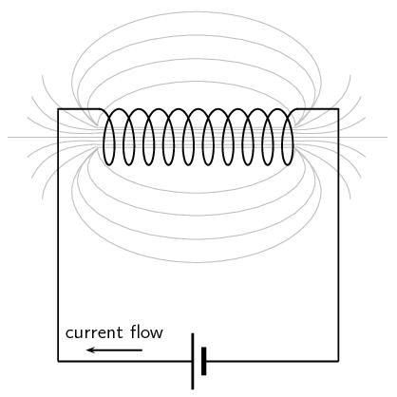
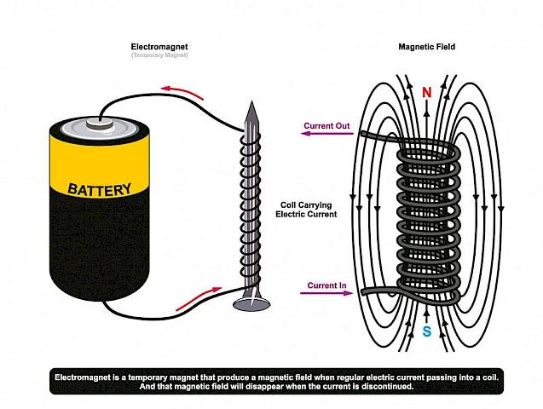

Slide 16
Creation of a magnetic field through application of electric current
An electric current creates a magnetic field whenever electrical charges (electrons) are in motion.
When electrons flow through a conductor, they generate invisible, concentric rings of magnetic force encircling the wire.
This foundational principle is the basis of electromagnetism

Slide 17
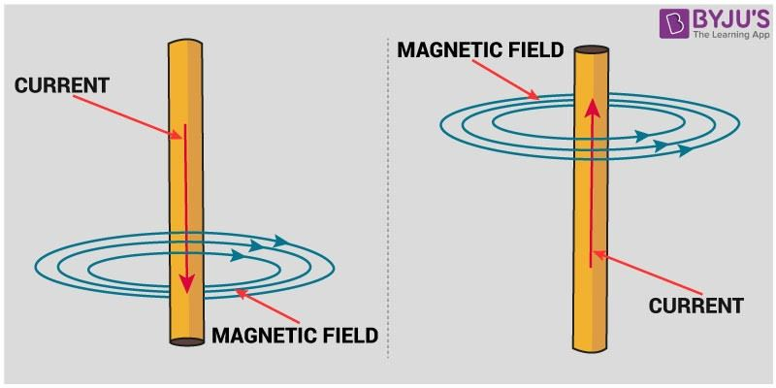
Magnetic Field through Current

Slide 18
Magnetic Field Due to Current Carrying Conductor
Current is generally defined as the rate of flow of charge. We already know that stationary charges produce an electric field proportional to the charge’s magnitude.
The same principle can be applied here. Moving charges produce magnetic fields which are proportional to the current, and hence a current carrying conductor produces a magnetic effect around it.
This magnetic field is generally attributed to the sub-atomic particles in the conductor, for e.g. the moving electrons in the atomic orbitals.

Slide 19
Continue
A magnetic field has both magnitude and direction. Hence, it is a vector quantity denoted by B
The magnetic field due to a current-carrying conductor depends on the conductor’s current and the distance from the point. The direction of the magnetic field is perpendicular to the wire.
If you wrap your right hand’s fingers around the wire with your thumb pointing in the direction of the current, then the direction in which the fingers would curl will give the direction of the magnetic field. This will be clearer with the diagram below, where the red lines represent the magnetic field lines.

Slide 20
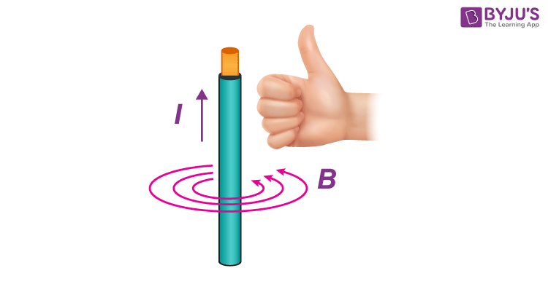

Slide 21
Characteristics of Magnetic Field Due to Current Carrying Conductor
The magnetic field produced due to a current-carrying conductor has the following characteristics:
It encircles the conductor.
It lies in a plane perpendicular to the conductor.
Reversal in the current flow direction reverses the field’s direction.
Strength of the field is directly proportional to the magnitude of the current.
Strength of the field at any point is inversely proportional to the distance of the point from the wire.

Slide 22
Right-Hand Thumb Rule
According to Faraday’s law of electromagnetic induction, when a conductor moves through a magnetic field, an electric current is induced in it. Fleming’s right-hand rule is used to determine the direction of the induced current.

Slide 23
Right Hand Rule
Fleming’s Right Hand Rule states that if we arrange our thumb, forefinger and middle finger of the right-hand perpendicular to each other, then the thumb points towards the direction of the motion of the conductor relative to the magnetic field, the forefinger points towards the direction of the magnetic field and the middle finger points towards the direction of the induced current.

Slide 24
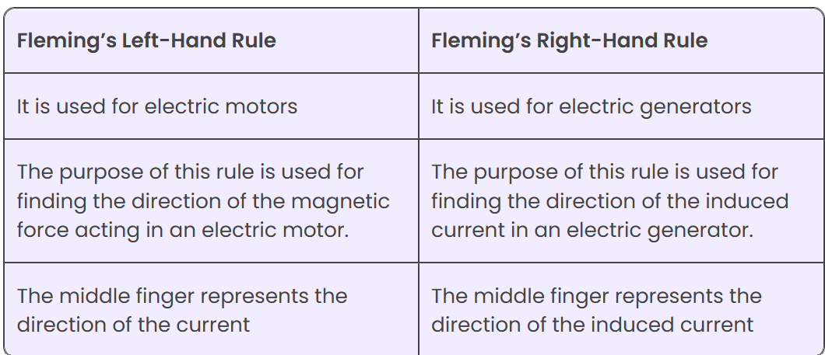
Fleming Left Hand VS Right Hand Rule

Slide 25
Magnetic Field Around a Current-Carrying Wire
Observation
When electric current passes through a wire:
Circular magnetic field forms around the wire.
Direction
Determined by Right-Hand Thumb Rule.
Stronger Magnetic Field Produced By
Increasing current
Coiling the wire
Using iron core

Slide 26
Principle of Electromagnetism
Electromagnetism is the phenomenon in which an electric current flowing through a conductor produces a magnetic field around it.
Basic Principle
When electric current passes through a wire, magnetic lines of force are generated around the wire. The strength of the magnetic field depends on:
The amount of current flowing through the conductor.
The number of turns in the coil.
The type of core material (e.g., iron core increases magnetic strength).

Slide 27
Right-Hand Thumb Rule
If the right-hand thumb points in the direction of current flow, the curled fingers indicate the direction of the magnetic field around the conductor.
Applications
Electric motors
Generators
Transformers
Relays
MRI scanners
X-ray equipment and imaging systems

Slide 28
What is Electromagnetic Force?
The electromagnetic force is a type of physical interaction that occurs between electrically charged particles. It acts between charged particles and is the combination of all magnetic and electrical forces. The electromagnetic force can be attractive or repulsive.
When a conductor is electrically charged it generates magnetic lines. For example, if current i.e., positive charges move in a wire, it produces the magnetic field along the wire, and the direction of magnetic lines and force can be determined using Right-hand Rule.

Slide 29
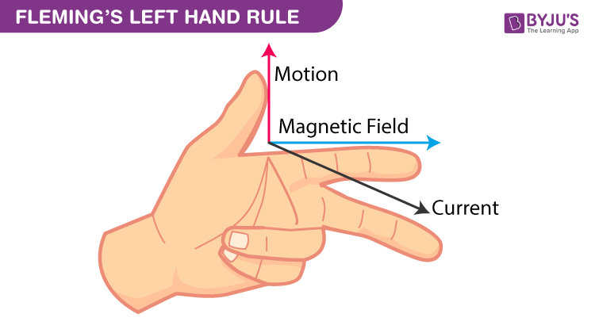
Fleming Left Hand Rule

Slide 30
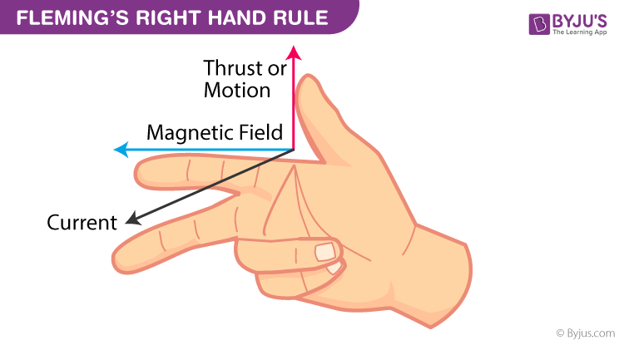
Fleming Right Hand Rule

Slide 31
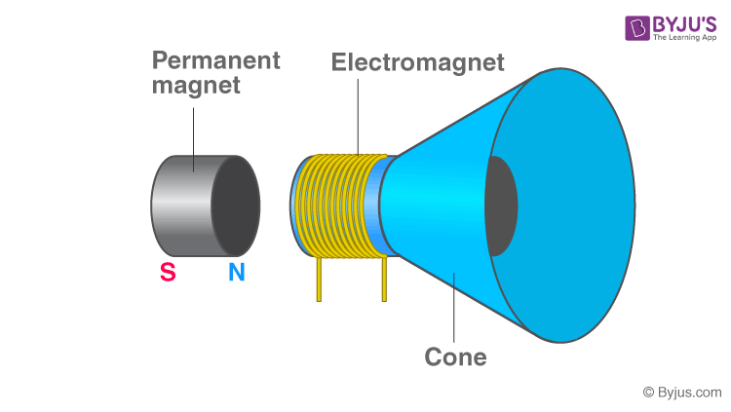
Explanation of Electromagnetism with an Example
Permanent Magnetic speakers commonly used in TV’s and Radios are perfect examples of Electromagnetic devices.

Slide 32
Electromagnetism
In order to convert electrical waves into audible sound, the speakers are designed. A metal coil is attached to a permanent magnet and when current passes through the coil it generates a magnetic field. The newly formed magnetic field is repelled by the permanent magnetic field resulting in the vibrations. These vibrations are amplified by the cone-like structure causing the sound. This is how speakers work based on electromagnetism.

Slide 33
Applications of Electromagnetism
1. Electric Motors
Convert electrical energy into mechanical energy.
Used in fans, pumps, washing machines, and industrial machinery.
2. Electric Generators
Convert mechanical energy into electrical energy.
Used in power plants and backup generators.
3. Transformers
Increase or decrease AC voltage through electromagnetic induction.
Essential in power transmission and distribution systems.

Slide 34
Transformers
The transformer, in a simple way, can be described as a device that steps up or steps down voltage.
In a step-up transformer, the output voltage is increased, and in a step-down transformer, the output voltage is decreased.
The step-up transformer will decrease the output current, and the step-down transformer will increase the output current to keep the input and output power of the system equal.

Slide 35
What Is a Transformer?
A transformer is a device used in the power transmission of electric energy. The transmission current is AC.
It is commonly used to increase or decrease the supply voltage without a change in the frequency of AC between circuits.
The transformer works on the basic principles of electromagnetic induction and mutual induction.

Slide 36
Transformer Types
Transformers are used in various fields like power generation grid, distribution sector, transmission and electric energy consumption. There are various types of transformers which are classified based on the following factors:
Working voltage range
The medium used in the core
Winding arrangement
Installation location

Slide 37
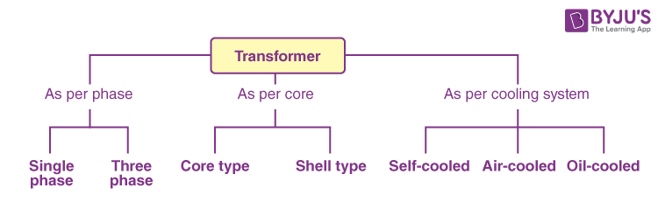
Transformer

Slide 38
Based on Voltage Levels
Commonly used transformer types, depending on the voltage, are classified as follows:
Step-up Transformer: They are used between the power generator and the power grid. The secondary output voltage is higher than the input voltage.
Step-down Transformer: These transformers are used to convert high-voltage primary supply to low-voltage secondary output.

Slide 39
Based on the Medium of Core Used
In a transformer, we will find different types of cores that are used.
Air Core Transformer: The flux linkage between primary and secondary winding is through the air. The coil or windings wound on the non-magnetic strip.
Iron Core Transformer: Windings are wound on multiple iron plates stacked together, which provides a perfect linkage path to generate flux.

Slide 40
Working Principle of a Transformer
There are usually two coils – primary coil and secondary coil – on the transformer core. The core laminations are joined in the form of strips. The two coils have high mutual inductance.
When an alternating current passes through the primary coil, it creates a varying magnetic flux.
As per Faraday’s law of electromagnetic induction, this change in magnetic flux induces an EMF (electromotive force) in the secondary coil, which is linked to the core having a primary coil. This is mutual induction.

Slide 41
Transformer
Overall, a transformer carries out the following operations:
Transfer of electrical energy from one circuit to another
Transfer of electrical power through electromagnetic induction
Electric power transfer without any change in frequency
Two circuits are linked with mutual induction

Slide 42
Faraday's Law of Electromagnetic Induction
Faraday’s law of electromagnetic induction, also known as Faraday’s law, is the basic law of electromagnetism which helps us predict how a magnetic field would interact with an electric circuit to produce an electromotive force (EMF). This phenomenon is known as electromagnetic induction.
Michael Faraday proposed the laws of electromagnetic induction in the year 1831. Faraday’s law or the law of electromagnetic induction is the observation or results of the experiments conducted by Faraday. He performed three main experiments to discover the phenomenon of electromagnetic induction.

Slide 43
Faraday Law
Whenever a conductor is placed in a varying magnetic field, an electromotive force is induced. If the conductor circuit is closed, a current is induced, which is called induced current.

Slide 44
Few ways to change the magnetic field intensity in a closed loop
By rotating the coil relative to the magnet.
By moving the coil into or out of the magnetic field.
By changing the area of a coil placed in the magnetic field.
By moving a magnet towards or away from the coil.

Slide 45
Faraday’s Second Law of Electromagnetic Induction
Faraday’s second law of electromagnetic induction states that ‘‘The induced emf in a coil is equal to the rate of change of flux linkage’’

Slide 46
Lenz’s Law
The German physicist Heinrich Friedrich Lenz deduced a rule known as Lenz’s law that describes the polarity of the induced emf.
Lenz’s law states that “The polarity of induced emf is such that it tends to produce a current which opposes the change in magnetic flux that produced it.”
The negative sign in the formula represents this effect. Thus, the negative sign indicates that the direction of the induced emf and the change in the direction of magnetic fields have opposite signs.

