Slide 1

Introduction to Lipids
BS MLT ,OT , RIT
Saman Naveed

Slide 2
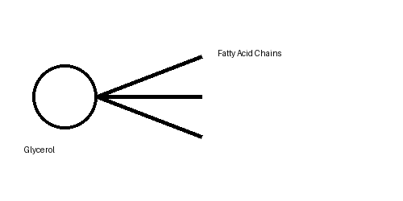
What are Lipids?
Lipids are organic biomolecules that are insoluble in water
They are soluble in non-polar organic solvents such as ether and chloroform
Composed mainly of carbon, hydrogen, and oxygen
Some lipids also contain phosphorus, nitrogen, and sulfur .

Slide 3
Characteristics of Lipids
Hydrophobic or amphipathic molecules
Provide high energy yield
Stored mainly in adipose tissues
Essential components of biological membranes

Slide 4
Occurrence of Lipids
Present in plants and animals
Found in cell membranes and adipose tissue
Abundant in seeds, nuts, oils, butter, meat, and fish

Slide 5
Importance of Lipids
Major source of stored energy
Protect organs from physical damage
Provide insulation against heat loss
Essential for absorption of fat-soluble vitamins

Slide 6
Classification of Lipids
Simple Lipids
Compound (Complex) Lipids
Derived Lipids

Slide 7
Simple Lipids
Esters of fatty acids with alcohols
Include fats, oils, and waxes
Mainly serve as energy storage molecules

Slide 8
Fats and Oils
Triglycerides made of glycerol and fatty acids
Fats are solid at room temperature
Oils are liquid at room temperature
Found in animal fats and vegetable oils

Slide 9
Waxes
Esters of long-chain fatty acids with long-chain alcohols
Provide waterproof protection
Examples include beeswax and plant wax

Slide 10
Compound Lipids
Contain additional groups such as phosphate or carbohydrate
Include phospholipids, glycolipids, and lipoproteins
Important in membrane structure and transport

Slide 11
Phospholipids
Contain phosphate group
Major components of cell membranes
Hydrophilic head and hydrophobic tail
Examples: Lecithin and cephalin

Slide 12
Glycolipids
Contain carbohydrate groups
Present mainly in nervous tissue
Important in cell recognition and communication

Slide 13
Lipoproteins
Combination of lipids and proteins
Transport lipids in the bloodstream
Examples: HDL, LDL, and VLDL

Slide 14
Derived Lipids
Produced from hydrolysis of simple and compound lipids
Include fatty acids, glycerol, steroids, and vitamins

Slide 15
Fatty Acids
Basic structural units of lipids
Can be saturated or unsaturated
Essential fatty acids must be obtained through diet

Slide 16
Saturated Fatty Acids
Do not contain double bonds
Usually solid at room temperature
Examples: Butter and animal fats

Slide 17
Unsaturated Fatty Acids
Contain one or more double bonds
Usually liquid at room temperature
Examples: Olive oil and fish oil

Slide 18
Functions of Lipids
Energy storage and fuel source
Structural components of membranes
Protection and insulation
Hormone synthesis and cell signaling

Slide 19
Lipids in Energy Storage
Provide 9 kcal of energy per gram
Stored in adipose tissues
Used during fasting and starvation
Structural Functions

Slide 20
Structural Functions
Phospholipids and cholesterol form cell membranes
Maintain membrane fluidity and integrity

Slide 21
Protective Functions
Cushion internal organs
Protect body from mechanical shock
Help maintain body temperature

Slide 22
Regulatory Functions
Steroid hormones are lipid derivatives
Lipids act in signaling pathways
Important in inflammation and immunity
Regulatory Functions

Slide 23
Clinical Importance of Lipids
High cholesterol may cause cardiovascular disease
Excess lipid accumulation leads to obesity
Abnormal lipid metabolism causes metabolic disorders

