Slide 1

Visual Arts
DPT (Doctor Of physical Therapy )

Slide 2
Course Objectives
• Understand major modern and contemporary art movements
• Explore the historical background of each movement
• Analyze characteristics, themes, and techniques
• Study important artists and artworks
• Examine the influence of technology on contemporary art

Slide 3
Introduction to Modern and Contemporary Art
• Modern art movements challenged traditional artistic values
• Artists experimented with new materials and ideas
• Art became connected with politics, society, media, and technology
• Contemporary art reflects globalization and digital culture.

Slide 4
POP Art – Definition and Background
• Emerged in the 1950s–1960s in Britain and the USA
• Inspired by popular culture, advertisements, comics, and celebrities
• Challenged the distinction between 'high art' and 'popular culture'
• Reflected consumerism and mass production

Slide 5
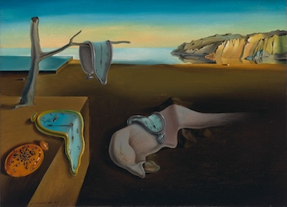
Characteristics of POP Art
• Bright and bold colors
• Use of commercial imagery and mass media
• Repetition and mechanical techniques
• Everyday objects used as artistic subjects
• Humorous, ironic, and critical tone

Slide 6
Important POP Art Artists
• Andy Warhol – Campbell’s Soup Cans, Marilyn Monroe series
• Roy Lichtenstein – Comic strip paintings
• Richard Hamilton – Early British POP Art pioneer
• Claes Oldenburg – Large-scale sculptures of everyday objects.

Slide 7
Minimalism – Definition and Background
• Developed in the 1960s in the USA
• Reaction against emotional expression in Abstract Expressionism
• Focused on simplicity, order, and geometry
• Reduced art to its basic forms and materials

Slide 8

Characteristics of Minimalism
• Simple geometric forms
• Limited color palettes
• Clean lines and repetition
• Industrial materials such as steel and glass
• Emphasis on space and viewer experience

Slide 9
Important Minimalist Artists
• Donald Judd – Geometric installations
• Dan Flavin – Light-based artworks
• Agnes Martin – Subtle grids and lines
• Frank Stella – Abstract geometric paintings

Slide 10
Conceptual Art – Definition
• Emerged in the late 1960s
• The idea or concept is more important than the physical artwork
• Artists questioned the purpose and value of art
• Art could exist as text, performance, photography, or documentation

Slide 11
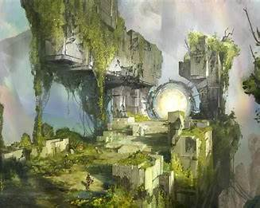
Characteristics of Conceptual Art
• Focus on ideas and intellectual meaning
• Use of language, text, and instructions
• Non-traditional materials and forms
• Often critical of politics, society, and institutions
• Viewer interpretation is important

Slide 12
Important Conceptual Artists
• Marcel Duchamp – Readymades and Fountain
• Joseph Kosuth – One and Three Chairs
• Sol LeWitt – Conceptual wall drawings
• Yoko Ono – Instruction-based artworks

Slide 13
Postmodernism – Definition and Background
• Developed in the late 20th century
• Rejected the idea of one universal truth in art
• Mixed different styles, media, and cultural references
• Encouraged diversity, irony, and experimentation

Slide 14
Characteristics of Postmodernism
• Use of parody and irony
• Mixing of historical and contemporary styles
• Fragmentation and multiple meanings
• Critique of power, media, and consumer culture
• Inclusion of popular culture and identity politics

Slide 15
Important Postmodernism Artists
• Jean-Michel Basquiat – Graffiti-inspired expression
• Cindy Sherman – Identity and photography
• Jeff Koons – Consumer culture sculptures
• Barbara Kruger – Text and media criticism

Slide 16
Contemporary Digital & New Media Art
• Art created using digital technologies
• Includes video art, animation, virtual reality, AI, and interactive installations
• Artists use computers, software, and internet platforms
• Expands the definition of artistic practice

Slide 17
Characteristics of Digital & New Media Art
• Interactive and immersive experiences
• Use of sound, motion, and multimedia
• Global accessibility through online platforms
• Combination of art, science, and technology
• Constant innovation and experimentation

Slide 18
Important Digital & New Media Artists
• Nam June Paik – Pioneer of video art
• Refik Anadol – AI and data-driven installations
• Beeple – Digital artworks and NFTs
• team Lab – Interactive digital environments

Slide 19
Comparison of Art Movements
POP Art: Popular culture and consumerism
Minimalism: Simplicity and geometric forms
Conceptual Art: Importance of ideas over objects
Postmodernism: Diversity, irony, and mixed styles
Digital/New Media Art: Technology and interactivity

Slide 20
Conclusion
• These movements transformed the understanding of art
• Artists explored new ideas, materials, and technologies
• Contemporary art continues to evolve with society and innovation
• Understanding these movements helps students analyze modern visual culture.

