Slide 1

ANATOMY
THE THORAX
BS RIT,OTT
2ND SEMESTER
DR DANISH
DPT(S.M.C),MPPTA

Slide 2
Phrenic Nerve – Course
Forms at lateral border of anterior scalene muscle
Descends obliquely across anterior surface of anterior scalene
Lies deep to:
  Prevertebral fascia
  Sternocleidomastoid muscle
Passes posterior to:
  Subclavian vein
Enters thorax between:
  Subclavian artery
  Subclavian vein

Slide 3
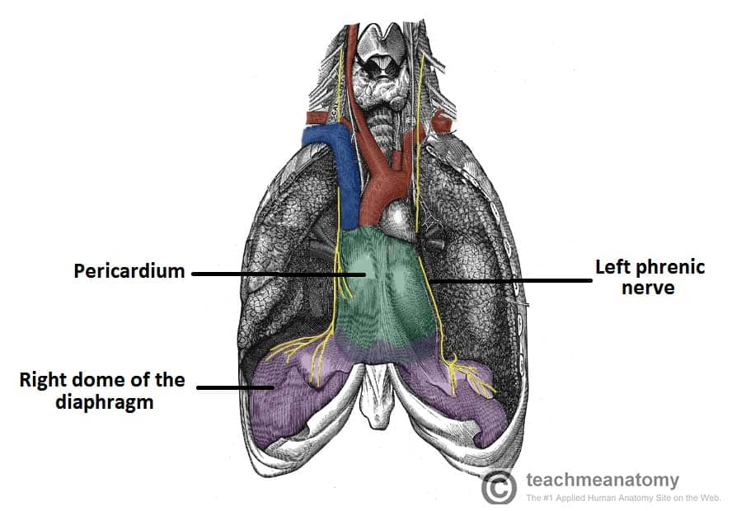

Slide 4
Right Phrenic Nerve in Thorax
Descends along right side of:
  Right brachiocephalic vein
  Superior vena cava
Runs anterior to root of right lung
Accompanied by:
  Pericardiacophrenic vessels
Descends on fibrous pericardium over right atrium
Passes through diaphragm with:
  Inferior vena cava
Traverses caval opening at T8 level

Slide 5
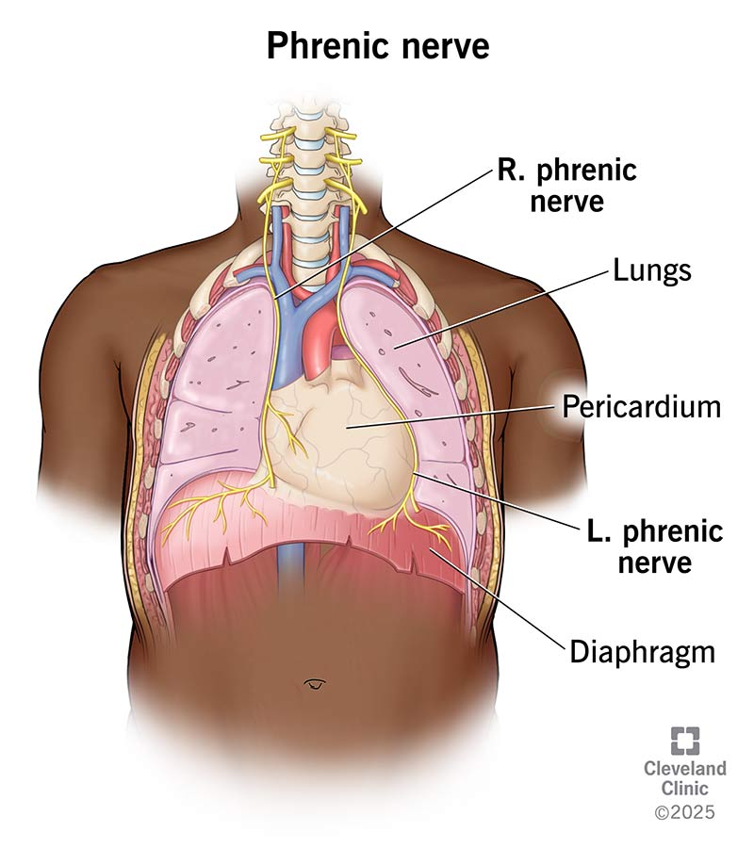

Slide 6
Left Phrenic Nerve in Thorax
Crosses left side of:
  Aortic arch
Passes anterior to root of left lung
Descends on fibrous pericardium over left ventricle
Pierces diaphragm independently
Reaches abdominal surface of diaphragm

Slide 8
Functions of the Phrenic Nerve
Motor Supply
Entire diaphragm
Sensory Supply
Fibrous pericardium
Parietal serous pericardium
Mediastinal pleura
Central diaphragmatic pleura
Central diaphragmatic peritoneum

Slide 10
Clinical Importance of Phrenic Nerve
Diaphragmatic paralysis may result from:
  Neck injury
  Thoracic surgery
  Tumors compressing nerve
Unilateral paralysis:
  Elevation of affected hemidiaphragm
Referred pain:
  Pain referred to shoulder region

Slide 12
Vagus Nerve
Tenth cranial nerve (CN X)
Main parasympathetic nerve of thorax and abdomen
Supplies:
  Heart
  Lungs
  Esophagus
  Gastrointestinal tract (up to proximal two-thirds of transverse colon)
Carries:
  Motor fibers
  Sensory fibers
  Parasympathetic fibers

Slide 13
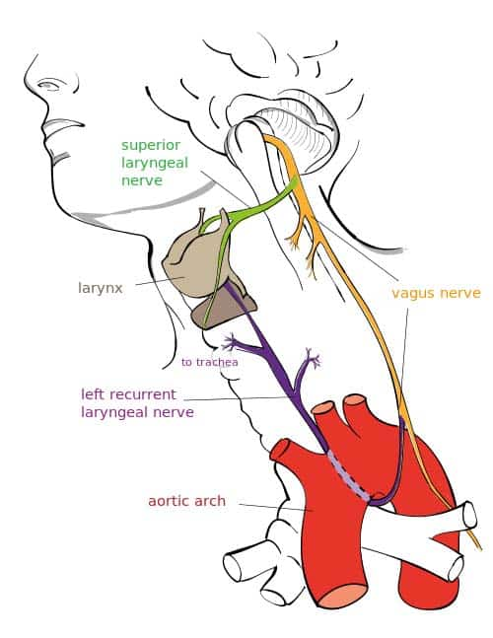

Slide 14
Right Vagus Nerve in Thorax
Enters thorax anterior to right subclavian artery
Gives:
  Right recurrent laryngeal nerve
Descends posterior to:
  Right brachiocephalic vein
  Superior vena cava
Passes posterior to root of right lung
Contributes to:
  Pulmonary plexus
  Esophageal plexus
Forms posterior vagal trunk

Slide 15
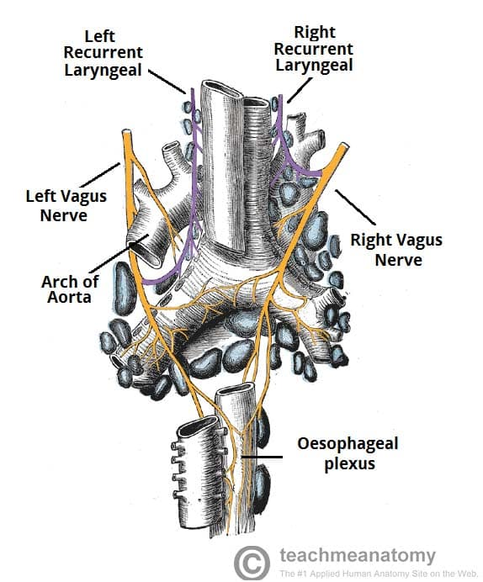

Slide 16
Left Vagus Nerve in Thorax
Crosses left side of aortic arch
Gives:
  Left recurrent laryngeal nerve
Left recurrent laryngeal nerve loops under:
  Arch of aorta
  Lateral to ligamentum arteriosum
Passes posterior to root of left lung
Contributes to:
  Pulmonary plexus
  Esophageal plexus
Forms anterior vagal trunk

Slide 18
Recurrent Laryngeal Nerves
Right Recurrent Laryngeal Nerve
Loops around right subclavian artery
Left Recurrent Laryngeal Nerve
Loops beneath aortic arch
Ascends in tracheoesophageal groove
Functions
Motor supply to most intrinsic laryngeal muscles
Sensory supply below vocal folds

Slide 20
Functions of the Vagus Nerve
Heart
Decreases heart rate
Decreases force of contraction
Lungs
Bronchoconstriction
Increased glandular secretion
Gastrointestinal Tract
Increases peristalsis
Stimulates secretion

Slide 21
Clinical Importance of Vagus Nerve
Injury may cause:
  Hoarseness
  Dysphagia
  Voice changes
Left recurrent laryngeal nerve may be compressed by:
  Aortic aneurysm
  Enlarged lymph nodes
  Mediastinal tumors
Bilateral vagal injury:
  Severe autonomic dysfunction

Slide 23
Sympathetic Trunks
Paired longitudinal nerve trunks
Extend from skull base to coccyx
Located on either side of vertebral column
Components of sympathetic nervous system
Connected to spinal nerves by:
  White rami communicantes
  Gray rami communicantes

Slide 24
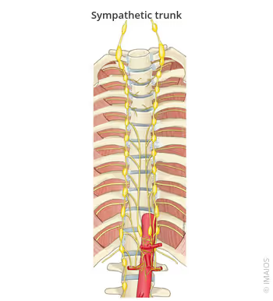

Slide 25
Thoracic Sympathetic Trunk – Position
Lies on heads of ribs in upper thorax
Lies on sides of vertebral bodies in lower thorax
Covered by parietal pleura

Slide 27
Structure of Sympathetic Trunks
Consist of
Sympathetic ganglia
Interganglionic nerve fibers
White Rami Communicantes
Carry preganglionic fibers
Present from T1–L2 spinal levels
Gray Rami Communicantes
Carry postganglionic fibers
Present at all spinal levels

Slide 28
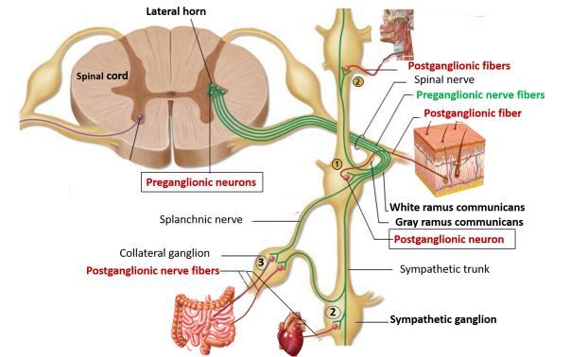

Slide 29
Functions of Sympathetic Trunks
Cardiovascular Effects
Increase heart rate
Increase force of contraction
Respiratory Effects
Bronchodilation
Vascular Effects
Vasoconstriction of many blood vessels
Other Effects
Decreased gastrointestinal activity
Increased sweating
Pupil dilation

Slide 30
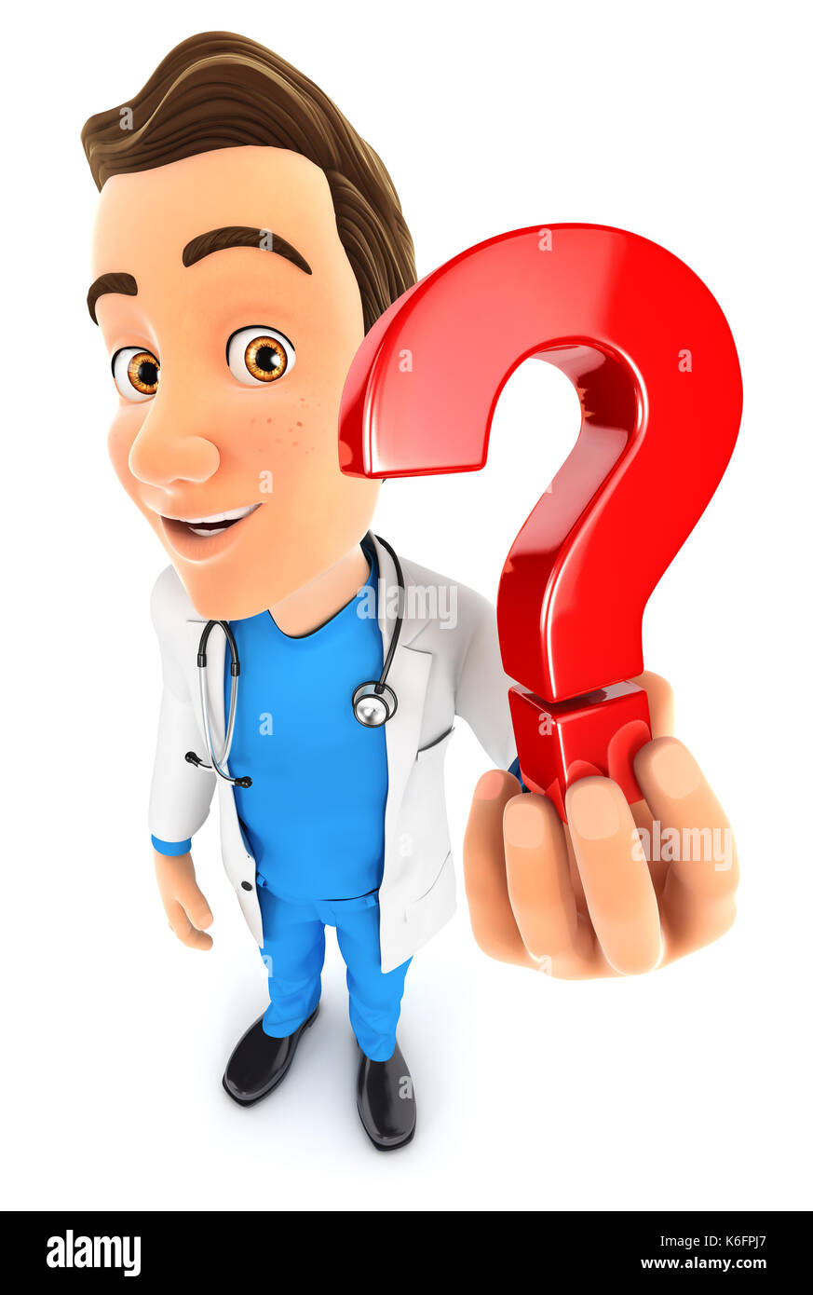

Slide 31


