Slide 1

ANATOMY
THE LOWER LIMB
DPT
2ND SEMESTER
DR DANISH
DPT(S.M.C),MPPTA

Slide 2
Tibial Nerve
Largest terminal branch of the sciatic nerve
Root value: L4, L5, S1, S2, S3
Begins at the superior angle of the popliteal fossa
Descends vertically through the popliteal fossa
Passes deep to the tendinous arch of soleus
Continues in the posterior compartment of the leg
Enters the foot posterior to the medial malleolus through the tarsal tunnel

Slide 3
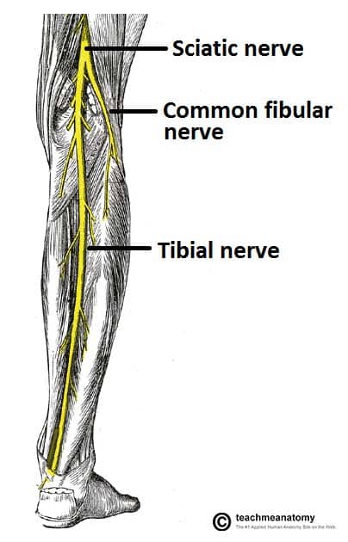

Slide 4
Continued
Terminates by dividing into:
  Medial plantar nerve
  Lateral plantar nerve

Slide 5
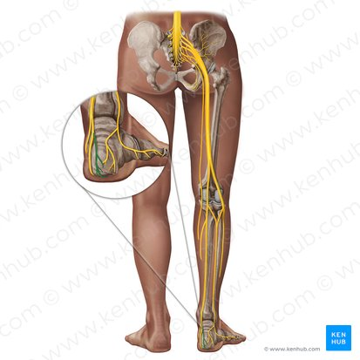

Slide 6
Tibial Nerve – Branches in the Popliteal Fossa
Muscular Branches
Gastrocnemius
Plantaris
Soleus
Popliteus
Articular Branches
To the knee joint
Cutaneous Branch
Medial sural cutaneous nerve

Slide 7
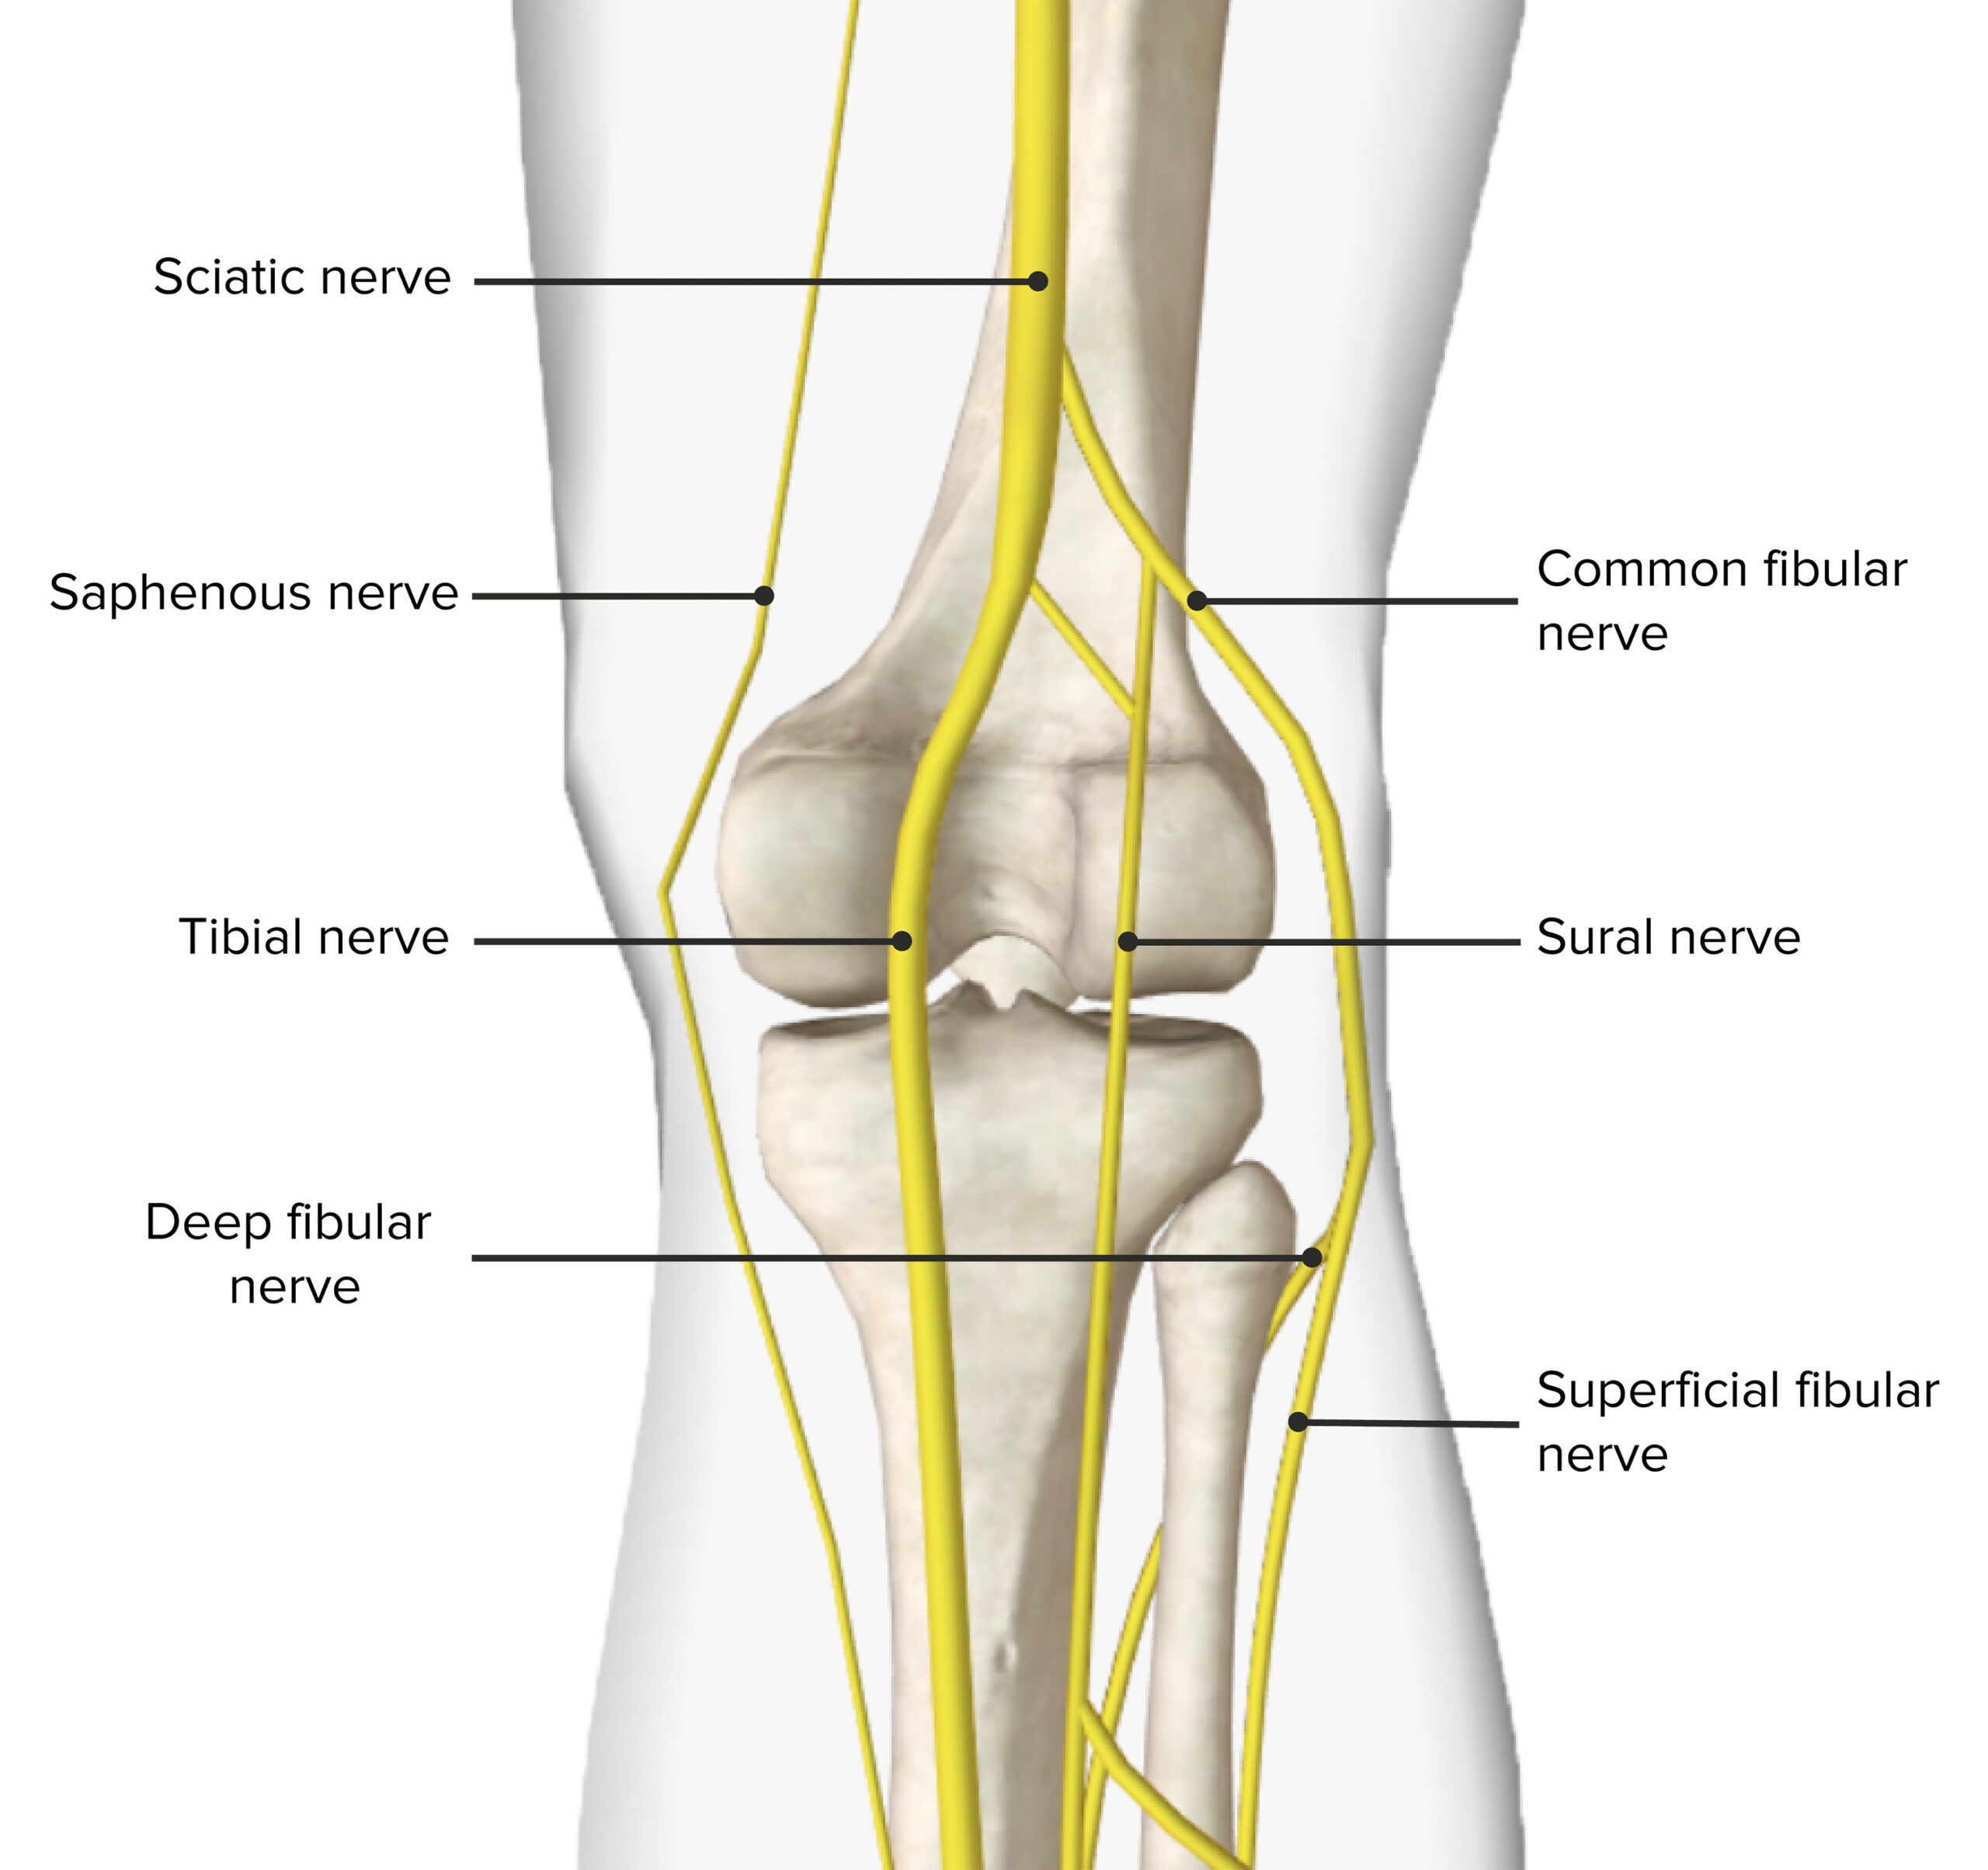

Slide 8
Terminal branches of Tibial Nerve
Medial Plantar Nerve
Larger terminal branch of tibial nerve
Comparable to median nerve of hand
Lateral Plantar Nerve
Smaller terminal branch of tibial nerve
Comparable to ulnar nerve of hand

Slide 10
Common Peroneal (Fibular) Nerve
Smaller terminal branch of sciatic nerve
Root value: L4, L5, S1, S2
Course
Follows medial border of biceps femoris
Winds around neck of fibula
Pierces fibularis longus
Divides into:
  Superficial peroneal nerve
  Deep peroneal nerve

Slide 13
Obturator Nerve
Root Value
L2, L3, L4
Origin
Lumbar plexus

Slide 14
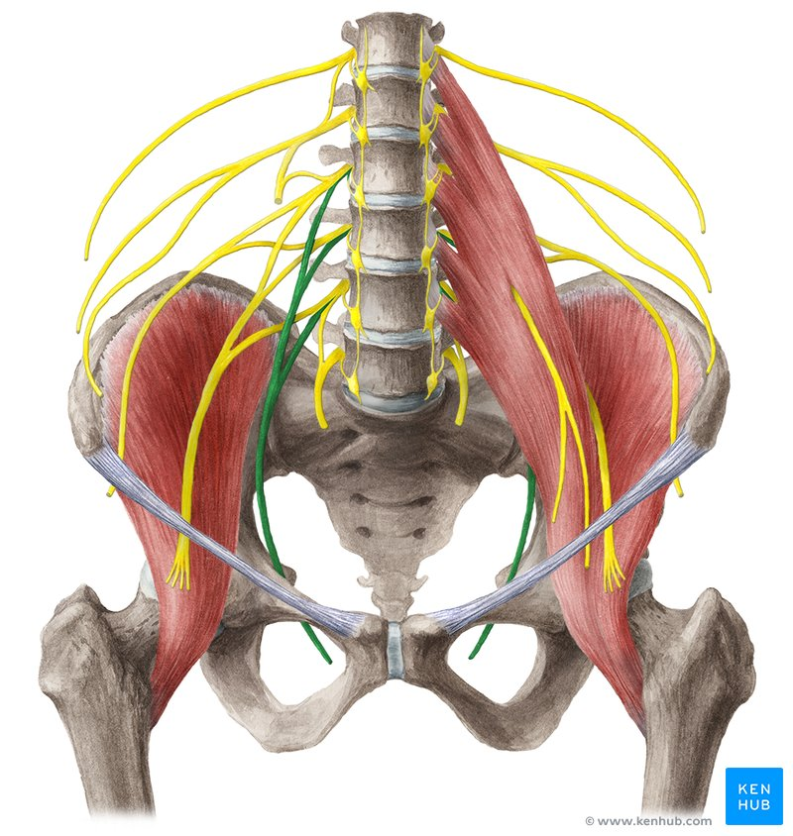

Slide 15
Continued
Course
Emerges from medial border of psoas major
Passes along lateral pelvic wall
Traverses obturator canal
Enters medial compartment of thigh
Divisions
Anterior division
Posterior division

Slide 17


Slide 18


