Slide 1
Applied Science
Fsc Medical Technology

Slide 2
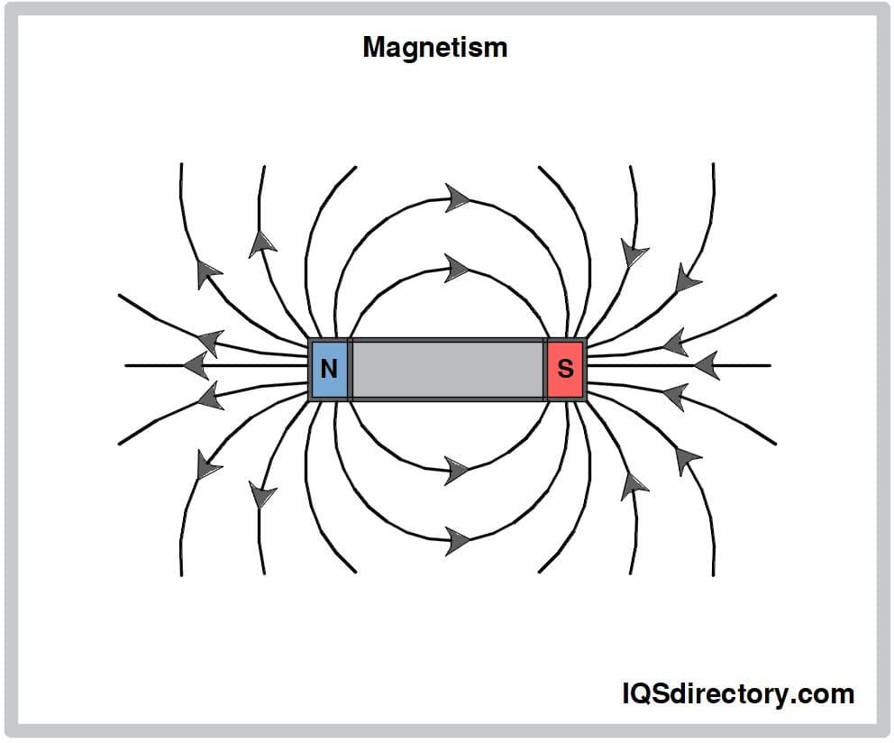
Magnetism and Electromagnetism
Magnetism is a force produced by magnets.
It can attract or repel certain materials like iron,
nickel, and cobalt.
Every magnet has:
  North Pole
  South Pole
Basic Rule
Opposite poles attract.
Like poles repel.

Slide 3
Concept of Magnetic Field
A magnetic field is the invisible region around a magnet where magnetic force can be experienced.
Important Points
The field surrounds every magnet.
Strongest near the poles.
Weakens with distance.
Effects on Nearby Objects
A magnet can:
Attract iron objects
Move compass needles
Influence electric charges

Slide 4
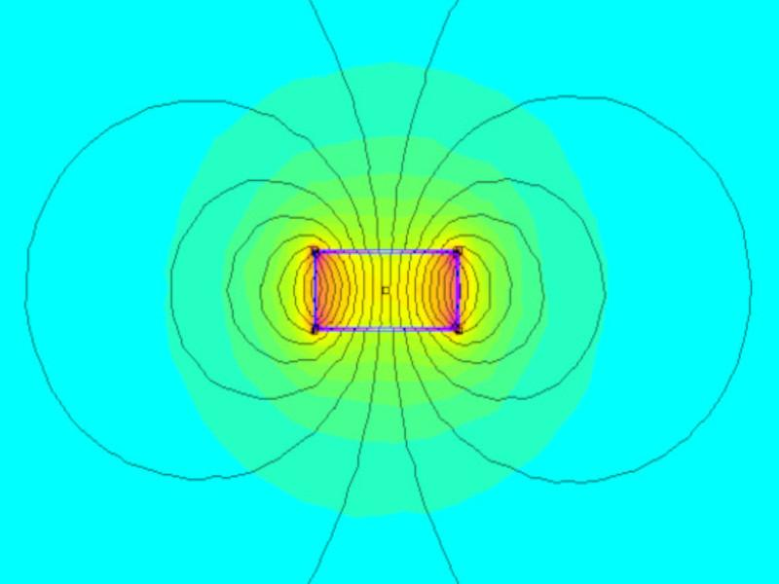
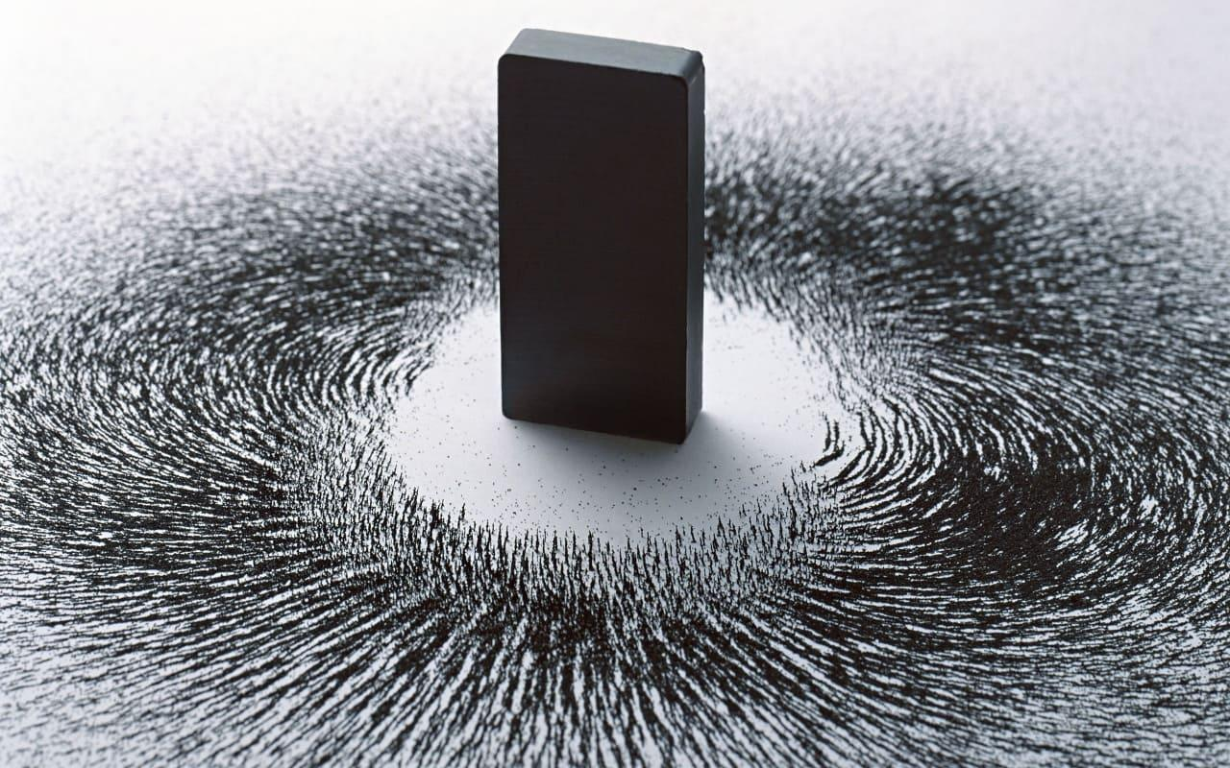
Magnetic Field

Slide 5
How Magnets Influence Space Around Them
Influence of Magnets
Magnets create an invisible force field in surrounding space.
Nearby Objects Experience
Attraction
Repulsion
Alignment with magnetic field
Example
A compass needle aligns with Earth’s magnetic field.
Real-World Applications
Navigation systems , Magnetic locks , Generators , Medical imaging

Slide 6
Magnetic Lines of Force
Definition
Magnetic lines of force are imaginary lines representing a magnetic field.
Characteristics
Originate from North Pole
Enter South Pole
Form closed loops
Never intersect each other
Importance
They help visualize: Direction , Shape , Strength of magnetic field

Slide 7
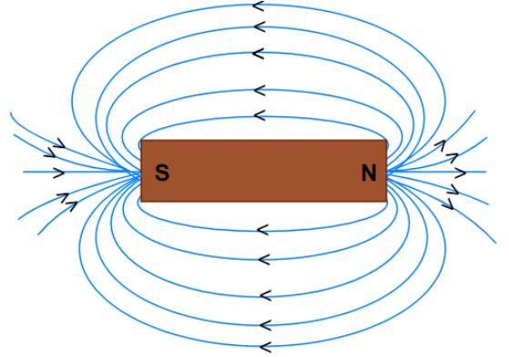
Magnetic Lines

Slide 8
Pattern Formed by Magnetic Field Lines
Field Pattern Around a Bar Magnet
Dense near poles → stronger field
Wider apart away from poles → weaker field
Circular Pattern
Field lines curve from:
North → South outside magnet
South → North inside magnet
Observation Method
Iron filings sprinkled near a magnet show the field pattern.

Slide 9
Direction of Magnetic Field
Direction Rule
Magnetic field direction is:
From North Pole to South Pole outside the magnet
Compass Method
A compass needle points in the direction of magnetic field lines.
Right-Hand Thumb Rule
Used for current-carrying conductors:
Thumb → current direction
Curled fingers → magnetic field direction

Slide 10
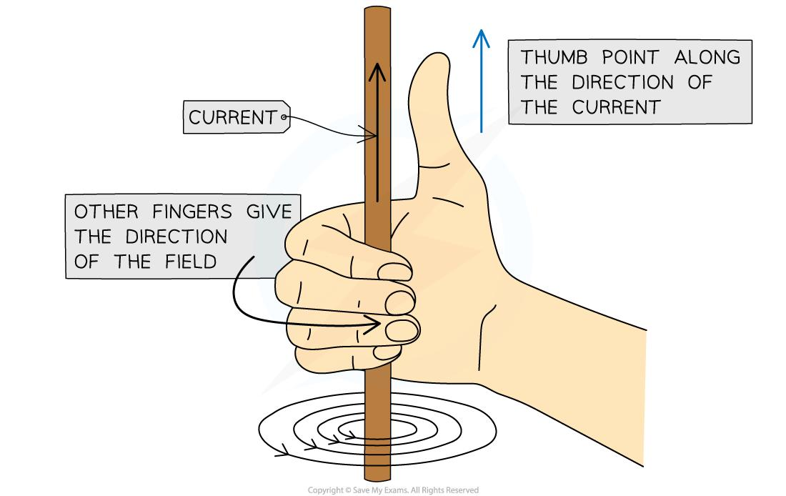
Thumb Rule

Slide 11
Strength of Magnetic Field
Factors Affecting Magnetic Field Strength
Distance from magnet
Size of magnet
Material of magnet
Electric current magnitude
Strong Field: Lines close together
Weak Field: Lines spread apart
Measurement Unit
Magnetic field strength is measured in: Tesla (T)

Slide 12
Introduction to Electromagnetism
Electromagnetism
Electromagnetism is the relationship between electricity and magnetism.
Principle
Electric current flowing through a conductor creates a magnetic field.
Discovery
Discovered by Hans Christian Ørsted
Key Idea
Electricity can produce magnetism.

Slide 13
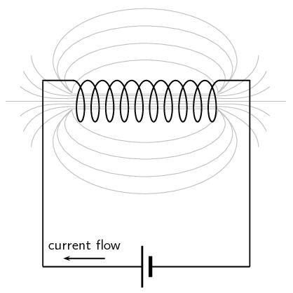
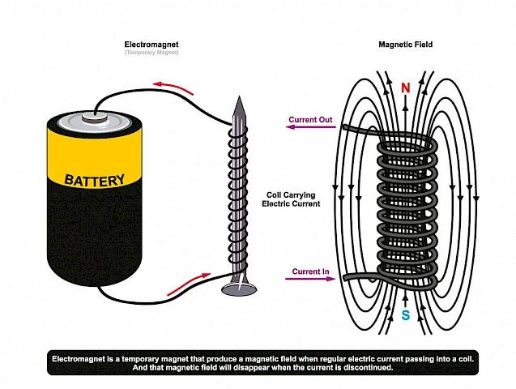

Slide 14
Magnetic Field Around a Current-Carrying Wire
Observation
When electric current passes through a wire:
Circular magnetic field forms around the wire.
Direction
Determined by Right-Hand Thumb Rule.
Stronger Magnetic Field Produced By
Increasing current
Coiling the wire
Using iron core

