Slide 1
Applied Science
Fsc Medical Technology
Awais Hamza

Slide 2
Concept of Sound Absorption
Sound absorption is the process in which a material takes in sound energy instead of reflecting it back into the surroundings. When sound waves strike a surface, part of the energy may be:
Reflected back
Absorbed by the material
Transmitted through the material
Soft and porous materials absorb more sound because they trap sound vibrations and convert them into small amounts of heat.

Slide 3
Materials and Surfaces that Absorb Sound
Common Sound-Absorbing Materials
Carpet , Curtains , Foam
Cotton ,Wool
Acoustic panels ,Cushioned furniture
Why They Absorb Sound
They are soft
They contain tiny air spaces
They reduce vibration reflections

Slide 4
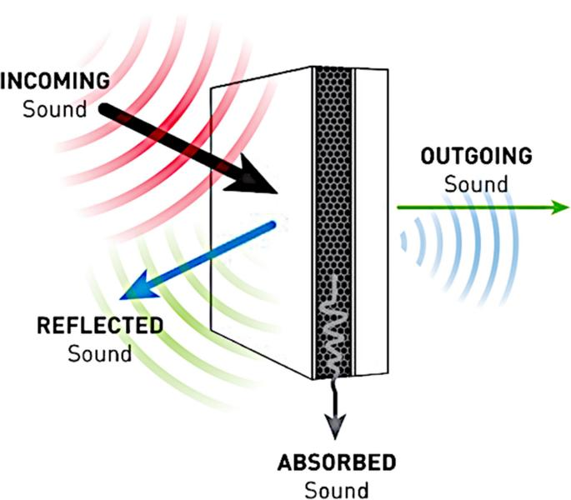
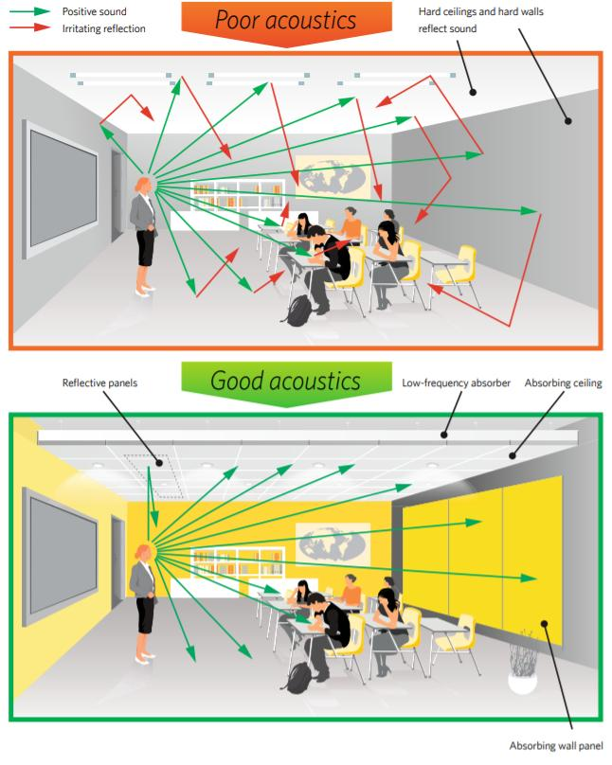

Slide 5
Materials and Surfaces that Reflect Sound
Common Sound-Reflecting Materials
Concrete walls , Metal sheets
Glass , Tiles , Marble
Why They Reflect Sound
They are hard and smooth
Sound waves bounce back easily from them

Slide 6
Echoes
An echo is a distinct repetition of sound caused by the reflection of sound waves from a distant surface.
Definition
An echo occurs when reflected sound is heard separately from the original sound.
Conditions for Hearing an Echo
The reflecting surface must be far enough away.
The reflected sound should return after at least 0.1 second.

Slide 7

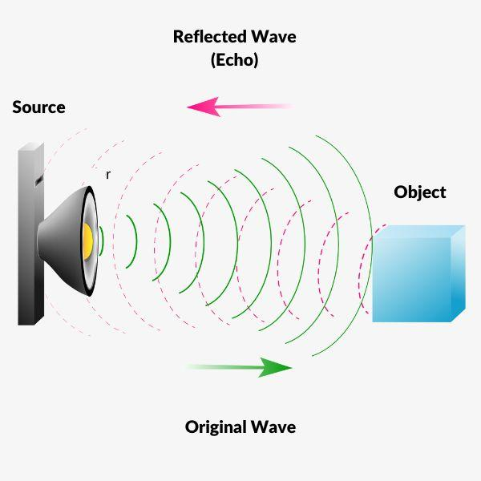

Slide 8
Atomic Structure
Atomic structure refers to the arrangement of tiny particles inside an atom. An atom is the basic building block of matter.
Main Parts of an Atom
An atom contains three main subatomic particles:
Particle | Charge | Location
Electron | Negative (−) | Around the nucleus
Proton | Positive (+) | Inside the nucleus
Neutron | No charge (0) | Inside the nucleus

Slide 9
Arrangement of Electrons, Protons, and Neutrons
Nucleus
The center of the atom is called the nucleus.
It contains: Protons , Neutrons
The nucleus is dense and positively charged because of protons.
Electrons
Electrons move around the nucleus in energy levels or shells. These shells are arranged at different distances from the nucleus.
Example:
First shell → maximum 2 electrons
Second shell → maximum 8 electrons
Third shell → maximum 18 electrons

Slide 10
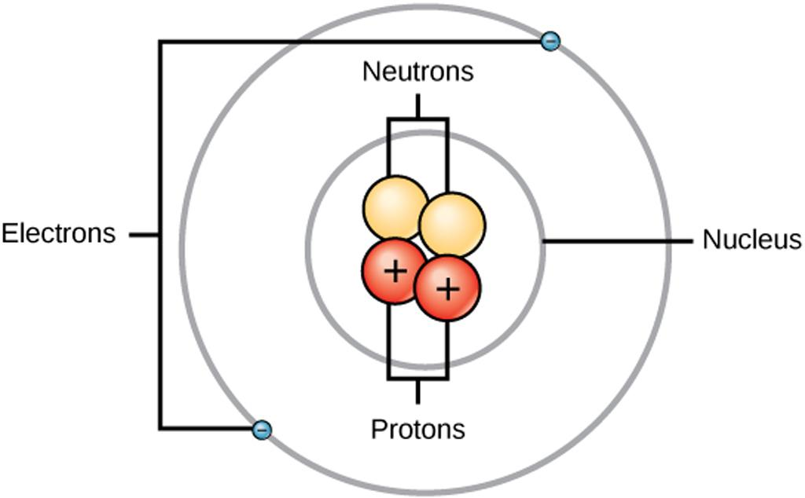
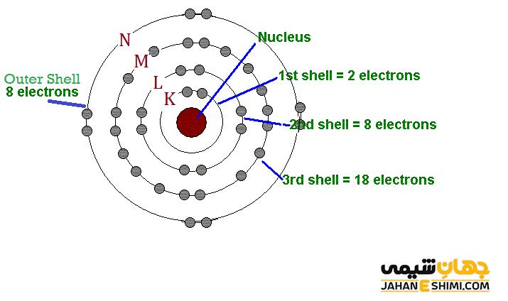

Slide 11
Role of Atomic Structure in Electric Conductivity
Electric conductivity is the ability of a material to allow electric current to flow.
The conductivity of a material mainly depends on its electrons, especially the outermost electrons called valence electrons.
Conductors: Materials like copper, silver, and aluminum are good conductors because: Their outer electrons are loosely bound.
Electrons can move easily from one atom to another.
Insulators
Materials like rubber, plastic, and glass are poor conductors because: Their electrons are tightly bound. Electrons cannot move freely.
Semiconductors
Materials such as silicon and germanium have conductivity between conductors and insulators.

Slide 12
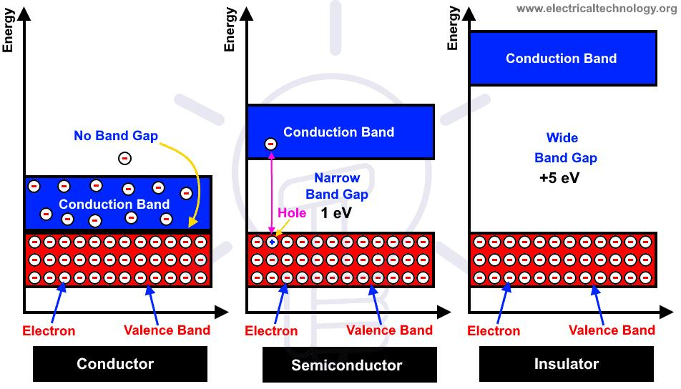
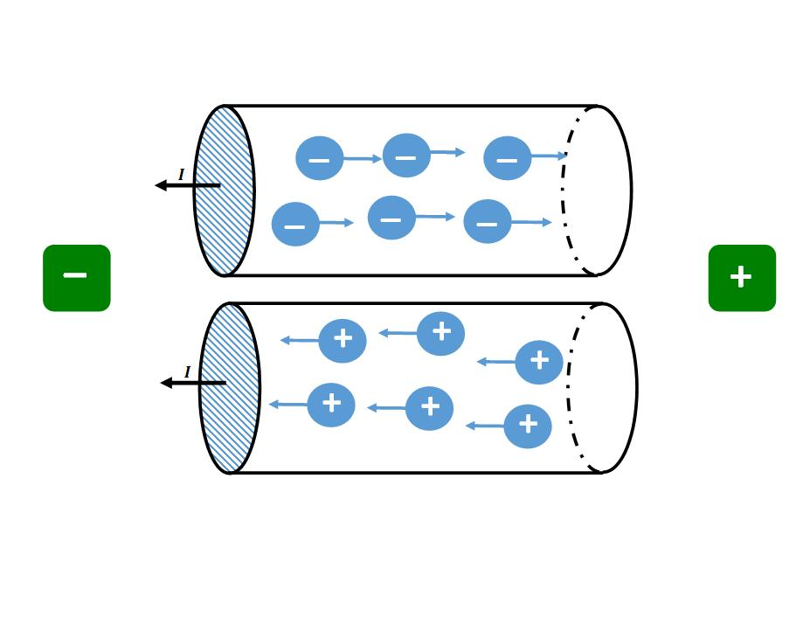

Slide 13
Concept of Free Electrons in Conductive Materials
Free electrons are electrons that are not tightly attached to a single atom and can move freely within a material.
In metals: Outer electrons easily leave their atoms.
These moving electrons are called free electrons.
These free electrons form an “electron cloud” inside the metal.
Importance of Free Electrons
They are responsible for:
Electric current
Heat conduction
High electrical conductivity in metals

Slide 14
Mobility of Free Electrons
Electron mobility means the ease with which free electrons move through a material.
When a voltage is applied:
An electric field is created.
Free electrons begin moving toward the positive terminal.
Their movement produces electric current.
Factors Affecting Mobility
Temperature
Type of material
Number of impurities
Crystal structure of the conductor
Higher temperature usually causes more collisions and lowers mobility.

Slide 15
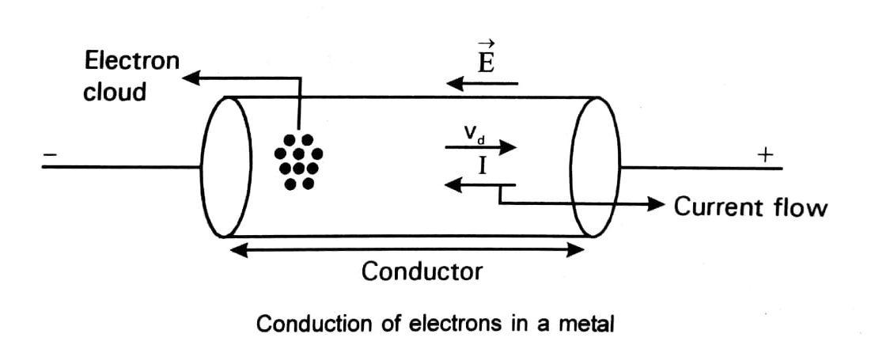

Slide 16
Contribution of Free Electrons to Electric Current
Electric current is the flow of electric charge.
In metallic conductors:
Free electrons move continuously when voltage is applied.
Their directed movement forms electric current.
Direction of Current
Electrons actually move from negative to positive.
Conventional current is considered from positive to negative.
Example
In a copper wire connected to a battery: Battery creates electric field. Free electrons start drifting.
Electric current flows through the wire.

Slide 17
Difference Between Conductors and Insulators
Conductors | Insulators
Allow electric current to pass easily | Resist the flow of electric current
Have many free electrons | Have very few or no free electrons
Low electrical resistance | High electrical resistance
Electrons move freely | Electrons are tightly bound
Used for wiring and electrical circuits | Used for protection and covering wires

Slide 18
Examples of Conductors
Copper , Aluminum
Silver , Gold
Iron , Graphite
Mercury
Common Uses
Electrical wires
Motors
Circuits
Electrical appliances

Slide 19
Insulators
Insulators are materials that do not allow electric current to pass through easily.
Why Insulators Resist Electricity
Their electrons are tightly attached to atoms.
They do not have free-moving electrons.
Examples of Insulators
Rubber , Plastic
Glass , Wood (dry)
Air , Paper
Porcelain

Slide 20
Identifying Conductors and Insulators
Materials Usually Considered Conductors
Metals
Most metals are good conductors:
Copper , Silver
Aluminum , Gold
Non-Metal Conductors
Some non-metals can also conduct:
Graphite
Salt water
Human body

Slide 21
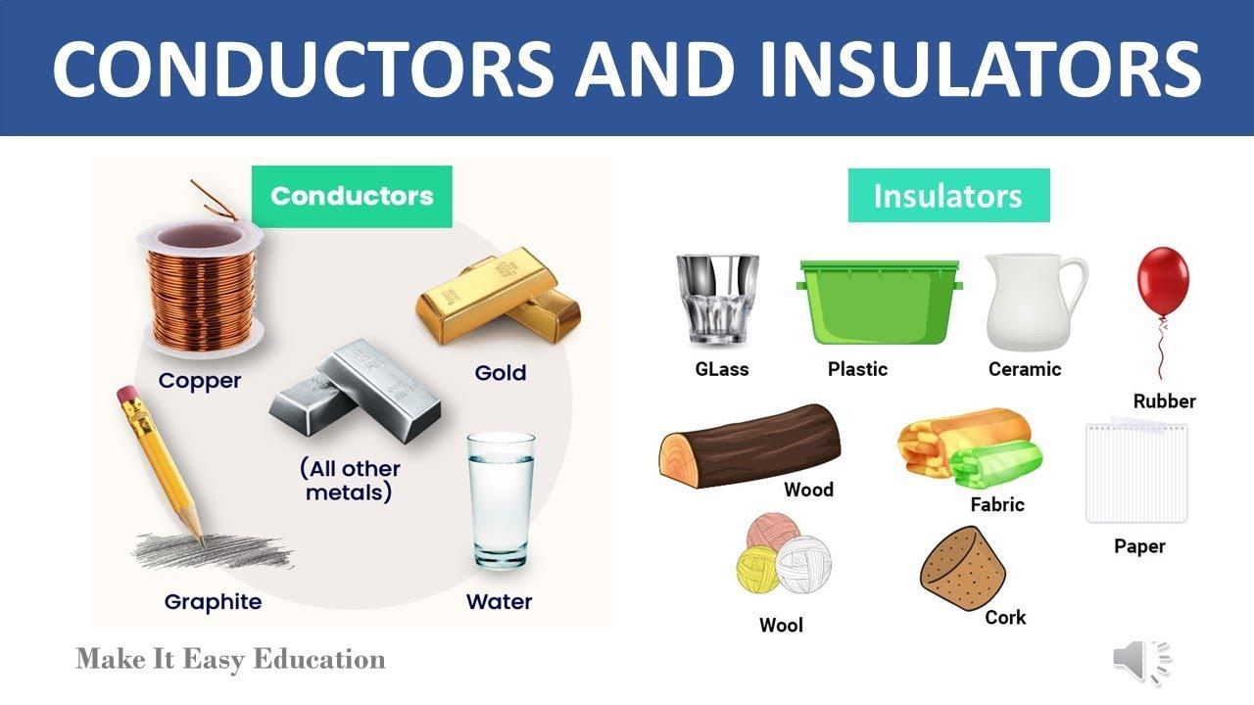

Slide 22
Electric Current
Electric current is the flow of electric charge through a conductor.
In most electrical circuits, the charge is carried by electrons moving through a wire.
Definition
Electric current is the rate at which electric charge flows through a conductor.
I=Q/t Where:
I = electric current
Q = electric charge
t= time

Slide 23
Direction of Current Flow
Electron Flow
Electrons move from the negative terminal to the positive terminal.
Conventional Current
By convention, current is considered to flow from the positive terminal to the negative terminal.
Although electron flow is opposite, conventional current direction is used in circuit diagrams.

Slide 24
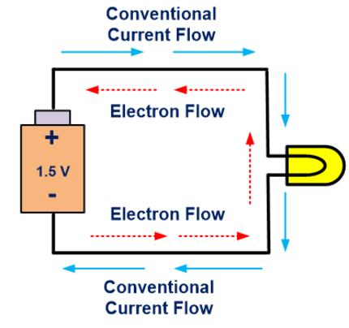
Conventional current flow

Slide 25
Measurement of Current
The SI unit of electric current is the ampere (A).
Meaning of One Ampere
One ampere means one coulomb of charge flows per second.
1 A=1 Cs
Instrument Used
Current is measured using an ammeter.
Ammeter is connected in series with the circuit.

Slide 26
Potential Difference (Voltage)
Potential difference is the work done to move a unit charge from one point to another in a circuit.
It is also called voltage.
Definition
Potential difference is the amount of energy supplied per unit charge.
V=W/Q
Where:
V= potential difference
W = work done or energy
Q = charge
Unit
The SI unit is the volt (V).

Slide 27
Unit
The SI unit is the volt (V).
Meaning of One Volt
One volt means one joule of energy is used to move one coulomb of charge.
1 V=1 JC1\,V = 1\,\frac{J}{C}1V=1CJ​
Instrument Used
Potential difference is measured using a voltmeter.
Voltmeter is connected in parallel across a component.

