Slide 1
Applied Science
Fsc Medical Technology
Awais Hamza

Slide 2
Calorimeter (Physics – Heat)
A calorimeter is a device used to measure heat energy gained or lost during a physical or chemical process.
It helps us study:
Heat transfer
Specific heat capacity
Latent heat
Heat produced in reactions
Heat exchange between substances

Slide 3
Simple Idea of Calorimeter
A calorimeter works on the principle:
Heat lost by the hot object = Heat gained by the cold object
This is based on the law of conservation of energy.
If no heat escapes outside:
Q lost= Q gained

Slide 4
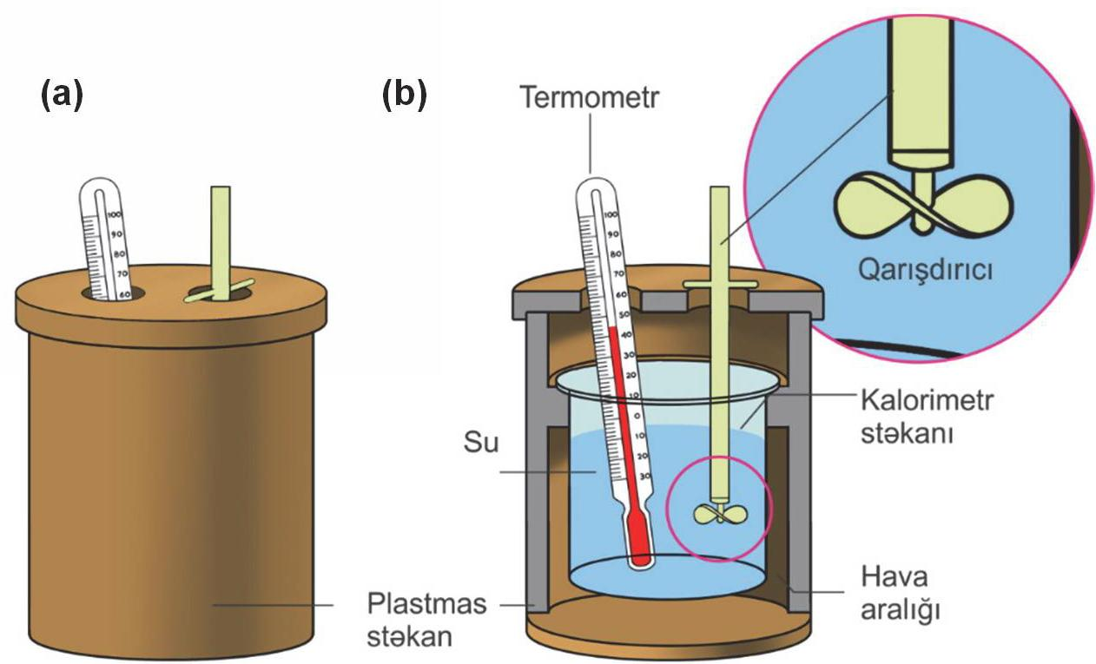
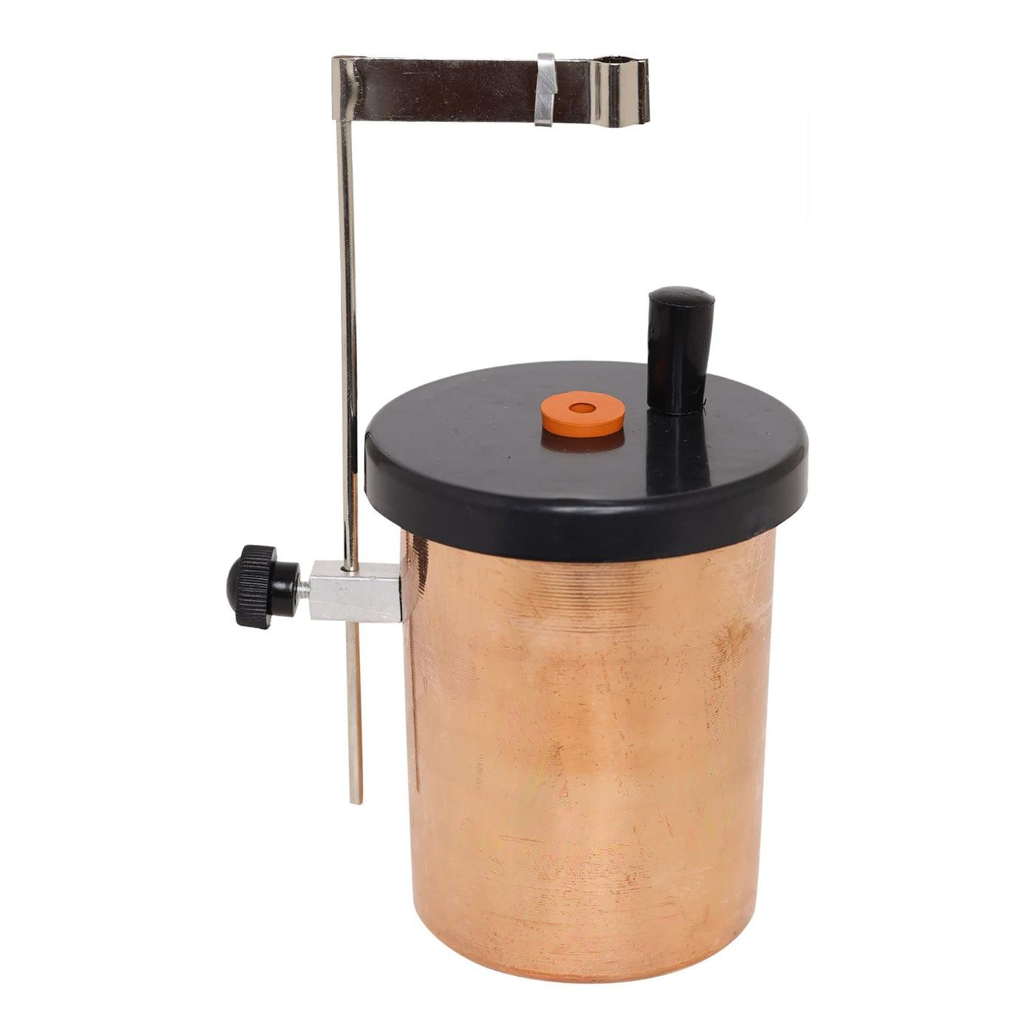

Slide 5
Main Parts of a Calorimeter
A simple calorimeter usually contains:
Metal container (Copper or Aluminum) : Holds the substance or water .Good conductor of heat
Insulating outer jacket : Prevents heat loss to surroundings
Thermometer : Measures temperature changes
Lid :Reduces heat escape
Stirrer :Ensures uniform temperature

Slide 6
Working of a Simple Calorimeter
Suppose:
Hot metal is placed into cold water.
Step-by-step:
Measure mass of water
Record initial water temperature
Heat metal separately
Put hot metal into calorimeter
Stir gently
Measure final temperature

Slide 7
Light as Electromagnetic Radiation
Light is a form of electromagnetic radiation that can travel through space without needing a material medium.
More specifically: Light consists of oscillating electric and magnetic fields that travel together in the form of waves.

Slide 8
Definition
Simple Definition
Light is electromagnetic energy visible to the human eye.
Physics Definition
Light is a transverse electromagnetic wave made of vibrating electric and magnetic fields moving through space.

Slide 9
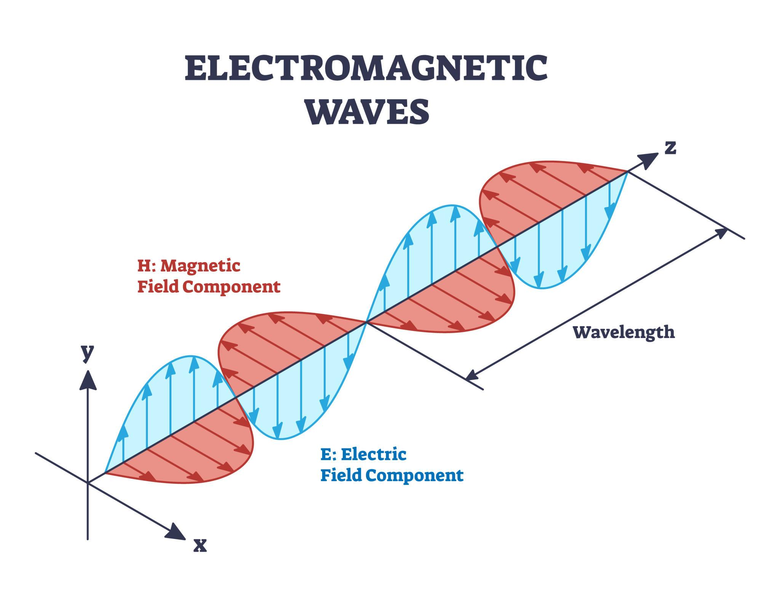

Slide 10
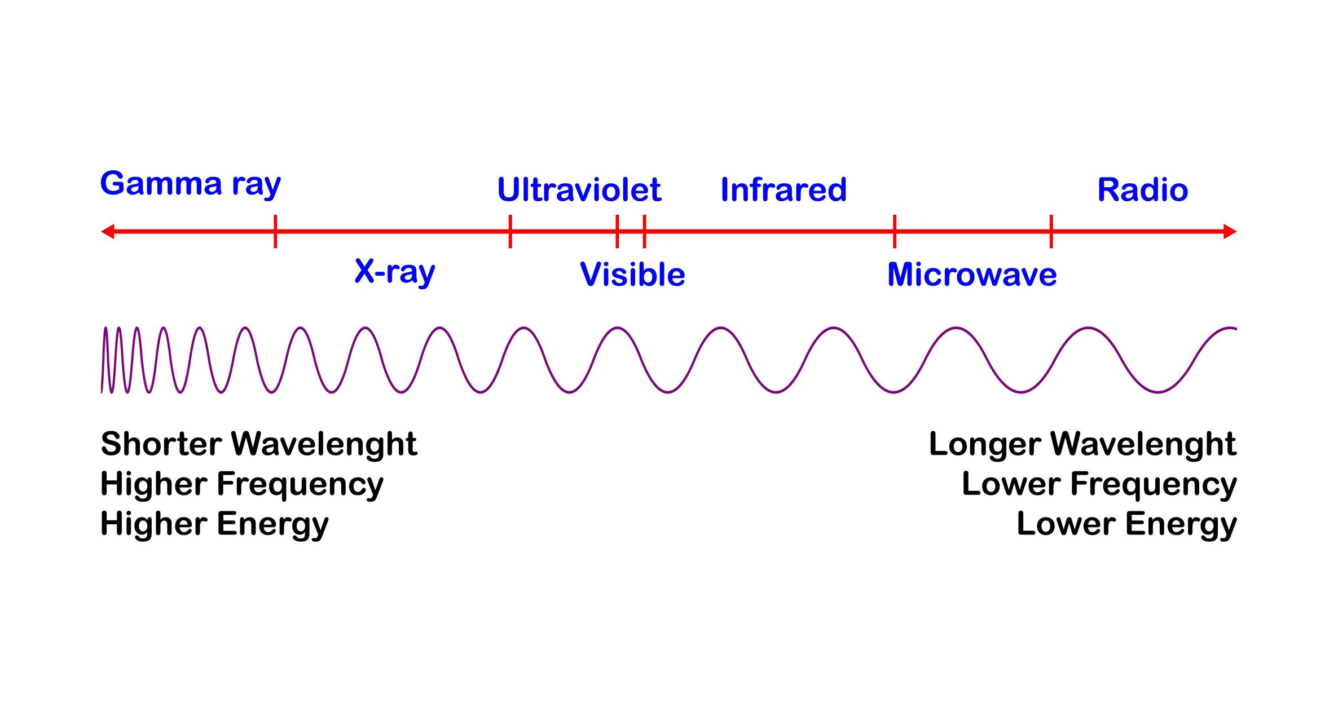

Slide 11
In light waves:
Electric field vibrates in one direction
Magnetic field vibrates perpendicular to it
Both are perpendicular to direction of travel
This makes light a transverse wave.

Slide 12
Key Characteristics of Light as EM Radiation
Property | Description
Nature | Electromagnetic wave
Type | Transverse wave
Needs medium? | No
Speed in vacuum | (3* 10^8 , m/s)
Produced by | Accelerating charged particles
Carries | Energy

Slide 13
Light is part of the electromagnetic spectrum, which includes
Radio waves
Microwaves
Infrared
Visible light
Ultraviolet
X-rays
Gamma rays
Visible light is only a small portion of the spectrum.

