Slide 1

ANATOMY
THE LOWER LIMB
DPT
2ND SEMESTER
DR DANISH
DPT(S.M.C),MPPTA

Slide 2
Obturator Nerve & Obturator Artery
Obturator Nerve
Origin
Arises from lumbar plexus
Root value: L2, L3, L4
Emerges from medial border of psoas major

Slide 3
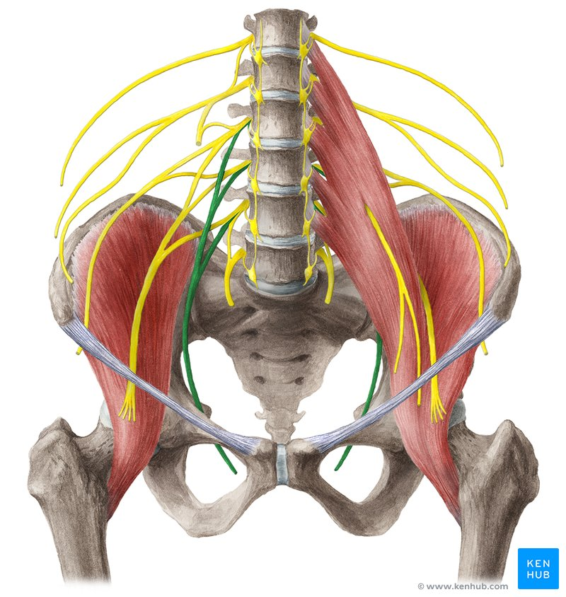

Slide 4
CONTINUED
Course
Passes through pelvis along lateral pelvic wall
Travels with obturator vessels
Enters thigh via obturator canal
Divides into:
  Anterior division
  Posterior division

Slide 5
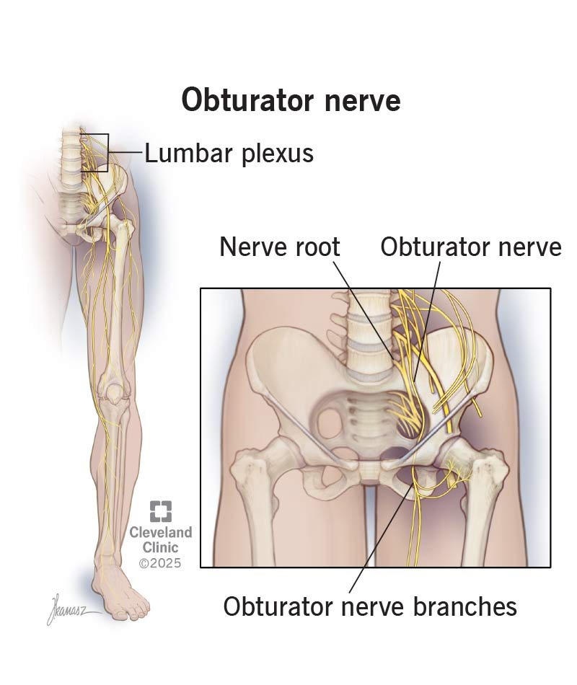

Slide 6
Relations
Lies:
  Lateral to internal iliac vessels
  Inferior to pelvic brim
In thigh:
  Anterior division between adductor longus & adductor brevis
  Posterior division between adductor brevis & adductor magnus

Slide 7
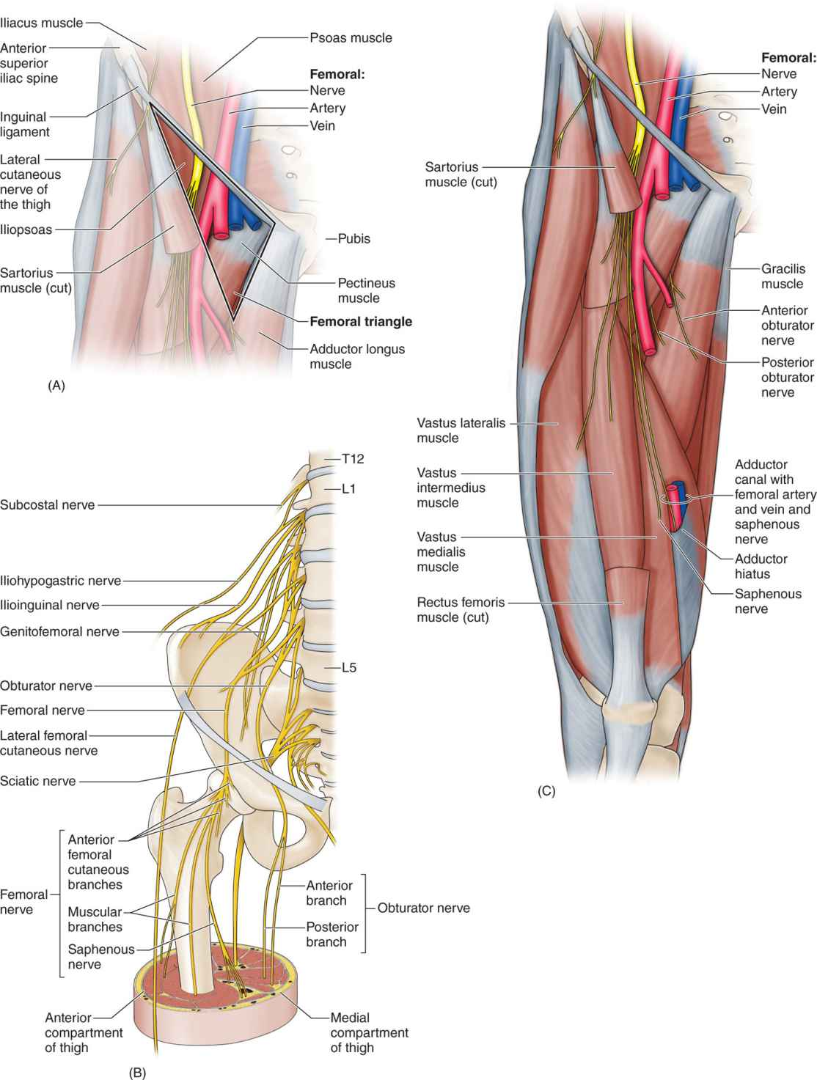

Slide 8
Obturator Artery
Origin
Usually arises from:
  Anterior division of internal iliac artery
Course
Runs along lateral pelvic wall
Accompanied by obturator nerve & vein
Passes through obturator canal
Enters medial compartment of thigh

Slide 9
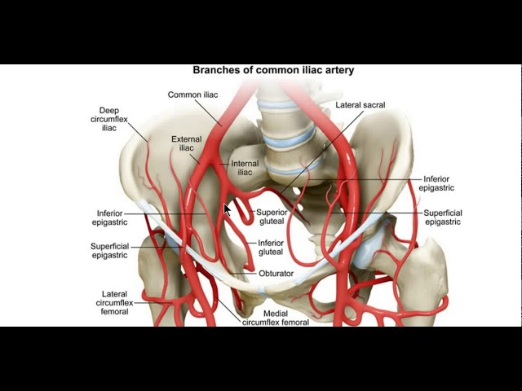

Slide 10
CONTINUED
Branches
Muscular branches
Acetabular branch to hip joint
Pubic branch
Distribution
Supplies:
  Medial thigh muscles
  Hip joint
  Head of femur (via acetabular branch)

Slide 12
Muscles of Posterior Fascial Compartment of Thigh
Biceps Femoris
Semitendinosus
Semimembranosus
Adductor Magnus (Hamstring Portion)

Slide 13
Biceps Femoris
Origin
Long head: Ischial tuberosity
Short head: Linea aspera and supracondylar ridge of shaft of femur
Insertion
Head of fibula
Nerve Supply
Long head: Tibial portion of sciatic nerve
Short head: Common fibular portion of sciatic nerve

Slide 14
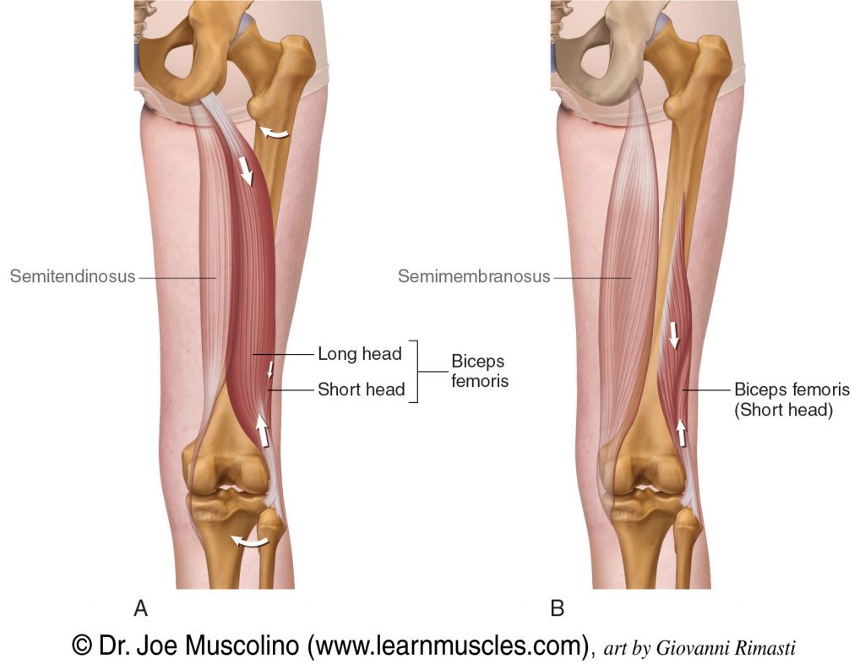

Slide 15
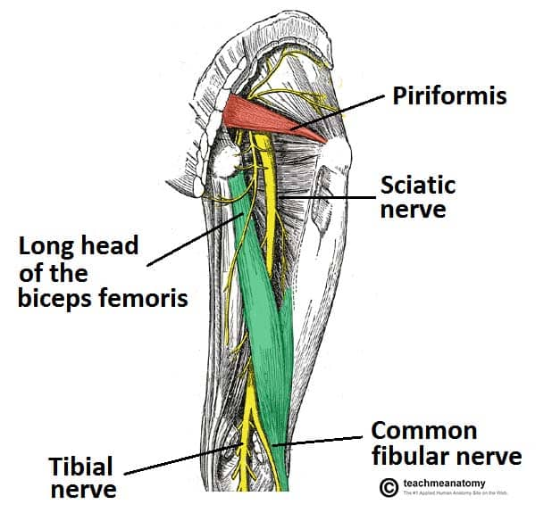

Slide 16
Continued
Nerve Root
L5, S1, S2
Action
Flexes and laterally rotates leg at knee joint
Long head also extends thigh at hip joint

Slide 17
Semitendinosus
Origin
Ischial tuberosity
Insertion
Upper part of medial surface of shaft of tibia
Nerve Supply
Tibial portion of sciatic nerve

Slide 18
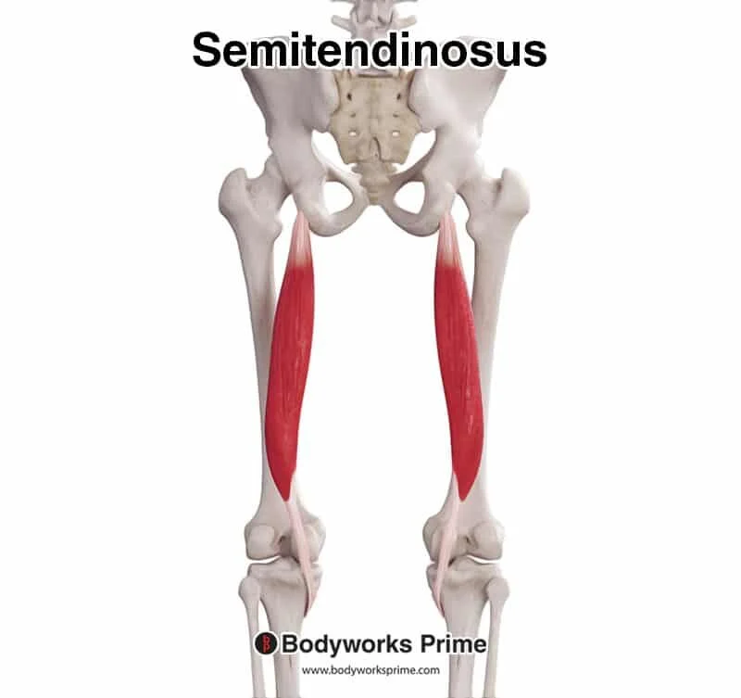

Slide 19
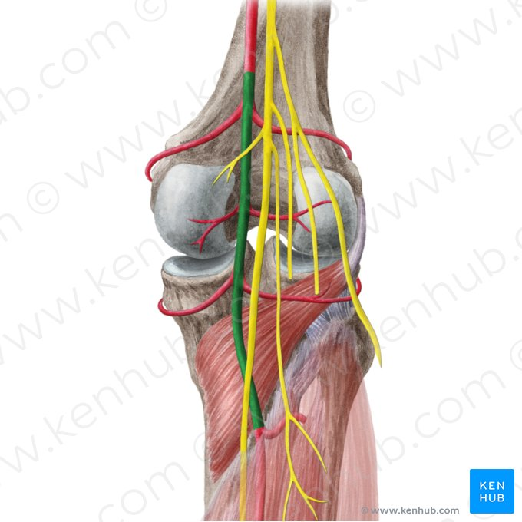

Slide 20
Continued
Nerve Root
L5, S1, S2
Action
Flexes and medially rotates leg at knee joint
Extends thigh at hip joint

Slide 21
Semimembranosus
Origin
Ischial tuberosity
Insertion
Medial condyle of tibia
Nerve Supply
Tibial portion of sciatic nerve

Slide 22
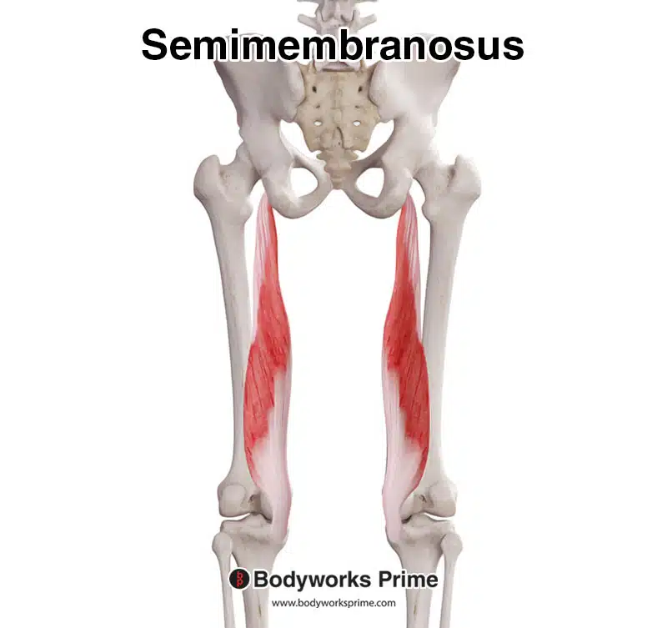

Slide 24
Continued
Nerve Root
L5, S1, S2
Action
Flexes and medially rotates leg at knee joint
Extends thigh at hip joint

Slide 25
Adductor Magnus (Hamstring Portion)
Origin
Ischial tuberosity
Insertion
Adductor tubercle of femur
Nerve Supply
Tibial portion of sciatic nerve
Nerve Root
L4, L5, S1
Action
Extends thigh at hip joint

Slide 26
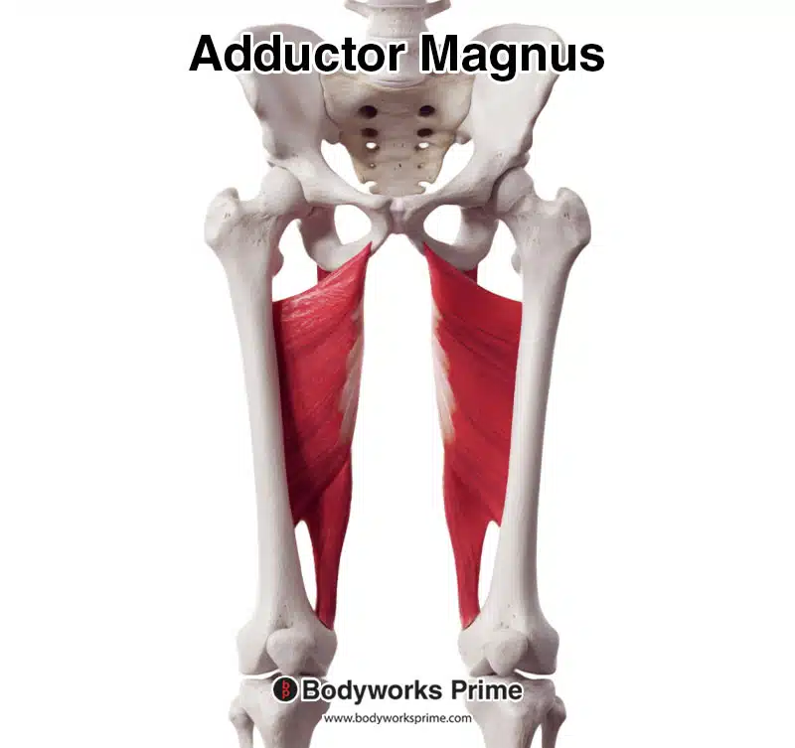

Slide 27


Slide 28


