Slide 1

ANATOMY
THE THORAX
BS RIT,OTT
2ND SEMESTER
DR DANISH
DPT(S.M.C),MPPTA

Slide 2
Great Thoracic Arteries and Veins
Great Thoracic Arteries
Ascending aorta
Arch of aorta
Descending thoracic aorta
Pulmonary trunk
Pulmonary arteries

Slide 3
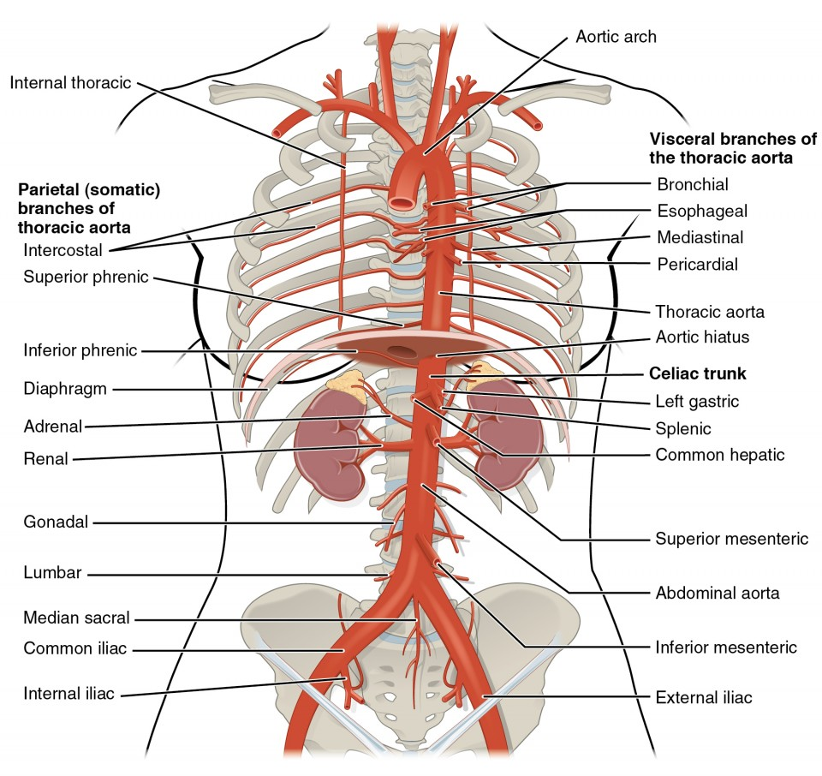

Slide 4
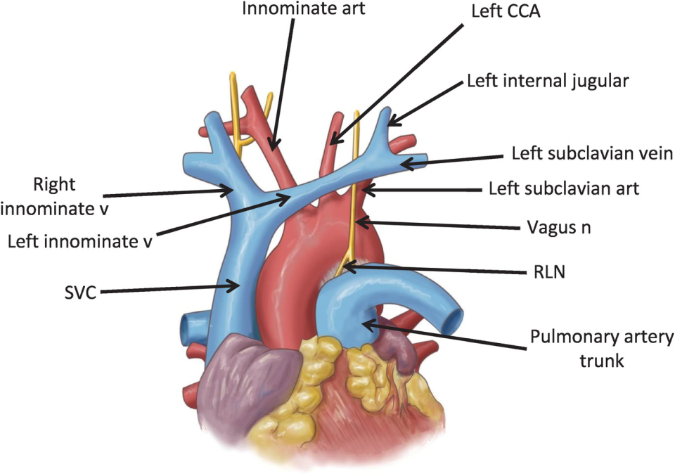

Slide 5
CONTINUED
Great Thoracic Veins
Superior vena cava
Inferior vena cava
Brachiocephalic veins
Azygos venous system
Pulmonary veins

Slide 6
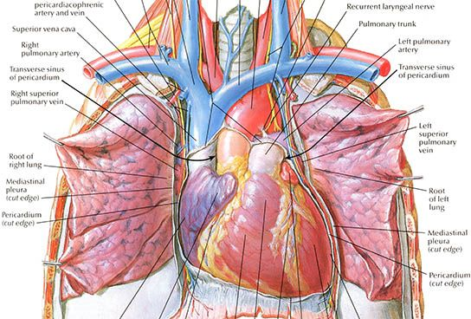

Slide 7
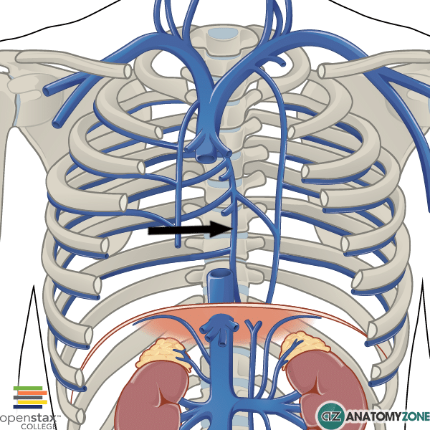

Slide 8
Ascending Aorta
Origin
Begins at aortic orifice of left ventricle
Course
Ascends upward, forward, and to the right
Located within fibrous pericardium
Lies in middle mediastinum

Slide 9
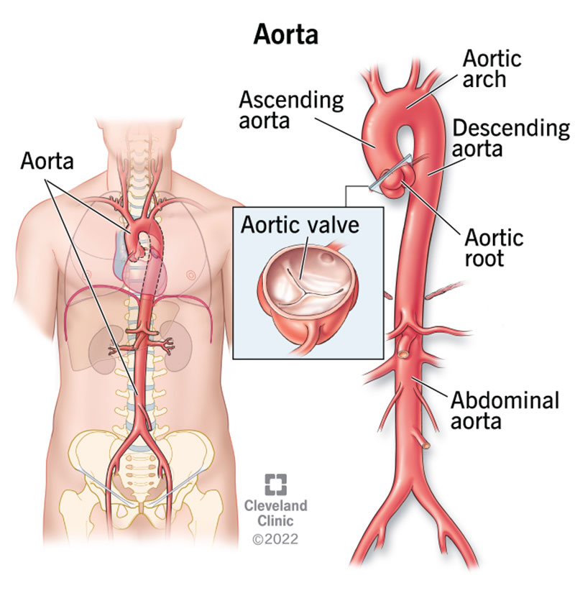

Slide 10
CONTINUED
Termination
Continues as arch of aorta behind right 2nd sternocostal joint
Branches
Right coronary artery
Left coronary artery

Slide 11
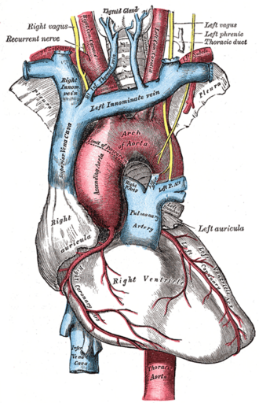

Slide 13
Relations of Ascending Aorta
Anterior
Pulmonary trunk
Right auricle
Pericardium
Posterior
Left atrium
Right pulmonary artery

Slide 15
CONTINUED
Right Side
Superior vena cava
Left Side
Pulmonary trunk

Slide 16
Clinical Importance of Ascending Aorta
Aortic aneurysm
Aortic dissection
Aortic valve stenosis
Coronary artery disease near aortic root

Slide 17
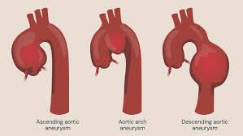

Slide 18
Arch of Aorta
Beginning
Behind right 2nd sternocostal joint
Course
Passes upward, backward, and to the left
Arches over root of left lung
Termination
Continues as descending thoracic aorta at lower border of T4 vertebra

Slide 20
Branches of Arch of Aorta
1. Brachiocephalic Trunk
Divides into:
  Right common carotid artery
  Right subclavian artery
2. Left Common Carotid Artery
3. Left Subclavian Artery

Slide 21
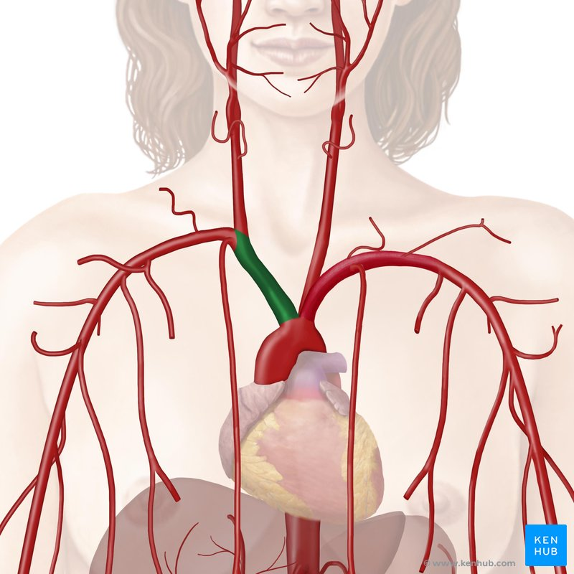

Slide 22
Relations of Arch of Aorta
Anterior and Left
Left vagus nerve
Left phrenic nerve
Left lung and pleura
Inferior
Left main bronchus
Pulmonary trunk
Left recurrent laryngeal nerve

Slide 24
CONTINUED
Posterior and Right
Trachea
Esophagus
Thoracic duct

Slide 25
Descending Thoracic Aorta
Beginning
Lower border of T4 vertebra
Course
Descends through posterior mediastinum
Initially left of vertebral column
Approaches midline inferiorly
Termination
Passes through aortic hiatus at T12
Continues as abdominal aorta

Slide 28
Branches of Descending Thoracic Aorta
Visceral Branches
Bronchial arteries
Esophageal arteries
Pericardial branches
Mediastinal branches
Parietal Branches
Posterior intercostal arteries
Subcostal arteries
Superior phrenic arteries

Slide 30
Pulmonary Trunk
Origin
Arises from right ventricle
Course
Ascends upward, backward, and to the left
Lies within fibrous pericardium
Termination
Divides into right and left pulmonary arteries below arch of aorta
Function
Carries deoxygenated blood to lungs

Slide 31
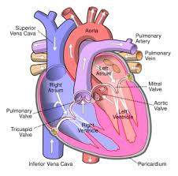

Slide 32
Right Pulmonary Artery
Features
Longer than left pulmonary artery
Passes horizontally to right lung root
Relations
Behind ascending aorta
Behind superior vena cava
Anterior to right bronchus

Slide 34
Left Pulmonary Artery
Features
Shorter than right pulmonary artery
Passes to left lung root
Relations
Anterior to descending thoracic aorta
Superior to left main bronchus

Slide 36
Pulmonary Veins
Number
Four pulmonary veins
Function
Carry oxygenated blood to left atrium

Slide 37
CONTINUED
Arrangement
Right superior pulmonary vein
Right inferior pulmonary vein
Left superior pulmonary vein
Left inferior pulmonary vein
Characteristics
Thin walls
No valves

Slide 38
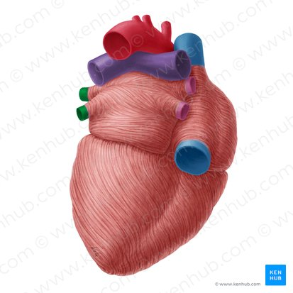

Slide 39
Superior Vena Cava (SVC)
Formation
Union of right and left brachiocephalic veins behind lower border of right 1st costal cartilage
Course
Descends vertically in superior mediastinum
Termination
Opens into right atrium at level of right 3rd costal cartilage
Tributary
Azygos vein

Slide 40
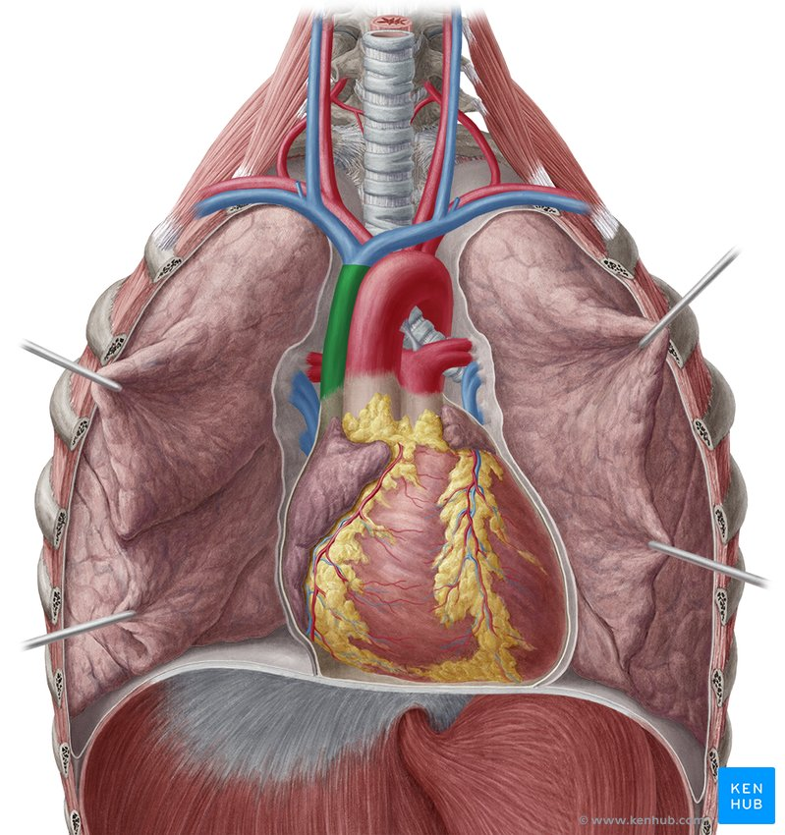

Slide 41
Relations of Superior Vena Cava
Anterior
Thymus remnants
Right lung and pleura
Posterior
Trachea
Right vagus nerve

Slide 43
CONTINUED
Medial
Ascending aorta
Lateral
Right phrenic nerve
Right lung

Slide 44
Brachiocephalic Veins
Formation
Union of internal jugular and subclavian veins
Right Brachiocephalic Vein
Short
Vertical
Left Brachiocephalic Vein
Longer
Oblique
Crosses superior mediastinum

Slide 46
Inferior Vena Cava (Thoracic Part)
Entry into Thorax
Through caval opening at T8
Relation
Traverses central tendon of diaphragm
Termination
Opens into right atrium

Slide 47
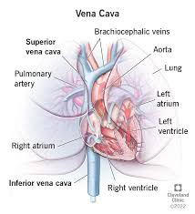

Slide 48
Azygos Vein
Origin
Continuation of right ascending lumbar vein
Course
Ascends through posterior mediastinum
Arches over root of right lung
Termination
Joins superior vena cava
Function
Important collateral venous pathway

Slide 50
Hemiazygos Vein
Hemiazygos Vein
Origin
Left ascending lumbar vein
Course
Ascends on left side of vertebral column
Crosses to right around T8
Drainage
Lower left posterior intercostal veins

Slide 51
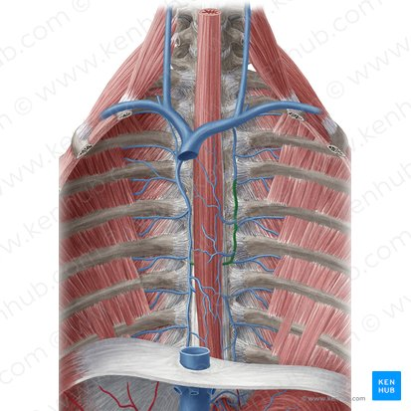

Slide 52


Slide 53


