Slide 1

Fauvism
DPT (Doctor of physical therpy)
Saman Naveed

Slide 2
What is Fauvism
Fauvism is an early modern art movement Started in France around 1905 Focuses on: Bold, unnatural colors
Emotional expression
Simplified forms
Artists painted feelings, not reality

Slide 3
Origin of the Name “Fauvism’’
The word Fauves means “wild beasts” in French
Named by critic Louis Vauxcelles
He saw shocking colors at the 1905 Paris exhibition .

Slide 4
Historical Background
Influenced by:
Impressionism (light & color)
Post-Impressionism (emotion & structure)
Key artists who inspired Fauvism:
Vincent van Gogh
Paul Gauguin
Georges Seurat.

Slide 5
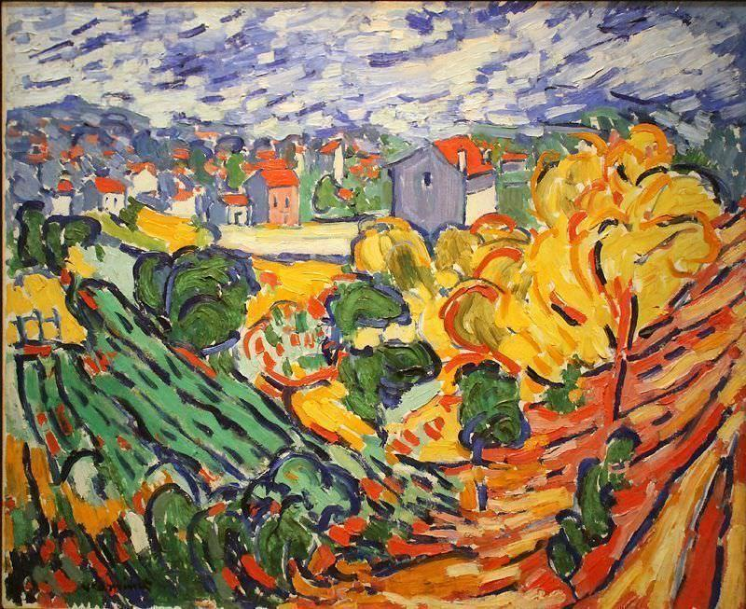
Characteristics of Fauvism
🎨Bright, unrealistic colors
🖌 Bold brush strokes
🧠 Emotional expression
🖼 Simple shapes
🌈 Decorative style

Slide 6
Artist of Fauvism
Henri Matisse (leader of the movement
Maurice de Vlaminck
André Derain
Raoul Dufy

Slide 7
Use of Color
Color is the most important element
Not used to represent reality
Used to express:
  Emotion
  Mood
  Energy
Example:
  Sky can be orange or red
  Faces can include green or blue tones

Slide 8
Style and Technique
Thick application of paint (impasto in some works)
Visible brush strokes
Flat composition (less depth)
Simplified outlines
Emphasis on artistic freedom

Slide 9
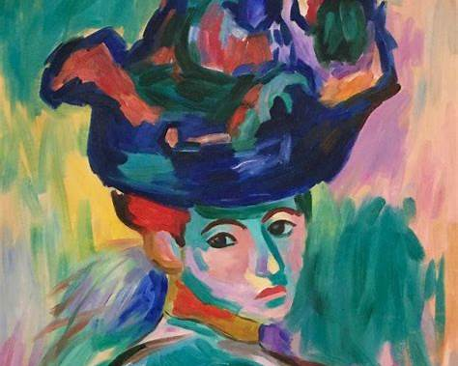
Famous Work Example
“Woman with a Hat” (1905)
by Henri Matisse
Portrait of Matisse’s wife
Face painted with unexpected colors (green, blue, orange)
Strong emotional impact over realism
Caused controversy when first exhibited

Slide 10
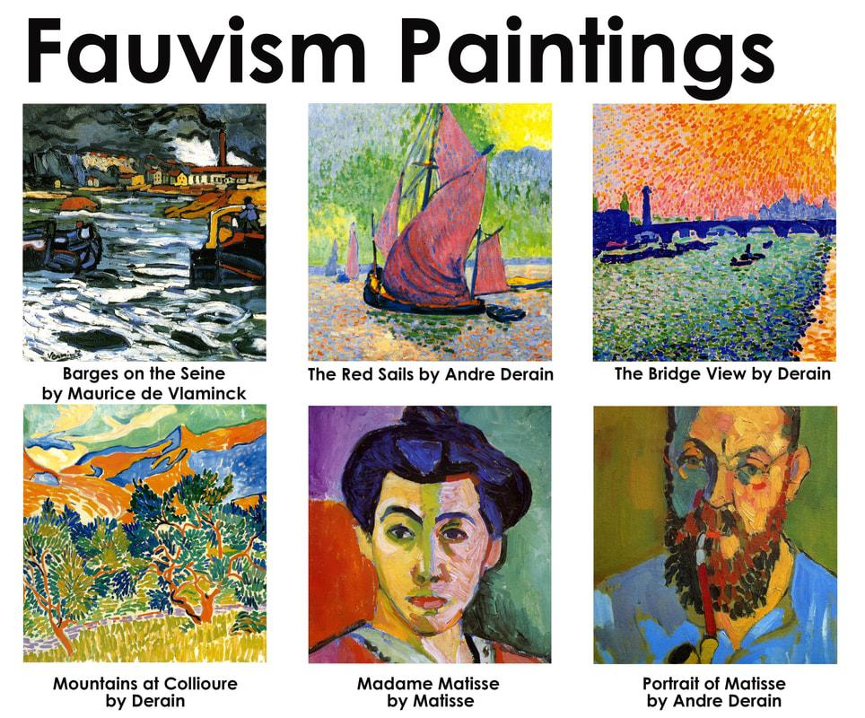
Themes in Fauvism
Nature and landscapes
Portraits and human emotion
Everyday scenes
Interior spaces
Focus is not subject matter but expression through color

Slide 11
Decline of Fauvism
Movement lasted only a few years (until ~1908) Artists moved in different directions Matisse later developed more structured style Fauvism merged into broader modern art movement

