Slide 1
Applied Science
Fsc Medical Technology
Awais Hamza

Slide 2
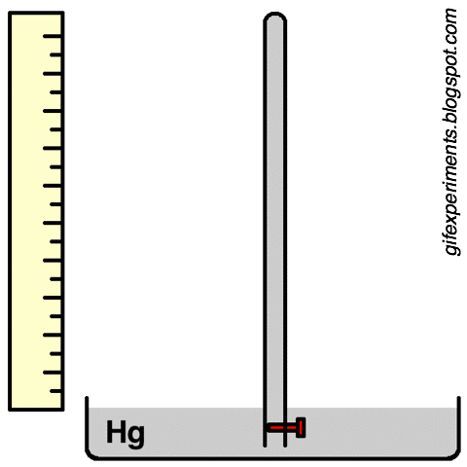
Atmospheric Pressure
Atmospheric pressure is the force exerted by the weight of air on the Earth and on our body.
Air may seem “light,” but the atmosphere has mass. Gravity pulls this air downward, so it presses on everything around us.
At sea level, normal atmospheric pressure is about:
1 atm=760 mmHg
This pressure acts on the body from all directions.

Slide 3
Mercury Barometer
A mercury barometer is one of the most common instruments used to measure atmospheric pressure.
It contains a column of mercury inside a glass tube.
The height of the mercury column balances the weight of the atmosphere above it.
At sea level:760 mmHg=29.92 inches of mercury
This value represents normal atmospheric pressure at sea level.

Slide 4
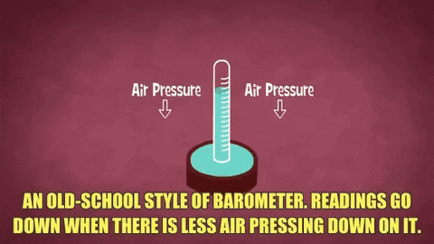
Mercury Barometer

Slide 5
Barometric Pressure and Weather
Rise in Barometric Pressure
Usually indicates:
  Clear skies
  Stable weather
  Improvement in weather conditions
Fall in Barometric Pressure
Usually indicates: Storms , Rainy weather ,Worsening weather conditions

Slide 6
Health Effects of Falling Pressure
A decrease in atmospheric pressure can affect the human body in several ways:
Altitude sickness
Joint pain and arthritis worsening
Headaches and migraines

Slide 7
High Altitude (Low Atmospheric Pressure)
Altitude sickness, also called mountain sickness, occurs when a person climbs or travels to a high altitude too quickly.
Common Altitude Range Usually occurs at:
  1,500–3,000 meters
  (5,000–10,000 feet)
Cause: Atmospheric pressure decreases with increasing altitude.
Oxygen pressure also decreases.
The body does not get enough oxygen.

Slide 8
Effects on body
Mild effects
Shortness of breath , Fatigue , Headache ,Dizziness
Severe effects (Altitude sickness)
Nausea
Confusion
Rapid heartbeat
Pulmonary edema (fluid in lungs)
Cerebral edema (brain swelling)

Slide 9
Why Altitude Sickness Occurs
Mechanism: Low atmospheric pressure causes:
Less oxygen entering the blood
Swelling of tissues in the lungs and brain
Brain Effects
Blood vessels dilate to increase oxygen supply.
Brain swelling increases pressure inside the skull.
This produces headaches and confusion.

Slide 10
High Altitude Cerebral Edema (HACE)
HACE is a severe form of altitude sickness caused by dangerous brain swelling.
Symptoms
Severe headache , Confusion
Irritability , Poor coordination
Lethargy , Vomiting
Seizures , Coma
Complication: Can lead to death if untreated.

Slide 11
High Altitude Pulmonary Edema
HAPE occurs when fluid accumulates inside the lungs at high altitude.
Cause
Lung capillaries become swollen and leaky.
Fluid enters the air sacs of the lungs.
Effects
Difficulty breathing
Reduced oxygen exchange
Severe breathlessness
Possible death if untreated

Slide 12
Barometric Pressure and Arthritis
Arthritis is inflammation of joints causing:
Pain
Swelling
Stiffness
Effect of Falling Pressure - Low atmospheric pressure may:
Cause tissues to expand
Increase pressure on joints
Worsen pain and stiffness

Slide 13
Barometric Pressure and Headaches
Effect on Sinuses
The skull contains air-filled spaces called sinuses.
When atmospheric pressure falls:
Pressure difference develops between:
  Outside air
  Air inside sinuses
This may trigger headaches.

Slide 14
Migraines and Pressure Changes
Falling barometric pressure may cause: Swelling of blood vessels near the brain , Increased pressure on sensitive tissues
Symptoms: Headache in one or both temples , Nausea , Vomiting , Sensitivity to light (photophobia)
Conclusion - Changes in atmospheric pressure can significantly affect:
Brain
Lungs
Joints
Sinuses and blood vessels

Slide 15
Heat
Heat is an important form of energy.
It is essential for:
Cooking food
Maintaining body temperature
Industrial processes
Understanding heat transfer helps us protect ourselves from:
High temperatures
Low temperatures

Slide 16
Transfer of Heat
Definition
When two bodies at different temperatures come in contact, thermal energy flows from the hotter body to the colder body.
This flow of thermal energy is called heat transfer.
Important Point
Heat transfer is a natural process.
It continues until both bodies reach the same temperature.

Slide 17
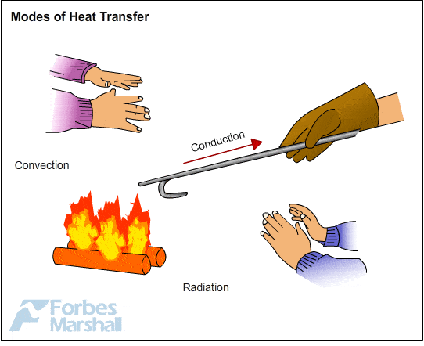
Methods of Heat Transfer
Method | Medium Required | Example
Conduction | Solids | Hot spoon
Convection | Liquids & gases | Boiling water
Radiation | No medium needed | Heat from Sun

Slide 18
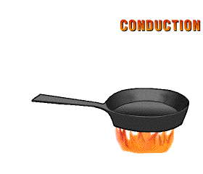
Conduction of Heat
Definition
The transfer of heat through solids from hot parts to cold parts without movement of matter is called conduction.
Example
A metal spoon placed in hot water becomes hot from one end to the other.
A wooden spoon does not heat quickly.
Observation
Metals conduct heat better than wood.

Slide 19
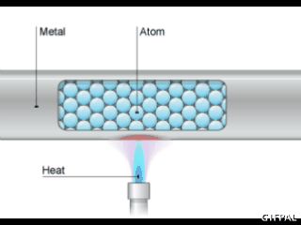
How Conduction Occurs in Solids
Structure of Solids
Atoms and molecules are closely packed.
They vibrate around their fixed positions.
What Happens When Heated?
Particles at the hot end vibrate faster.
They collide with neighboring particles.
Energy passes from particle to particle.
Result
Heat slowly moves from:
Hot region → Cold region

Slide 20
Heat Transfer in Metals
Why Metals Conduct Heat Faster
Metals contain:
Free electrons
These electrons:
Move rapidly inside the metal
Carry heat energy quickly
Result
Heat transfer in metals is much faster than in non-metals.

Slide 21
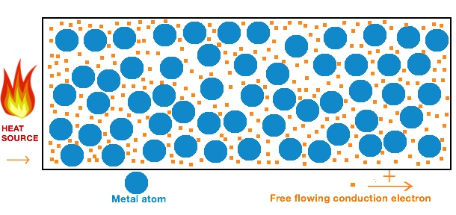
Free Electrons in Metals
Mechanism
In metals:
Free electrons move from hot areas to cold areas.
They transfer energy rapidly throughout the material.
Conclusion
Both vibrating atoms and free electrons help conduct heat in metals.

Slide 22
Definition of Conduction
Formal Definition
The mode of transfer of heat by vibrating atoms and free electrons in solids from hot parts to cold parts is called conduction of heat.

Slide 23
Good Conductors
Substances that allow heat to pass easily.
Examples
Copper
Iron
Aluminum
Silver

Slide 24
Bad Conductors (Insulators)
Substances that do not allow heat to pass easily.
Examples
Wood
Cork
Cotton
Wool
Glass
Rubber

Slide 25
Everyday Applications of Conduction
Uses of Good Conductors
Cooking utensils
Iron boxes
Radiators
Uses of Insulators
Handles of cooking pots
Woolen clothes
Thermos flasks
Reason: Insulators reduce heat transfer and protect us from burns or heat loss.

Slide 26
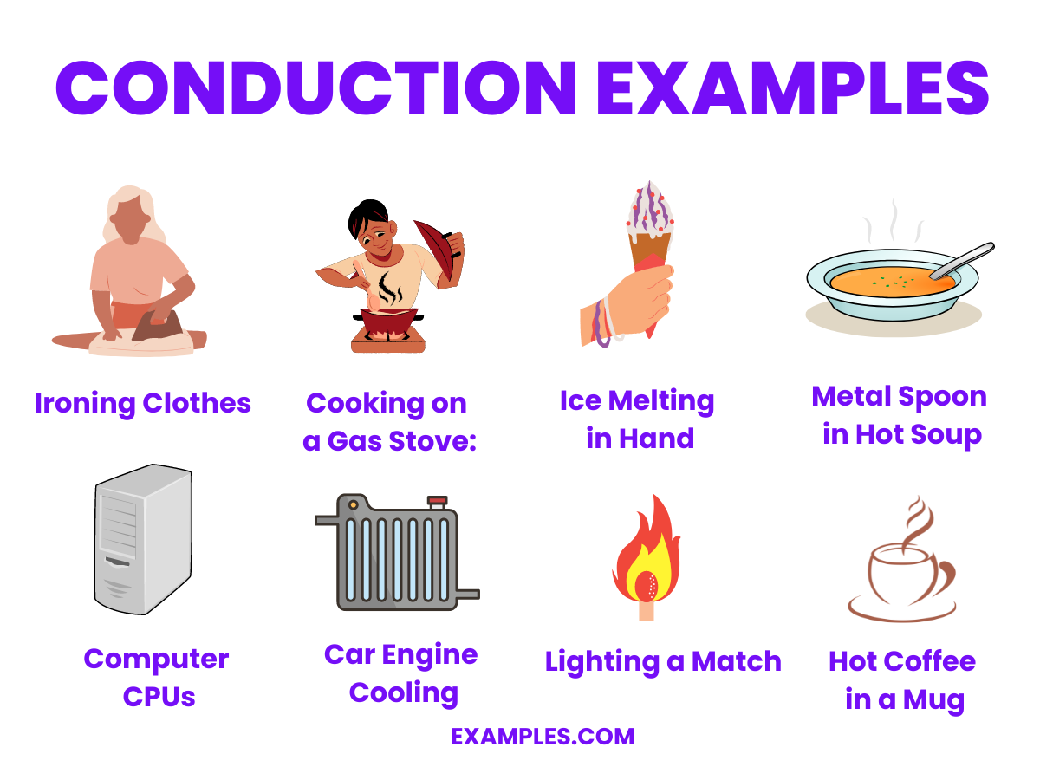

Slide 27
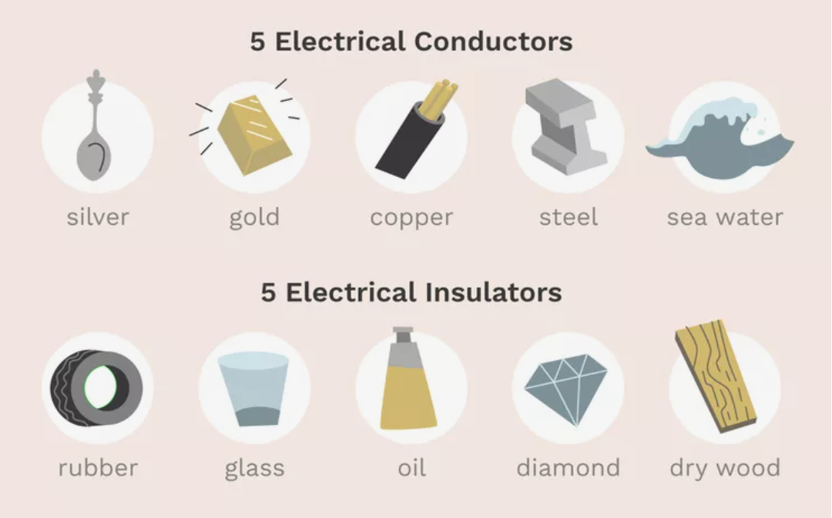
Examples

