Slide 1

ANATOMY
THE THORAX
BS RIT,OTT
2ND SEMESTER
DR DANISH
DPT(S.M.C),MPPTA

Slide 2
Heart Action
The heart acts as a muscular pump
Cardiac activity consists of alternating contraction and relaxation
One complete heartbeat is called the cardiac cycle
The cycle includes:
  Atrial systole
  Ventricular systole
  Complete cardiac diastole

Slide 3
CONTINUED
Normal resting heart rate:
  60–100 beats/minute
Duration of one cardiac cycle:
  Approximately 0.8 seconds

Slide 4
Cardiac Cycle
1. Atrial Systole
Atria contract
Blood is forced into ventricles
2. Ventricular Systole
Ventricles contract
Blood is ejected into:
  Aorta
  Pulmonary trunk

Slide 5
CONTINUED
3. Ventricular Diastole
Ventricles relax
Chambers refill with blood
Important Point
Right and left sides of the heart contract simultaneously.

Slide 6
Atrial Systole
Occurs near the end of ventricular diastole
Atria contract to complete ventricular filling
Contributes approximately 20–30% of ventricular filling
AV valves are open
Semilunar valves remain closed
Clinical Importance
Loss of atrial contraction decreases cardiac efficiency.

Slide 7
Ventricular Systole
Isovolumetric Contraction
Ventricles begin contracting
Intraventricular pressure rises rapidly
Mitral and tricuspid valves close
No blood leaves ventricles yet
Ventricular Ejection
Ventricular pressure exceeds arterial pressure
Aortic and pulmonary valves open
Blood enters great arteries

Slide 8
Ventricular Diastole
Isovolumetric Relaxation
Ventricles relax
Aortic and pulmonary valves close
Ventricular pressure decreases
Ventricular Filling
AV valves open
Blood flows into ventricles
Most ventricular filling occurs passively

Slide 9
Heart Sounds
First Heart Sound (S1)
“Lub”
Closure of:
  Mitral valve
  Tricuspid valve
Marks beginning of ventricular systole

Slide 10
CONTINUED
Second Heart Sound (S2)
“Dub”
Closure of:
  Aortic valve
  Pulmonary valve
Marks beginning of ventricular diastole

Slide 11
Surface Anatomy of Heart Valves
Pulmonary Valve
Behind medial end of left 3rd costal cartilage
Aortic Valve
Behind left side of sternum at level of 3rd intercostal space
Tricuspid Valve
Behind sternum opposite 4th and 5th intercostal spaces
Mitral Valve
Behind left half of sternum opposite 4th costal cartilage

Slide 12
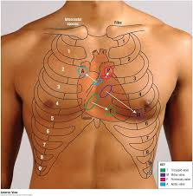

Slide 13
Principles of Auscultation
Heart valves are best heard:
  Downstream in direction of blood flow
Auscultation sites differ from anatomical valve positions

Slide 14
Stethoscope Use
Diaphragm
Best for:
High-pitched sounds
S1, S2
Aortic regurgitation murmurs

Slide 15
Main Auscultation Areas
Aortic Area
Right 2nd intercostal space
Close to sternum
Pulmonary Area
Left 2nd intercostal space
Close to sternum

Slide 17
CONTINUED
Tricuspid Area
Left lower sternal border
4th or 5th intercostal space
Mitral Area (Apex)
Left 5th intercostal space
Midclavicular line

Slide 19
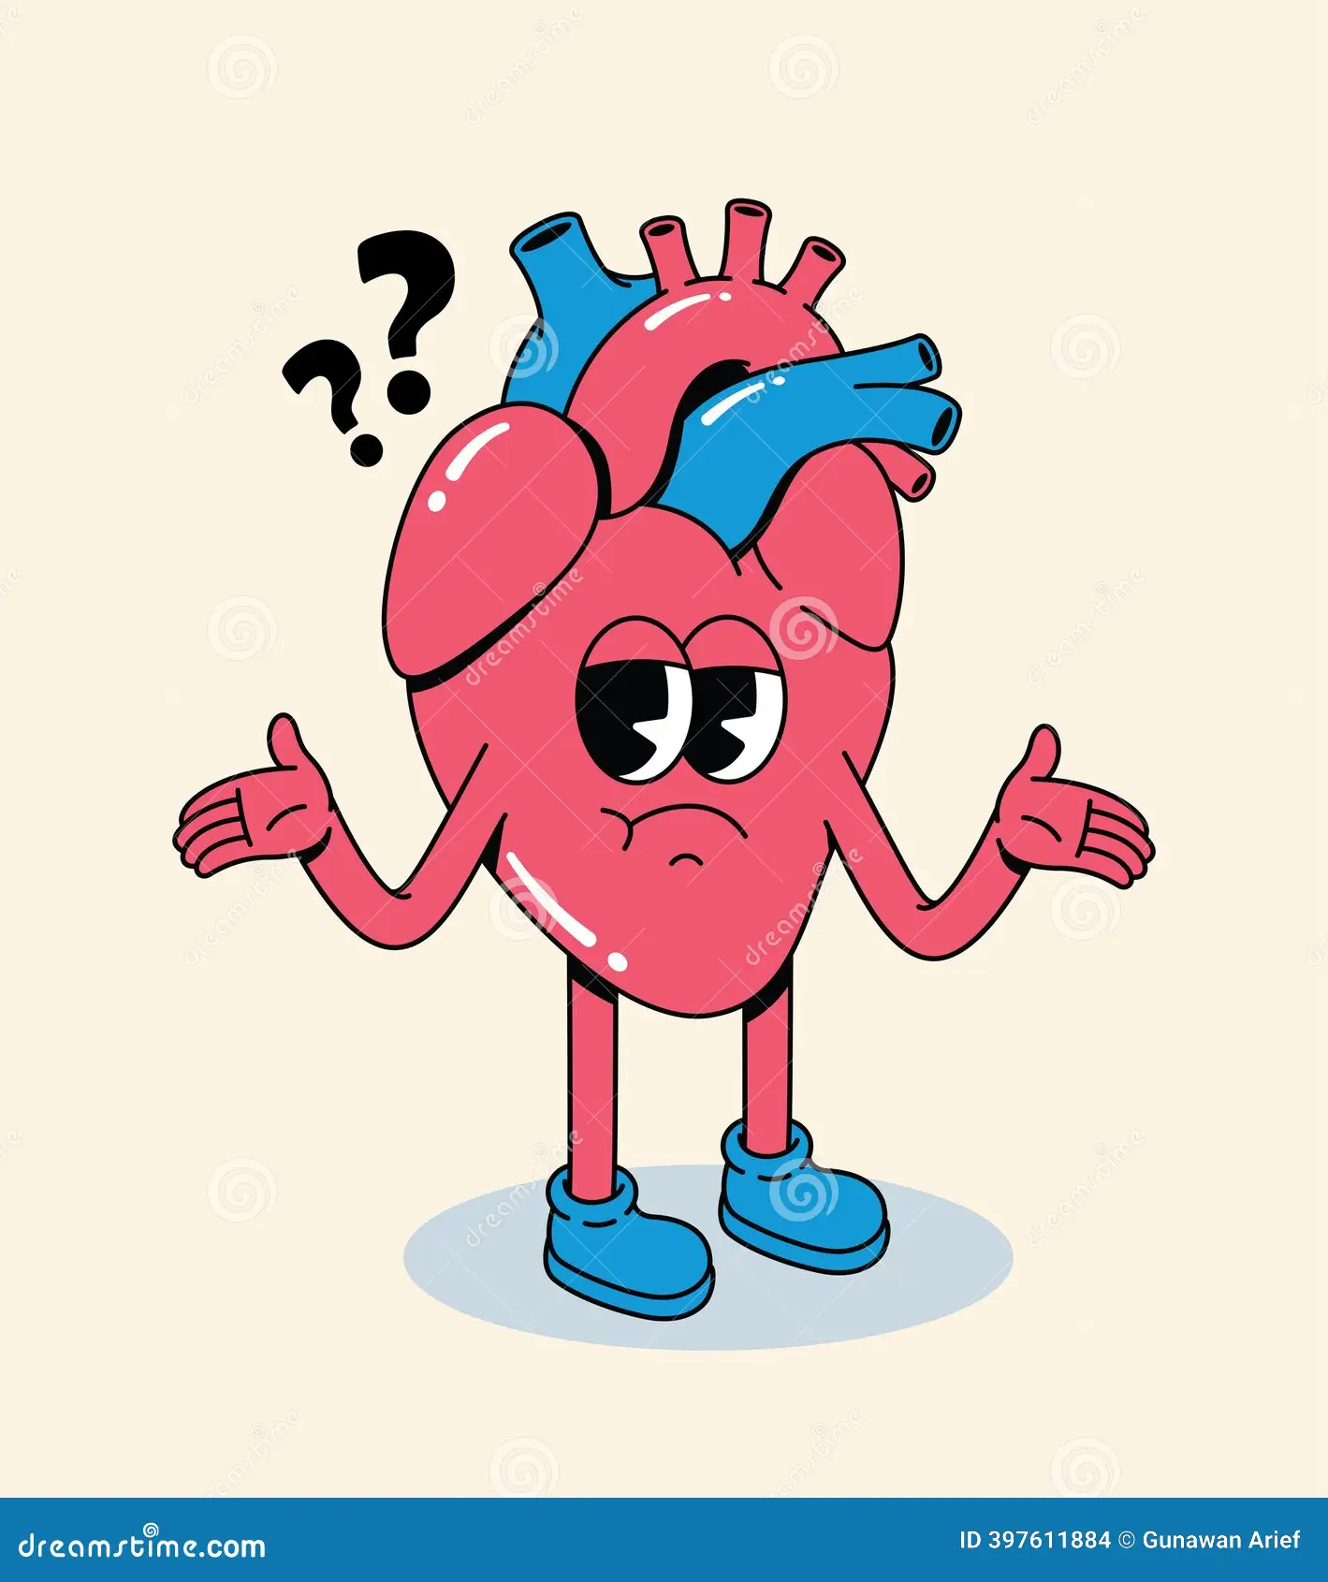

Slide 20


