Slide 1

Modernism
in Visual Arts
DPT Lecture
Saman Naveed

Slide 2
Introduction to Modernism
Modernism emerged in the late 19th and early 20th centuries.
Artists rejected traditional styles and experimented with new ideas.
Industrialization, urbanization, and world wars influenced modern art.
Focus shifted from realism to expression, abstraction, and innovation

Slide 3
Characteristics of Modernism
Experimentation with form, color, and technique.
Break from classical traditions and realism.
Emphasis on individual expression and originality.
Use of abstraction, symbolism, and distortion .

Slide 4
Historical Background
Rapid industrial and technological changes transformed society.
World War I challenged traditional beliefs and values.
Photography reduced the need for realistic painting.
Artists sought new ways to represent modern life.

Slide 5
Impressionism
Focused on light, color, and everyday scenes.
Visible brushstrokes and outdoor painting techniques.
Major artists: Claude Monet and Pierre-Auguste Renoir.
Laid the foundation for modern art movements.

Slide 6
Post-Impressionism
Artists moved beyond Impressionism’s focus on light.
Emphasized emotion, symbolism, and structure.
Major artists: Vincent van Gogh and Paul Cézanne.
Influenced Expressionism and Cubism

Slide 7
Expressionism
Focused on emotional experience rather than physical reality.
Used bold colors and distorted forms.
Major artists: Edvard Munch and Wassily Kandinsky.
Reflected anxiety and psychological tension.

Slide 8
Cubism
Developed by Pablo Picasso and Georges Braque.
Objects broken into geometric shapes and multiple viewpoints.
Rejected single-point perspective.
Introduced abstract approaches to representation.

Slide 9
Futurism
Celebrated speed, technology, and industrial progress.
Depicted movement and energy.
Originated in Italy during the early 20th century.
Influenced modern design and advertising.

Slide 10
Dadaism
Reaction against war and traditional values.
Used absurdity, satire, and unconventional materials.
Challenged the definition of art itself.
Marcel Duchamp’s ready-made works became iconic.

Slide 11
Surrealism
Inspired by dreams and the unconscious mind.
Influenced by Sigmund Freud’s psychoanalysis.
Major artists: Salvador Dalí and René Magritte.
Combined fantasy with unexpected imagery.

Slide 12
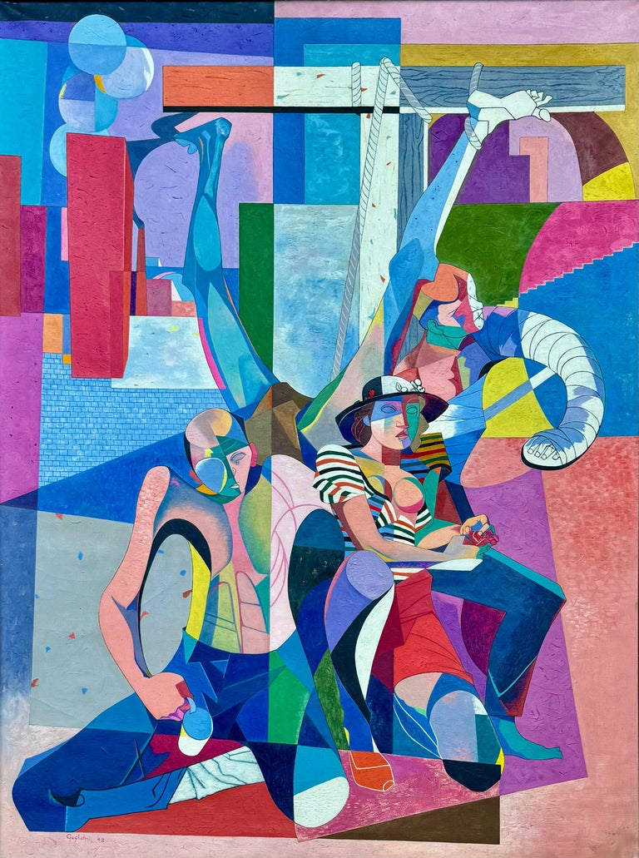
VISUAL ART MOVEMENTS

Slide 13
Abstract Art
Focused on shapes, colors, and lines instead of realistic subjects.
Encouraged emotional and intellectual interpretation.
Artists explored non-representational techniques.
Influenced later contemporary art movements.

Slide 14
Impact of Modernism
Changed the direction of visual arts permanently.
Encouraged artistic freedom and innovation.
Influenced architecture, literature, music, and design.
Prepared the foundation for postmodern and contemporary art.

Slide 15
Conclusion
Modernism transformed artistic expression in the 20th century.
Artists explored individuality, abstraction, and experimentation.
Modernist movements continue to influence artists today.
Understanding Modernism helps students analyze contemporary art.

