Slide 1

Biochemistry
BS Hons Medical Technology
Saman Naveed

Slide 2
Biological Importance of Proteins
Proteins perform numerous functions necessary for life

Slide 3
1. Structural Importance
Proteins provide structural support to cells and tissues
Examples
Collagen → connective tissue
Keratin → hair, nails, skin
Elastin → elastic tissues
Importance
Maintain body shape
Tissue strength and elasticity

Slide 4
2. Enzymatic Functions
Most enzymes are proteins that catalyze biochemical reactions
.
Examples
Amylase
Trypsin
DNA polymerase
Importance
Increase reaction speed
Essential for metabolism
Regulate biochemical pathways

Slide 5
3. Transport Functions
Proteins transport molecules in blood and across membranes
Examples
Hemoglobin transports oxygen
Albumin transports fatty acids and drugs
Transferrin transports iron

Slide 6
4. Hormonal and Regulatory Functions
Some hormones are proteins or peptides
.
Examples
Insulin
Glucagon
Growth hormone
Functions
Regulation of metabolism
Blood glucose control
Growth regulation

Slide 7
5 Protective Functions
Proteins protect the body against disease
Examples
Antibodies (immunoglobulins)
Complement proteins
Importance
Immunity
Defense against pathogens

Slide 8
6 Buffering Action
Proteins help maintain acid-base balnce
. Example
Hemoglobin acts as a blood buffer
7 Blood Clotting
Some proteins are involved in coagulation.
Examples
Fibrinogen
Prothrombin
emoglobin acts as a blood buffer

Slide 9
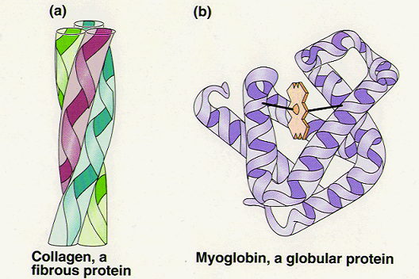
Physical & Structural Properties
Protein Classification: Size & Shape
Proteins are categorized by their overall
molecular architecture:
Globular Proteins: Spherical, water-soluble molecules with dynamic functions (e.g., Hemoglobin, Myoglobin).
Fibrous Proteins: Long, thread-like, water-insoluble molecules providing structural support (e.g., Collagen, Keratin).

Slide 10
The Isoelectric Point (pI)
Definition
The specific pH at which a protein carries no net electrical charge. In this state, molecules do not migrate in an electric field.
pI=pK1+pK22
Solubility Effects
At the pI, protein solubility is at its minimum. Since they have no net charge, they no longer repel each other and tend to precipitate.

Slide 11
Chemical & Amphoteric Properties
Amphoterism & Buffering Action
Amphoteric Nature: Proteins act as both acids and bases due to dissociable amino and carboxyl groups on side chains. Biological Buffers: By accepting or donating protons, proteins maintain pH stability in cellular fluids and blood. Hemoglobin Buffer: Crucial for neutralizing carbonic acid in the blood, maintaining vital physiological PH range .

Slide 12
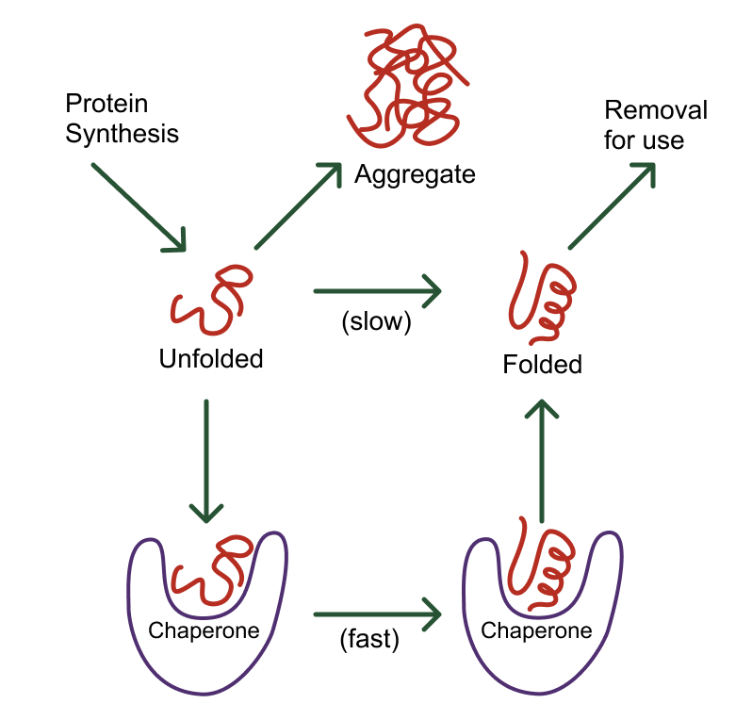
Denaturation and Stability
The Denaturation Process
Denaturation involves the disruption of the secondary, tertiary, and quaternary levels of protein structure.
Result: The protein unfolds into a random coil. While the primary peptide sequence remains intact, the 3D active site is lost, leading to immediate loss of biological function.

Slide 13
Common Denaturing Agents
Heat
Heat
Increases kinetic energy, vibrating atoms and breaking H-bonds.
pH Extremes
Alters charge distributions, disrupting ionic attractions.
Solvents
Alcohol/Acetone disrupts hydrophobic interactions.
Heavy Metals
Mercury/Lead bind to sulfhydryl groups, precipitating proteins.

Slide 14
Colloidal & Optical Properties
UV Absorption Trends (280 nm)
Proteins show a peak absorbance at 280 nm due to aromatic rings.

