Slide 1

ANATOMY
THE LOWER LIMB
DPT
2ND SEMESTER
DR DANISH
DPT(S.M.C),MPPTA

Slide 2
FEMORAL TRIANGLE
Triangular intermuscular space in the upper anterior thigh
Located immediately inferior to the inguinal ligament
Serves as a passageway for major neurovascular structures entering the lower limb
Important anatomical and clinical region

Slide 3
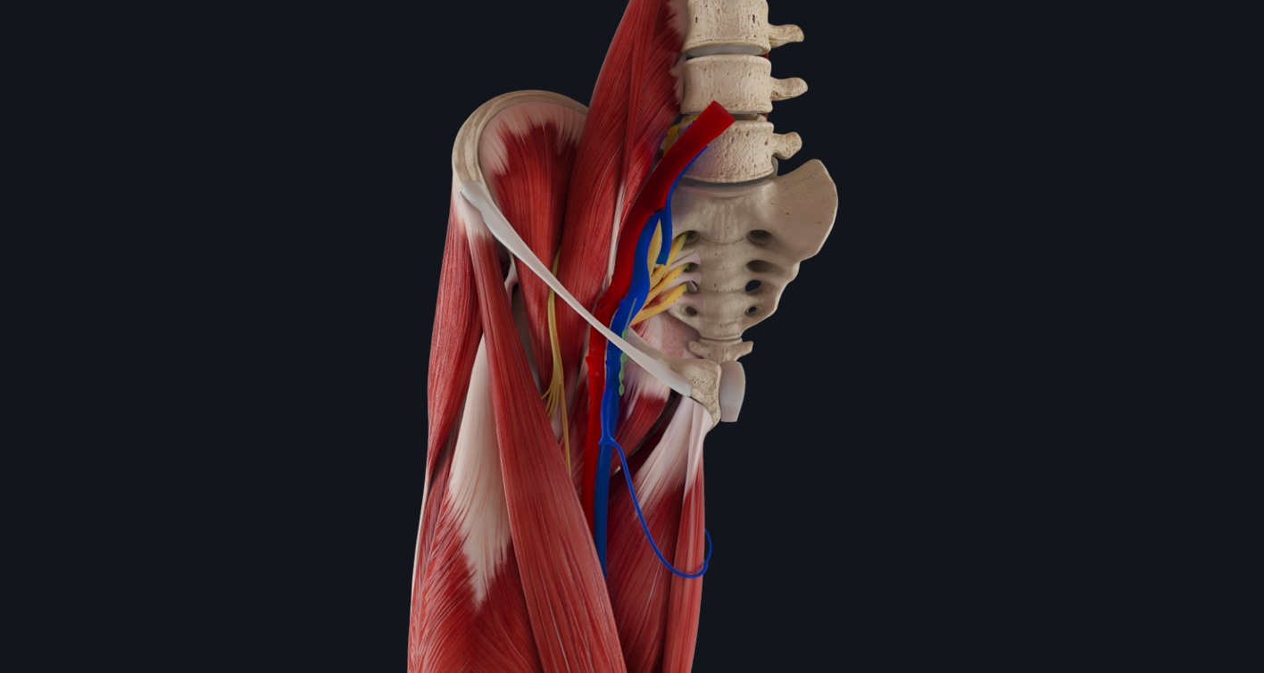

Slide 4
Definition
A triangular depression below the inguinal ligament
Formed by muscles of the thigh
Contains femoral nerve, artery, vein, and lymphatics

Slide 6
Boundaries of Femoral Triangle
Base (Superior Boundary)
Inguinal ligament
Lateral Boundary
Medial border of sartorius muscle
Medial Boundary
Medial border of adductor longus muscle
Apex
Point where sartorius crosses adductor longus
Continues as adductor canal

Slide 7
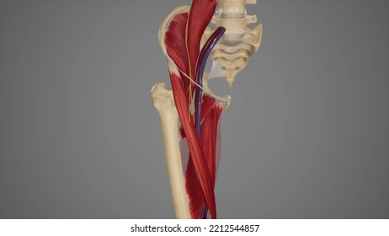

Slide 8
Roof of Femoral Triangle
Skin
Superficial fascia containing:
  Superficial inguinal lymph nodes
  Great saphenous vein
  Femoral branch of genitofemoral nerve
  Cutaneous nerves
Deep fascia (fascia lata)
Cribriform fascia covering saphenous opening

Slide 9
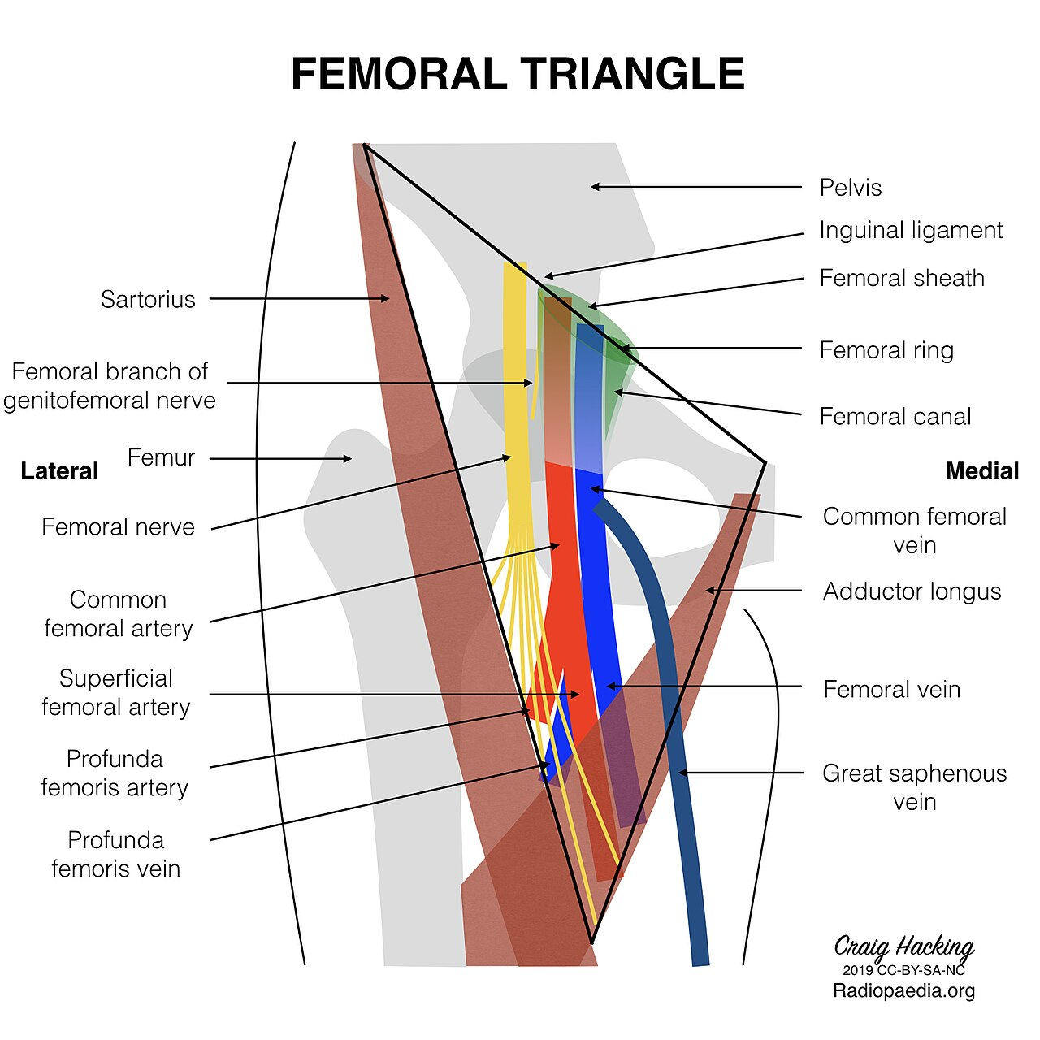

Slide 10
Floor of Femoral Triangle
From Lateral to Medial
Iliacus muscle
Psoas major tendon
Pectineus muscle
Adductor longus muscle

Slide 12
Contents of Femoral Triangle
Arranged from Lateral to Medial
Femoral nerve
Femoral artery
Femoral vein
Femoral canal containing lymphatics

Slide 14
Mnemonic
NAVEL
  N = Nerve
  A = Artery
  V = Vein
  E = Empty space (femoral canal)
  L = Lymphatics

Slide 16
Femoral Sheath
Funnel-shaped fascial sleeve surrounding upper femoral vessels
Derived from:
  Transversalis fascia anteriorly
  Iliac fascia posteriorly
Divided into three compartments:
  Lateral compartment → femoral artery
  Intermediate compartment → femoral vein
  Medial compartment → femoral canal
Femoral nerve lies outside the sheath

Slide 17
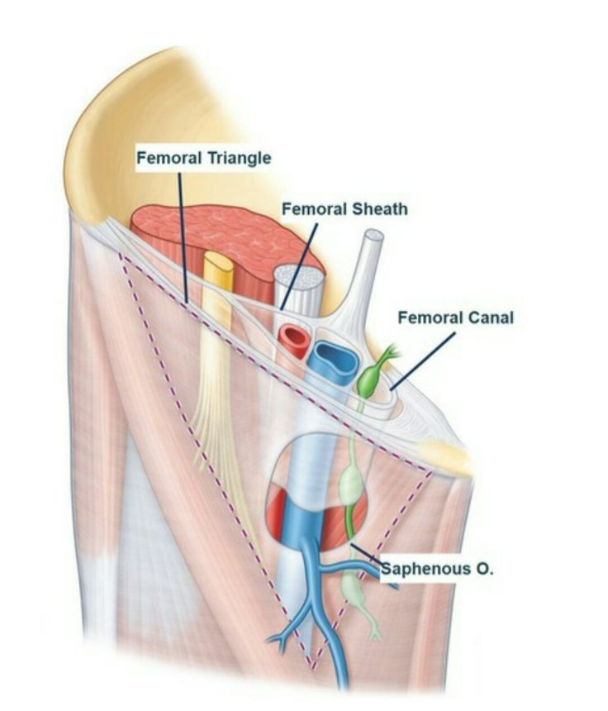

Slide 18
Femoral Canal
Medial compartment of femoral sheath
About 1.3 cm (½ inch) long
Contains:
  Fat
  Loose connective tissue
  Deep inguinal lymph node (node of Cloquet)
Function
Allows expansion of femoral vein during increased venous return

Slide 20
Femoral Ring
Boundaries
Anterior → Inguinal ligament
Posterior → Pectineal ligament and pectineus muscle
Medial → Lacunar ligament
Lateral → Femoral vein
Clinical Importance
Site through which femoral hernia occurs

Slide 21
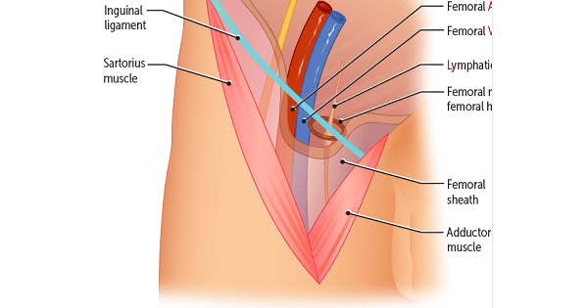

Slide 22
Femoral Artery
Continuation of external iliac artery distal to inguinal ligament
Enters triangle at midinguinal point
Main arterial supply to lower limb
Branches in Femoral Triangle
Superficial epigastric artery
Superficial circumflex iliac artery
Superficial external pudendal artery
Deep external pudendal artery
Profunda femoris artery

Slide 23
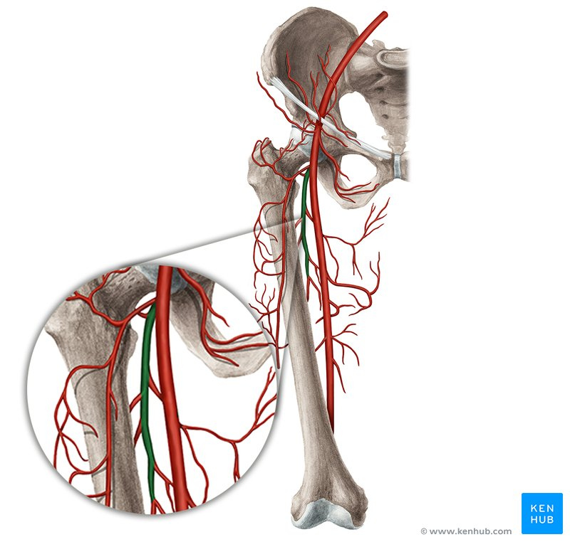

Slide 24
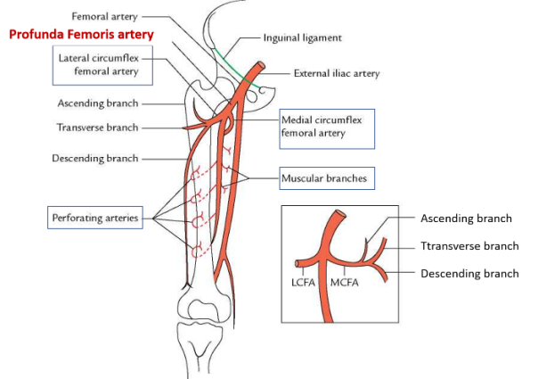

Slide 25
Femoral Vein
Continuation of popliteal vein
Ascends through adductor canal into femoral triangle
Lies medial to femoral artery in upper part of triangle
Receives great saphenous vein

Slide 26
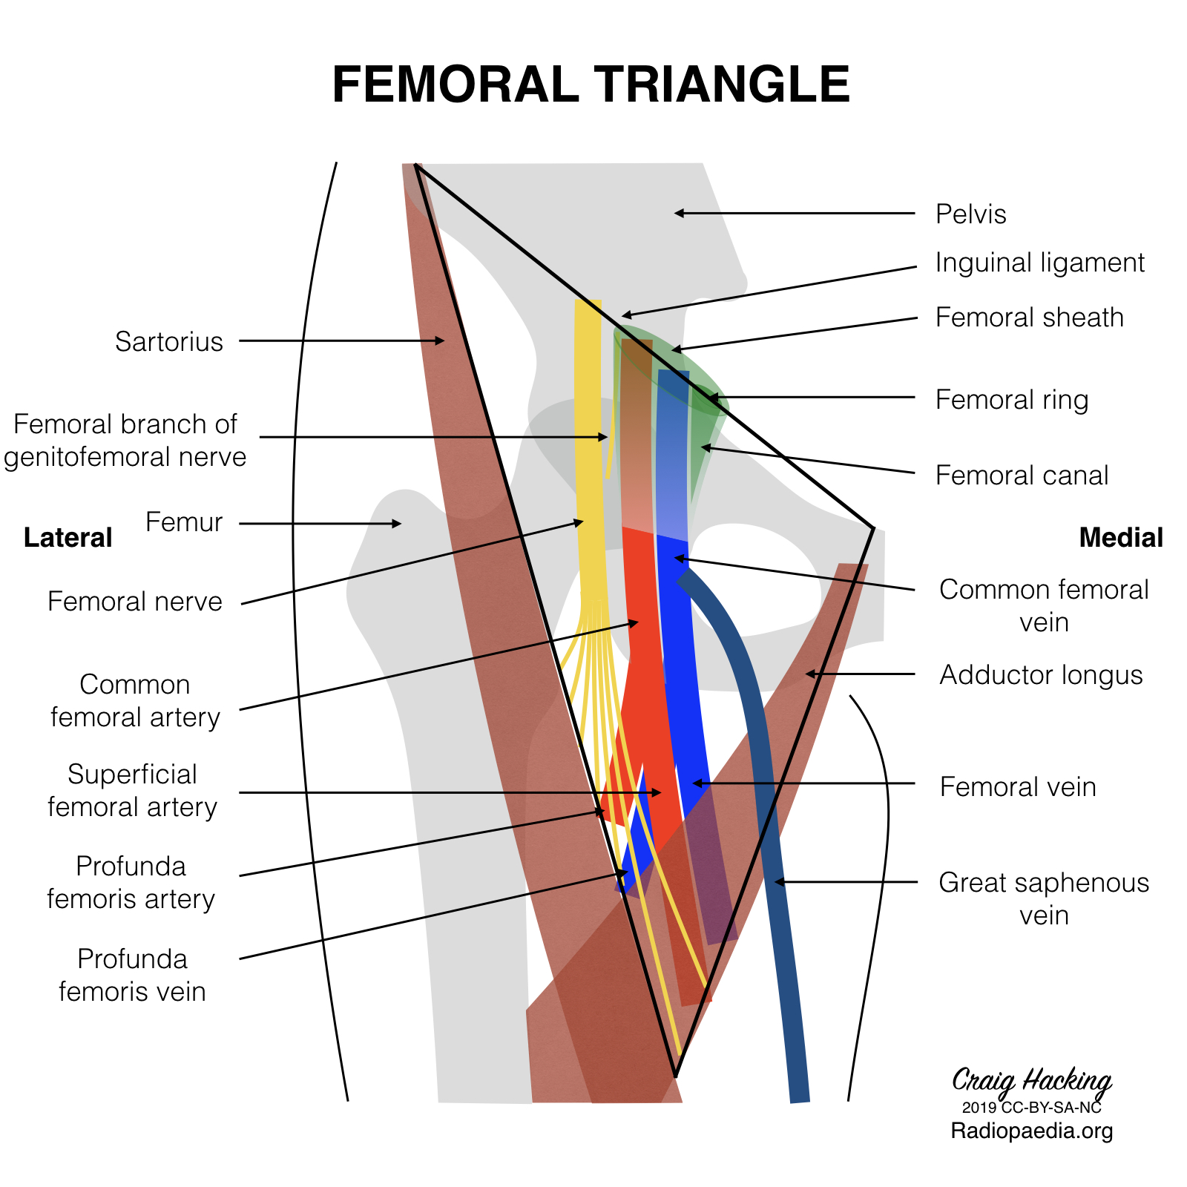

Slide 27
Femoral Nerve
Largest branch of lumbar plexus
Root value: L2, L3, L4
Lies lateral to femoral artery
Divides into anterior and posterior divisions within triangle
Supplies
Muscles of anterior compartment of thigh
Skin of anterior thigh
Medial side of leg through saphenous nerve

Slide 29
Surface Anatomy
Femoral artery pulse felt just below inguinal ligament
Pulse located at midinguinal point:
  Midway between anterior superior iliac spine and pubic symphysis

Slide 30


Slide 31


