Slide 1

PHARMACOLOGY
BS RIT,OTT,MLT
2ND SEMESTER
DR DANISH
DPT(S.M.C),MPPTA

Slide 2
Anesthetics
OVERVIEW:
Drugs used to reduce pain, anxiety, awareness, and movement during medical or surgical procedures
Help patients stay comfortable and safe during procedures
Can range from mild calming effects to complete unconsciousness

Slide 3
CONTINUED
Example
During a tooth extraction, a patient may receive anesthesia so they do not feel pain or remember the procedure.

Slide 4
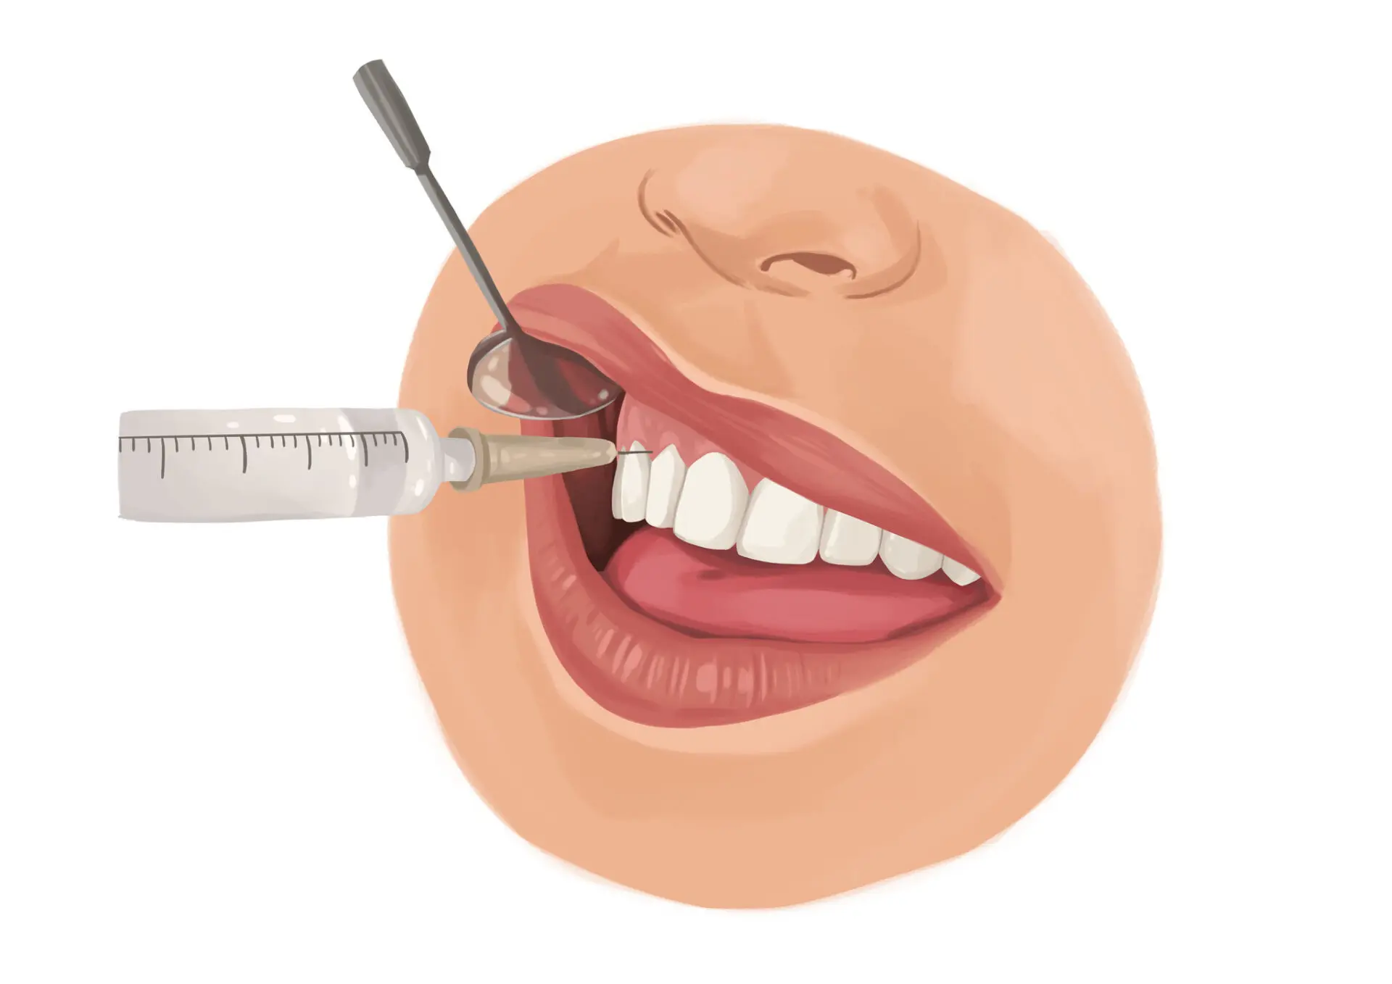

Slide 5
Goals of Sedation and Anesthesia
Anesthesia can produce:
Sedation and reduced anxiety
Lack of awareness and amnesia
Skeletal muscle relaxation
Suppression of unwanted reflexes
Analgesia (pain relief)

Slide 6
CONTINUED
Example:
Before surgery, a patient feels relaxed, sleeps during the operation, and wakes up without remembering it.

Slide 7
Why Multiple Drugs Are Used
No single drug provides all desired effects
Different drugs are combined for better results
Drug selection depends on:
  Type of surgery
  Duration of procedure
  Patient age and health
  Organ function
  Current medications

Slide 8
CONTINUED
Example
One drug may make the patient sleep, while another blocks pain and another relaxes muscles.

Slide 9
Preoperative Medications
Common Categories
Analgesics → reduce pain
Antacids → reduce stomach acid
Antiemetics → prevent nausea and vomiting
Benzodiazepines → reduce anxiety
Example:
A patient may receive anti-nausea medicine before surgery to prevent vomiting afterward.

Slide 10
Common Analgesic Drugs
Acetaminophen
Celecoxib
Gabapentin
Ketamine
Opioids
Purpose
Reduce pain before, during, or after surgery
Example:
Acetaminophen may be given after surgery to reduce mild pain.

Slide 11
General Anesthetics – Inhaled
Inhaled Anesthetic Drugs
Desflurane
Isoflurane
Nitrous oxide
Sevoflurane

Slide 12
CONTINUED
Features
Breathed in through a mask or breathing tube
Commonly used to maintain anesthesia
Example:
A child may breathe sevoflurane gas through a mask to fall asleep before surgery.

Slide 13
General Anesthetics – Intravenous (IV)
IV Anesthetic Drugs
Dexmedetomidine
Etomidate
Methohexital
Propofol
.

Slide 14
CONTINUED
Features
Given directly into a vein
Produce rapid unconsciousness
Example:
Propofol can make a patient unconscious within 30–40 seconds.

Slide 15
Neuromuscular Blocking Drugs
\Cisatracurium
Mivacurium
Pancuronium
Rocuronium
Succinylcholine
Vecuronium

Slide 16
CONTINUED
Purpose
Relax muscles
Help with endotracheal intubation and surgery
Example
Rocuronium helps relax the throat muscles so a breathing tube can be inserted easily.

Slide 17
Local Anesthetics
Amides
Bupivacaine
Lidocaine
Mepivacaine
Ropivacaine
Esters
Chloroprocaine
Tetracaine

Slide 18
CONTINUED
Purpose
Numb a specific area without causing unconsciousness
Easy Example
Lidocaine is used to numb the skin before stitches are placed.

Slide 19
Levels of Sedation
Minimal sedation (anxiolysis)
Moderate sedation
Deep sedation
General anesthesia
Example:
Minimal sedation: patient is calm but awake
General anesthesia: patient is fully unconscious

Slide 20
Minimal Sedation (Anxiolysis)
Characteristics
Responds normally to verbal commands
Airway remains normal
Breathing unaffected
Cardiovascular system unaffected
Example
A nervous patient takes a calming medicine before an MRI scan but remains awake

Slide 21
Moderate Sedation
Characteristics
Responds purposefully to verbal or light touch stimulation
Airway remains adequate
Breathing usually adequate
Cardiovascular function usually maintained
Example
During a colonoscopy, the patient is sleepy but can still respond when spoken to.

Slide 22
Deep Sedation
Characteristics
Responds only to repeated or painful stimulation
Airway support may be required
Breathing may become inadequate
Cardiovascular function usually maintained
Example:
During a painful procedure, a deeply sedated patient barely responds.

Slide 23
General Anesthesia
Characteristics
Patient is unresponsive even to painful stimuli
Airway intervention usually required
Breathing frequently inadequate
Cardiovascular function may be impaired
Example
During major heart surgery, the patient is fully unconscious and connected to a ventilator.

Slide 24
Stages of General Anesthesia
Three stages:
Induction
Maintenance
Emergence (Recovery)
Example
Falling asleep → staying asleep during surgery → waking up afterward

Slide 25
Induction Stage
Definition
Beginning of anesthesia
Patient becomes unconscious
Common Drugs
Propofol
Rocuronium
Vecuronium
Succinylcholine
Sevoflurane (especially in children)
.

Slide 26
CONTINUED
Example
A patient receives propofol through an IV and falls asleep quickly.

Slide 27
Maintenance Stage
Definition
Sustained period of general anesthesia during surgery
Features
Vital signs are continuously monitored
Anesthetic drugs are continuously given
Opioids like fentanyl may be added for pain control
Example
During surgery, the anesthesiologist adjusts medication to keep the patient asleep and pain-free.

Slide 28
Emergence Stage
Definition
Recovery period after anesthesia is stopped
Features
Return of consciousness
Recovery of breathing and protective reflexes
Monitoring continues until stable
Example
After surgery, the patient slowly wakes up and begins breathing normally again.

Slide 29
Conclusion of the lecture
Anesthesia provides pain relief, relaxation, and unconsciousness
Different drugs are combined for safe and effective care
Sedation ranges from minimal relaxation to full general anesthesia
General anesthesia has three stages:
  Induction
  Maintenance
  Emergence

Slide 30


Slide 31


