Slide 1
Biochemistry
BS Hons Medical Technology
Awais Hamza

Slide 2
Proteins
Proteins are large, complex organic molecules made up of smaller units called amino acids. Proteins are often called the building blocks of life because they:
Form body structures
Regulate body functions
Help in growth and repair
Act as enzymes and hormones
Maintain immunity and transport substances
About 50–60% of the dry weight of cells is made up of proteins.

Slide 3
Basic Composition of Proteins
Carbon (C)
Hydrogen (H)
Oxygen (O)
Nitrogen (N)
Some proteins also contain:
Sulfur (S)
Phosphorus (P)
Iron (Fe)
Copper (Cu)

Slide 4
Amino Acids – The Building Units
Each amino acid contains:
Amino group (–NH₂)
Carboxyl group (–COOH)
Hydrogen atom
Variable side chain (R group)
The R-group determines the properties of each amino acid.

Slide 5
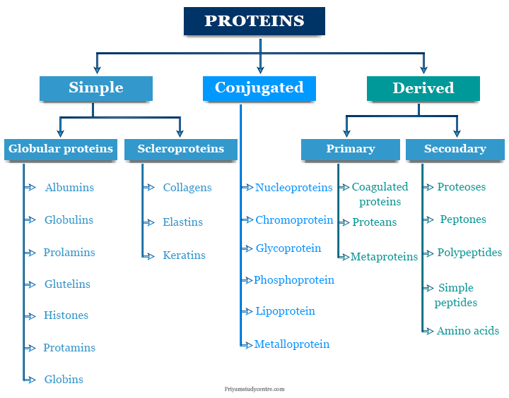
Classification

Slide 6
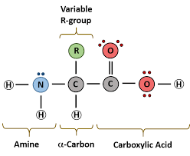
Peptide Bond Formation
A peptide bond forms when:
Carboxyl group of one amino acid reacts with
Amino group of another amino acid
Water molecule is removed (condensation reaction)
Representation:
Amino Acid+Amino Acid→Dipeptide
Dipeptide = 2 amino acids
Tripeptide = 3 amino acids
Polypeptide = many amino acids

Slide 7
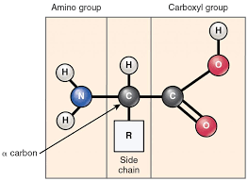
Structure

Slide 8
Simple Proteins
Yield only amino acids on hydrolysis.
Examples:
Albumin
Globulin
Histones

Slide 9
Albumins
Albumins are simple proteins that are soluble in water and coagulated by heat.
It is precipitated by the solutions of ammonium sulfate.
Some common examples of albumins are egg albumin, serum albumin, and lactalbumin.

Slide 10
Globulins
Globulins are proteins that are insoluble in water but soluble in dilute salts solution and inorganic acids and alkalies. It is coagulated by heat and half-saturated by ammonium sulfate solutions.
Globulins usually contain glycine.
Some typical examples of globulins are serum globulin, tissue globulin, and vegetable globulin.

Slide 11
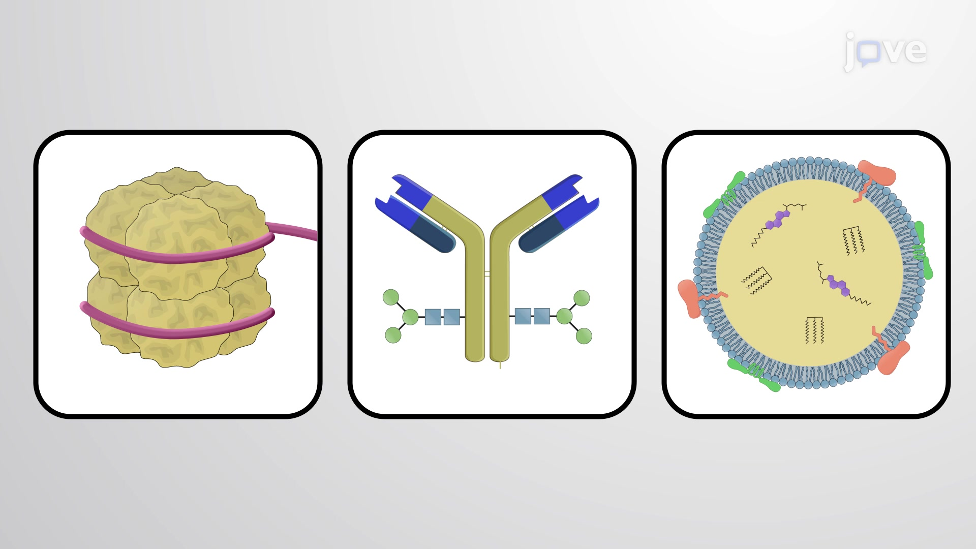
Conjugated Proteins
Contain protein + non-protein part (prosthetic group).
Examples:
Hemoglobin = globin + heme
Lipoproteins
Glycoproteins
Nucleoproteins
Chromoproteins

Slide 12
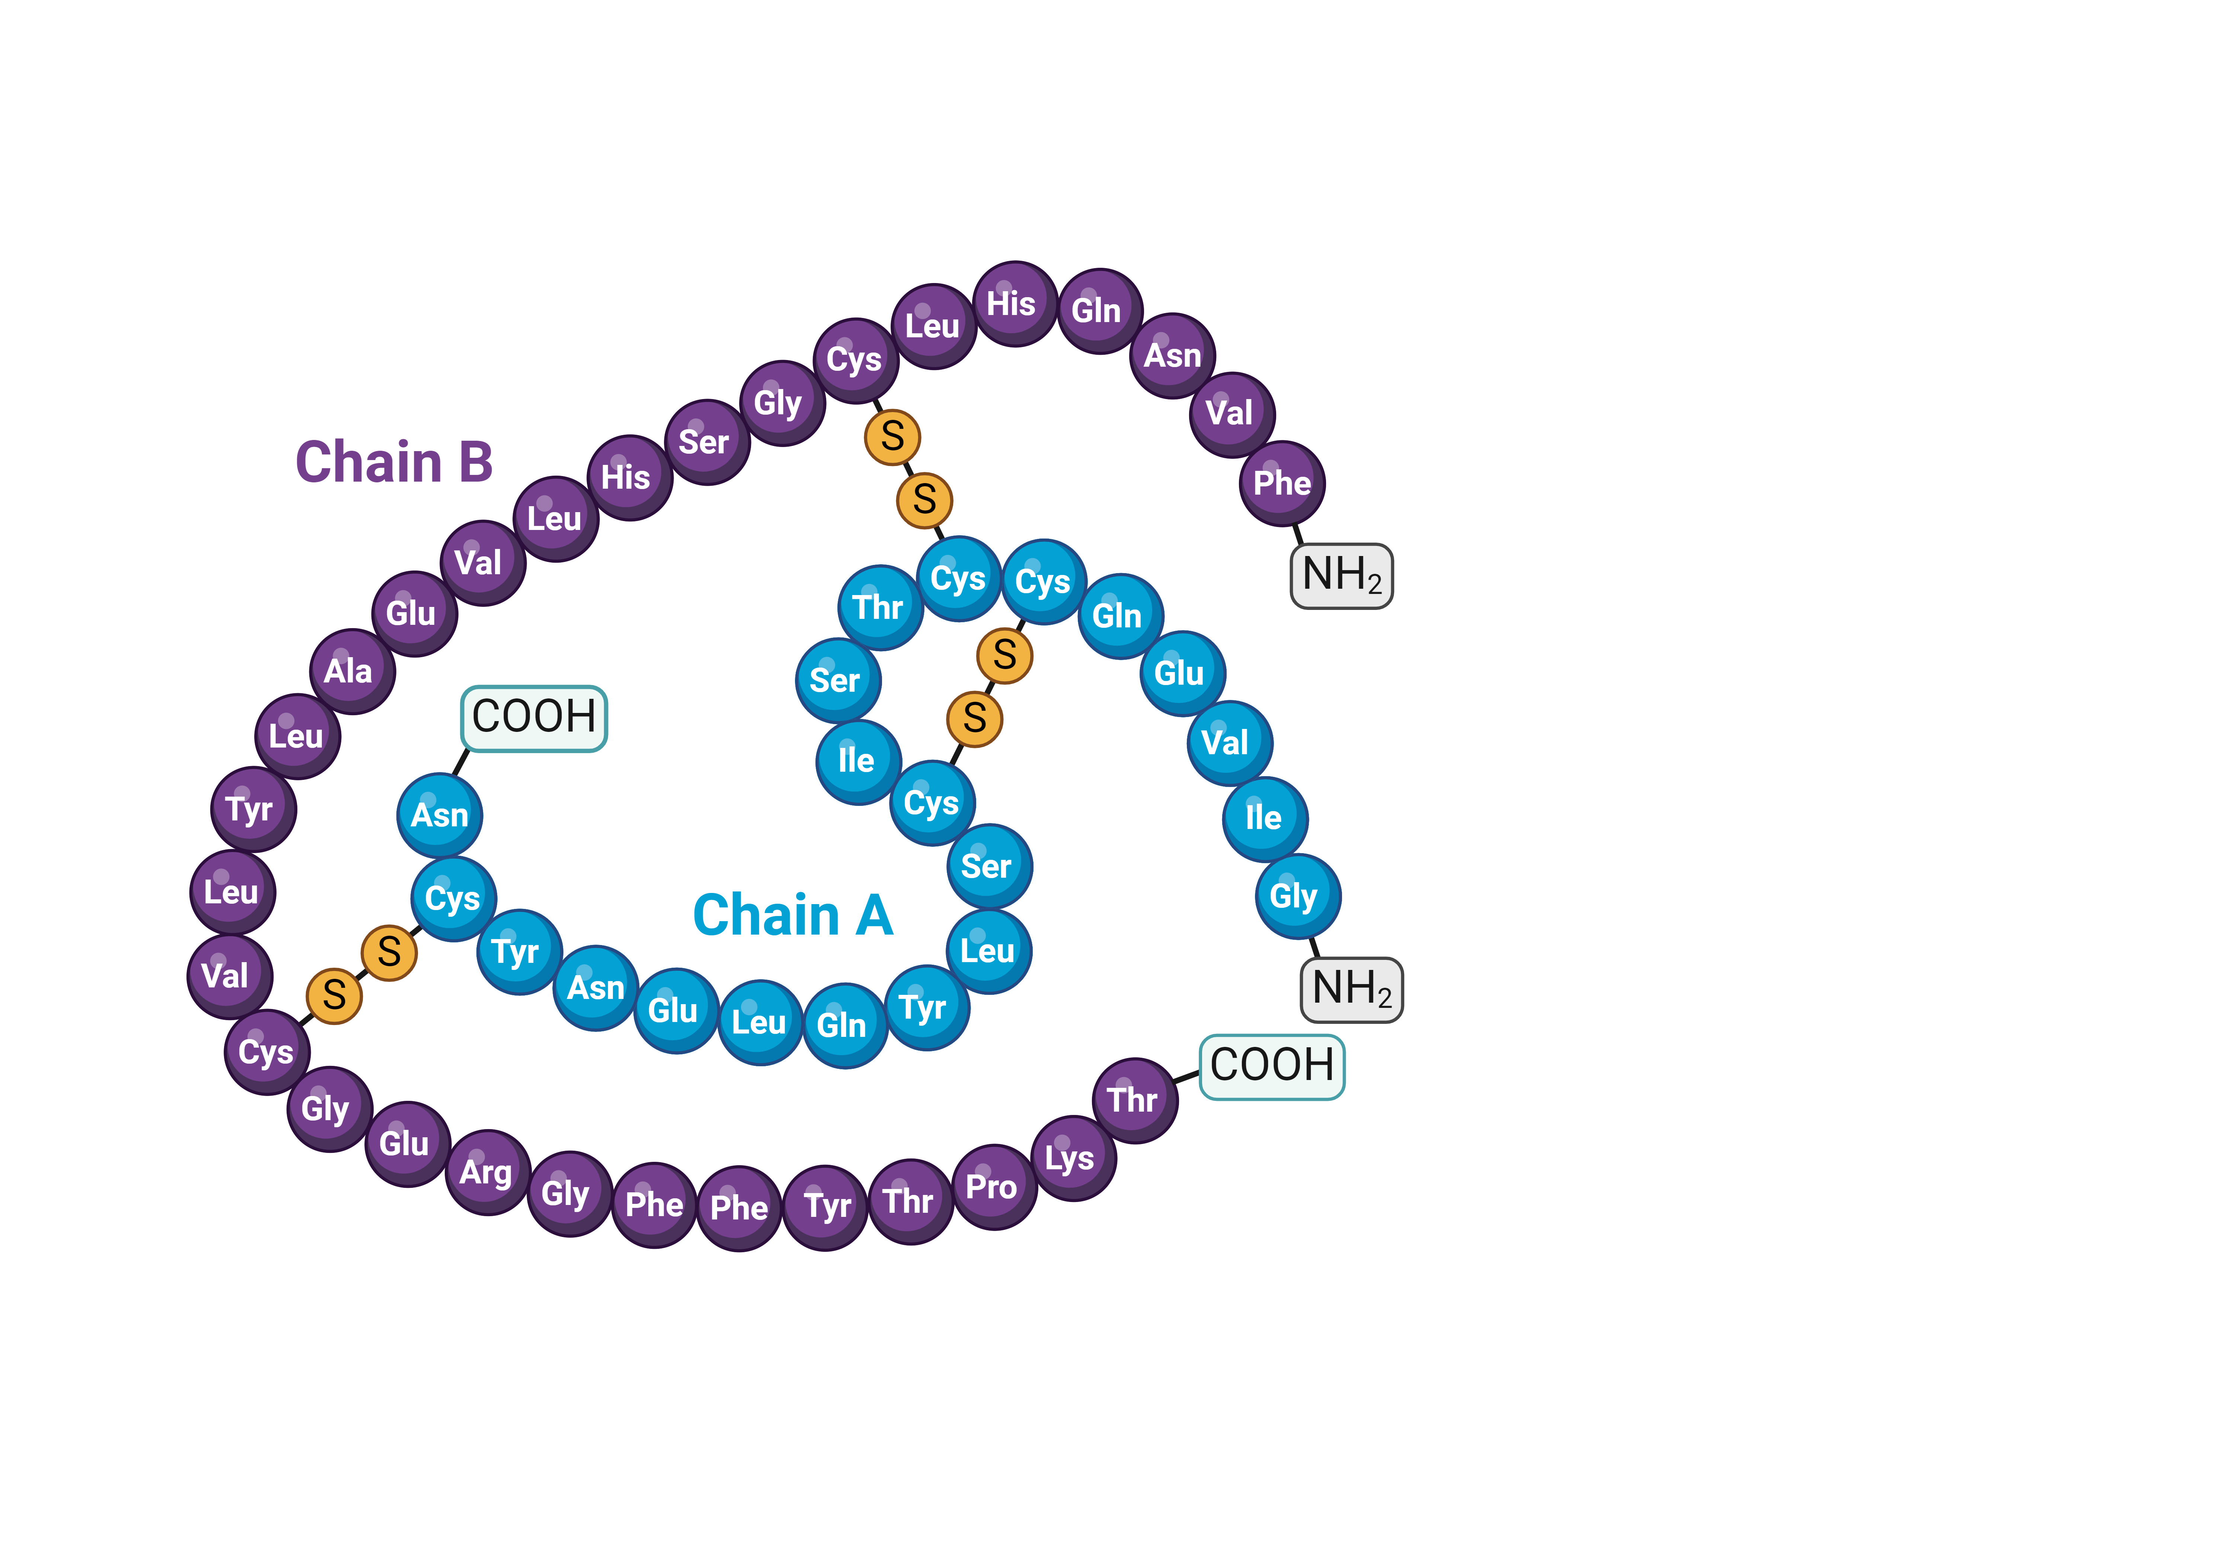
Derived Proteins
Produced by breakdown of proteins.
Examples:
Peptides
Proteoses

Slide 13
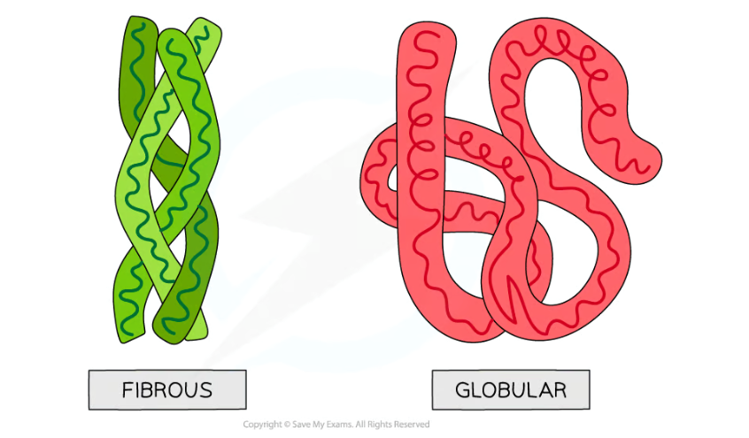
According to Shape
A. Fibrous Proteins
Long and thread-like
Insoluble in water
Structural role
Examples:
Collagen
Keratin
Elastin

Slide 14
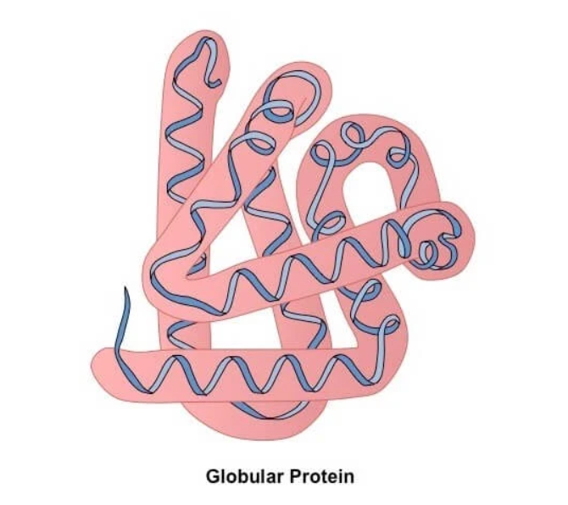
Globular Proteins
Spherical
Water soluble
Functional proteins
Examples:
Enzymes
Hemoglobin
Antibodies

Slide 15
Levels of Protein Structure
1. Primary Structure: Sequence of amino acids in a chain.
Example: Ala−Gly−Val−Leu
2. Secondary Structure: Local folding due to hydrogen bonds.
Types: Alpha helix (α-helix)Beta pleated sheet (β-sheet)

Slide 16
Levels of Protein Structure
3. Tertiary Structure
Three-dimensional folding of a polypeptide chain.
Maintained by: Hydrogen bonds,Ionic bonds,Disulfide bonds,Hydrophobic interactions
4. Quaternary Structure
Association of multiple polypeptide chains.
Example:Hemoglobin has 4 subunits

Slide 17
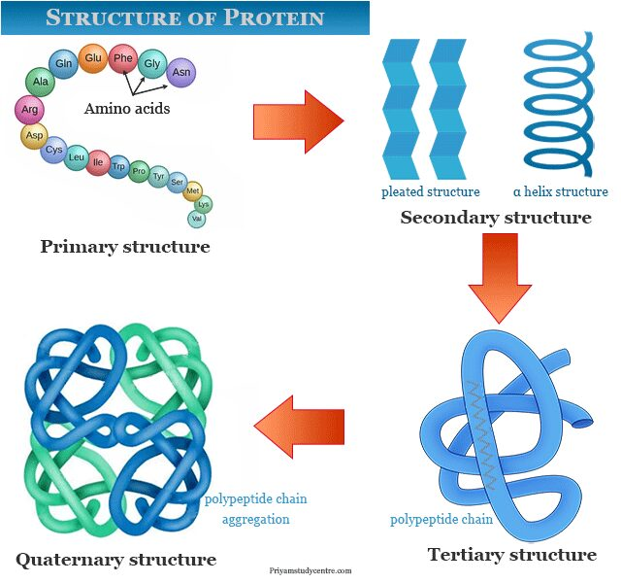
Structure of Proteins

