Slide 1

بسم اللہ الرحمٰن الرحیم

Slide 2


Slide 3
PAKISTAN STUDIES
Instructor: Khalid Makhdoom
Course code : PST-321
Credit hours :02

Slide 4
HISTORICAL PERSPECTIVE
Geographical Location of Pakistan
Pakistan is situated in South Asia, spanning approximately 23°35'N to 37°05'N latitude and 60°50'E to 77°50'E longitude, covering 796,095–881,913 sq km. It borders India (east, 2,912 km), Afghanistan (northwest, 2,430 km), Iran (west, 909 km), China (northeast, 523 km), with a 1,046 km Arabian Sea coastline and a maritime border with Oman. This positions it at the crossroads of South Asia, Central Asia, the Middle East, and the Indian Ocean region.

Slide 5
HISTORICAL PERSPECTIVE
Geophysical Features
Pakistan features northern highlands (Himalayas, Karakoram, Hindu Kush with K2 at 8,611 m), Indus River plain (fertile Punjab/Sindh), Balochistan Plateau (arid, mountainous), western ranges (Sulaiman), Potohar/Salt Range, and deserts (Thar, Cholistan). It lies on the Indian-Eurasian plate boundary, making it seismically active.
Eurasia is Earth's largest contiguous landmass, combining the continents of Europe and Asia into a single geographical unit. It spans roughly 54 million square kilometers and houses about 70% of the world's population.

Slide 6
HISTORICAL PERSPECTIVE
Geophysical Features
Geophysically, Pakistan features diverse landscapes shaped by the collision of the Indian and Eurasian tectonic plates: northern highlands with the Himalayas, Karakoram (including K2 at 8,611 m), and Hindu Kush; the fertile Indus River plain in Punjab and Sindh; the arid Balochistan Plateau; the Thar Desert in the southeast; and the Potwar Plateau with the Salt Range. This tectonic overlap causes high seismic activity, with earthquakes common in regions like Quetta and the north. The Indus River and its tributaries (Jhelum, Chenab, Ravi, Sutlej, Kabul) form a vast alluvial plain, sustaining agriculture for millennia.

Slide 7
HISTORICAL PERSPECTIVE
Historically, these features have profoundly influenced human settlement and civilizations. The Indus Valley Civilization (c. 3300–1300 BCE), one of the world's earliest urban societies, thrived in the fertile Indus basin in modern Sindh, Punjab, and Balochistan, with major sites like Mohenjo-daro and Harappa relying on monsoon-fed rivers for agriculture and trade. Aridification around 1900 BCE contributed to its decline, shifting populations eastward. Subsequent eras saw the northern mountains act as barriers against invasions while passes enabled Achaemenid (518 BCE), Alexander's (326 BCE), Mauryan, Kushan, and later Arab, Ghaznavid, Mughal, and Sikh incursions, blending Central Asian, Persian, and South Asian cultures.

Slide 8
HISTORICAL PERSPECTIVE
The Punjab plains supported Vedic tribes, Mughal agriculture, and Sikh Empire consolidation (1799–1849), while Balochistan's plateaus hosted nomadic pastoralism and trade routes to Iran. Post-1947 independence, these features continue to shape demographics, economy (e.g., Indus irrigation), and defense strategies. This topographic map illustrates Pakistan's varied relief, from northern peaks to southern plains and deserts, highlighting the Indus system's centrality. A political map delineates Pakistan's boundaries and provinces, underscoring its strategic location amid neighbors and disputed areas like Kashmir.

Slide 9
HISTORICAL PERSPECTIVE
Strategic and Geopolitical Significance
Pakistan's location bridges resource-rich Central Asia/West Asia to energy-deficient South Asia, enabling trade/transit via Gwadar port (China-Pakistan Economic Corridor). It influences Afghan stability, Kashmir dynamics, counter-terrorism, and regional forums such as South Asian Association for Regional Cooperation(SAARC), Economic Cooperation Organization(ECO),Organization of Islamic Cooperation (OIC). Northern mountains block cold winds, Indus plains support 60%+ population/agriculture, while the coast facilitates maritime trade. This geo-strategic pivot enhances its role in Eurasian connectivity and global energy/security routes.

Slide 10
South Asian Association for Regional Cooperation(SAARC)
It is an intergovernmental organization formed in 1985 to promote economic, social, and cultural cooperation among South Asian nations.
SAARC includes eight full members: Afghanistan, Bangladesh, Bhutan, India, Maldives, Nepal, Pakistan, and Sri Lanka. Its headquarters is in Kathmandu, Nepal.

Slide 11
Economic Cooperation Organization(ECO)
It is an Eurasian intergovernmental organization founded in 1985 by Iran, Pakistan, and Turkey to promote economic, technical, and cultural cooperation. The group expanded in 1992 to include Afghanistan, Azerbaijan, Kazakhstan, Kyrgyzstan, Tajikistan, Turkmenistan, and Uzbekistan.
ECO aims to create a single market for goods and services, similar to the European Union model, while fostering trade and investment. Its headquarters are in Tehran, Iran.

Slide 12
Organization of Islamic Cooperation(OIC)
Founded in 1969, it is the second-largest intergovernmental organization after the United Nations, with 57 member states, most of which are Muslim-majority. The OIC serves as the collective voice of the Muslim world, promoting peace, cooperation, and the protection of Muslim interests globally.
Its headquarters is in Jeddah, Saudi Arabia. The organization focuses on economic, social, cultural, and political collaboration among members.

Slide 13
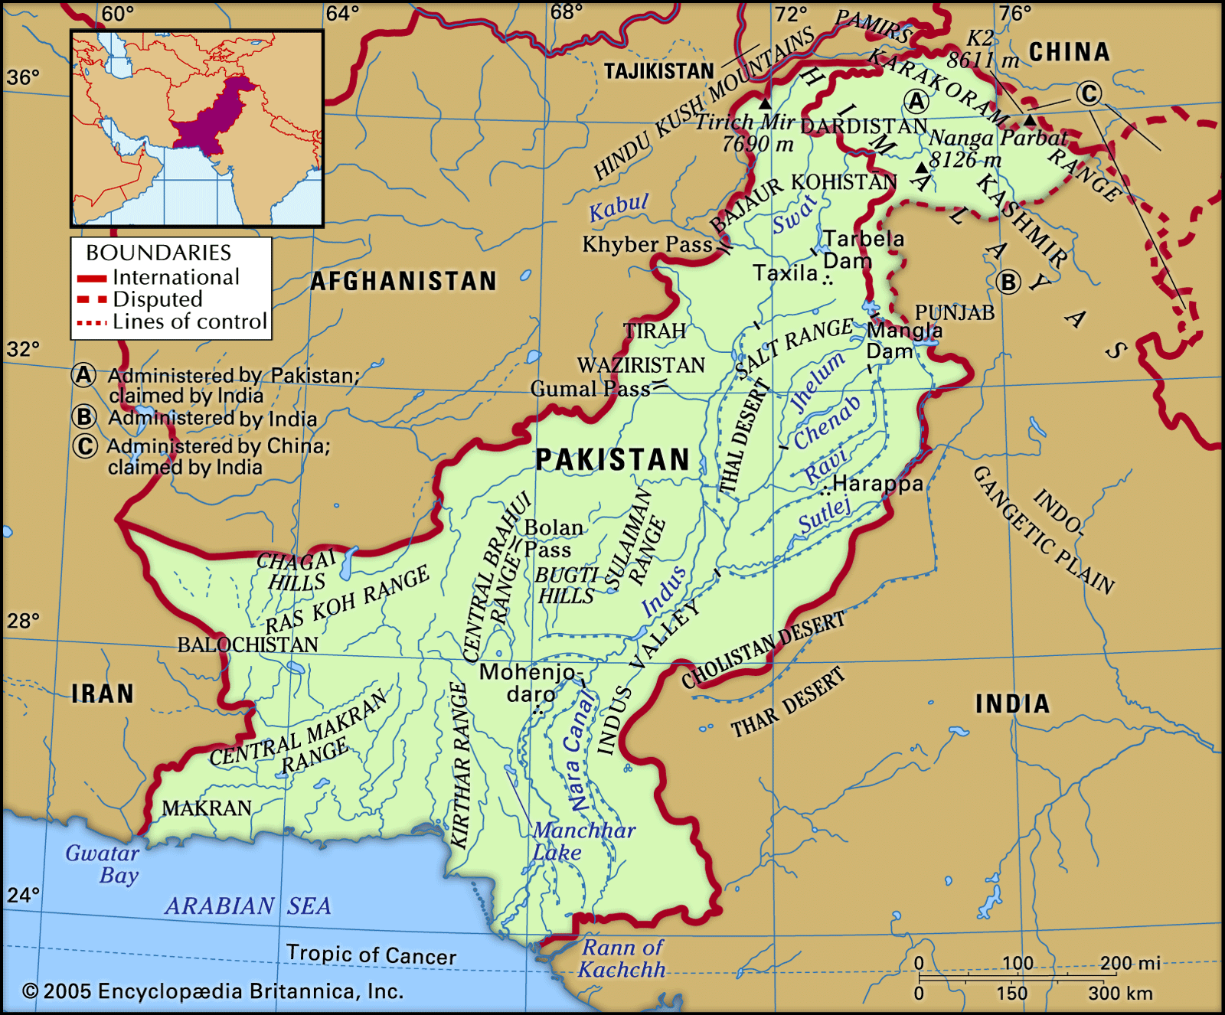
This relief map illustrates Pakistan's diverse topography, from northern highlands (green/brown) to Indus plains and the Arabian Sea coast.

Slide 14
Thank you

Slide 15


