Slide 1

بسم اللہ الرحمٰن الرحیم

Slide 2


Slide 3
PAKISTAN STUDIES
Instructor: Khalid Makhdoom
Course code : PST-321
Credit hours : 02

Slide 4
INDUS CIVILIZATION
The Indus Valley Civilization, also known as the Harappan Civilization, was one of the world's earliest urban cultures, flourishing in the northwestern Indian subcontinent.
Timeline
This Bronze Age society spanned roughly 3300–1300 BCE, with its mature phase from 2600–1900 BCE, making it contemporary with ancient Egypt and Mesopotamia. Pre-Harappan roots trace to sites like Mehrgarh around 7000 BCE, evolving through early, mature, and late phases until about 600 BCE in some areas.
The early phase map highlights key sites along rivers like the Indus and Ghaggar- Hakra , showing its expansion across modern Pakistan, northwest India, and parts of Afghanistan.

Slide 5
INDUS CIVILIZATION
Geography
It covered over 1 million square kilometers—larger than Egypt or Mesopotamia—centered on the Indus River plain in present-day Pakistan (Punjab, Sindh) and northwest India (Rajasthan, Gujarat), extending to Balochistan, Afghanistan, and even Turkmenistan. Major rivers supported agriculture, trade, and cities prone to flooding.
Key Sites
Harappa and Mohenjo-Daro were twin capitals, with advanced urban planning including grid streets, baked-brick houses, drainage systems, and public baths. Other sites include Rakhigarhi, Lothal (with a dockyard), Dholavira, and Kalibangan, totaling over 1,000 settlements.

Slide 6
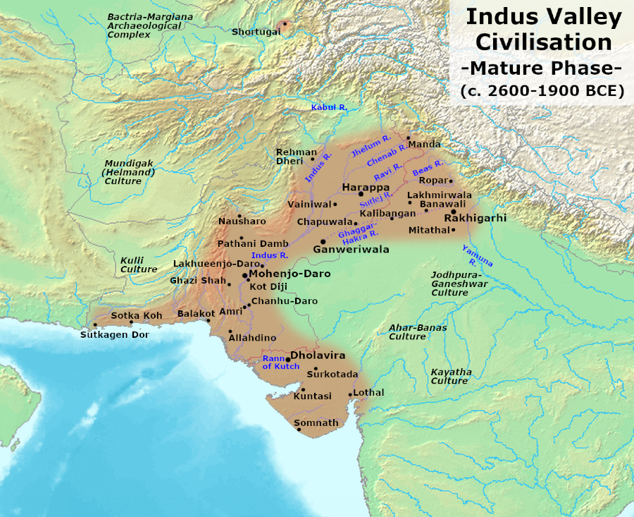
INDUS CIVILIZATION

Slide 7
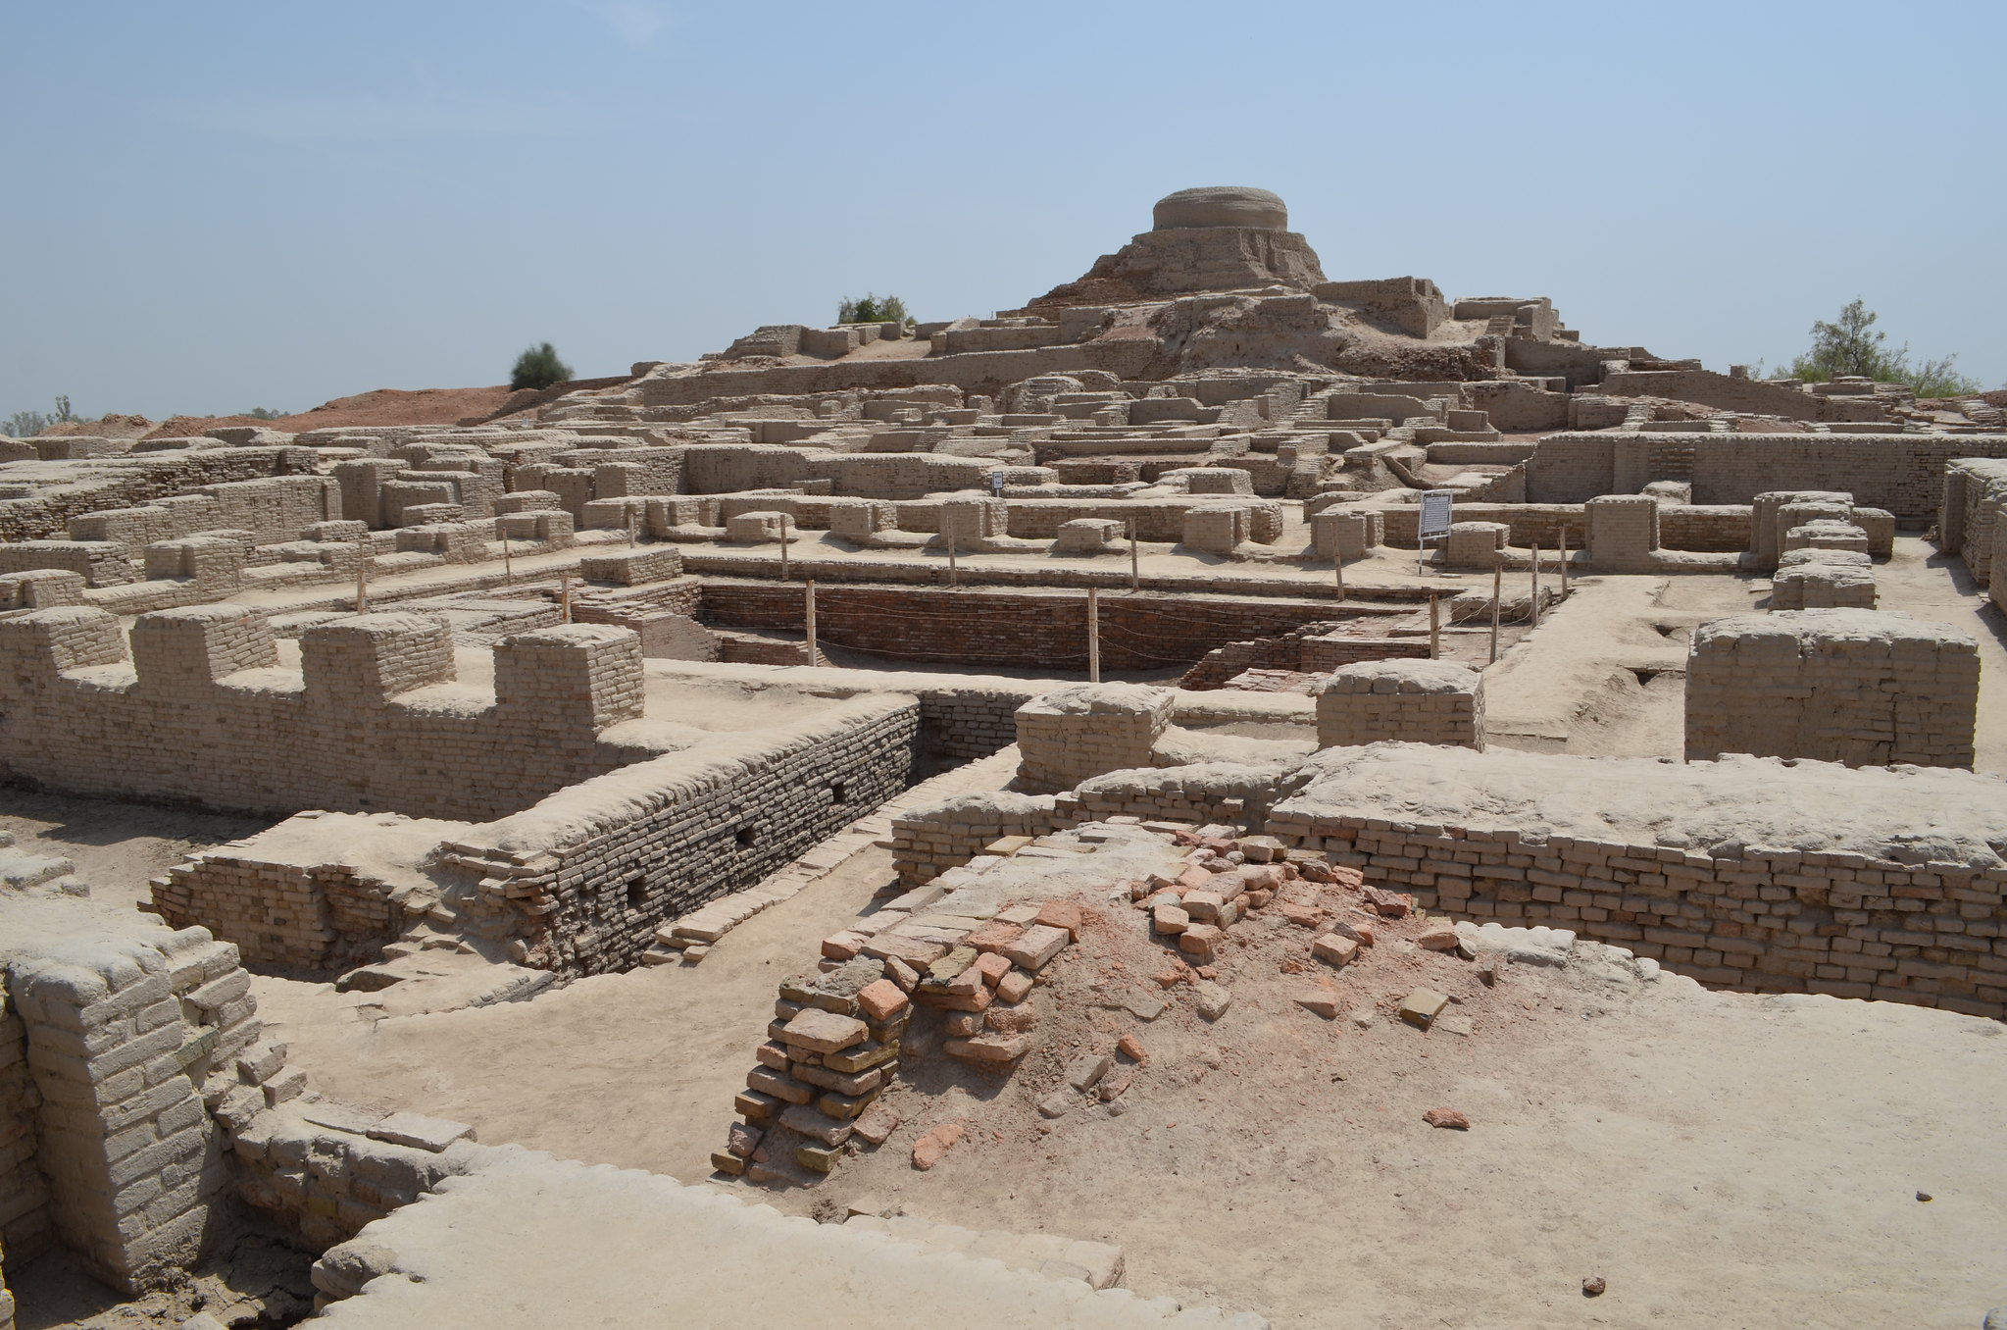
INDUS CIVILIZATION
Mohenjo-Daro's aerial ruins reveal a vast, organized city with a stupa-like mound and precise street layouts.

Slide 8
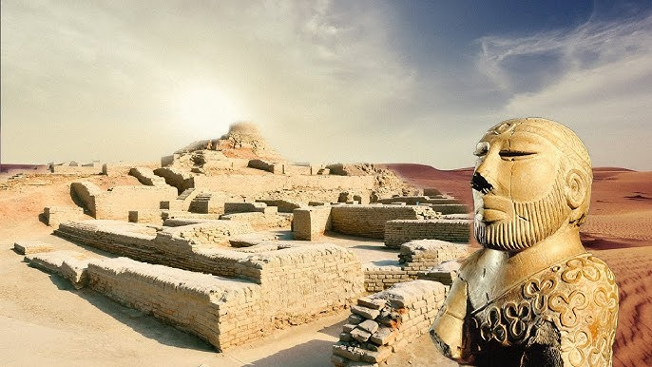
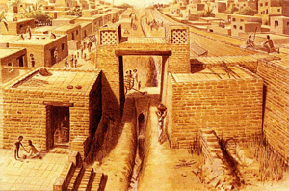
INDUS CIVILIZATION

Slide 9
INDUS CIVILIZATION
Society and Economy
Residents practiced farming (wheat, barley, cotton), animal husbandry, and crafts like bead-making and pottery; trade linked them to Mesopotamia via seals and goods. No palaces or temples suggest an egalitarian society, with standardized weights, measures, and undeciphered script on seals like the Pashupati (horned figure).The Pashupati seal shows a yogic figure surrounded by animals, hinting at possible religious or proto-Shiva iconography.
Decline
Around 1900 BCE, cities were abandoned due to climate shifts weakening monsoons, river changes (like Ghaggar-Hakra drying), and possible floods or invasions, leading to rural dispersal. Today, these Pakistani sites form Pakistan's richest archaeological heritage, central to its ancient history narrative.

Slide 10
INDUS CIVILIZATION
Significance in Pakistan
Pakistan's fertile Indus plains (Punjab, Sindh, Balochistan) supported Indus Valley Civilization(IVC’s) agriculture (wheat, barley, cotton), animal husbandry, and trade with Mesopotamia via coastal routes. Sites here show standardized baked bricks, weights, and the undeciphered script, with no clear palaces indicating egalitarian governance. Balochistan's Mehrgarh provides the longest cultural continuity, from Neolithic to urban phases.

Slide 11
Thank you

Slide 12


