Slide 1

بسم اللہ الرحمٰن الرحیم

Slide 2
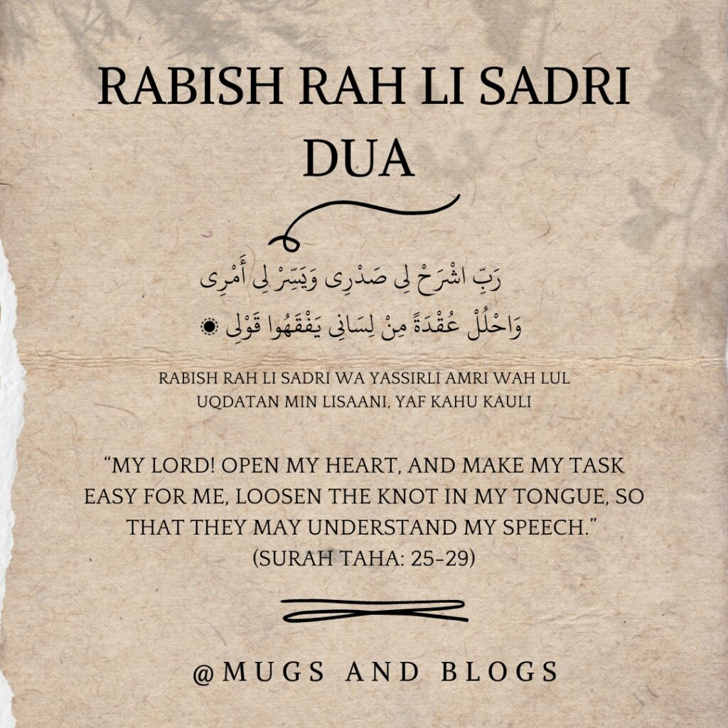

Slide 3
PAKISTAN STUDIES
Instructor: Khalid Makhdoom
Program: BS(MLT)
Course code : PST-321
Credit hours : 2

Slide 4
LAND AND PEOPLE OF PAKISTAN
Geography
Society
Natural Resources
Agriculture
Industry
Education
Culture

Slide 5
GEOGRAPHY
Population Overview
Pakistan's population reached an estimated 258 million on March 11, 2026, with projections hitting 259.3 million by mid-year. The country experiences rapid growth, with urban areas housing around 38-40% of residents, driven by cities like Karachi and Lahore. Density stands at over 320 people per square kilometer of land, rising steadily.

Slide 6
GEOGRAPHY
Ethnic Composition
Punjabis form the largest group at 44.7%, followed by Pashtuns (15.4%), Sindhis (14.1%), Saraikis (8.4%), Muhajirs (7.6%), and Balochis (3.6%). Smaller groups make up the rest, reflecting diverse linguistic and cultural regions.
Land Characteristics
Pakistan ranks 33rd globally in total area, with 297,638 square miles of land (about 771,000 km²). Around 46.7% is agricultural land, forests cover 4.7-5.4%, and much of the remainder includes deserts, mountains, and urban zones.

Slide 7
GEOGRAPHY
Population Distribution
Punjab holds over half the population at about 128 million, Sindh around 56 million, while Balochistan remains sparsely populated despite its vast size. Fertility centers along the Indus River basin support dense settlement in fertile plains.
Metric | Value (approx.)
Population (Mar 2026) | 258 million
Land Area | 771,000 km² (excluded water)
Density (2023) | 321 people/km²
Urban Population | 38-40%
Agricultural Land | 46.7% of territory

Slide 8
GEOGRAPHY
Pakistan features diverse geography spanning mountains, plains, plateaus, and deserts across its 796,096 square kilometers.
Major Regions
Pakistan divides into three primary zones: northern highlands with Karakoram, Hindukush, and Himalayas; the fertile Indus River plain covering Punjab and Sindh; and the arid Balochistan Plateau. The northern mountains host K2, the world's second-highest peak at 8,611 meters. Western ranges like Sulaiman and Kirthar frame the south, while the Thar Desert lies east.​

Slide 9
GEOGRAPHY
Key Rivers and Coastline
The Indus River, spanning 2,900 km, forms a vital alluvial plain for agriculture, fed by tributaries like Jhelum and Chenab. Pakistan's 1,046-km Arabian Sea coast includes the Indus Delta and Makran range. These waterways support dense populations along fertile basins.

Slide 10
GEOGRAPHY
Climate Zones
Northern areas stay cooler with alpine conditions; central plains face hot summers and mild winters; Balochistan endures arid, extreme temperatures. Monsoons bring heavy rain to the east, while dust storms affect the west. Elevation and location create nine ecological zones overall.
Borders and Location
Pakistan borders India (east), Afghanistan (west), Iran (southwest), and China (north), lying across Indian and Eurasian plates. Its position north of the Tropic of Cancer influences tropical to temperate climates.

Slide 11
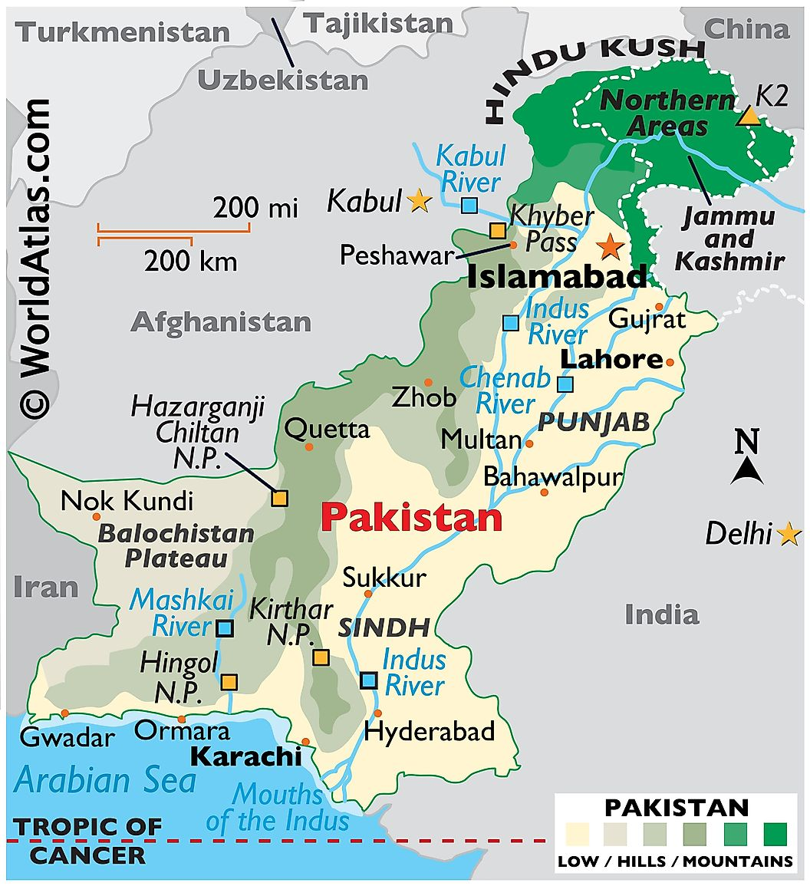
GEOGRAPHY
Feature | Details
Total Area | 796,096 km² ​
Highest Point | K2 (8,611 m)
Longest River | Indus (2,900 km) ​
Coastline | 1,046 km ​
Provinces | Punjab, Sindh, KP, Balochistan ​

Slide 12
SOCIETY
Pakistan's society is multicultural, multilingual, and predominantly Muslim, shaped by family values, ethnic diversity, and urban-rural divides.
Demographics
Pakistan's 2023 census recorded 241.5 million people, with a young median age of 19 and a sex ratio of 106 males per 100 females. Over 60% live rurally, but urbanization reached 38.9% by 2023, concentrated in megacities like Karachi (18.9 million) and Lahore (13 million).

Slide 13
SOCIETY
Ethnic Groups
Punjabis dominate at around 45%, followed by Pashtuns (15-18%), Sindhis (14%), Saraikis (8-10%), Muhajirs (7-8%), and Baloch (3-4%). This diversity fosters regional identities, with Punjab holding over half the population.​
Social Structure
Society stratifies into upper (2%, controlling 60-70% wealth), middle (53%, urban professionals), and lower/working classes (45%, rural laborers). Patriarchal norms prevail, emphasizing family obedience and elder respect, though urban nuclear families grow. Feudalism lingers in rural Sindh and Punjab, limiting mobility.

Slide 14
SOCIETY
Religion and Culture
Islam claims 96.4% (mostly Sunni Hanafi), with Hindus (2.2%), Christians (1.4%), and minorities like Ahmadis (0.07%). Urdu unites as lingua franca, but Punjabi (37%), Pashto (18%), and Sindhi (14%) prevail regionally. Customs blend Islamic egalitarianism with caste-like influences from history.

Slide 15
NATURAL RESOURCES
Mineral Wealth
Pakistan holds vast reserves of rock salt at Khewra (world's second-largest mine, 220 million tons), gypsum (Mianwali, Dera Ghazi Khan), limestone, and iron ore (Kalabagh). Balochistan leads in minerals like copper-gold (Saindak, Reko Diq), chromite, while gems abound in Khyber Pakhtunkhwa; uranium exists in Sulaiman Range and Dera Ghazi Khan.

Slide 16
NATURAL RESOURCES
Energy Resources
Thar Desert (Sindh) contains 175 billion tones of lignite coal, among world's largest. Natural gas fields at Sui (Balochistan) and Mari (Sindh) supply much of energy needs, with oil from Potwar Plateau, Badin, and Attack; proven reserves lag consumption.
Agricultural Land
About 27% of land (over 200,000 km²) is arable, mainly Indus Basin plains, producing wheat, rice, cotton, sugarcane—key exports. Forests cover 4.7-5%, including coniferous in north and mangroves along coast.

Slide 17
Natural Resources
Water and Others
Indus River system (2,900 km) supports irrigation and hydropower (e.g., Tarbela Dam). Fisheries thrive off 1,046 km Arabian Sea coast; human resources add value with young population.
Resource Type | Key Locations | Reserves/Notes
Coal | Thar (Sindh) | 175B tons ​
Natural Gas | Sui, Mari | Major fields ​
Salt | Khewra (Punjab) | 220M tons ​
Arable Land | Indus Plains | 27% of territory ​
Copper/Gold | Reko Diq, Saindak (Balochistan) | Vast deposits ​

Slide 18
AGRICULTURE
Agriculture employs 37-40% of Pakistan's workforce and contributes 23% to GDP, making it the economy's backbone despite challenges like water scarcity and climate risks. The sector covers 47% of land (30.5 million hectares), with 82% irrigated via the Indus system.
Major Crops
Wheat, the staple, covers 37% of cropland with 2026 output projected high due to above-average planting and government procurement of 2.5-3 million tones. Rice (11%), cotton, sugarcane (cash crops), maize, and pulses dominate; 2026 targets over 4% growth amid lower costs. Kharif (summer: rice, cotton) and Rabi (winter: wheat) seasons structure production. Punjab's wheat fields illustrate the fertile plains central to Pakistan's grain output.

Slide 19
AGRICULTURE
Livestock Sector
Livestock adds 62% to agriculture's value (PKR 5.5 trillion in 2023), with Pakistan as the 5th largest milk producer (67 million tones yearly). Population nears 225 million animals, boosting leather exports (USD 950 million).​
Challenges and Outlook
Key issues include low yields, fertilizer overuse (160 kg/ha), floods, and irrigation cuts in 2025-26 budget. Government boosts subsidies for wheat, fertilizers, insurance, and climate funds, targeting resilience. Logistics growth supports exports (70% Agri-derived).

Slide 20
AGRICULTURE
Crop | Share of Cropland | Production Notes (recent)
Wheat | 37% ​ | 26M tons (2018); 2026 high
Rice | 11% ​ | Major export
Sugarcane | Cash crop | 0.9% GDP ​
Cotton | Cash crop | 0.3% GDP ​
Milk (Livestock) | 67M tonnes | 5th globally ​

Slide 21
INDUSTRY
Pakistan's industrial sector contributes about 20-22% to GDP and employs around 20% of the workforce, with manufacturing as its core despite energy shortages and infrastructure gaps.
Key Industries
Textiles dominate, accounting for 60% of exports through cotton spinning, weaving, and garments, centered in Faisalabad and Karachi. Cement production ranks 6th globally (45 million tons yearly), fueled by construction; steel, sugar, fertilizers, and automobiles follow. Pharmaceuticals and surgical instruments (Sialkot) lead niche exports.

Slide 22
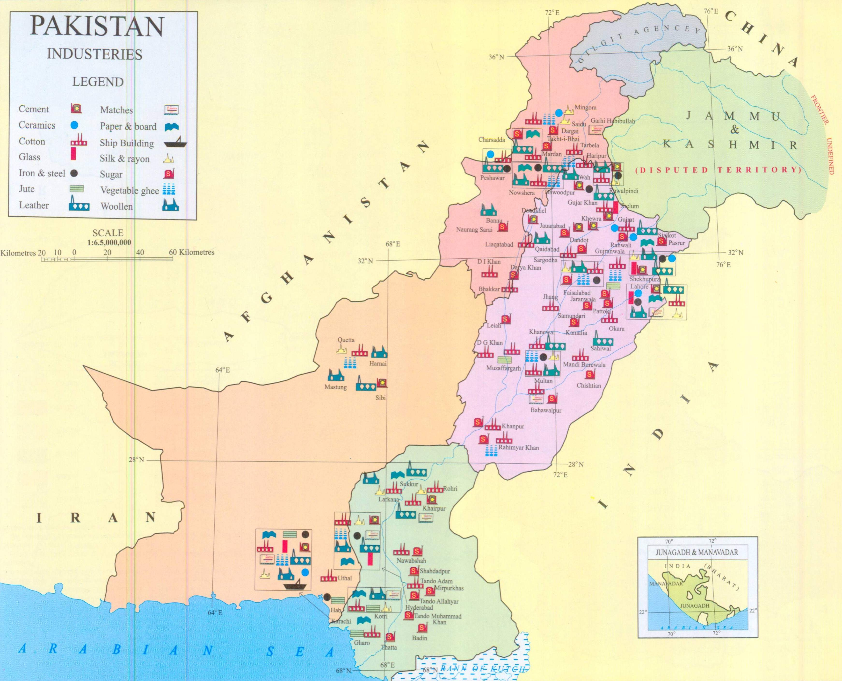
INDUSTRY
This map shows industrial distribution, with textiles in Punjab, cement in the north, and oil refineries along coasts.

Slide 23
EDUCATION
Pakistan's education system faces significant challenges despite constitutional mandates for free and compulsory schooling. It serves millions but struggles with access, quality, and infrastructure issues.
Structure
The system spans preschool (ages 3-5), primary (grades 1-5), middle (grades 6-8), secondary (grades 9-10, ending in SSC exams), intermediate (grades 11-12, ending in HSSC), and university levels.
Provinces manage educational institutions, while the federal government handles curriculum, accreditation, and higher education via the Higher Education Commission.
Streams at higher levels include science, humanities, pre-medical, and technical options.​

Slide 24
EDUCATION
Key Challenges
Literacy stands at 57%, lagging neighbors, with poor infrastructure—only 54-68% of schools have electricity, water, or latrines.
Teacher absenteeism and quality issues persist, especially in rural areas.
The 18th Amendment devolved control to provinces, complicating uniformity.​
Reforms
Article 25-A mandates free education for ages 5-16. Efforts like the Single National Curriculum aim for standardization by 2022 (grades 1-12).​ Boosting vocational training to 25-50% of secondary enrollment is targeted.

Slide 25
CULTURE
Core Values
Islam governs daily life for most, emphasizing prayer, modesty, hospitality, and family ties, with extended families central to society.
Society remains hierarchical and patriarchal, though urban youth adopt modern elements like Western dress.
Pre-Islamic customs persist alongside religious conservatism introduced in 1979. Pakistan's culture blends Islamic traditions with diverse ethnic influences.

Slide 26
CULTURE
Dress and Cuisine
Shalwar kameez is the national attire, colorful for women and plainer for men, varying by region.
Cuisine features spicy dishes like biryani, nihari, kebabs, and breads (naan, roti), with regional specialties using cumin and turmeric.
Schoolgirls in traditional shalwar kameez highlight everyday cultural dress in Pakistan.

Slide 27
CULTURE
Festivals and Arts
Major events include Eid al-Fitr, Eid al-Adha, and regional celebrations like Basant or harvest festivals with music and dance.
Folk arts encompass truck art, calligraphy, crafts, sitar music, and dances; sports like cricket unite the nation.​
Weddings and Customs
Multi-day weddings feature mehndi, baraat, nikah, and valima, showcasing community and extravagance.​
Hospitality demands offering tea or meals to guests, reflecting strong social bonds.​

Slide 28
Thank you

Slide 29
