Slide 1

Ultrastructure of a Bacterial Cell
Presented by Dr Uswa Fazal
Fsc part(1)

Slide 2
Ultrastructure of a Bacterial Cell
Introduction to Bacteria.
Bacteria have a straightforward structure.
Single-Celled Organisms: Composed of one cell, lacking a nucleus and organelles.
Classification: Classified as prokaryotic organisms due to the absence of a defined nucleus.

Slide 3
Versatility of Bacteria
Survival in Harsh Conditions:
Capable of living in extreme environments.
Extremophiles:
Organisms that thrive under extreme conditions.

Slide 4
Types of Extremophiles
Thermophiles: Heat-loving bacteria that thrive in high-temperature environments.
Acidophiles: Bacteria that flourish in acidic environments, often found in highly acidic waters.
Alkaliphiles: Bacteria that thrive in alkaline (basic) conditions, found in soda lakes or alkaline soils.

Slide 5
Unique Adaptations of Bacteria
Osmophiles: Thrive in environments with high solute concentrations, such as sugar-rich solutions.
Barophiles: Adapted to live under high pressure, typically found in deep-sea environments.
Cryophiles: Prefer cold temperatures and thrive in icy habitats

Slide 6
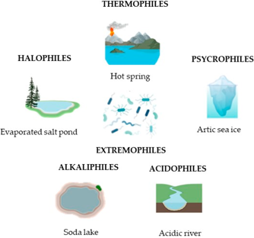
Versatility of Bacteria

Slide 7
Protective Cell Wall
Peptidoglycan Structure: Unique structural component of bacterial cell walls, vital for their shape and protection.
Defining Feature: The cell wall's composition is critical for distinguishing bacteria from other microorganisms

Slide 8
External Structures
Locomotion Organs: Some bacteria possess flagella or pili, which aid in movement.
Pili: Pili can serve as appendages for movement or attachment to surfaces

Slide 9
Cellular Characteristics:
Lack of Organelles: Bacteria do not contain membrane-bound organelles, unlike eukaryotic cells.
Ribosomes: Sites for protein synthesis, essential for bacterial function and growth.

Slide 10
Genetic Material
DNA and Plasmids: In addition to main DNA, bacteria contain circular DNA called plasmids.
Antibiotic Resistance: Plasmids can carry genes that confer resistance to antibiotics, posing challenges in treatment.

Slide 11
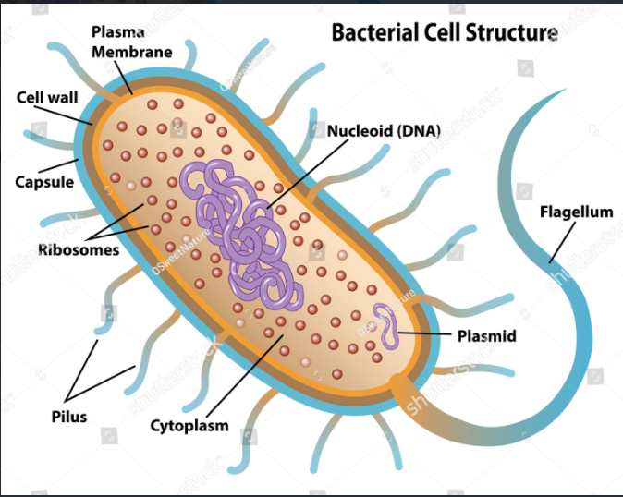
Ultrastructure of a Bacterial Cell

Slide 12
Reproduction in Bacteria
Overview of Bacterial Reproduction:
Definition of Reproduction: The process of producing offspring from parent organisms.
Bacterial Reproduction Methods: Bacteria primarily reproduce asexually, but can also engage in sexual reproduction.

Slide 13
Asexual Reproduction in Bacteria
Parents produce genetically identical offspring.
Quick and efficient since no mate is required.
Single-Celled Entities - Bacteria are unicellular and lack membrane-bound organelles, enabling rapid replication

Slide 14
:)
Thank You

